Slide 1
Metabolic mediators of sex/gender: Do risk factors explain the gender gap in coronary heart disease?
Josef Fritz
Department for Medical Statistics, Informatics and Health Economics,
Innsbruck Medical University
Contact: josef.fritz@i-med.ac.at
www.oegepi.at

Slide 2
Situation
Sex/Gender influences CHD risk factors which in turn affect the outcome (death from CHD).
Estimate effects of the different paths.

Slide 3
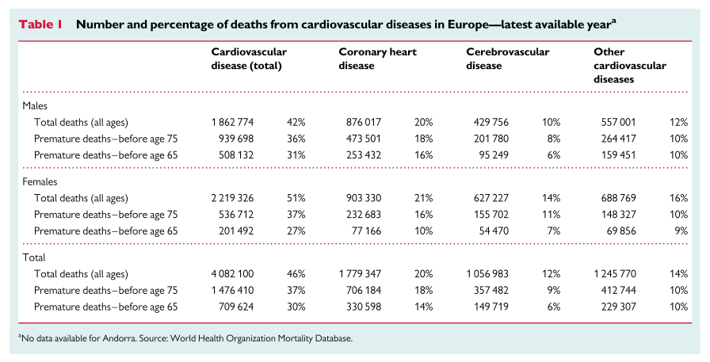
CHD as death cause
Source: Nichols et al. Cardiovascular disease in Europe 2014: epidemiological update. European Heart Journal (2014)

Slide 4
CHD and risk factors (1)
Prevention is possible via control of modifiable risk factors.
Fixed
Age
Sex
Genetics
…
Modifiable
Blood pressure
Type 2 diabetes
Smoking
Lipids (cholesterol, triglycerides)
Body weight
…

Slide 5
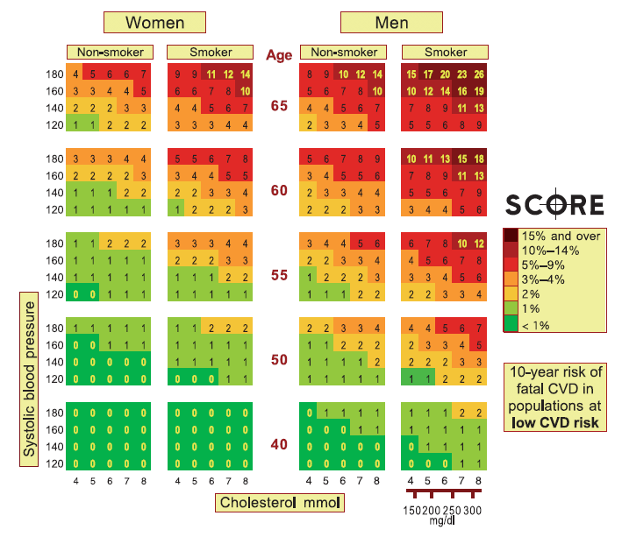
CHD and risk factors (2)
Ten-year risk of fatal cardiovascular disease in populations at low cardiovascular disease risk.
Source: Conroy et al. Estimation of ten-year risk of fatal cardiovascular disease in Europe: the SCORE project. European Heart Journal (2003)

Slide 6
Sex and age differences in major CHD risk factors
Source: Ulmer et al. Why Eve is not Adam: prospective follow-up in 149650 women and men of cholesterol and other risk factors related to cardiovascular and all-cause mortality. Journal of Women’s Health (2004)

Slide 7
Research question (1)
In general, men have a higher CHD mortality risk than women, especially at younger ages.
Men have also other risk factor profiles (TC, blood pressure, glucose, smoking) than women.

Slide 8
Research question (2)
Can the difference in CHD mortality risk (ICD-10 code I20-I25) between sexes be explained by different risk factor profiles and if yes, how much can be explained?
Method: Mediation analysis stratified for age groups <50, 50-64, 65-74, and ≥75 years based on a Cox regression model for survival data.
New mediation approach according to Lange et al. which further allows breakdown of indirect effect into single components.
Lange T, Rasmussen M, Thygesen LC. Assessing natural direct and indirect effects through multiple pathways. Am J Epidemiol. 2014 Feb 15;179(4):513-8.

Slide 9
Results (1)
Effect decomposition

Slide 10
Results (2)
Results of mediation analysis: Total, direct, and indirect effects of sex/gender on CHD mortality by age groups, adjusted for age at baseline and year of examination

Slide 11
Take home messages
Premature mortality from CHD is substantially lower in women.
We estimated the contribution of major risk factors to this gender difference.
BP and TC explain one third of the survival benefit in pre-menopausal women.
This is in line with the oestrogen hypothesis.
In older persons, risk factors contribute much less to the mortality difference.

