Slide 1
Metabolic mediators of body mass index: Are published results reliable?
Josef Fritz
Department for Medical Statistics, Informatics and Health Economics,
Innsbruck Medical University
Contact: josef.fritz@i-med.ac.at
www.oegepi.at

Slide 2
Introduction
Aim: Estimate effect of high BMI on CHD (ICD-10 code I20-I25), and quantify how much of the excess risk of BMI is mediated through metabolic factors blood pressure, cholesterol, and blood glucose
Problem of mediation analysis

Slide 3
Recently published results (1)
Strengths: number of participants, 97 cohorts (including VHM&PP)
Drawbacks: the classical difference method of the Baron&Kenny approach was used which can lead to unreliable results

Slide 4
Recently published results (2)
Strengths: better methodolgy, new approach from T. VanderWeele improving on the classical product method (Baron&Kenny), more confounders, sensitivity analyses
Drawbacks: smaller number of participants (~58,000), only 9 cohorts

Slide 5
Lu et al. (2014): Results
HRs (relative to normal weight (BMI ≥20–<25 kg/m²)) and excess risk of overweight and obesity mediated through different combinations of metabolic risk factors

Slide 6
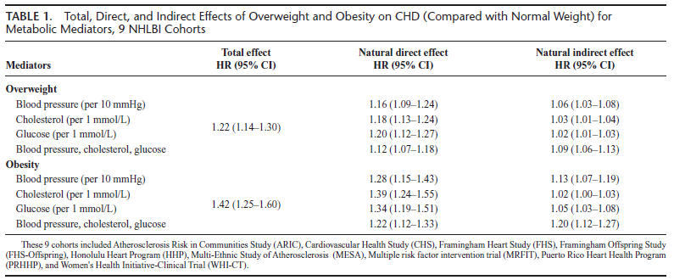
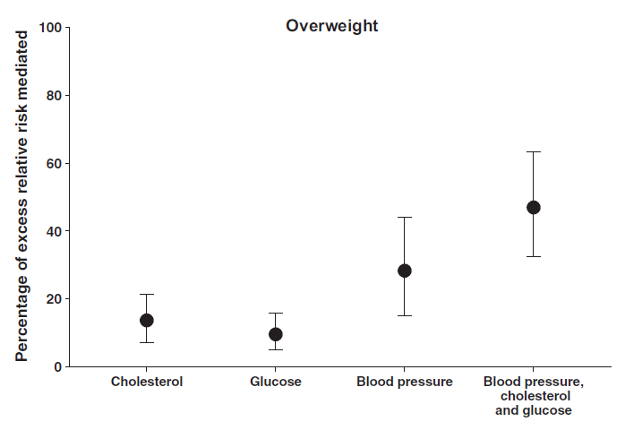
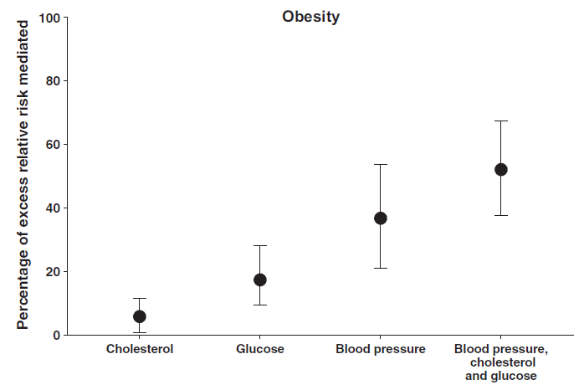
Lu et al. (2015): Results
48%
47%
37%
28%
17%
14%
10%
6%

Slide 7
Lu et al. (2014, 2015): Conclusions
About half of the excess risk of BMI on CHD is mediated through the three metabolic risk factors
Blood pressure is the most important mediator (mediating about one third)
Interventions that reduce BP, TC, and glucose might address a substantial proportion of the effect of high BMI on CHD
However, to achieve full benefits, also maintenance of optimum bodyweight is needed

Slide 8
Application to VHM&PP data
Aim: To apply different methods for multivariable mediation to VHM&PP data and compare results
Methods used:
Classical product method (Baron&Kenny, 1986)
Classical difference method (Baron&Kenny, 1986)
Regression based approach developed by T. VanderWeele (refinement of product method) (2011; 2012)
Weighting based approach developed by T. Lange (2014)
Observation: BMI*Age is highly significant in a survival model on CHD
Therefore, stratification by age group is highly indicated!

Slide 9
VHM&PP data Results Overweight vs. Normal

Slide 10
VHM&PP data Results Obesity vs. Normal

Slide 11
Remarks concerning methodology
Despite large studies there is still a large amount of uncertainty in the results
Since models deliver only approximate results and/or impose strict assumptions to the data which may be violated in practice, methods deliver considerably different results
Analysis of other subgroups (sex, smokers) und univariate mediation models (each risk factor separately) could/should still be done to get more details of the relationship

Slide 12
Take home messages
The hazard ratio of BMI decreases significantly with age
For individuals 65-74 years, overweight per se is only harmful to a very small extent if risk factors are controlled
In individuals ≥75 years overweight is even beneficial if risk factors are controlled
For obesity, this is not true: obesity negatively affects CHD risk also in older individuals, even if risk factors can be controlled
For overweight in younger individuals and for obesity throughout all ages, about 50% of the increased CHD risk can be explained indirectly via major risk factors

