Slide 1
Statistical mediation analysis in cardiovascular epidemiology
Josef Fritz
Department of Medical Statistics, Informatics and Health Economics, Medical University of Innsbruck, Austria
josef.fritz@i-med.ac.at
Malmö, May 23th 2017

Slide 2
Motivation: Mediators and mediation analysis (1)
X
Y
Investigating the effect of X on Y
Why/how does X exert its influence on Y?
E.g. statins: benefical effect on coronary heart disease through lipid lowering
Such an intermediate variable on the causal pathway of X on Y is called a mediator
Statin (X)
Cholesterol (M)
CHD (Y)

Slide 3
Motivation: Mediators and mediation analysis (2)
Another example: Effect of BMI on CHD
The total (causal) effect of BMI on CHD can be split up into two components:
The so called indirect effect going through diabetes
The so called direct effect (the remaining part)
Aim of mediation analysis: Decompose the total effect into direct and indirect effects
Mediation analysis assumes the direction of causalities to be known; other methods are needed for the study of the direction of causalities
Cave: Mediator ≠ confounder!!
Diabetes
BMI
CHD

Slide 4
Classical approaches to meditation analysis
Difference method:
Calculate a model without the mediator → total effect
Calculate another model conditioned on the mediator → direct effect
Subtract the direct effect from the total effect → indirect effect
Product method:
Outcome model conditioned on the mediator
Mediator model
Indirect effect by multiplying over regression coefficients
M
X
Y

Slide 5
Difference method
An intuitive suggestion to identify total/direct/indirect effect would be:
Calculate a model without the mediator → total effect
Calculate another model conditioned on the mediator → direct effect
The indirect effect is the difference between total and direct effect
→ Regression-based approach
M
X
Y

Slide 6
Product method or “Baron and Kenny“ method
Another regression-based approach
Introduced by Baron and Kenny (1986)
Calculate an model for the outcome adjusted for the mediator → direct effect
Calculate a model for the mediator
The indirect effect is the product (path tracing rule)
M
X
Y

Slide 7
Limitations of the difference and product method
Results of the product and difference method do
in general differ! (MacKinnon and Dwyer, 1993)
The results coincide only in the case of continuous mediator and outcome in the absence of interactions.
Which method delivers the correct results?
We need generic definitions of direct and indirect effects!
More than „standard statistics“ necessary.
With tools and notation of the counterfactual framework, definitions of controlled direct, natural direct and natural indirect effects can be given (J. Pearl, 2001).

Slide 8
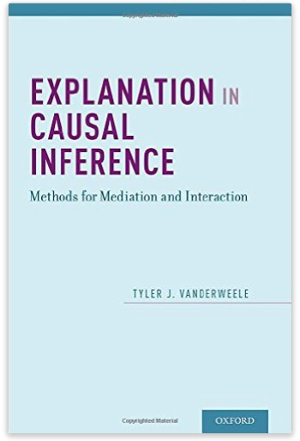
Challenges in mediation
Non-linear dependencies (binary mediators/outcomes, time-to-event outcomes)
Multiple mediators:
Interactions:
M₁
M
X
Y
X
Y
Issues with additional confounding
M₂
→ Over the last decade, research based on the causal inference theory - and here specifically counterfactuals (potential outcomes) - adressed many of these issues and many new methods were developed

Slide 9
Aim of our research
Theoretical statistics
New sophisticated methods
Statistical background necessary to comprehend (counterfactual theory)
Not so easy to implement (no handy software packages)
Applied research/ epidemiology
(Biomedical) research questions where mediation naturally appears
Recent developments in mediation have not arrived yet
Cardiovascular epidemiology
Data from large cohort studies
Demonstrate feasibility of novel mediation methods

Slide 10
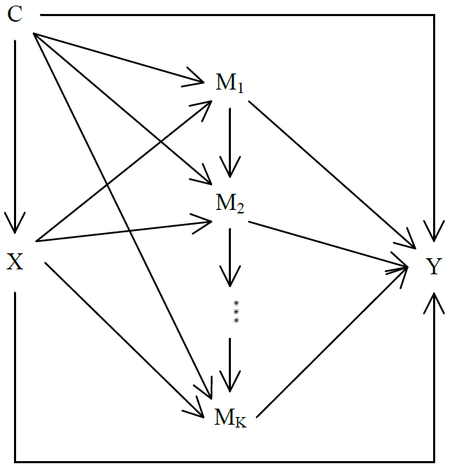
Material and methods
Material:
Malmö Diet and Cancer Study (MDCS)
Middle-aged men and women from Malmö
~24,000 participants, more than 2,200 CHD events
Vorarlberg Health Monitoring and Promotion Programme (VHM&PP)
~180,000 individuals, nearly 4,000 CHD deaths
Methods:
Regression-based approach for multiple mediators for the Cox proportional hazards model (VanderWeele, Epidemiology 2012)
Natural effect models (Lange, Am J Epidemiol 2014)
Break-down of indirect effect into single mediator components

Slide 11
Study 1: Mediators of sex/gender differences in CHD mortality (1)
Can sex/gender differences in the mortality due CHD be explained by traditional cardiovascular risk factors?
If yes, how much can be explained?
Are there age differences?
No proper mediation analysis been done before (only rudimentarily tackled treating risk factors as confounders)
Aim: Mediation analysis using natural effects models (Lange) allowing breakdown into single components of the indirect sex/gender effect

Slide 12
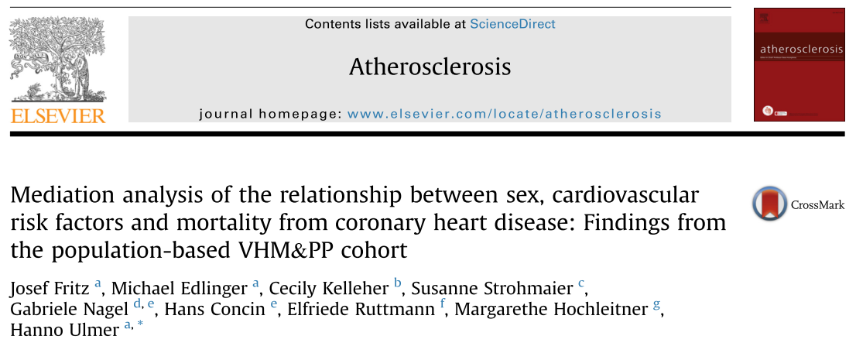
Study 1: Mediators of sex/gender differences in CHD mortality (2)
Data of the Vorarlberg Health Monitoring and Promotion Programme
The extent to which risk factors contribued varied with age
<50 years: the 4 RFs explained 41% (95% CI: 27%-54%) of the sex effect
≥50 years: the 4 RFs explained 8% (95% CI: 4%-12%) of the sex effect
In younger individuals, the female survival advantage was explained to a substantial part through the pathways of the 4 major risk factors
Blood pressure and cholesterol were the strongest factors
The study was published in Atherosclerosis in September 2015

Slide 13
Study 2: Age, metabolic mediators of BMI and CHD mortality (1)
Previous studies by Lu et al. (Lancet, 2014; Epidemiology, 2015) showed that about half of the risk of BMI on CHD is mediated by metabolic risk factors
Age only as confounder, not as effect moderator
Our additional question: Are there age dependencies in metabolic mediation of body mass index (BMI) on CHD mortality?
Aim: Mediation analysis using the regression-based mediation analysis approach by VanderWeele

Slide 14
Study 2: Age, metabolic mediators of BMI and CHD mortality (2)
Our results indicate that metabolic risk factors may play different roles in explaining the risk of increased BMI on CHD between the younger and the elderly
Published in Epidemiology in May 2016 as an extended letter referring to the original article by Lu et al.

Slide 15
Study 3: Metabolic mediators and CHD genetics (1)
Guidelines on CVD/CHD prevention acknowledge that conventional CV risk factors can “partly explain the impact of genetic risk“
Otherwise very unspecific
How much exactly is explained?
By which risk factors exactly?

Slide 16
Study 3: Metabolic mediators and CHD genetics (2)
Data of the Malmö Diet and Cancer Study
Genetical CHD risk measured as
Self-reported family history of CHD
genetic risk scored based on 50 CHD related SNPs (GRS50)
The data indicates that a fraction of the CHD risk associated with family history or with GRS50 is mediated through dyslipidaemia and hypertension, but not through diabetes.
However, it seems that the major part (≥80%) of the genetic effect operates independently from the established metabolic risk factors.
The study was published in JAHA in March 2017

Slide 17
Study 3: Model dependencies of the results
 | Family history (yes vs. no) |  |  | GRS50 (high vs. low/intermediate)
Effects | Natural effects model¹ | Regression-based approach² | Difference method | Natural effects model¹ | Regression-based approach² | Difference method
Total effect | 1.52 | 1.55 | 1.52 | 1.53 | 1.55 | 1.53
Direct effect | 1.40 (80%) | 1.44 (83%) | 1.43 (86%) | 1.45 (87%) | 1.48 (89%) | 1.49 (93%)
Indirect effect, combined | 1.09 (20%) | 1.08 (17%) | 1.06 (14%) | 1.06 (13%) | 1.05 (11%) | 1.03 (7%)
Indirect effect, through systolic blood pressure | 1.04 (9%) | - | - | 1.02 (4%) | - | -
Indirect effect, through apoA-I | 1.01 (2%) | - | - | 1.01 (1%) | - | -
Indirect effect, through apoB | 1.04 (8%) | - | - | 1.04 (8%) | - | -
Indirect effect, through diabetes mellitus | 1.01 (1%) | - | - | 1.00 (0%) | - | -
Effects given as HR (Proportion explained)
¹Lange, Am J Epidemiol 2014
²VanderWeele, Epidemiology 2012

Slide 18
Thanks to / Acknowledgements
Hanno Ulmer (Innsbruck)
Michael Edlinger (Innsbruck)
Cecily Kelleher (Dublin)
Susanne Strohmaier (Oslo/Harvard)
Gabriele Nagel (Ulm)
Hans Concin (Bregenz)
Elfriede Ruttmann (Innsbruck)
Margarethe Hochleitner (Innsbruck)
Dov Shiffman (Quest Diagnostics, CA)
Olle Melander (Malmö)
Hayato Tada (Kanazawa)

