Slide 1
Metabolically healthy obesity and risk of cancer Prognostic vs etiologic effects of MHO
Josef Fritz, Hanno Ulmer
Department of Medical Statistics, Informatics and Health Economics, Medical University of Innsbruck, Austria
Lund, September 10th 2018

Slide 2
Introduction
Excess body weight/obesity is a major risk factor for many cancer forms
However, there is a subgroup of obese people who present with few or no elevated metabolic risk factors – the ‘metabolically healthy obese’ (MHO) – as opposed to the ‘metabolically unhealthy obese’ (MUHO)
Regarding the association of metabolic health (MH) status and BMI with cardiovascular outcomes, there is a large volume of literature

Slide 3
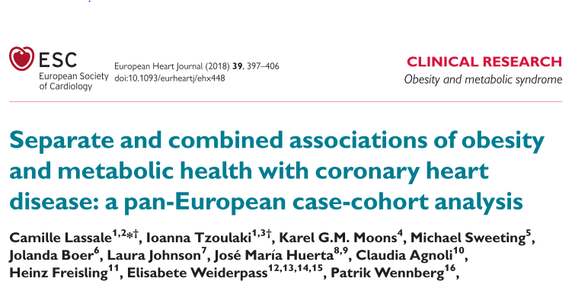
MHO and cardiovascular risk
Results are in line with the assumption that a large part of the effect of BMI, but not all, is mediated through metabolic factors

Slide 4
MHO and cancer risk
However, MHO has not yet been systematically investigated in cancer epidemiology
The aim of this study is to exactly do this
Because the mechanisms linking obesity and cancer are different from those linking obesity and CVD, we can expect that MH status shows different patterns in conveying risk of cancer than the patterns observed for MH status and cardiovascular risk

Slide 5
Competing risk analysis
In prospective settings, the association of the outcome of interest – in our case time to incident cancer – is routinely quantified with Cox proportional hazards regression models
Death from other (cancer-unrelated) causes is clearly a competing event to our event of interest
Because MHO and MUHO individuals differ in their probability of suffering from a competing event, it is a natural idea to think about integration of the competing event information in the analysis -> Fine-Gray subdistribution hazards model

Slide 6
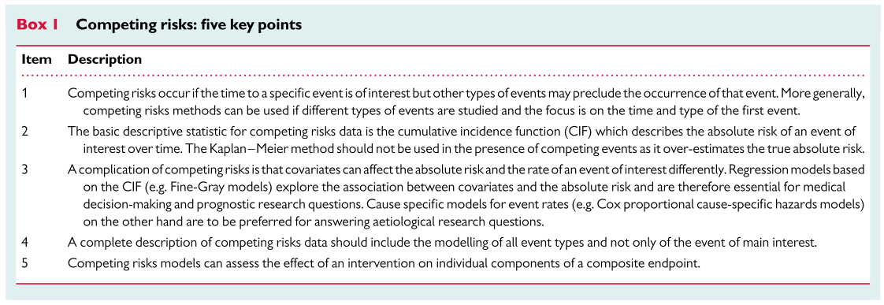
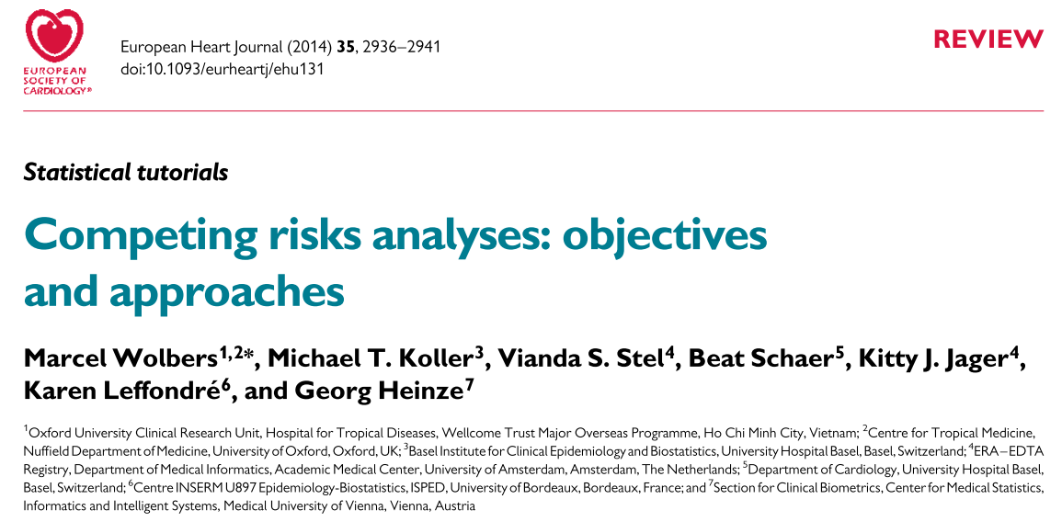
Cox vs. Fine-Gray model
The effect size given by the Cox model, namely the HR, answers etiologic research questions (it compares the cause-specific hazard function irrespective of the competing events)
→ therefore also the name cause-specific hazard model
The effect size of the Fine-Gray model, the SHR (subdistribution hazard ratio), on the other hand, answers prognostic or medical decision-making research questions (it compares the CIFs)
→ therefore also the name cumulative incidence function (CIF) regression

Slide 7
Example Cox vs. Fine-Gray model
It is even possible that HR and SHR have different signs (i.e. >1 and <1 or vice versa)
Example:
Smoking increases the cause-specific risk (in terms of HR) of Alzheimer‘s disease
However, the actual incidence rate (in terms of CIF) is lower because many smokers have already died of other causes before they can actually develop Alzheimer‘s disease

Slide 8
Aims of the study
To systematically quantify the association between obesity, MH status and cancer risk for various types of cancer (all cancers? only obesity-related cancers? cancer subgroups?)
To do this analysis both from an etiologic (Cox) AND prognostic (Fine-Gray) standpoint

Slide 9
Material and methods
After exclusion of observations with missing or implausible information on relevant variables (in particular fasting status, BMI, glucose, triglyceride, blood pressure, cholesterol, smoking status), prevalent cancer or a follow-up less than twelve months, 509,963 baseline observations were left for analysis
60,443 individuals developed cancer during a median follow-up of 17 years
Stratification of analyses by sex and cancer type, comparison of MH normal weight (reference) with MUH normal weight, MHO and MUHO
Cumulative incidence functions (cancer events and competing events (death from other causes))
Cox models vs Fine-Gray models, using age as the underlying time variable, and excluding the first 12 months of follow-up after baseline

Slide 10
Definition of MHO (Lassale et al, EHJ 2018)
Being metabolically unhealthy was defined as having three or more of the following metabolic abnormalities:
elevated BP (SBP>=130 and/or DBP>=85mmHg) and/or use of antihypertensive medication
hypertriglyceridaemia, defined as triglycerides >=1.7mmol/L (150mg/dL) or current use of lipid-lowering medication at baseline
low HDL-cholesterol, defined as <1.0mmol/L (40mg/dL) for men and <1.3mmol/L (50mg/dL) for women
hyperglycaemia, defined as fasting blood glucose >=5.6mmol/L (100mg/dL) or non-fasting blood glucose>=7.8mmol/L (140mg/dL, with fasting defined as >=3 h between last meal and blood draw) and/or current use of antidiabetic medication
elevated waist circumference, defined as WC>=94cm for men and WC>=80cm for women
(Definition according to the 2009 Joint Interim Statement of the International Diabetes Federation Task Force on Epidemiology and Prevention; National Heart, Lung, and Blood Institute; American Heart Association; World Heart Federation; International Atherosclerosis Society; and International Association for the Study of Obesity)

Slide 11
Proposed definition of MHO in our study
Being metabolically unhealthy is defined as having two or more of the following metabolic abnormalities:
SBP>=160 and/or DBP>=95mmHg
non-fasting (<8h) triglycerides >=2.3mmol/L (204 mg/dl) or fasting (>=8h) triglycerides >=1.7mmol/l (150mg/dl)
total cholesterol >=6.2 mmol/L (241mg/dl)
non-fasting (<8h) blood glucose >=7.8mmol/L (141mg/dL) or fasting blood glucose>=5.6mmol/L (101mg/dl)
 | Female (N=252,246) | Male (N=257,717)
High BP | 23,895 (9.5%) | 35,640 (13.8%)
High TG | 35,054 (13.9%) | 80,655 (31.3%)
High TC | 62,019 (24.6%) | 82,210 (31.9%)
High BG | 34,801 (13.8%) | 47,698 (18.5%)
MUH | 36,665 (14.5%) | 69,004 (26.7%)

Slide 12
Alternative definition of MHO in our study
Calculate z-scores of logarithmized triglycerides, logarithmized glucose, cholesterol and mid blood-pressure stratified by sex, cohort, and fasting status
Sum up these four scores and standardize again
Being metabolically unhealthy is defined as being in the highest quartile (Q4)
 | Female (N=252,246) | Male (N=257,717)
MUH | 62,537 (24.8%) | 64,155 (24.9%)

Slide 13
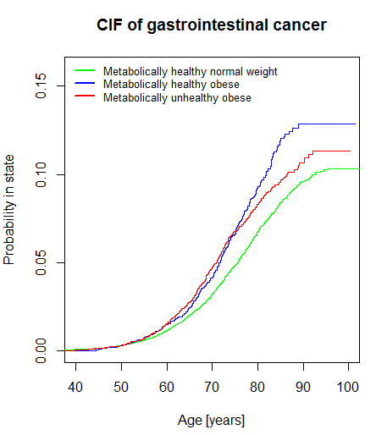
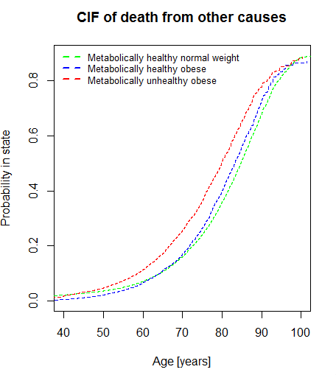
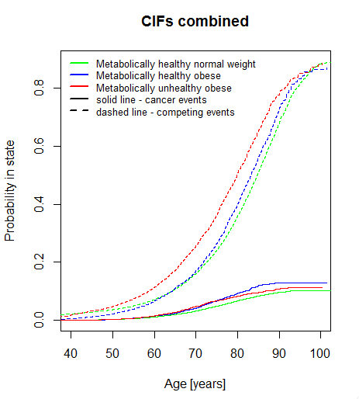
Preliminary results for obesity-related gastrointestinal cancers (1)
Gastrointestinal cancers defined as ICD-9 codes 150-157 / ICD-10 C15-C25
A total of 6,604 cancers are included in this analysis
CIF curves for males

Slide 14
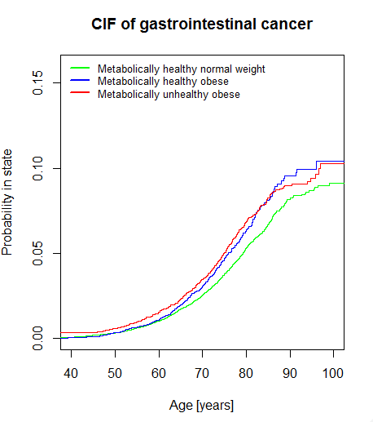
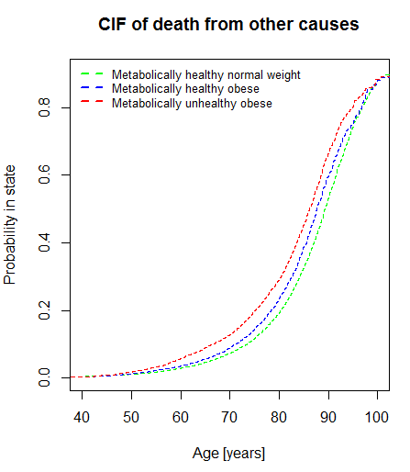
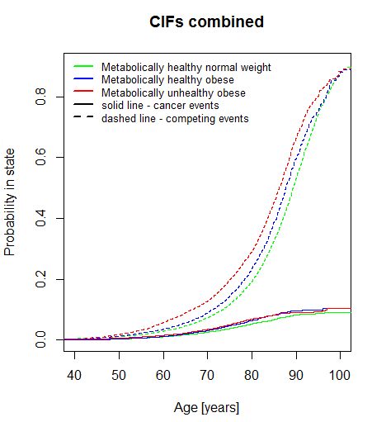
Preliminary results for obesity-related gastrointestinal cancers (2)
Gastrointestinal cancers defined as ICD-9 codes 150-157 / ICD-10 C15-C25
A total of 6,604 cancers are included in this analysis
CIF curves for females

Slide 15
Gender comparison
Males
Females

Slide 16
Preliminary results for obesity-related gastrointestinal cancers
 | Cause-Specific Hazard Model (Cox) |  |  | Subdistribution Hazard Model (Fine-Gray)
 | MHNW | MHO | MUHO | MHNW | MHO | MUHO
Males | Ref | 1.46 (1.30-1.63) | 1.47 (1.33-1.63) | Ref | 1.35 (1.21-1.51) | 1.24 (1.12-1.37)
Females | Ref | 1.34 (1.18-1.51) | 1.34 (1.21-1.49) | Ref | 1.24 (1.11-1.37) | 1.22 (1.09-1.37)
Each cell contains the hazard ratio / subdistribution hazard ratio and associated 95% confidence interval
MHNW – metabolically healthy normal weight; MHO – metabolically healthy obese; MUHO – metabolically unhealthy obese

Slide 17
Summary (regarding gastrointestinal cancers)
As expected, prognostic effects (SHR) are somewhat smaller than etiologic effects (HR) for both MHO and MUHO
In strong contrast to cardiovascular disease, cause-specific effects do almost not differ between MHO and MUHO
It appears that obesity itself rather than metabolic risk factors is the main driver for increased cancer risk
Because of competing risks, male MUHO are better off in regard to cancer risk than male MHO; probably caused by gender differences regarding CVD

