Slide 1
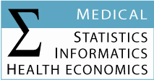
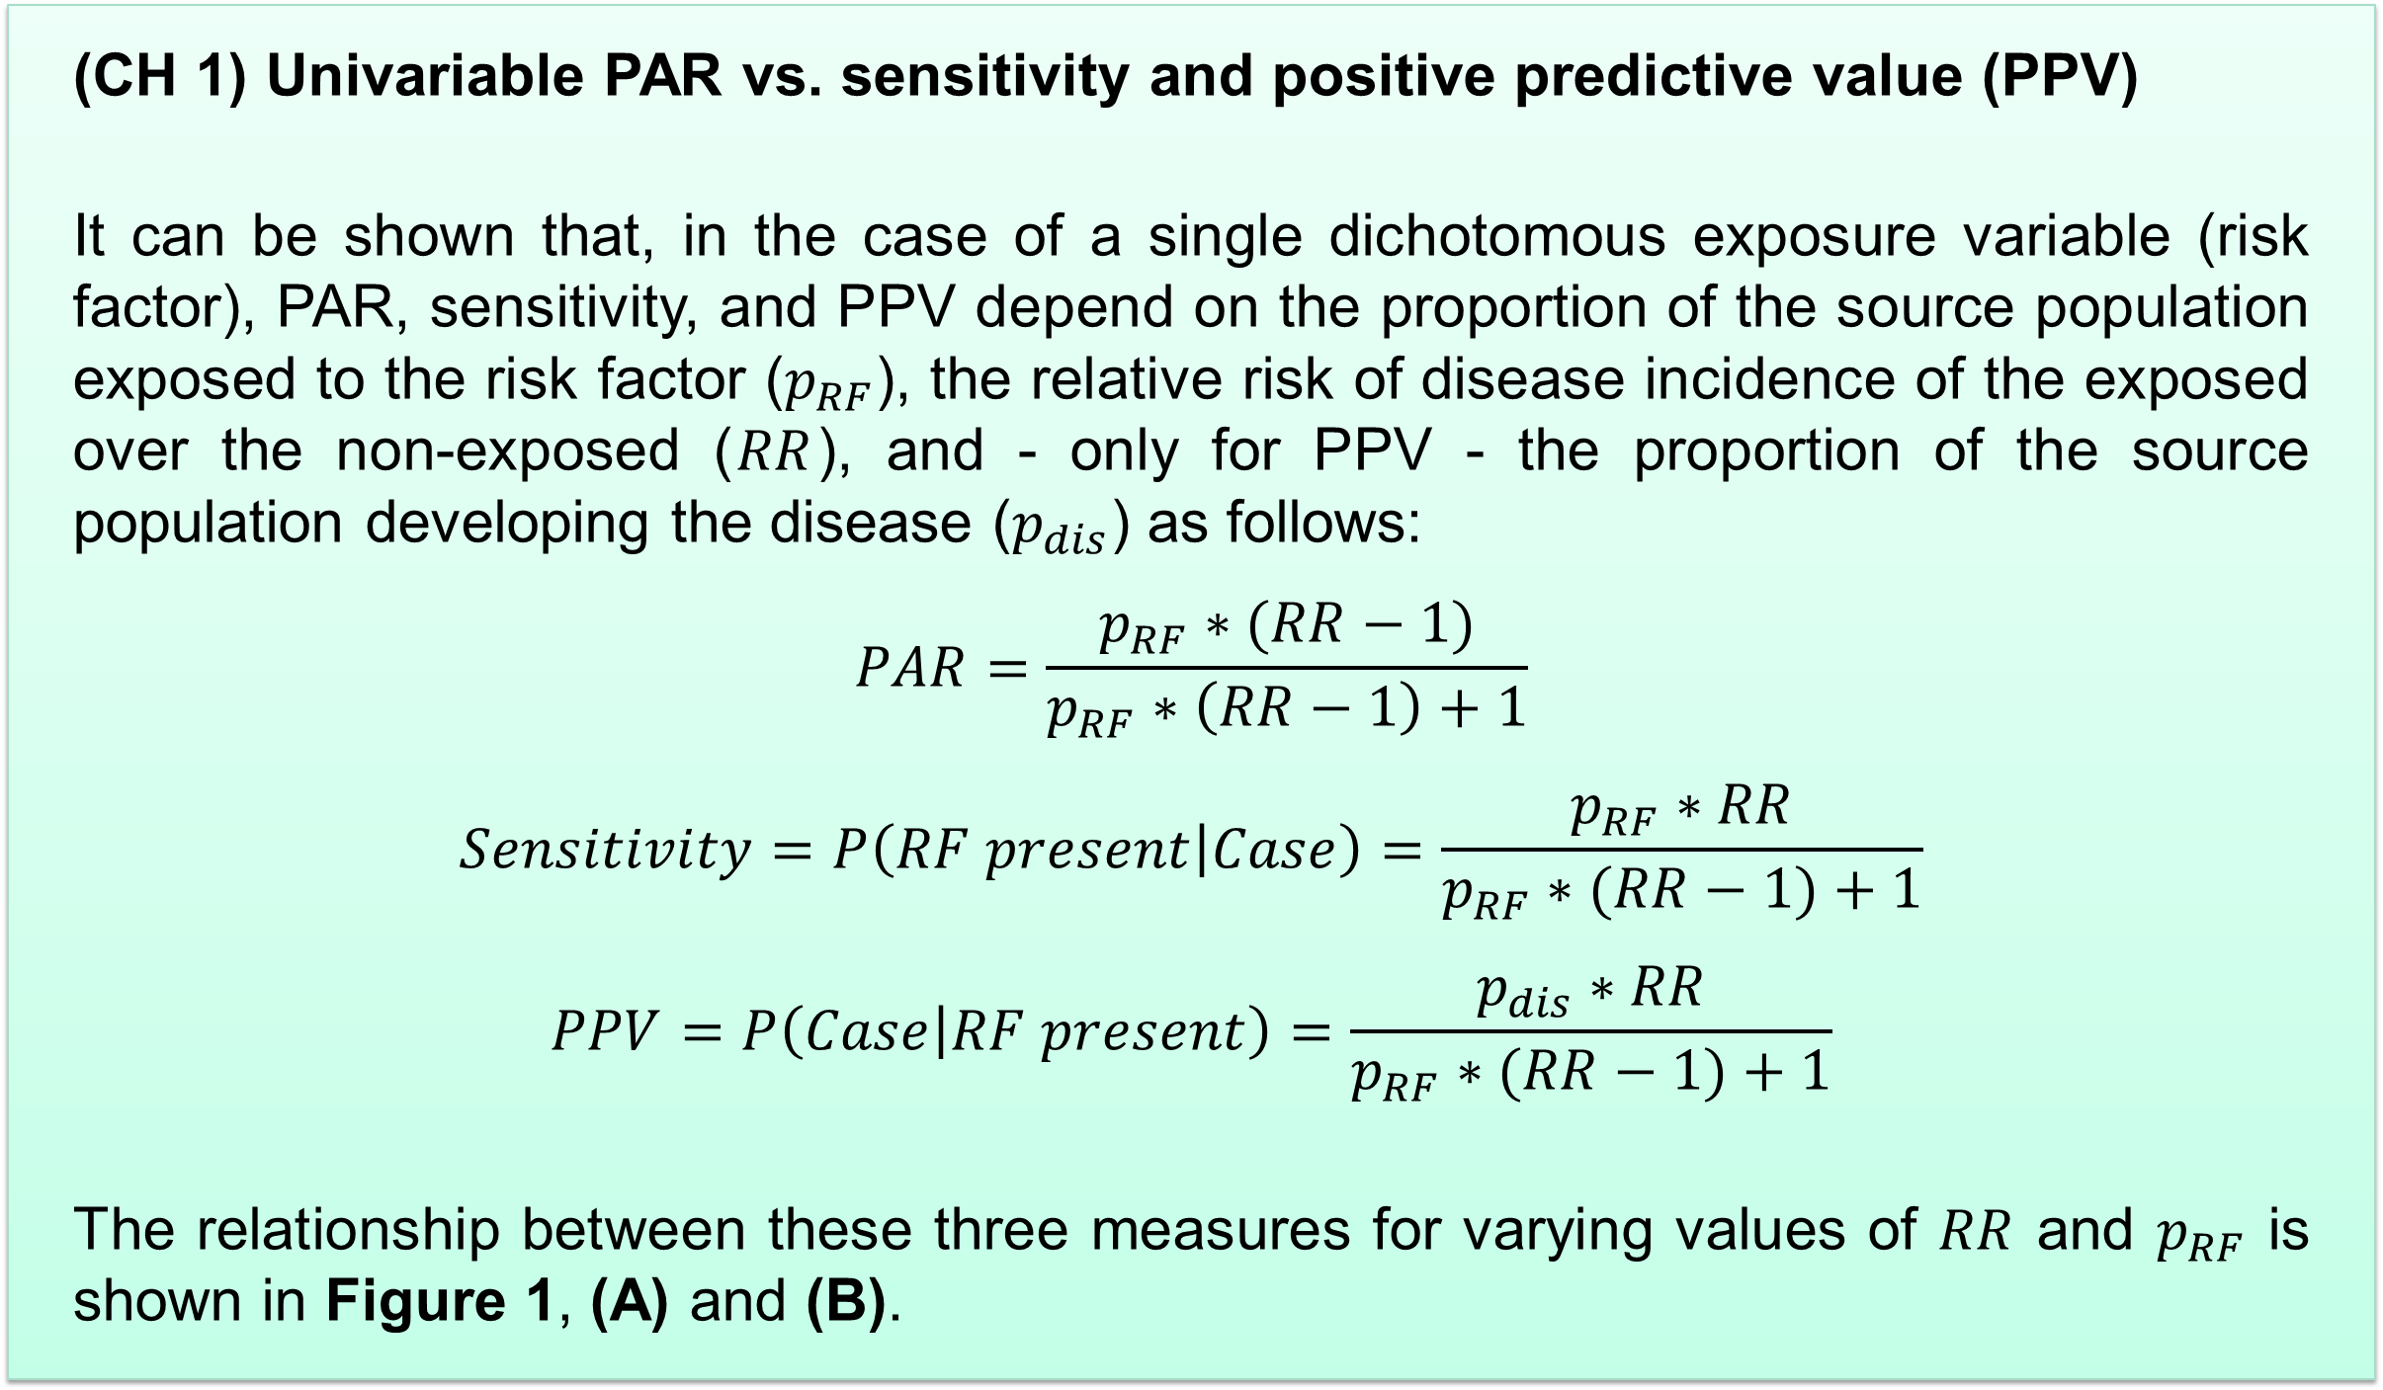
Challenges regarding the use and interpretation of the population attributable risk (PAR) in epidemiological studies
Josef Fritz¹, Hanno Ulmer¹
¹ Department of Medical Statistics, Informatics and Health Economics, Medical University of Innsbruck, Innsbruck, Austria
The population attributable risk (PAR) – sometimes also called population attributable fraction (PAF) - is defined as the reduction in incidence (of a certain disease) that would be observed if a population were entirely unexposed (to a set of risk factors), compared with its current exposure pattern. The PAR thus depends on both the prevalence of the exposure and the risk associated with the exposure. It is a measure with immediate clinical relevance, especially for policymakers when assessing the impact of public health interventions. Presentation of PARs has increased substantially in the epidemiological literature over the last few years. However, the discussion about PARs is often sparse and the correct interpretation left to the reader.
In the following, five challenges (CH 1) – (CH 5) regarding use and interpretation of PARs often not appreciated enough are presented (see also [1] – [4]).
Finally, in Table 1, the handling regarding these five challenges are scrutinized taking four recent case studies from the cardiovascular literature.
(CH 4) Dichotomizing originally continuous risk factors
For a continuous risk factor, the magnitude of the PAR generally depends on the specific cut-off point classifying individuals as "exposed" or "unexposed". It can be made artificially high only by defining risk factors in such a way that almost the entire population is labelled as "exposed". Furthermore, when estimating RRs for such "extreme" cut-off points from observational data, instability of estimates can become an issue.
(CH 5) PAR and causality
A critical implicit assumption when reporting PARs is that the exposure-outcome relationship is indeed causal. In this way, relying on evidence from observational studies always carries the potential limitation of confounding and overestimation of the PARs.
(CH 1) Univariable PAR vs. sensitivity and positive predictive value (PPV)
It can be shown that, in the case of a single dichotomous exposure variable (risk factor), PAR, sensitivity, and PPV depend on the proportion of the source population exposed to the risk factor ($p_{RF}$), the relative risk of disease incidence of the exposed over the non-exposed ($RR$), and - only for PPV - the proportion of the source population developing the disease ($p_{dis}$) as follows:
$$PAR=\frac{p_{RF}∗(RR−1)}{p_{RF}∗\left(RR−1\right)+1}$$
$$Sensitivity=P\left(RF present | Case\right)=\frac{p_{RF}∗RR}{p_{RF}∗(RR−1)+1}$$
$$PPV=P\left(Case | RF present\right)=\frac{p_{dis}∗RR}{p_{RF}∗(RR−1)+1}$$
The relationship between these three measures for varying values of $RR$ and $p_{RF}$ is shown in Figure 1, (A) and (B).
Figure 1: Relationship between PAR, sensitivity and PPV (for values $p_{dis}=0.1$ and $p_{dis}=0.3$, respectively) depending on $RR$ when $p_{RF}$ is fixed at a value of 0.5 (A) and depending on $p_{RF}$ when $RR$ is fixed at a value of 2.5 (B).
(CH 2) Multivariable PAR
When a bunch of risk factors is considered simultaneously, it is not correct to add up the various single risk factor PARs; doing so generally overestimates the true PAR and may result in sums greater than one.
The correct formula for multivariable PARs is as follows (see also [5]):
$$PAR=1−\frac{1}{\sum_{i}{p_{i}{RR}_{i}}}$$
Here, subscript $i$ runs through all possible exposure patterns (e.g. for four dichotomous risk factors, there are $2^{4}=16$ possible patterns), $p_{i}$ is the proportion of the source population presenting with the $i$th exposure pattern, and ${RR}_{i}$ is the relative risk comparing the $i$th exposure pattern with the unexposed group.
Table 1: Evaluation of four case studies from the cardiovascular literature regarding the correctness and extent of discussion of points (CH 1) to (CH 5).
(1) Only technical definitions of PAR are given; no tangible explanation; (2) Multivariable PARs wrongly calculated and thus exceeding 100%; (3) Selection of unrealistic cut-off values for some dietary patterns may artificially boost PARs; (4) No discussion of causality in the context of PAR. NA – not applicable.
Case study | (CH 1) | (CH 2) | (CH 3) | (CH 4) | (CH 5)
Yusuf et al.: Effect of potentially modifiable risk factors associated with myocardial infarction in 52 countries (the INTERHEART study): case-control study. Lancet 2004. | ☹⁽¹⁾ | 😐 | ☺ | ☺ | ☹⁽⁴⁾
Nilsson et al.: Population-attributable risk of coronary heart disease risk factors during long-term follow-up: the Malmö Preventive Project. J Intern Med 2006. | 😐 | ☹⁽²⁾ | NA | 😐 | ☹⁽⁴⁾
O'Donnell et al.: Global and regional effects of potentially modifiable risk factors associated with acute stroke in 32 countries (INTERSTROKE): a case-control study. Lancet 2016. | ☹⁽¹⁾ | ☺ | ☺ | ☺ | ☺
Micha et al.: Association Between Dietary Factors and Mortality From Heart Disease, Stroke, and Type 2 Diabetes in the United States. JAMA 2017. | ☹⁽¹⁾ | 😐 | NA | ☹⁽³⁾ | 😐
(CH 3) PAR in case-control studies
In case-control studies, the relative risks (RRs) needed for the calculation of the PAR are often approximated by odds ratios (ORs). This is normally no problem for univariable PARs, but it may lead to overestimation of multivariable PARs due to the exponential accumulation of the approximation errors. For example, in a simulation analysis, the OR-derived PAR did not overestimate the RR-derived PAR by more than 0.05 when the relative difference between OR and RR was smaller than 0.02 and when there were not more than 10 single dichotomous risk factors.
Contact information:
Josef Fritz, PhD
Department of MSIG
Medical University of Innsbruck
Schoepfstraße 41 / 1
6020 Innsbruck, Austria
P: +43 512 9003 70915
E: josef.fritz@i-med.ac.at
I: http://www.i-med.ac.at/msig/
References:
[1] Rockhill B, Newman B, Weinberg C. Use and Misuse of Population Attributable Fractions. Am J Public Health. 1998;88(1):15-19.
[2] Poole C. A history of the population attributable fraction and related measures. Ann Epidemiol. 2015;25(3):147-154.
[3] Mueller NT, Appel LJ. Attributing Death to Diet: Precision Counts. JAMA. 2017;317(9):908-909.
[4] Krieger N. Health Equity and the Fallacy of Treating Causes of Population Health as if They Sum to 100%. Am J Public Health. 2017;107(4):541-549.
[5] Kleinbaum DG, Kupper LL, Morgenstern H. Epidemiologic Research. Belmont, Calif: Lifetime Learning Publications; 1982:163.

