Slide 1
The Vorarlberg Health Monitoring & Promotion Programme (VHM&PP)
(Preventive health care cohort in Vorarlberg)
Wolfgang Brozek^{a,*}, Hans Concinª, Kristin Ganahlª, Gabriele Nagel^{a,b}, Hanno Ulmer^{a,c}, Emanuel Zitt^{a,d,e}
ª Agency for Preventive and Social Medicine (Arbeitskreis für Vorsorge- und Sozialmedizin), Bregenz, Austria
^{b} Institute of Epidemiology and Medical Biometry, Ulm University, Germany
^{c} Institute of Medical Statistics and Informatics, Medical University of Innsbruck, Austria
^{d} Vorarlberg Institute for Vascular Investigation and Treatment (VIVIT), Feldkirch, Austria
^{e} Department of Internal Medicine 3 (Nephrology and Dialysis), Feldkirch Academic Teaching Hospital, Austria
*contact:
wolfgang.brozek@aks.or.at
aks gesundheit GmbH
Rheinstr. 61, 6900 Bregenz, Austria

Slide 2
The Vorarlberg Health Monitoring & Promotion Programme (VHM&PP)
(Preventive health care cohort in Vorarlberg)
Datasets of health care programmes in Vorarlberg documented and managed by the Agency of Preventive and Social Medicine (Arbeitskreis für Vorsorge- und Sozialmedizin, aks gesundheit GmbH)
Basic idea:
Merge data of these programmes into one cohort containing information of at least the largest and most comprehensive programme for any member of the cohort. This largest programme accounting for the base dataset of the cohort is the General Health Examination (Allgemeine Gesundenuntersuchung) in Vorarlberg 1985-2005 (appr. 185,000 participants corresponding to 50-60% of the adult population, appr. 716,000 examinations)
Subcohorts (other, smaller programmes) add further examinations and variables
- „real“ subcohorts: 100% participants of the General Health Examination (additive programmes dependent on the General Health Examination)
- intersecting subcohorts: <100% participating also in the General Health Examination (programmes independent from the General Health Examination, but participation rate usually high)
Objective of the cohort:
Reveal risk factors for diseases, in particular cardiovascular and malignant diseases, for efficient and targeted public health-related planning and decision-making

Slide 3
The Vorarlberg Health Monitoring & Promotion Programme (VHM&PP)
Overview
(cf. Stöhr S. & Klenk J. Systematische Aufarbeitung und Dokumentation der aks Daten. Kommentar zur Datenqualität. Master Thesis, Ulm University, 2004)
Intersecting subcohorts
Preventive gynaecological examination (1985-2005)
650,171 examinations in 117,400 women
Skin cancer prevention programme
(1989-1994)
12,069 exams in 9382 persons
Chronic diseases intervention programme
WHO-CINDI 1986
N = 2401 participants
WHO-CINDI 1991
N = 2400 participants
WHO-CINDI 1998
N = 2794 participants
General Health Examination in Vorarlberg (1.1.1985 – 30.6.2005)
185,397 participants
716,679 examinations
Colorectal cancer prevention programme
(1992-2007)
N = 13,379 participants
Breast cancer prevention programme
by mammography screening
(1989-2005)
136,254 exams in 53,223 women
“real“ subcohorts
(additive programmes)
Preventive programme for
postmenopausal women (1991-2000)
N = 5297 women
Preventive programme for ageing people (2000-2001)
N = 3453 participants

Slide 4
The Vorarlberg Health Monitoring & Promotion Programme (VHM&PP)
General Health Examination: the base dataset
Documentation by aks Jan. 1st 1985 – June 30th 2005 (thereafter by Federation of Social Insurances = Dachverband der Sozialversicherungsträger)
716,679 examinations
185,397 participants aged ≥19 years, 53.9% female; 50-60% of adult population
Socio-demographic data: age, sex, marital status, occupational status (blue collar, white collar, self-employed)
Body height, body weight, blood pressure (sys, dia), smoking status, blood glucose, serum uric acid, triglycerides, total cholesterol, gamma-GT, fecal occult blood
only 1985-1986: dementia, alcohol abuse, status of stress, lack of physical activity
Closed dataset, however, permanently updated for survival and causes of death → very long follow-up!

Slide 5
The Vorarlberg Health Monitoring & Promotion Programme (VHM&PP)
Subcohorts: additive programmes
Preventive programme
for ageing people
(„Demenz 2000“, „VHM&PP 65+“)
Variables (by questionnaire):
Pre-existing diseases, medications, allergies, smoking, alcohol consumption, nutrition, bone fractures, various ailments (dyspnoea, insomnia, rheumatism, reduction of hearing and vision, vertigo); gynecological information asked from women (intake of hormones, pain and swellings of the breast, number of births, operations of the abdomen and breast); information on living situation and everyday life
n |  | period |  | Age profile |  | % female
3453 |  | June 2000 - July 2001 |  | ≥ 65 years |  | 58%
Preventive programme for
postmenopausal women („Frauen Plus“)
HDL-cholesterol
Bone mineral density by DXA or QCT (n=4750)
Questionnaire covering various topics: climacteric period, general satisfaction, vitality, cardiovascular risk, osteoporotic risk
n |  | period |  | Age profile
5297 women |  | Jan. 1991 – Dec. 2000 |  | ≥ 35 years

Slide 6
The Vorarlberg Health Monitoring & Promotion Programme (VHM&PP)
Intersecting subcohorts (1)
Preventive gynaecological examination
Various examinations documented (breast, uterus, vagina, vulva, …), e. g. cervical swabs, inspection and palpation of the breast, inspection of the vulva, colposcopy, cytology
n |  | period |  | Age profile
117,400 women, 650,171 examinations |  | Jan. 1985 – June 2005 |  | ≥ 15 years
Mammography screening programme
Offered to all (female) participants of the General Health Examination and the Preventive gynaecological examination
Mammography results; acquistion of breast cancer family history, operations of the breast, use of contraceptives, and breastfeeding
n |  | period |  | Age profile
53,223 women, 136,254 examination |  | Jan. 1989 – Dec. 2005 |  | ≥ 18 years

Slide 7
The Vorarlberg Health Monitoring & Promotion Programme (VHM&PP)
Intersecting subcohorts (2)
Skin cancer prevention
Acquisition of risk for skin cancer, skin type
n |  | period |  | Age profile |  | % female
9382 participants, 12,069 examinations |  | Aug. 1989 – Dec. 1994 |  | ≥ 13 years |  | 61%
Colorectal cancer prevention
Family history of colorectal cancer, fecal occult blood, colorectal cancer risk (adenomas, colorectal cancer syndroms, ulcerative colitis, cancer familiy history)
n |  | period |  | Age profile |  | % female
13,379 participants |  | 1992 - 2007 |  | >= 7 Jahre |  | 41%

Slide 8
The Vorarlberg Health Monitoring & Promotion Programme (VHM&PP)
Intersecting subcohorts (3)
n |  | period |  | Age profile |  | % female
2401 (CINDI 1986), 2400 (CINDI 1991), 2794 (CINDI 1998) |  | 1986, 1991, 1998 |  | 25 – 64 years |  | 50%
Chronic diseases intervention
programme (“CINDI“ of the WHO)
CINDI (Countrywide Integrated Non-communicable Diseases Intervention) programme of the WHO with the purpose of prevention of chronic diseases in 1986, 1991, and 1998
Inquiries, additional acquisition of laboratory parameters
Randomly selected participants aged 25-64 years with residency in Vorarlberg, same proportion females/males (representative random sample)
All years: Socio-demographic variables (age, sex, marital status, occupation), physical activity, nutrition, smoking, alcohol consumption, information sources for health-related topics
CINDI 1986: blood pressure (sys, dia), pulse, body height, body weight; serum uric acid, total cholesterol, gamma-GT, blood glucose, HDL-cholesterol, triglycerides
CINDI 1991: blood glucose, HDL-cholesterol, triglycerides; disease history (in particular, hypertension, cardiovascular disease, pulmonary disease, diabetes, malignant disease, urinary tract infection), medication history (analgesics, hypnotics, contraceptives, and other drugs)
CINDI 1998: blood glucose, serum uric acid, triglycerides, total cholesterol, HDL-cholesterol, gamma-GT

Slide 9
The Vorarlberg Health Monitoring & Promotion Programme (VHM&PP)
Scientific publications
>150 scientific publications in peer-reviewed journals since 2003 (up to April 2023)
(cf. https://www.i-med.ac.at/msig/mitarbeiter/ulmer/vhmpp.html.de)
Often combination with other datasets, registries, and cohorts, and part of multi-center studies (MCS):
  National Mortality Registry (Statistik Austria) (follow-up, causes of death)
  Cancer Registry Vorarlberg
  Coronary Angiography Cohort Vorarlberg (VIVIT [Vorarlberg Institute of Vascular Investigation and Treatment])
  Hip fracture dataset Vorarlberg (2003-2013)
  Austrian Dialysis and Transplant Registry (ÖDTR)
  Me-Can (Metabolic Syndrome and Cancer) (MCS)
  ESCAPE (European Study of Cohorts for Air Pollution Effects) (MCS)
  ELAPSE (Effects of Low-Level Air Pollution: A Study in Europe) (MCS)
  NCD RisC (non-communicable diseases risk factor collaboration) (MCS)
  ERFC (emerging risk factors collaboration) (MCS)

Slide 10
The Vorarlberg Health Monitoring & Promotion Programme (VHM&PP)
Scientific publications_examples (1)
Ulmer H, Kelleher C, Diem G, Concin H. Long-term tracking of cardiovascular risk factors among men and women in a large population-based health system: The Vorarlberg Health Monitoring & Promotion Programme. Eur. Heart J. 2003;24:1004–13.
Stability (tracking) of cardiovascular risk factors during a max. of 15 years:
BMI (body mass index) very stable
Triglycerides and gamma-GT not very stable, blood pressure fluctuating
Stable (vs. fluctuating) triglycerides and gamma-GT associated with higher total mortality, more stable systolic blood pressure with lower total mortality, both in women; no such effects in men
Strasak AM, Rapp K, Brant LJ, Hilbe W, Gregory M, Oberaigner W, Ruttmann E, Concin H, Diem G, Pfeiffer KP, Ulmer H. Association of γ-glutamyltransferase and risk of cancer incidence in men: a prospective study. Cancer Res. 2008;68:3970–7.
Elevated gamma-GT associated with increased cancer risk in men
In particular cancer of digestive, respiratory, and urinary organs
Marked dose-response effect

Slide 11
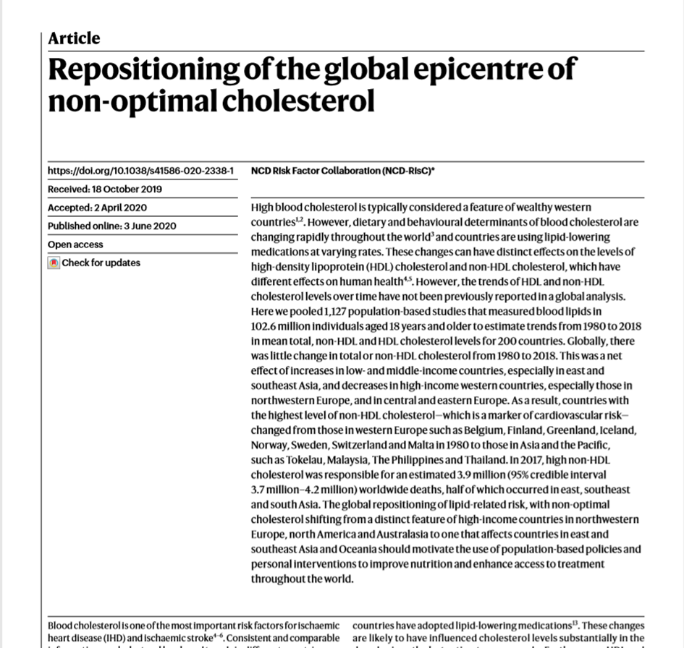
The Vorarlberg Health Monitoring & Promotion Programme (VHM&PP)
Scientific publications_examples (2)
Borena W, Strohmaier S, Lukanova A, Bjørge T, Lindkvist B, Hallmans G, Edlinger M, Stocks T, Nagel G, Manjer J, Engeland A, Selmer R, Häggström C, Tretli S, Concin H, Jonsson H, Stattin P, Ulmer H. Metabolic risk factors and primary liver cancer in a prospective study of 578,700 adults. Int. J. Cancer 2012;131:193–200.
Me-Can MCS
Primary hepatic tumors (liver cancer) as endpoint
BMI, blood glucose, and MetS Index: positively associated with primary hepatic tumors
Total cholesterol inversely associated
NCD Risk Factor Collaboration. Repositioning of the global epicentre of non-optimal cholesterol. Nature 2020;582:73-77.
NCD-RisC MCS
Total and non-HDL cholesterol decreasing since 1980 in Western industrialized countries, also in Austria
Increasing in newly industrialized and low-income countries of South-East Asia and Oceania (changing nutritional habits, restricted availability of statins)
Data for Austria in large part from VHM&PP cohort

Slide 12
The Vorarlberg Health Monitoring & Promotion Programme (VHM&PP)
Scientific publications_examples (3)
Strak M, et al. Long-term exposure to low level air pollution and mortality in eight European cohorts within the ELAPSE project: pooled analysis. BMJ 2021;374:n1904.
ELAPSE MCS (various European cohorts)
Long-term exposure to air pollution (PM_{2.5}, NO₂, black carbon) associated with increased mortality, even below current threshold values
Increase in mortality risk due to cardiovascular and respiratory diseases
O₃ (probably) no risk factor
Leiherer A, Ulmer H, Muendlein A, Säly C, Vonbank A, Fraunberger P, Föger B, Brandtner EM, Brozek W, Nagel G, Zitt E, Drexel H, Concin H. Value of total cholesterol readings earlier versus later in life to predict cardiovascular risk. EBioMed. 2021;67.
Total cholesterol measured at 50 years of age on average vs. 15 years later is significantly more accurate to predict cardiovascular risk at an advanced age

Slide 13
The Vorarlberg Health Monitoring & Promotion Programme (VHM&PP)
Scientific publications_examples (4)
Fritz J, Brozek W, Concin H, Nagel G, Kerschbaum J, Lhotta K, Ulmer H, Zitt E. The association of excess body weight with risk of ESKD is mediated through insulin resistance, hypertension, and hyperuricemia. J. Am. Soc. Nephrol. 2022;33:1377-89.
Hypertension, insulin resistance, and hyperuricemia but not elevated total cholesterol mediate the risk association of excess body weight and end-stage kidney disease
Brozek W, Ulmer H, Pompella A, Nagel G, Leiherer A, Preyer O, Concin H, Zitt E. Gamma-glutamyl-transferase is associated with incident hip fractures in women and men ≥ 50 years: a large population-based cohort study. Osteoporos. Int. 2022;33:1295-1307.
Gamma-GT as risk factor for hip fractures at age ≥ 50 independent from alcohol consumption, particularly in men

Slide 14
The Vorarlberg Health Monitoring & Promotion Programme (VHM&PP)
Summary
Strengths & limitations:
- Population-based cohort, but arguably selection for more health-conscious participants (healthy volunteer effect)
Prospective and standardized data acquisition, long follow-up times
Vorarlberg as “epidemiologic model region“: relatively isolated because of high mountains (east and south) and borders with non-EU countries (Switzerland, Liechtenstein) with a distinct social insurance system
Repeated examinations, in particular in the base data set (General Health Examination)
No new participants because dataset is closed since July 1st, 2005 (as of then, documentation by the Austrian Federation of Social Insurances)
Desired cooperation with other databases and cohorts, concerning:
Data of the General Health Examination for Vorarlberg since July 1st, 2005
Information on medication
Biosamples, biological material

