Slide 1
Doktorats-Studium Medizinische Wissenschaft (Dr. scient. med.)
Meta-Analysis Hanno Ulmer

Slide 2
Meta-Analysis Hanno Ulmer
hanno.ulmer@i-med.ac.at

Slide 3
Introduction
Hanno Ulmer
hanno.ulmer@i-med.ac.at
Department of Medical Statistics, Informatics and Health Economics, Innsbruck Medical University

Slide 4


References

Slide 6
Internet, software, online calculators
British Medical Journal: Statistics at Square One
A Series on Evaluation of Scientific Publications, Deutsches Ärzteblatt
R, Stata, SPSS, SAS, Statistica, GraphPad, MedCalc
Installation von R und R Commander:
https://www.uni-ulm.de/fileadmin/website_uni_ulm/mawi.inst.110/lehre/ss09/WiStat/R.pdf
https://r-empirische-wissenschaften.de/
https://jasp-stats.org/
nQuery Advisor, East, PASS, StudySize
RevMan5, Cochrane Collaboration

Slide 7
Internet, software, online calculators
https://www.sealedenvelope.com/
Randomisierung und Power Kalkulation
https://stattools.crab.org/
SWOG statistical tools
http://www.meta-mar.com/
Free online Meta-Analyse
https://www.polyu.edu.hk/mm/effectsizefaqs/calculator/calculator.html
Effect size calculator, Cohens d, Hedges g für Meta-Analyse
https://www.graphpad.com/quickcalcs/
Online Kalkulatoren der Software GraphPad
https://www.medcalc.org/calc/
Online Kalkulatoren der Software MedCalc

Slide 8
JASP et al
https://jasp-stats.org/
https://jasp-stats.org/2017/11/15/meta-analysis-jasp/
https://bookdown.org/MathiasHarrer/Doing_Meta_Analysis_in_R/preface.html
https://www.youtube.com/watch?v=BJUMpoWNAPw
https://shinyapps.org/apps/p-hacker/

Slide 9
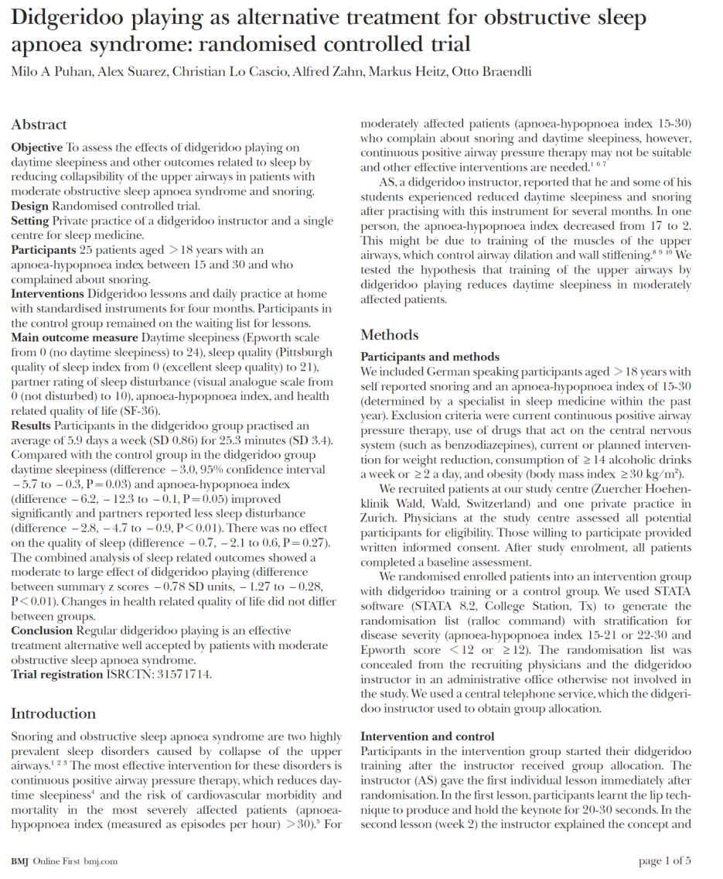
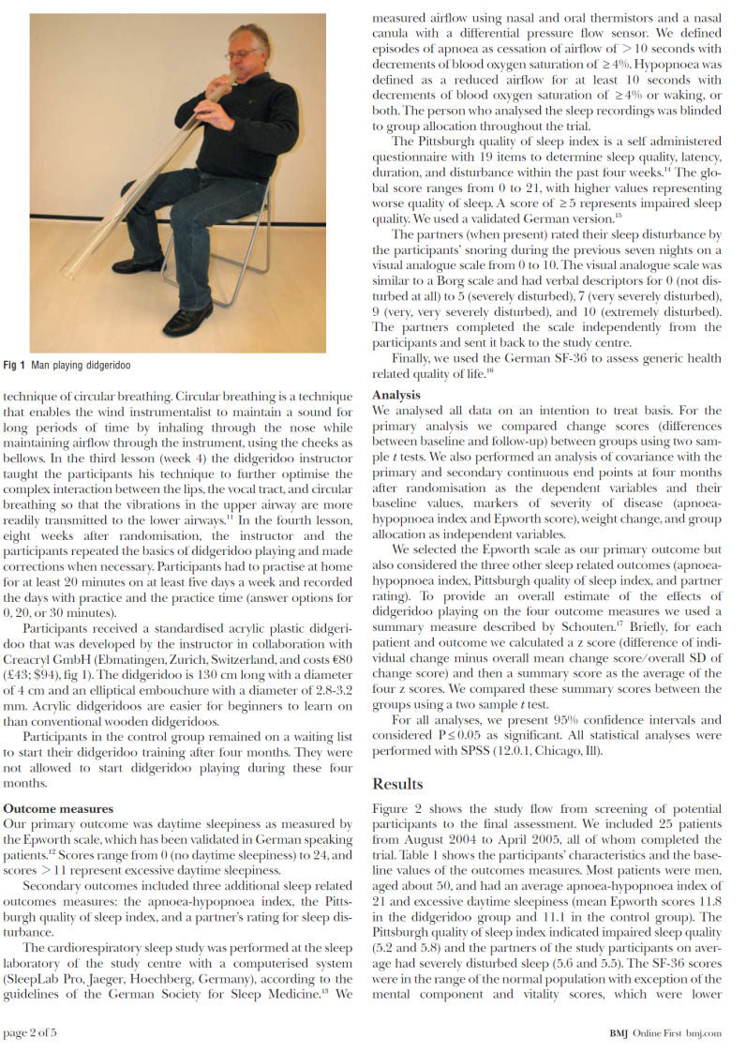
Case study: clinical trial

Slide 10
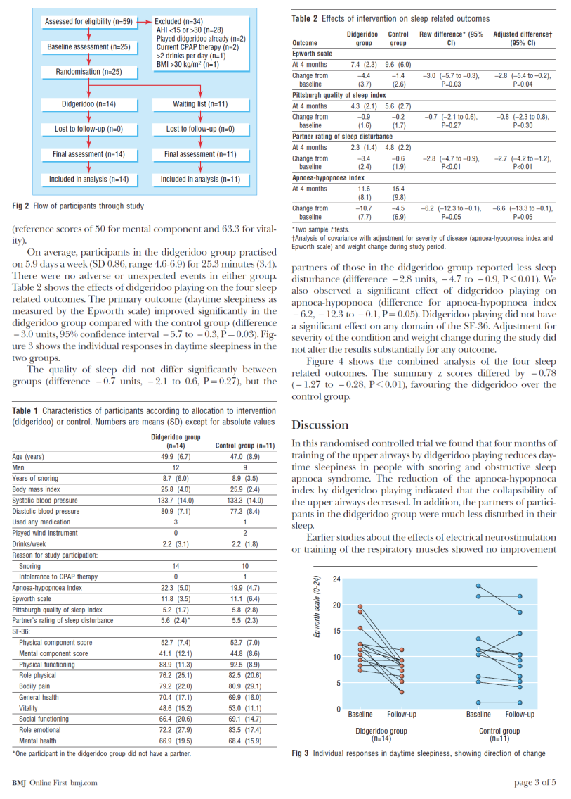
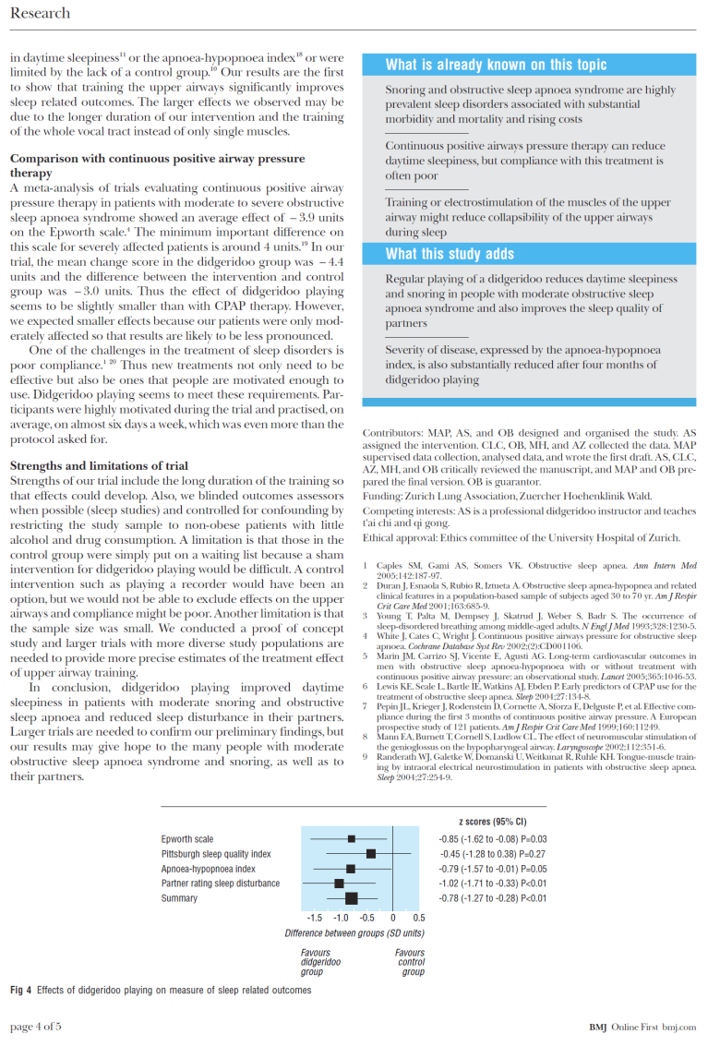
Case study: clinical trial

Slide 11
„How to read a study in 10 minutes“
Structure of a study report:
IMRaD scheme
Guidelines for writing a study report
CONSORT statement for interventional studies (RCTs)
STROBE statement for observational studies
(epidemiologic study designs: cohort study, case-control study, cross-sectional study)
STARD statement for diagnostic studyies
PRISMA statement for meta-analyis

Slide 12
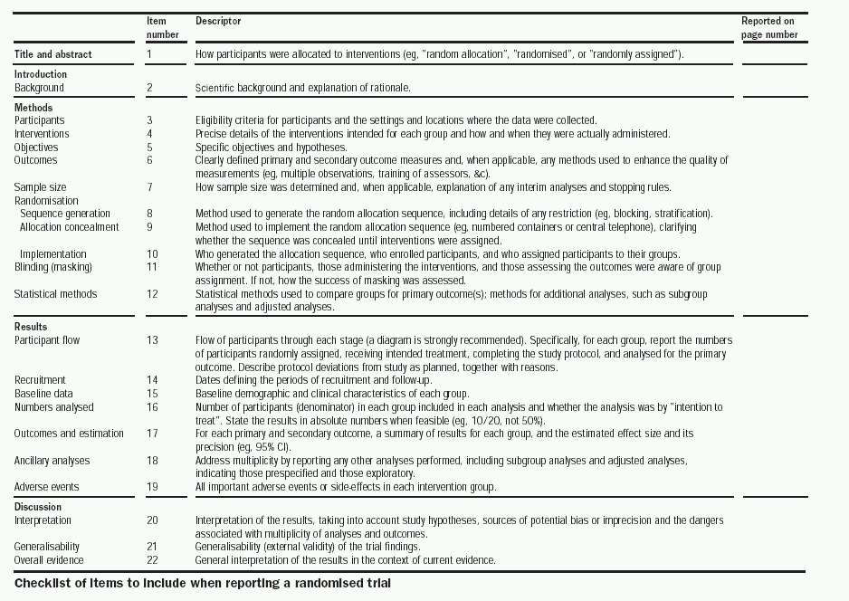

Slide 13
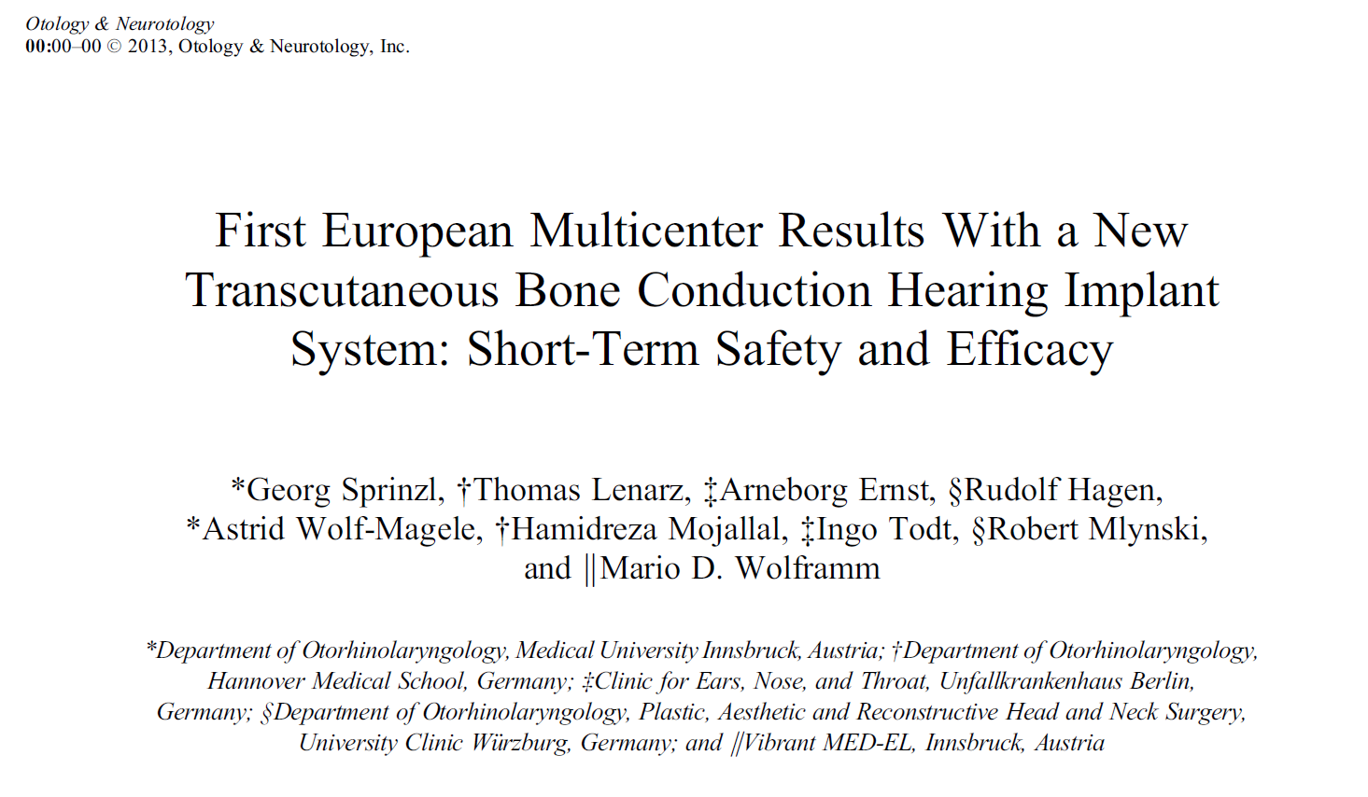
Case study: clinical trial (medical device)

Slide 14
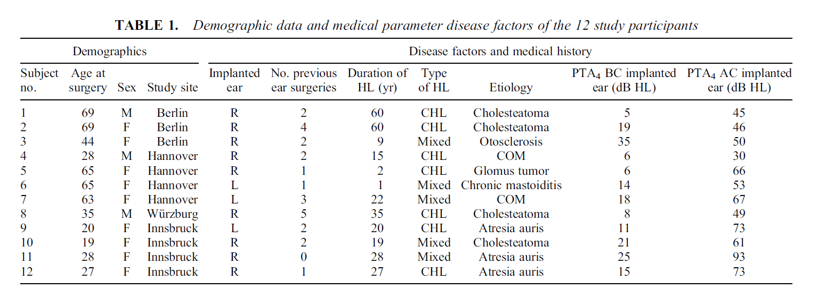
Case study: clinical trial (medical device)

Slide 15
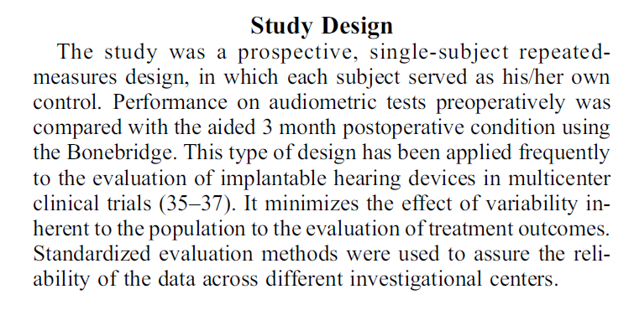
Case study: clinical trial (medical device)

Slide 16
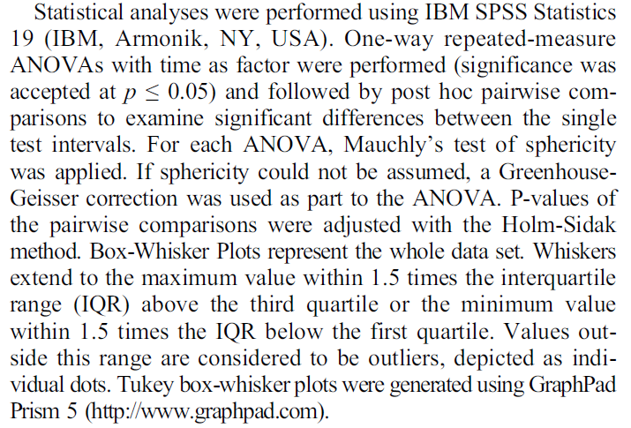
Case study: clinical trial (medical device)

Slide 17
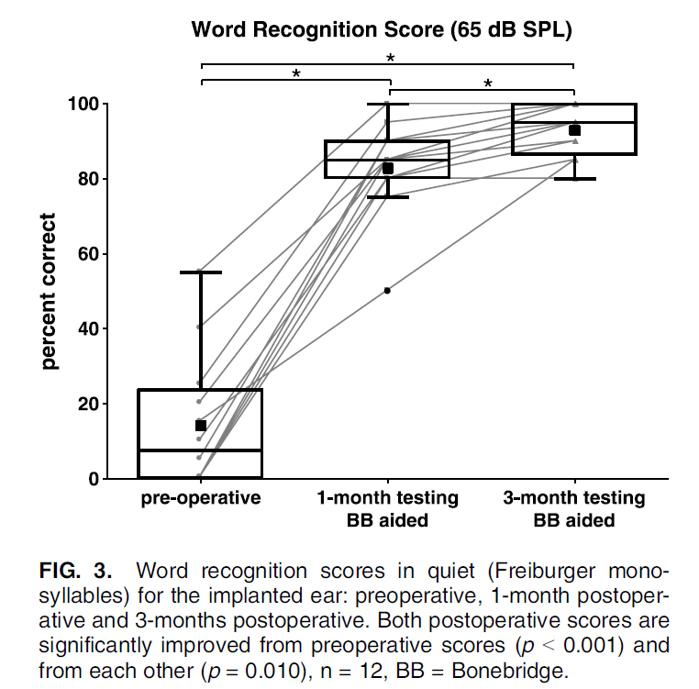
Case study: clinical trial (medical device)

Slide 18

Case study: clinical trial (drug)

Slide 19
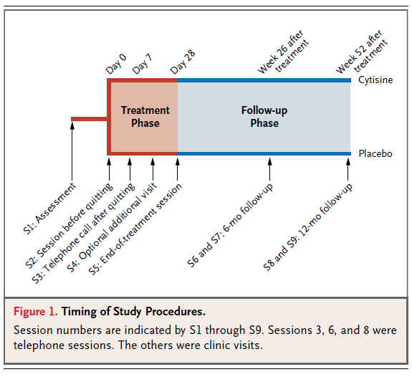
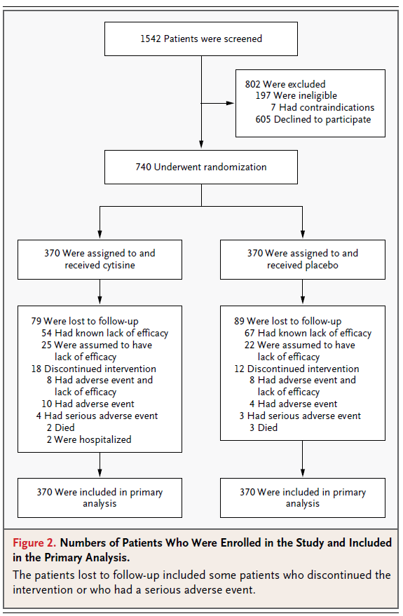
Case study: clinical trial (drug)

Slide 20
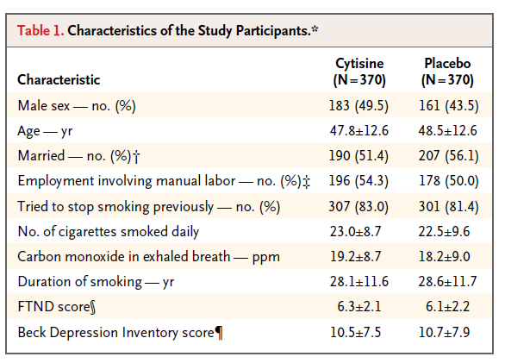
Case study: clinical trial (drug)

Slide 21
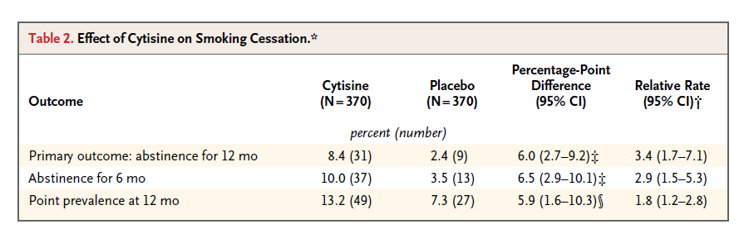
Case study: clinical trial (drug)

Slide 22
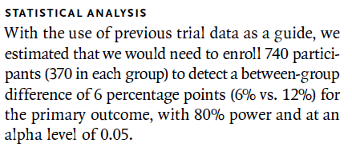
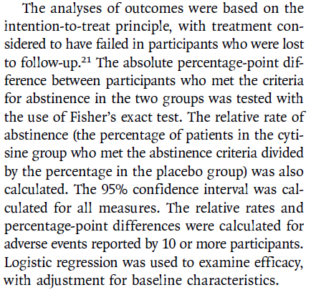
Case study: clinical trial (drug)

Slide 23
Case study: meta-analysis

Slide 24
Case study: meta-analysis

Slide 25
Case study: meta-analysis

Slide 26
Case study: meta-analysis

Slide 27
Case study: meta-analysis

Slide 28
Types of research studies
Dr. Hanno Ulmer
hanno.ulmer@i-med.ac.at
Department of Medical Statistics, Informatics and Health Economics, Innsbruck Medical University

Slide 29
Interventional versus observational
a factor that is to be investigated
(efficacy of a therapy such as a new medication, a risk factor such as smoking, a protective factor such as physical activity)
interventional
observational
clinical trial,
interventional cohort study
cohort study, case-control study, (cross-sectional study)

Slide 30
Longitudinal (incidence) versus cross-sectional (prevalence) studies

Slide 31
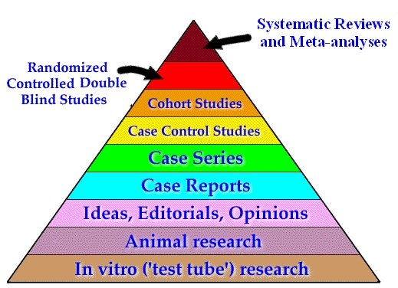
Strength of evidence

Slide 32
Clinical trial

Slide 33
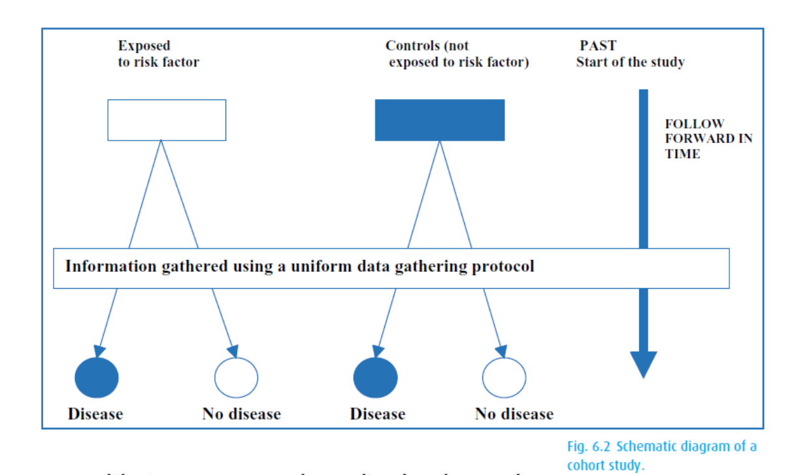
Cohort studies

Slide 34

Framingham Heart Study
1948 Recruiting of 5209 healthy individuals (age 30-62 years)
1960
smoking ↑ CHD
1970
hypertension
↑ stroke
1978
Psychosocial
factors ↑ CHD
1961
cholesterol, hypertension ↑ CHD
1988
HDL ↓ CHD
1976
menopause ↑ CHD
1967
physical activity ↓ CHD
obesity ↑ CHD

Slide 35
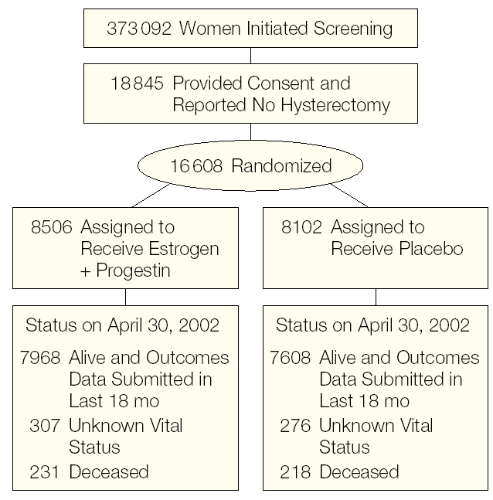
Interventional cohort study: Women`s Health Initiative (WHI)

Slide 36
Case control study

Slide 37
UCP breast cancer case-control study

Slide 38
Cohort Study
Case-Control Study
prospective
retrospective
Risk Factor +
Diseased
Risk Factor +
Cases
(Diseased)
Healthy Study Population
Healthy
Risk Factor -
Diseased
Risk Factor +
Controls
(Healthy)
Risk Factor -
Healthy
Risk Factor -
Diseased
Healthy
Diseased
Healthy
Risk Factor +
A
B
A + B
Risk Factor +
A
B
A + B
Risk Factor -
C
D
C + D
Risk Factor -
C
D
C + D
Relative
Risk
A / A+B
Odds
Ratio
(A / A+B) / (B / A+B)
A x D
=
=
C / C+D
=
(C / C+D) / (D / C+D)
B x C

Slide 39
Risk assessment and 2x2 tables
Dr. Hanno Ulmer
hanno.ulmer@i-med.ac.at
Department of Medical Statistics, Informatics and Health Economics, Medical University Innsbruck

Slide 40
2x2 table

Slide 41
Absolute risk

Slide 42
Relative risk

Slide 43
Odds ratio

Slide 44
Attributable risk = absolute risk reduction

Slide 45
Summary of risk measures
 | Outcome positive | Outcome negative
Exposition positive | a | b | Relative Risk
Exposition negative | c | d | Odds Ratio
 | Abs. Risk Reduct. | Number needed to treat (NNT) = 1/ARR

Slide 46
Practice: Calculate RR, OR, ARR and NNT for primary outcome

Slide 47
Practice: Calculate RR, OR, ARR and NNT for primary outcome
 | abstinence (12 months) | still classified smoking
Cytisine | 31 (8.4%) | 339 | RR = 3.4
Placebo | 9 (2.4%) | 361 | OR = 3.7
 | ARR = 6% | NNT = 16.7 NNT = 1/ARR

Slide 48
Adjustment and multivariate analysis
Dr. Hanno Ulmer
hanno.ulmer@i-med.ac.at
Department of Medical Statistics, Informatics and Health Economics, Innsbruck Medical University

Slide 49
Adjusting for a single variable in multivariate analysis

Slide 50
Adjusting for two variable in multivariate analysis

Slide 51
Adjusting for >2 variables: regression analyses
Multiple linear regression (when the outcome variable is continuous)
Multiple logistic regression (when the outcome variable is binary event)
Cox proportional hazards regression analysis (when the outcome variable is time-to-event)

Slide 52
Regression analyses
Regression analysis is a statistical method to assess associations and relationships between independent and dependent variables
Predictor (risk factor, therapy) -- > Outcome (disease)
Multivariable analysis:
k independent variables (predictors) -- > 1 dependent variables (outcome)

Slide 53
Confounding,
Moderation, Mediation
With regression analyses (models) it is possible to assess the effect of a predictor variables on an outcome and to adjust this effect for a third variables.
The third variable can act as a confounder, moderator or mediator.
A causal graph (DAG – directed acylic graph) allows to visualize the relationships

Slide 54
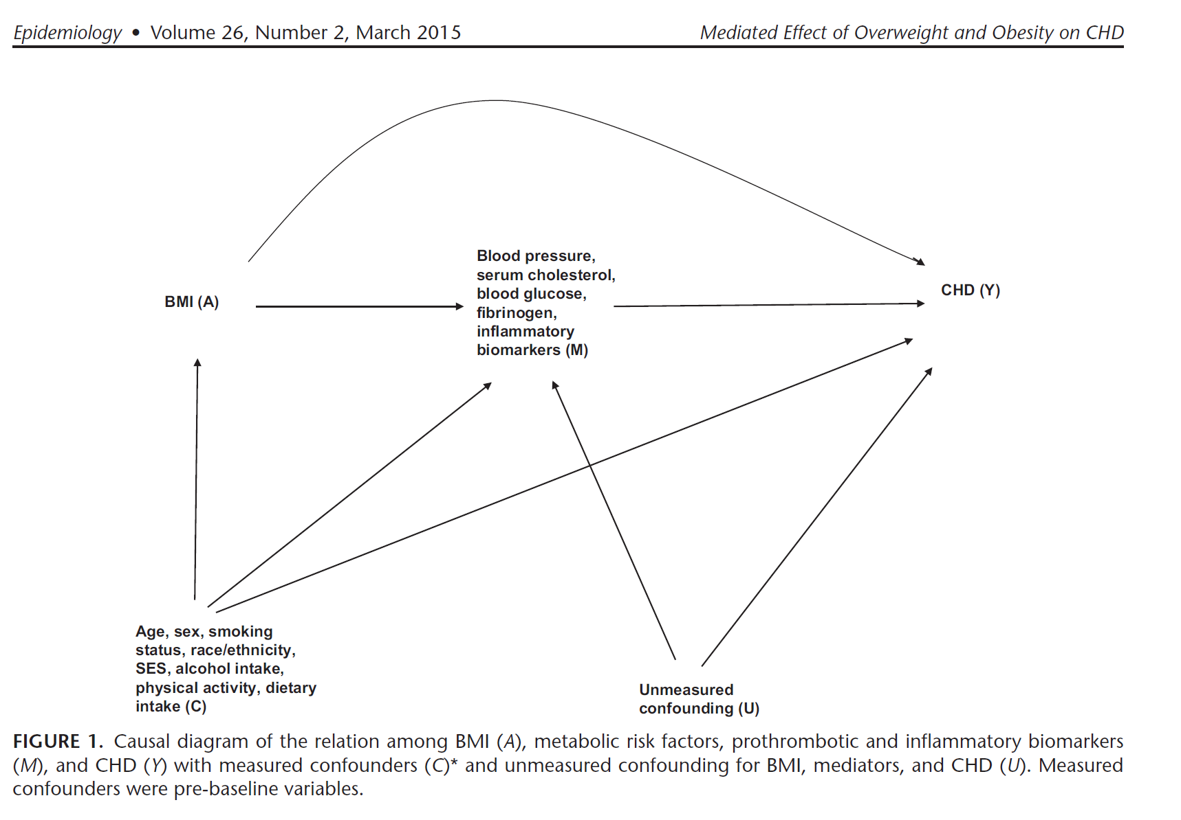

Confounding, Moderation, Mediation

Slide 55
Example
Continuous outcome: linear regression
Sex, age, BMI -> systolic blood pressure
Estimating beta coefficient (slopes)
Binary outcome: logistic regression
Sex, age, BMI -> CHD within 10 years
Estimating odds ratio
Time-to-event outcome: Cox proportional hazards regression
Sex, age, BMI -> time to CHD (survival analysis)
Estimating hazard ratio

Slide 56
Example data
Vorarlberg Health Examinations (VHM&PP)
Sex (male, female) categorical
Age in years continuous
Year of examination continuous
Body mass index in kg/m2 continuous
Systolic blood pressure in mmHG continuous
Total cholesterol in mg/dl continuous
Fasting glucose in mg/dl continuous
Smoking (current or past, never) categorical
Coronary heart disease mortality time to event
(ICD-10: I20-I25) continuous and categorical

Slide 57
Confounding
Confounding:
A “mixing of the effect” of the exposure-disease relationship with a third (or more) factors
BMI ----------------------------------------- > CHD
< ------ sex, age, smoking ----- >

Slide 58
Example
Relationship between BMI and CHD incidence:
Crude Hazard Ratio
Obesity (30+ kg/m2) versus normal weight (20-25 kg/m2)
HR = 2.54 95%CI (2.32-2.78)
Sex, age and smoking adjusting hazard ratio:
HR = 1.60 95%CI (1.46-1.75)
Adjusted = controlled for confounding
Calculated with Cox proportional hazards regression analysis

Slide 59
Confounding
Three essential characteristics:
The confounder is associated with the exposure of interest (BMI)
The confounder is associated with the disease (CHD)
The confounder is not in the causal pathway leading from the exposure of interest (BMI) to the disease of interest (CHD)

Slide 60
Methods for Preventing Confounding in Study Designs
1. Stringent inclusion criteria to narrow the variability between study participants
2. Randomization (intervention/RCT only)
In an optimal RCT, study groups only differ regarding the intervention
3. Matching (observational studies):
Simple Matching e.g. for age and sex in case-controls studies
versus
Propensity Score Matching (involves logistic regression analysis)
Very popular in clinical research:
Blackstone EH. Comparing apples and oranges. J Thoracic and Cardiovascular Surgery 2002; 1: 8-15.
An example:
Ruttmann E et al. Second internal thoracic artery versus radial artery in coronary artery bypass grafting: a long-term, propensity score-matched follow-up study. Circulation. 2011 20;124(12):1321-9.

Slide 61
Effect Modification/Moderation
Effect modification occurs when the association between the exposure (BMI) and the disease (CHD) varies by levels of a third factor.
How to assess: include interaction terms into the regression model
Interaction age*obesity p<0.001
Young: BMI ----------------------------------------- > CHD
Old: BMI ----------------------------------------- > CHD

Slide 62
Example
Relationship between BMI and CHD incidence moderated by age:
Interaction age*obesity p<0.001
Obesity (30+ kg/m2) versus normal weight (20-25 kg/m2)
Sex, age and smoking adjusting hazard ratio:
<50 years of age:
HR = 3.13 95%CI (2.27-4.31)
50+ years of age:
HR = 1.51 95%CI (1.37- 1.66)

Slide 63
Mediation
Mediation occurs if factors, like confounders, are associated with the exposure of interest (BMI) and the disease (CHD), but are in the causal pathway leading from the exposure to the disease.
These factors are called mediators:
BMI ---- > blood Pressure, cholesterol, diabetes ---- > CHD

Slide 64
Example
Mediators in the relationship between BMI and CHD incidence:
Sex, age and smoking adjusting hazard ratio:
Total effect of BMI (obesity versus normal weight) on CHD:
HR = 1.70 95%CI (1.57-1.85)
Direct effect of BMI on CHD
HR = 1.30 95%CI (1.15–1.47)
Indirect effect mediated by blood pressure, cholesterol and glucose
HR = 1.31 95%CI ( 1.16-1.48) (95%CIs estimated by Bootstrap)
HRs … multiplicative, do not add

Slide 65
Example
Mediators in the relationship between BMI and CHD incidence:
Effect of BMI on CHD mediated by blood pressure, cholesterol and glucose
PERM (Percentage of excess risk mediated) =
(1.70-1.30)/(1.70-1)*100
= 57% (approximative formula)
Global Burden of Metabolic Risk Factors for Chronic Diseases Collaboration. Metabolic mediators of the effects of body-mass index, overweight, and obesity on coronary heart disease and stroke: a pooled analysis of 97 prospective cohorts with 1·8 million participants. Lancet. 2014 Mar 15;383(9921):970-83

Slide 66
Mediation Techniques
Traditional approach:
Baron RM, Kenny DA. The moderator-mediator variable distinction in social
psychological research: conceptual, strategic, and statistical considerations. J
Pers Soc Psychol. 1986 Dec;51(6):1173-82
New approaches:
Lange T, Rasmussen M, Thygesen LC. Assessing natural direct and indirect effects through multiple pathways. Am J Epidemiol. 2014 Feb 15;179(4):513-8.
VanderWeele T. Explanation in Causal Inference: Methods for Mediation and Interaction. Oxford University Press 2015.
New approaches applied on BMI --- > CHD problem:
Lu Y, Hajifathalian K, Rimm EB, Ezzati M, Danaei G. Mediators of the effect of body mass index on coronary heart disease: decomposing direct and indirect effects. Epidemiology. 2015 Mar;26(2):153-62.

Slide 67
Confidence intervals and significance testing
Dr. Hanno Ulmer
hanno.ulmer@i-med.ac.at
Department of Medical Statistics, Informatics and Health Economics, Innsbruck Medical University

Slide 68
Confidence intervals
“A confidence interval is used when estimating an unknown parameter from sample data. The interval gives a range for the parameter – and a confidence level that the range covers the true value.”
Freedman et al. (1991), p. 385.

Slide 69
Example for 95%CI
Rule of three (adverse events in drug testing)
Phase I study:
no adverse events in n=10 patients (study sample)
--> 95%CI (0-30%) (population estimate)
Phase II study:
no adverse events in n=100 patients
--> 95%CI (0-3%)
Phase III study:
no adverse events in n=1000 patients
--> 95%CI (0-0.3%)

Slide 70
Confidence interval relates to significance testing

Slide 71
Significance testing

Slide 72
Significance testing

Slide 73
Significance testing

Slide 74
Overview of statistical significance test

Slide 75
Survival analysis
Dr. Hanno Ulmer
hanno.ulmer@i-med.ac.at
Department of Medical Statistics, Informatics and Health Economics, Innsbruck Medical University

Slide 76
Survival Analysis
Kaplan-Meier Method
KAPLAN, E. L. and MEIER, P. (1958). Nonparametric estimation from incomplete observations. J. Amer. Statist. Assoc. 53 457-481.
Log-rank test
Cox proportional hazards regression analysis
Cox, D. R. (1972). Regression Models and Life Tables (with discussion). J. R. Statistic. Soc. 34: 187-220.

Slide 77
Survival analysis
Time-to-event analysis
Two outcome variables:
- time (hours, days, months, years)
- event: occurs
does not occur during study (censored)

Slide 78
Survival analysis

Slide 79
Survival analysis

Slide 80
Survival analysis

Slide 81
Meta-analysis
Dr. Hanno Ulmer
hanno.ulmer@i-med.ac.at
Department of Medical Statistics, Informatics and Health Economics, Innsbruck Medical University

Slide 82
References
Borenstein M, Hedges LV, Higgins JPT, Rothstein HR (2009) Introduction to meta-analysis. Chichester, UK: Wiley.
Egger M, Smith GD, Schneider M, Minder C (1997) Bias in meta-analysis detected by a simple, graphical test. BMJ 315: 629–634.
Higgins JP, Thompson SG, Deeks JJ, Altman DG (2003) Measuring inconsistency in meta-analyses. BMJ 327:557-560.
Petrie A, Bulman JS, Osborn JF (2003) Further statistics in dentistry. Part 8: systematic reviews and meta-analyses. British Dental Journal 194:73-78.
Sterne JA, Egger E (2001) Funnel plots for detecting bias in meta-analysis: guidelines on choice of axis. Journal of Clinical Epidemiology 54:1046–1055.
Sterne JA, Sutton AJ, Ioannidis JP et al. (2011) Recommendations for examining and interpreting funnel plot asymmetry in meta-analyses of randomised controlled trials. BMJ 2011;343:d4002.
DerSimonian R, Laird N (1986) Meta-analysis in clinical trials. Controlled Clinical Trials 7:177-188
Mantel N, Haenszel W (1959) Statistical aspects of the analysis of data from the retrospective analysis of disease. Journal of the National Cancer Institute 22: 719-748.
Hedges LV, Olkin I (1985) Statistical methods for meta-analysis. London: Academic Press.
Zhou XH, NA Obuchowski, DK McClish (2002) Statistical methods in diagnostic medicine. New York: Wiley.

Slide 83
Contents
Evidence Based Medicine
Systematic Review
Meta-analysis
Meta-analysis with the software MedCalc
Combine Lionheart and Levorep

Slide 84
Evidence based patient care
Decide on a relevant question
Identify the best evidence available
Appraise the evidence using objective criteria
Apply the findings to your patients
Evaluate the impact of the modifications on your patient care
E.g. Evidence based dentistry can be described as addressing the oral health needs of the patient by making best use of the current scientific evidence in the choice of treatment methods

Slide 85
Systematic review
Over the past 50 years there has been an explosion of research in the medical world
Meta-analyses and systematic reviews are relatively new techniques used to synthesize and summarize the results of multiple research
A systematic review summarizes the results of available carefully designed healthcare studies (controlled trials) and provides a high level of evidence on the effectiveness of healthcare interventions
These reviews depend largely on what clinical trials are available, how they were carried out (the quality of the trials) and the health outcomes that were measured
Systematic reviews aim to summarize the existing clinical research on a topic
Notes:
statistische Analyse einer großen Sammlung von Analyse-Ergebnissen mehrerer Einzelstudien

Slide 86
Meta-analysis
Meta-analysis was first mentioned in 1979 by a psychologist named Gene V. Glass
Typically, a meta-analysis looks at data from multiple studies posing the same clinical question and uses certain statistical techniques to integrate their findings
A meta-analysis is usually done to reconcile primary studies with different results or primary studies that show a lack of statistical power (studies with small sample sizes)
Meta-analysis techniques are available for different effect measures such as means, relative risk, odds ratios, hazard ratios, …
Notes:
statistische Analyse einer großen Sammlung von Analyse-Ergebnissen mehrerer Einzelstudien

Slide 87
Advantages, disadvantages
Meta-analysis is a secondary analysis, no primary data needs to be collected
Relatively cheap
High impact, highly cited
Certain conditions must be met in order for a meta-analysis to be calculated: availability of at least two studies with similar treatment and endpoints
Quality of primary research (garbage in, garbage out)
Publication bias!
Notes:
statistische Analyse einer großen Sammlung von Analyse-Ergebnissen mehrerer Einzelstudien

Slide 88
Summary of individual studies
A review is the qualitative summary of the results of individual studies. A distinction is made between narrative reviews (A) and systematic reviews. In contrast, systematic review articles (B) claim that, if possible, they consider all published studies on a specific theme — after the application of previously defined inclusion and exclusion criteria.
Notes:
statistische Analyse einer großen Sammlung von Analyse-Ergebnissen mehrerer Einzelstudien

Slide 89

Cochrane
Cochrane’s logo illustrates the summary results from an iconic systematic review: Antenatal corticosteroids for accelerating fetal lung maturation for women at risk of preterm birth
Each horizontal line represents the results of one study, while the diamond represents the combined result - our best estimate of whether the treatment is effective or harmful. The diamond sits clearly to the left of the vertical line representing “no difference”; therefore the evidence indicates that the treatment is beneficial. We call this representation a “forest plot”. This forest plot within our logo illustrates an example of the potential for systematic reviews to improve health care. It shows that corticosteroids given to women who are about to give birth prematurely can save the life of the newborn child.

Slide 90
A hypothetical meta-analysis
Notes:
statistische Analyse einer großen Sammlung von Analyse-Ergebnissen mehrerer Einzelstudien

Slide 91
A real example (streptokinase, AMI)

Slide 92
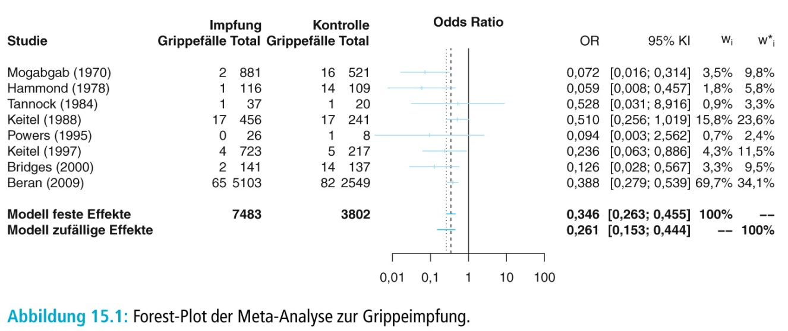
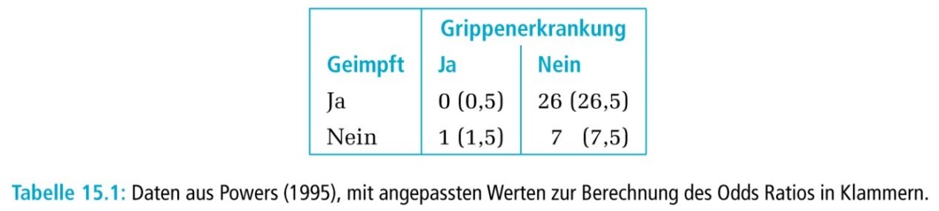
A real example (vaccination, flu)

Slide 93
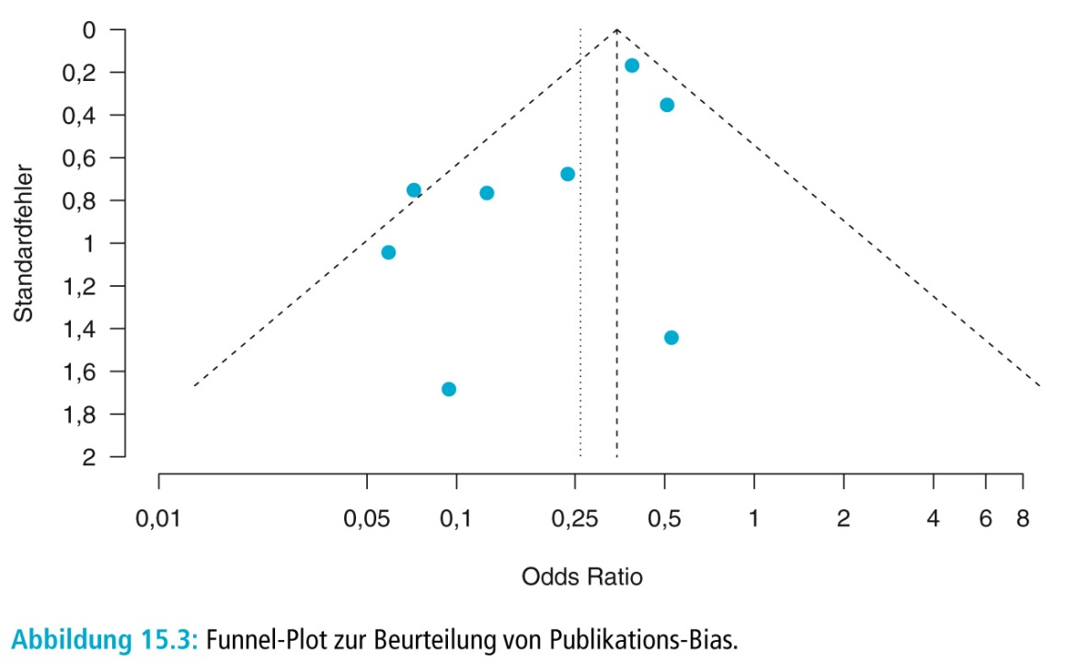
A real example (vaccination, flu)

Slide 94
Case study: meta-analysis

Slide 95
Case study: meta-analysis

Slide 96
Case study: meta-analysis

Slide 97
Case study: meta-analysis

Slide 98
Case study: meta-analysis

Slide 99
Meta-Analysis Protocol (FDA guidance)
The planned purpose of the meta-analysis
The background information available at the time of protocol development that motivated the meta-analysis
The design features of the meta-analysis, including outcome definition and ascertainment, exposure periods and assessment, comparator drugs, and target subject population
A description of the search strategy that will be used to identify candidate trials and the criteria that will be applied for trial selection
The analysis strategy for conducting the meta-analysis, including planned subgroup analyses and sensitivity analyses

Slide 100
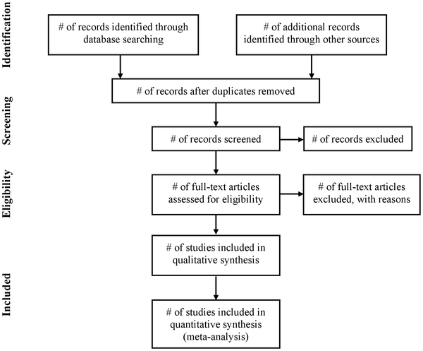

Figure 1. Flow of information through the different phases of a systematic review.
Moher D, Liberati A, Tetzlaff J, Altman DG, The PRISMA Group (2009) Preferred Reporting Items for Systematic Reviews and Meta-Analyses: The PRISMA Statement. PLOS Medicine 6(7): e1000097. https://doi.org/10.1371/journal.pmed.1000097
https://journals.plos.org/plosmedicine/article?id=10.1371/journal.pmed.1000097

Slide 101
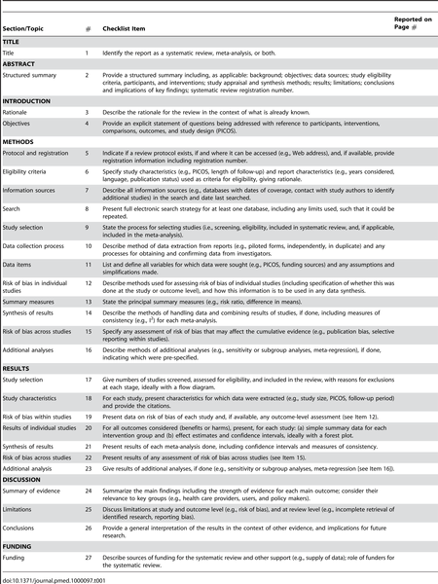
Table 1. Checklist of items to include when reporting a systematic review or meta-analysis.
Moher D, Liberati A, Tetzlaff J, Altman DG, The PRISMA Group (2009) Preferred Reporting Items for Systematic Reviews and Meta-Analyses: The PRISMA Statement. PLOS Medicine 6(7): e1000097. https://doi.org/10.1371/journal.pmed.1000097
https://journals.plos.org/plosmedicine/article?id=10.1371/journal.pmed.1000097

Slide 102
Methods: Search strategy
Search strategy
Databases
Key terms:
“physical activity”, “exercise”, “increase”, “brief intervention”, “counselling”, “systematic review”, “meta analysis”.
Period covered: 1854 - October 2011.
CINAHL
Cochrane Database of Systematic Reviews
Database of Abstracts of Reviews of Effects (DARE) on Cochrane Library and Centre for Reviews and Dissemination (CRD)
Health Technology Assessment database on Cochrane Library and Centre for Reviews and Dissemination (CRD)
Embase
MEDLINE
PsycINFO
SCI-Expanded
SSCI SIGN
Hand search of first authors’(LL) personal collections of articles
Notes:
We systematically searched a number of databases using a strategy comprising four filters. These filters were developed by looking at previous reviews and in consultation with a medical librarian, as well as taking the design filters from the Hedges team.

Slide 103

Quality of evidence, hierarchy of studies

Slide 104
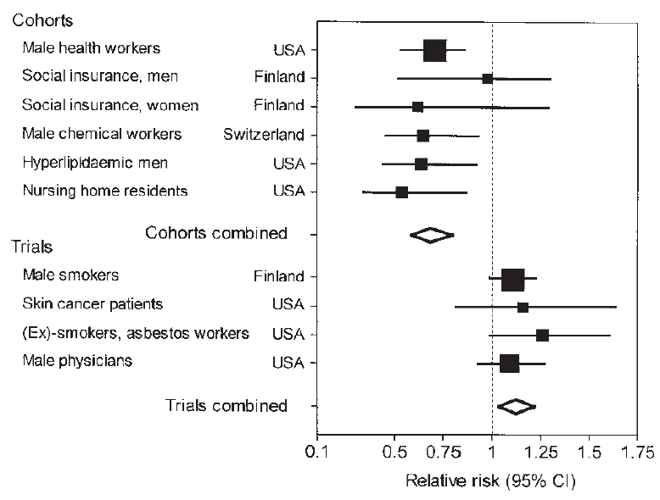
Consistency
Beta carotene
and
cardiovascular
mortality
Davey Smith & Ebrahim, Int J Epidemiol 2001

Slide 105
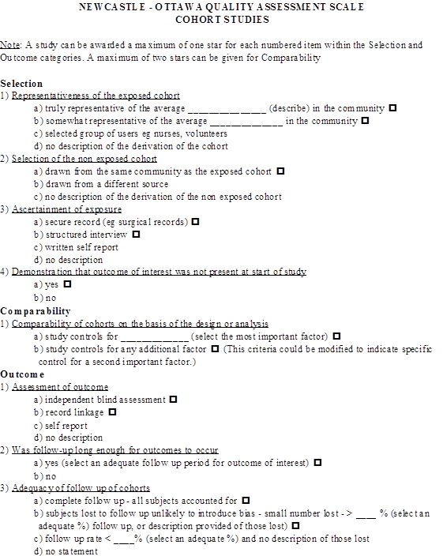
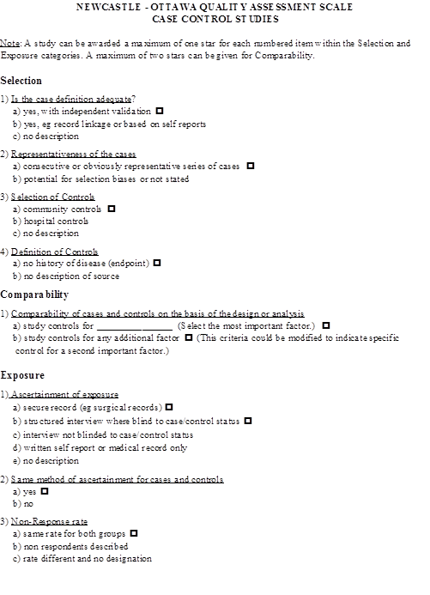
Critical appraisal:
The Newcastle-Ottawa Scale (NOS) for Assessing the Quality of Nonrandomized Studies in Meta-Analysis

Slide 106
Critical appraisal: checklist example

Slide 107
Critical appraisal:
Centre for Evidence-Based Medicine, University of Oxford
https://www.cebm.net/2014/06/critical-appraisal/
Critical Appraisal Worksheets
English
Systematic Reviews Critical Appraisal Sheet
Diagnostics Critical Appraisal Sheet
Prognosis Critical Appraisal Sheet
Randomised Controlled Trials (RCT) Critical Appraisal Sheet
Critical Appraisal of Qualitative Studies Sheet
IPD Review Sheet
Chinese – Translated by Chung-Han Yang and Shih-Chieh Shao
Systematic Reviews Critical Appraisal Sheet
Diagnostic Study Critical Appraisal Sheet
Prognostic Studies Critical Appraisal Sheet
RCT Critical Appraisal Sheet

Slide 108
Stratifying the analysis by trial
An important principle involved in estimating risk from a meta-analysis is that the randomized comparisons of the individual trials should be maintained when analyzing the combined data
In other words, when comparing drug A to drug B, subjects randomly assigned to drug A in a single trial are compared to subjects assigned to drug B from the same trial and not to subjects from other trials. In the statistics literature, this is referred to as stratifying the analysis by trial
Simple pooling of data usually leads to misleading results

Slide 109
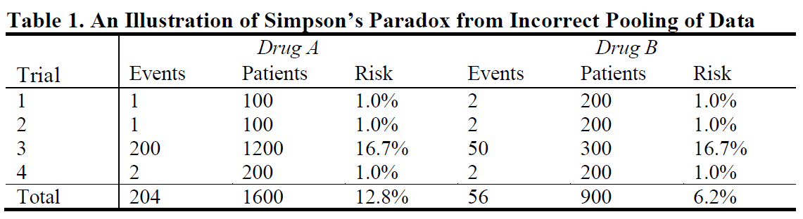
Simpson`s Paradoxon
The hypothetical example in Table 1 illustrates an extreme example of Simpson’s paradox in which, for each of four trials, the estimated risk of a safety event is identical for both Drug A and Drug B. With simple pooling, however, the risk for Drug A appears to be more than twice as high as that for Drug B (12.8 percent vs. 6.2 percent)

Slide 110
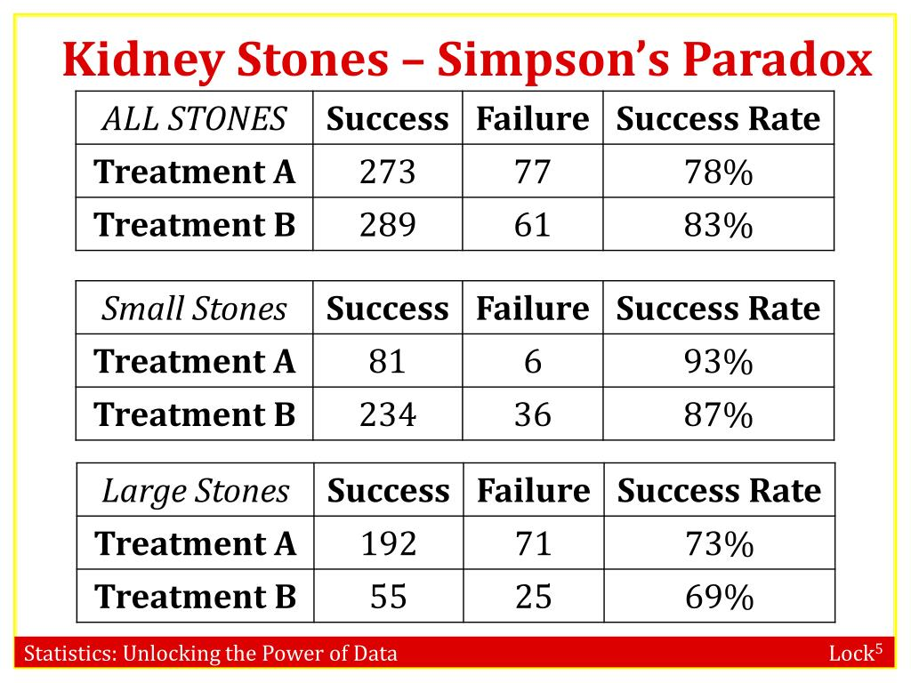

Mantel-Haenszel method – stratified analysis, kidney stones
$Odds Ratio Mantel−Haenszel=\frac{\frac{81x36}{357}+\frac{192x25}{343}}{\frac{6x234}{357}+\frac{71x55}{343}}$ = 1,45 (p=0,12)

Slide 111
Sensitivity Analysis
The goal of any sensitivity analysis should not be to search for additional findings, but to support and understand the primary findings of the meta-analysis
For example, a meta-analysis that included one very large study contributing a large proportion of subjects and events could raise a concern that it was overly influencing the meta-analytic results
A sensitivity analysis that excluded that study would have reduced numbers of subjects and events and lower power to yield a significant finding, but a risk estimate that was consistent with the original estimate would add to the weight of evidence of the finding

Slide 112
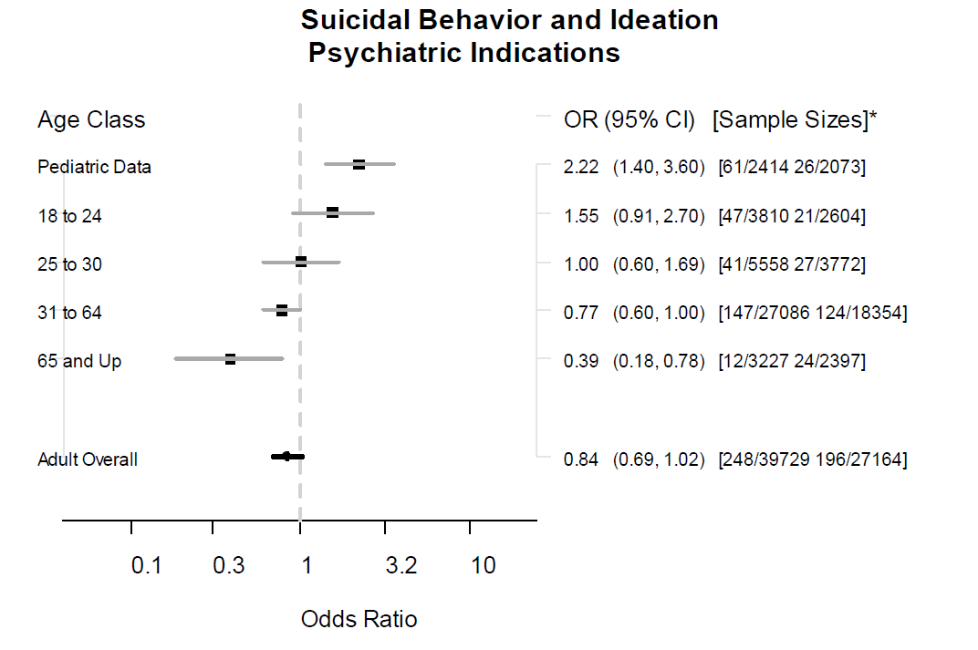
FDA Meta-analysis of antidepressants and suicidal behaviour
Hammad, Laughren et al. BMJ 2009

Slide 113
MedCalc statistical software:
Meta-analysis Introduction
A meta-analysis integrates the quantitative findings from separate but similar studies and provides a numerical estimate of the overall effect of interest (Petrie et al., 2003).
Different weights are assigned to the different studies for calculating the summary or pooled effect. The weighting is related with the inverse of the standard error (and therefore indirectly to the sample size) reported in the studies. Studies with smaller standard error and larger sample size are given more weight in the calculation of the pooled effect size.

Slide 114
The effect of interest can be
The effect of interest can be:
an average of a continuous variable
a correlation between two variables
an odds ratio, suitable for analyzing retrospective studies
a relative risk (risk ratio) or risk difference, suitable for analyzing prospective studies
a proportion
the area under the ROC curve

Slide 115
Fixed and random effects model
Under the fixed effects model, it is assumed that the studies share a common true effect, and the summary effect is an estimate of the common effect size.
Under the random effects model the true effects in the studies are assumed to vary between studies and the summary effect is the weighted average of the effects reported in the different studies (Borenstein et al., 2009).
The random effects model will tend to give a more conservative estimate (i.e. with wider confidence interval), but the results from the two models usually agree when there is no heterogeneity.
When heterogeneity is present (see below) the random effects model should be the preferred model.

Slide 116
Heterogeneity
Cochran’s Q is the weighted sum of squares on a standardized scale. It is reported with a P value with low P-values indicating presence of heterogeneity. This test however is known to have low power to detect heterogeneity and it is suggested to use a value of 0.10 as a cut-off for significance (Higgins et al., 2003). Conversely, Q has too much power as a test of heterogeneity if the number of studies is large.
I² statistics is the percentage of observed total variation across studies that is due to real heterogeneity rather than chance. It is calculated as I² = 100% x (Q - df)/Q, where Q is Cochran's heterogeneity statistic and df the degrees of freedom. Negative values of I² are put equal to zero so that I²lies between 0% and 100%. A value of 0% indicates no observed heterogeneity, and larger values show increasing heterogeneity (Higgins et al., 2003).

Slide 117
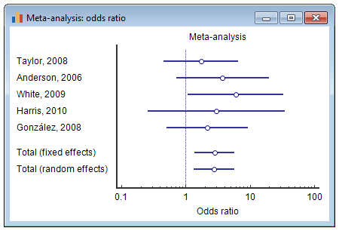
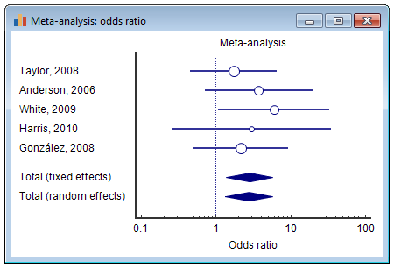
Forest plot
The results of the different studies, with 95% CI, and the overall effect (under the fixed and random effects model) with 95% CI are illustrated in a graph called "forest plot", e.g.:
In this example the markers representing the effect size all have the same size. Optionally, the marker size may vary in size according to the weights assigned to the different studies. In addition, the pooled effects can be represented using a diamond. The location of the diamond represents the estimated effect size and the width of the diamond reflects the precision of the estimate,

Slide 118
Funnel plot
A funnel plot (Egger et al., 1997) is a graphical tool for detecting bias in meta-analysis.
In a funnel plot treatment effect is plotted on the horizontal axis and MedCalc plots the standard error on the vertical axis (Sterne & Egger, 2001).
The vertical line represents the summary estimated derived using fixed-effect meta-analysis.
Two diagonal lines represent (pseudo) 95% confidence limits (effect ± 1.96 SE) around the summary effect for each standard error on the vertical axis. These show the expected distribution of studies in the absence of heterogeneity or of selection bias. In the absence of heterogeneity, 95% of the studies should lie within the funnel defined by these diagonal lines.

Slide 119
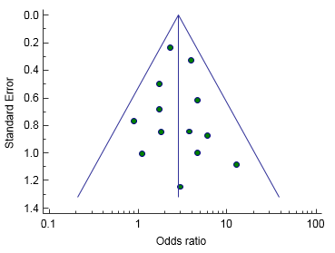
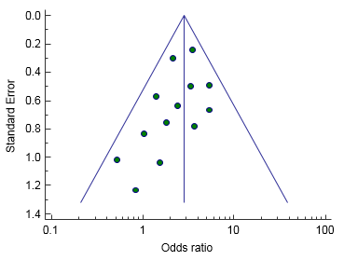
Funnel plot
Publication bias results in asymmetry of the funnel plot. If publication bias is present, the smaller studies will show the larger effects. See Sterne et al. (2011) for interpreting funnel plot asymmetry. The funnel plot may not always be a reliable tool, in particular when the number of studies included in the analysis is small.

Slide 120
Meta-analysis in MedCalc
Continuous measure
Correlation
Proportion
Relative risk
Risk difference
Odds ratio
Area under ROC curve
Generic inverse variance method

Slide 121
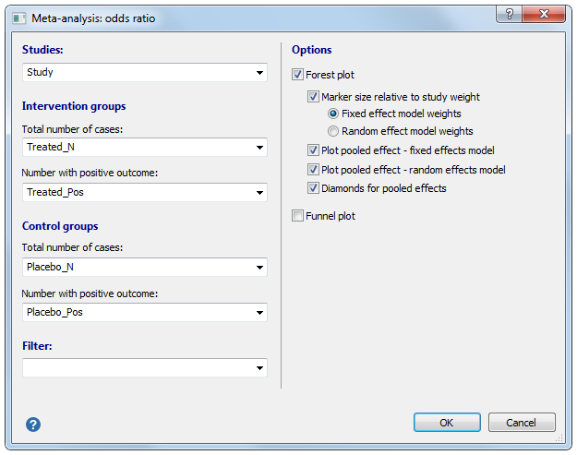
Meta-analysis: odds ratio
MedCalc uses the Mantel-Haenszel method (Mantel & Haenszel, 1959) for calculating the weighted pooled odds ratio under the fixed effects model. Next the heterogeneity statistic is incorporated to calculate the summary odds ratio under the random effects model (DerSimonian & Laird, 1986).

Slide 122
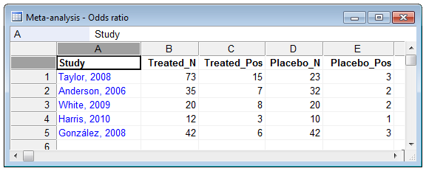
Meta-analysis: odds ratio

Slide 123
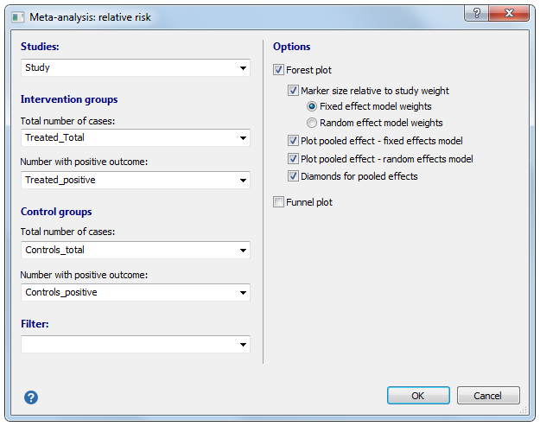
Meta-analysis: relative risk and risk difference
MedCalc uses the Mantel-Haenszel method (based on Mantel & Haenszel, 1959) for calculating the weighted pooled relative risk and risk difference under the fixed effects model. Next the heterogeneity statistic is incorporated to calculate the summary relative risk under the random effects model (DerSimonian & Laird, 1986).

Slide 124
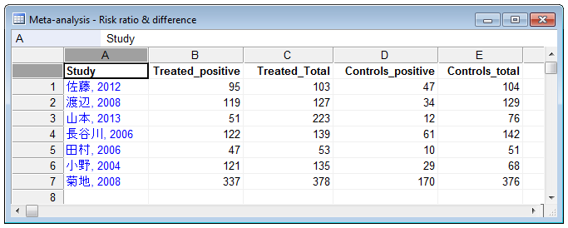
Meta-analysis: relative risk

Slide 125
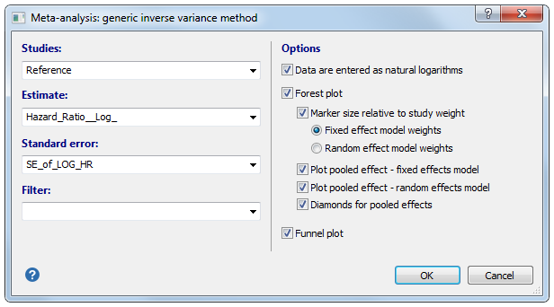
Meta-analysis: hazard ratio (generic inverse variance method)
Estimates and their standard errors are entered directly. For ratio measures of intervention effect, the data should be entered as natural logarithms (for example as a log Hazard ratio and the standard error of the log Hazard ratio).
In the inverse variance method the weight given to each study is the inverse of the variance of the effect estimate (i.e. one over the square of its standard error). Thus larger studies are given more weight than smaller studies, which have larger standard errors.

Slide 126
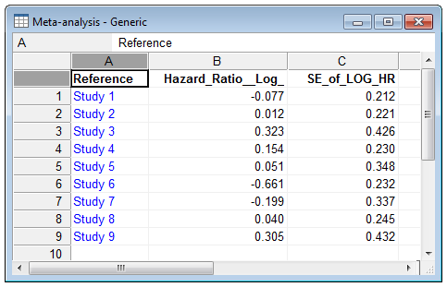
Meta-analysis: hazard ratio (generic inverse variance method)

Slide 127
Meta-analysis: continuous measure
For meta-analysis of studies with comparison of means between treated cases and controls, MedCalc uses the Hedges g statistic as a formulation for the standardized mean difference under the fixed effects model. Next, the heterogeneity statistic is incorporated to calculate the summary standardized mean difference under the random effects model (DerSimonian & Laird, 1986).
The standardized mean difference Hedges g is the difference between the two means divided by the pooled standard deviation, with a correction for small sample bias.

Slide 128
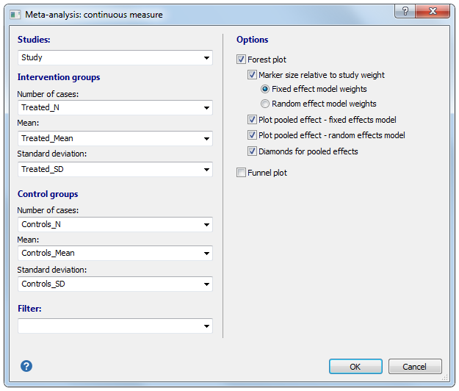
Meta-analysis: continuous measure

Slide 129
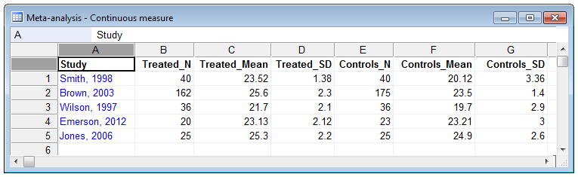
Meta-analysis: continuous measure

Slide 130
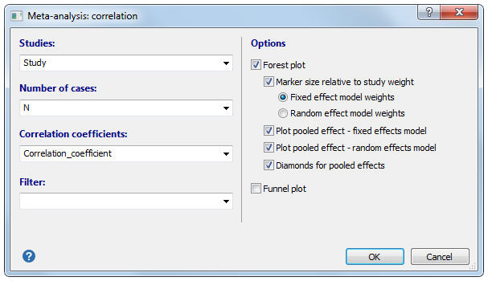
Meta-analysis: correlation
MedCalc uses the Hedges-Olkin (1985) method for calculating the weighted summary Correlation coefficient under the fixed effects model, using a Fisher Z transformation of the correlation coefficients. Next, the heterogeneity statistic is incorporated to calculate the summary Correlation coefficient under the random effects model (DerSimonian and Laird, 1986).

Slide 131
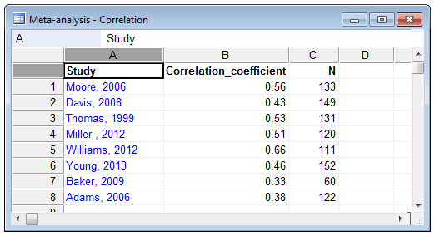
Meta-analysis: correlation

Slide 132
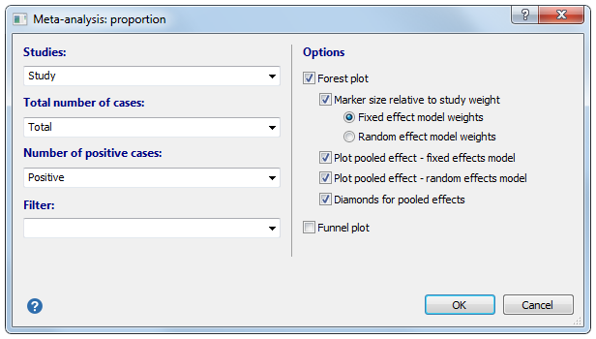
Meta-analysis: proportions
MedCalc uses a Freeman-Tukey transformation (arcsine square root transformation; Freeman and Tukey, 1950) to calculate the weighted summary proportion under the fixed and random effects model (DerSimonian & Laird, 1986).

Slide 133
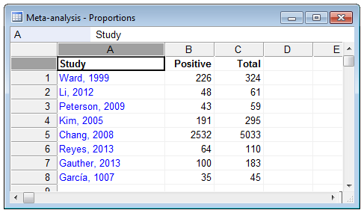
Meta-analysis: proportions

Slide 134
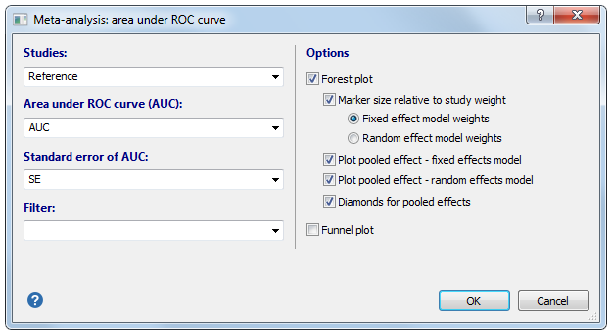
Meta-analysis: AUC
MedCalc uses the methods described by Zhou et al. (2002) for calculating the weighted summary Area under the ROC curve under the fixed effects model and random effects model.

Slide 135
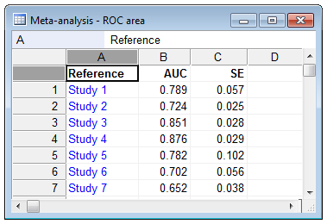
Meta-analysis: AUC

Slide 136
Lionheart+Levorep

Slide 137
Lionheart+Levorep

Slide 138
Lionheart+Levorep

Slide 139
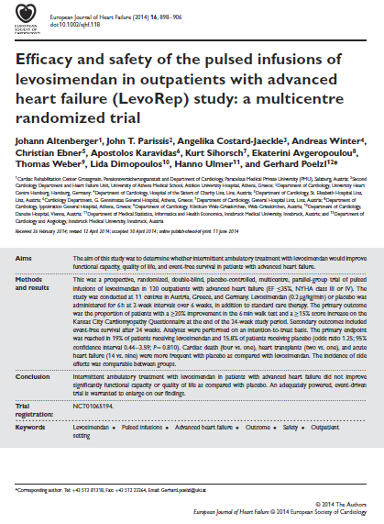
Lionheart+Levorep
Study Levo_N Levo_Deaths Placebo_N Placebo_Deaths
Lionheart 48 15 21 8
LevoRep 63 1 57 4

Slide 140
Lionheart+Levorep

Slide 141
PRISMA for Individual Patient Data
PRISMA for Individual Patient Data systematic reviews (PRISMA-IPD)
PRISMA-IPD was published in 2015 and provides guidelines for reporting systematic reviews and meta-analyses of IPD. Systematic reviews and meta-analyses of IPD aim to collect, check, and reanalyze individual-level data from all studies addressing a particular research question.
Statement paper:
Stewart LA, Clarke M, Rovers M, Riley RD, Simmonds M, Stewart G, Tierney JF; PRISMA-IPD Development Group. Preferred Reporting Items for Systematic Review and Meta-Analyses of individual participant data: the PRISMA-IPD Statement. JAMA. 2015;313(16):1657-1665.

Slide 142
Effect size calculator
Practical Meta-Analysis Effect Size Calculator David B. Wilson, Ph.D., George Mason University:
http://www.campbellcollaboration.org/escalc/html/EffectSizeCalculator-Home.php

Slide 143

Network Meta-Analysis
Cipriani A et al. Comparative efficacy and acceptability of 21 antidepressant drugs for the acute treatment of adults with major depressive disorder: a systematic review and network meta-analysis.
Lancet 2018

Slide 144


Network Meta-Analysis

Slide 145
PRISMA for Network Meta-Analyses
PRISMA for Network Meta-Analyses (PRISMA-NMA)
The PRISMA-NMA extension was published in 2015. It provides guidance for reporting systematic reviews comparing multiple treatments using direct and indirect evidence in network meta-analyses. In addition to providing guidance It also highlights educational information related to key considerations in the practice of network meta-analysis.
Statement/Explanatory paper:
Hutton B, Salanti G, Caldwell DM, Chaimani A, Schmid CH, Cameron C, Ioannidis JP, Straus S, Thorlund K, Jansen JP, Mulrow C, Catalá-López F, Gøtzsche PC, Dickersin K, Boutron I, Altman DG, Moher D. The PRISMA Extension Statement for Reporting of Systematic Reviews Incorporating Network Meta-analyses of Health Care Interventions: Checklist and Explanations. Ann Intern Med. 2015;162(11):777-784.

