Slide 1
How to anonymise data in excel

Slide 2
If you want to test this on some data before your own use the data file sent to you called “test”

Slide 3
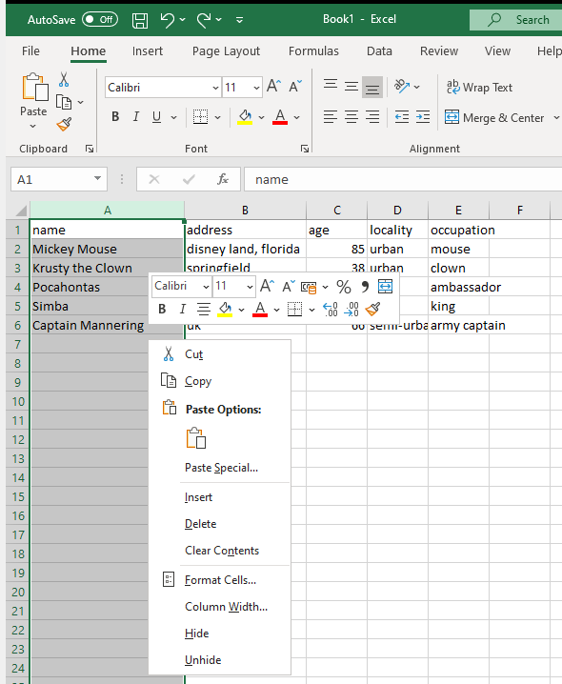
GENERAL INFO
All data you want to import into SPSS should be on one sheet
The first row represents the variable names
Categorical variables should have value labels (e.g. for locality this should be changed to e.g. urban=1 rural =0 – you need to record these labels elsewhere so you can add the value labels in spss!
Variable names should only include alphanumeric characters, with no spaces, if you need divisions between words e.g. age years you use an underscore so the variable name would be age_years

Slide 4
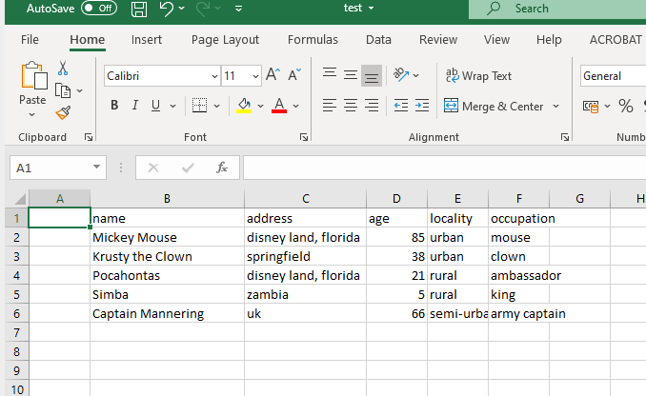
First step to anonymising!
Add a new column
Right click → insert → entire column

Slide 5
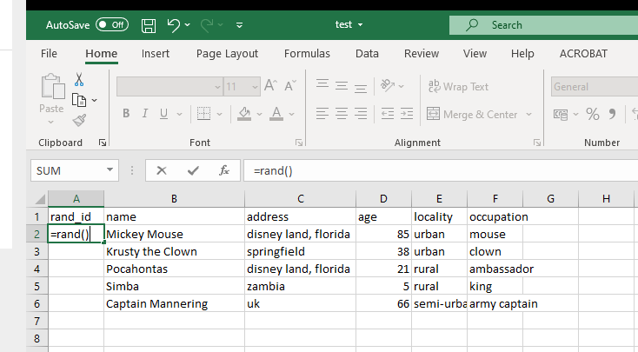
Label the new column rand_id
Type =rand() into the second row
Press enter
Then put the mouse on the
bottom right corner of the
same cell where you
wrote the formula and
drag down for all rows you
have

Slide 6
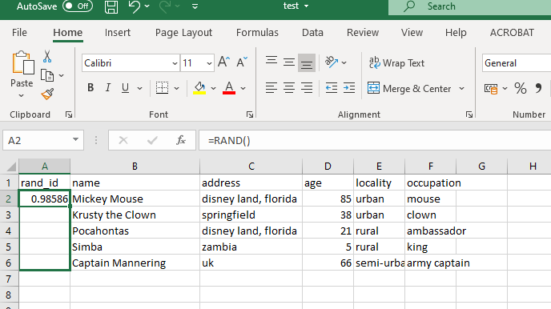
Example of dragging down!

Slide 7
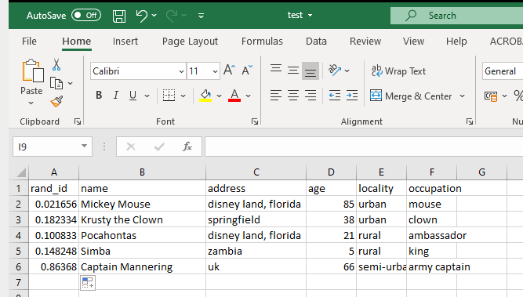
Each cell in that column
Should now have a number
Note your numbers WILL
NOT be the same as the ones
Here (they are random)
Note excel continues to change these numbers every time that column
Is used so we need to copy and paste the NUMBERS on top of the formula to prevent this.

Slide 8
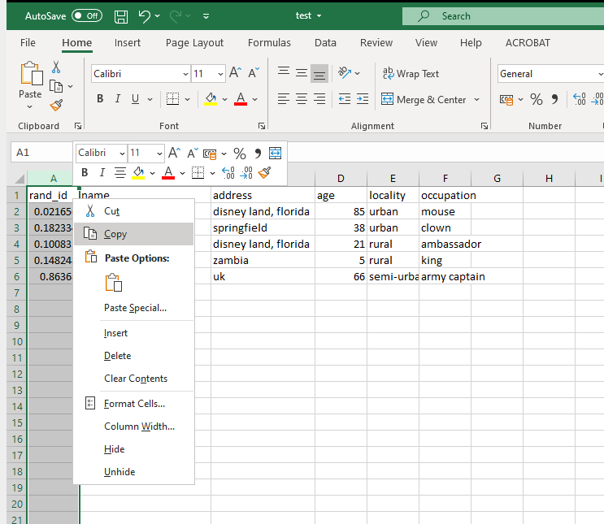
Select the whole
column by pressing A
at the top
Right click and select copy

Slide 9
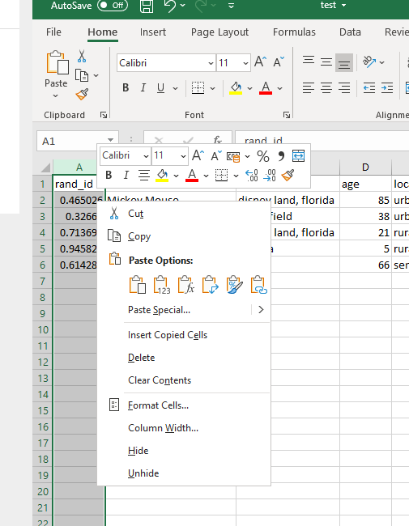
Right click again and in the paste options select the clipboard with the numbers (paste values)
You will note that the numbers keep on changing until after you do this

Slide 10
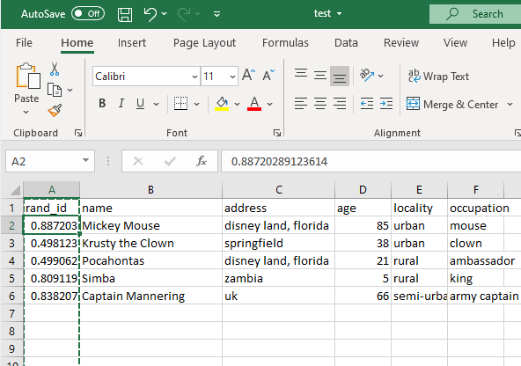
If you click on a cell you should now see that there is no formula behind is just a number!
WE ARE NOT FINISHED!

Slide 11
Right click on the A again and select sort and filter, sort A-Z

Slide 12
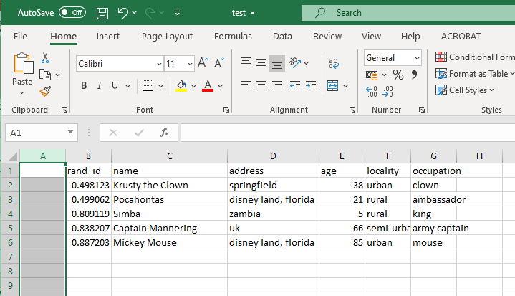
Insert a new
Column as before
As you can see
the rows are now
Ordered smallest to largest on the number in B (the rand_id) column
Label the new column e.g. pat_id (to reflect patient id)

Slide 13
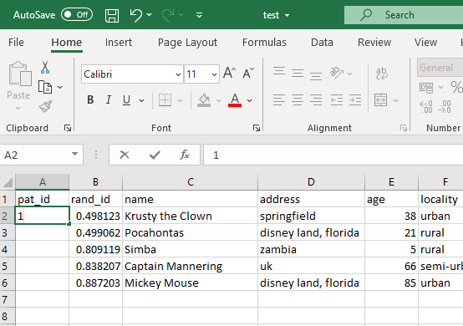
Put the number 1 in the first row and 2 in the second
Drag down, so
each row gets a
consecutive
number

Slide 14
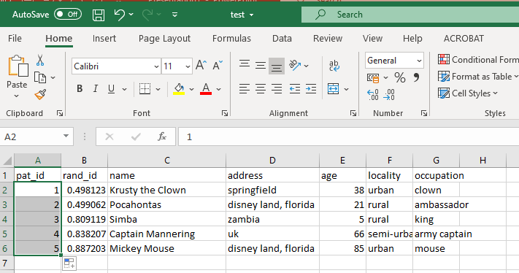
Your data now looks like this:
Remember, even
if you used my data
set you will have
a different order
as the random
numbers you will
have sorted on
will be
different – this is ok!

Slide 15
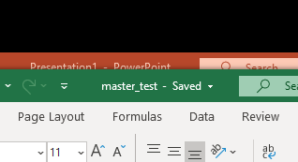
SAVE this data as the master copy

Slide 16
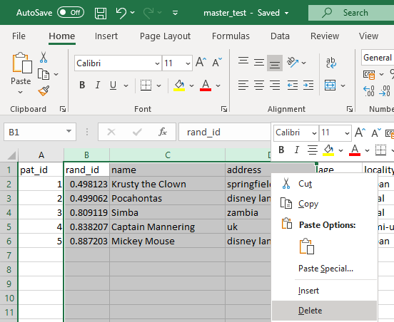
Select columns with identifying information and the rand_id
Delete

Slide 17
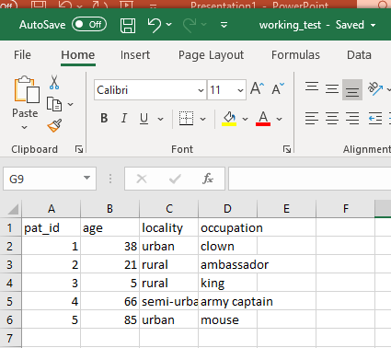
Save a new copy called “working_test”
This is the anonymised file
Your data will look like:

Slide 18
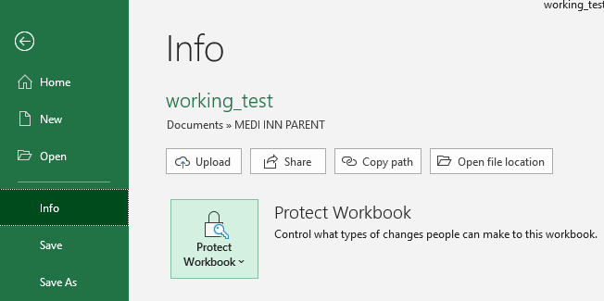
Even though it is anonymised it is best practice to have a password on the file click file, info, protect workbook add a password

Slide 19
IMPORTANT: Re-open the master copy and also add a password
NEVER SHARE YOUR MASTER COPY WITH ANYONE
Ensure the master copies password is different from the working copy
Strong passwords are longer and includes Numbers, Symbols, Capital Letters, and Lower-Case Letters

Slide 20
BEST PRACTICE
When sharing the working copy – e.g. by email, you should send the password in a separate email
Where the master copy (and working copy is stored) the device should have a password – be in your laptop or your USB stick
You should have an encrypted drive on any device where you store data, e.g. veracrypt
You can also use veracrypt to create and encryted drive on a USB
If you put data on a USB to transfer it to another device, always then remove the data from the USB device! THIS IS THE MOST EASILY LOST PIECE OF EQUIPMENT!
You can make smaller working copies – ie only containing the variables needed for analysis, this minimises the risk of people de-anonymising your data due to the “MOSAIC EFFECT”

Slide 21
THE MOSAIC EFFECT:
“a person is indirectly identifiable via linkage attacks because information can be combined with other pieces of information known to relate to the same individual, enabling the individual to be distinguished from others.”
Source: www.mosaiceffect.com

Slide 22
To import data into SPSS
You will need to temporarily remove your password
File → info →protect workbook
Change the password to nothing
Import into spss
Store the SPSS file in an encrypted drive and/or add a password to the SPSS file (see next slide)
Re-apply the password to the working copy

Slide 23
PASSWORD PROTECT SPSS FILE Click file –> save as -> check the encrypt with password box
A pop up box appears where you can enter
Your chosen password

