Slide 1
Medizinische Statistik
ao. Univ.-Prof. Mag. Dr. Hanno Ulmer
hanno.ulmer@i-med.ac.at
Department für Medizinische Statistik, Informatik und Gesundheitsökonomie, Medizinische Universität Innsbruck

Slide 2
Grundlagen
Hanno Ulmer
hanno.ulmer@i-med.ac.at
Department für Medizinische Statistik, Informatik und Gesundheitsökonomie, Medizinische Universität Innsbruck

Slide 3
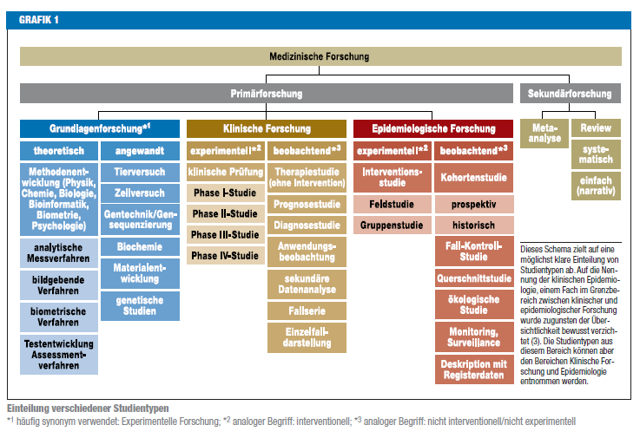
Medizinische Forschung

Slide 4

Statistik in medizinischen
Top Journals

Slide 5

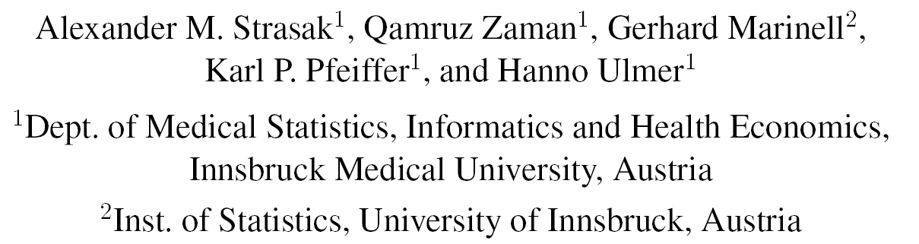
Methodik der Fallstudie
Alle Originalarbeiten publiziert im ersten Halbjahr 2004:
  Vol. 350 No. 1–26 of NEJM
  Vol. 10 No. 1–6 of NatMed
wurde für die bibliometrische Analyse ausgewählt
Editorials, Letters, Case Reports wurden nicht analysiert
Zusätzlich wurden die Wiener klinische und die Wiener medizinische Wochenschrift untersucht:

Slide 6
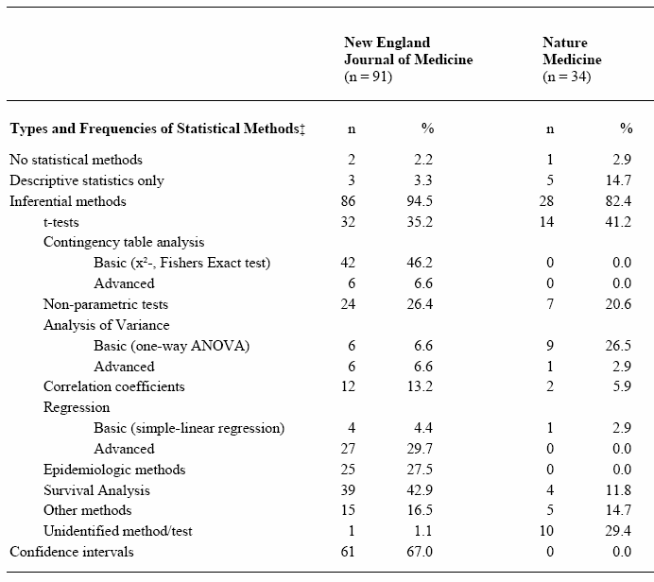
Statistische Verfahren
Kategorien nach
Emerson/Colditz 1985

Slide 7
Nature Medicine versus
New England Journal of Medicine
In über 95% der Originalarbeiten wurden statistische Methoden verwendet
Statistische Methodik unterscheidet sich zwischen
- Grundlagenwissenschaft (Nature Medicine)
- Klinische Forschung (NEJM)
Methodik komplexer in NEJM
Keine Fallzahlschätzung bzw. Poweranalyse in NatMed
Dokumentation der Methoden mangelhaft, fehlt fast völlig in Nature Medicine
Chi² Test, Überlebenszeitanalyse in NEJM, t-test in Nature Medicine

Slide 8







Literaturhinweise
Grundlagenwissenschaft
Klinische Forschung
Epidemiologische Forschung

Slide 10
Quellen, Internet, Software
British Medical Journal Statistics at Square One
Deutsches Ärzteblatt Bewertung wissenschaftlicher Publikationen
Deutsche Medizinische Wochenschrift Statistik-Serie
Jumbo Münster
Graphpad Quickcalcs
R, Stata, SPSS, SAS, Statistica, GraphPad, MedCalc
nQuery Advisor, East, PASS, StudySize

Slide 11
Häufig verwendete statistische Methoden
Studienplanung
Fragestellung
Hypothesen
Studiendesign
Fallzahlschätzung
Datenerhebung
Statistische Auswertung
Deskriptive Statistik
Inferenzstatistik I: Schätzen von Parametern mittels Konfidenzintervallen
Inferenzstatistik II: Unterschiede, Hypothesenprüfung mittels Signifikanztests
Inferenzstatistik III: Zusammenhänge, Korrelations- und Regressionsanalysen

Slide 12
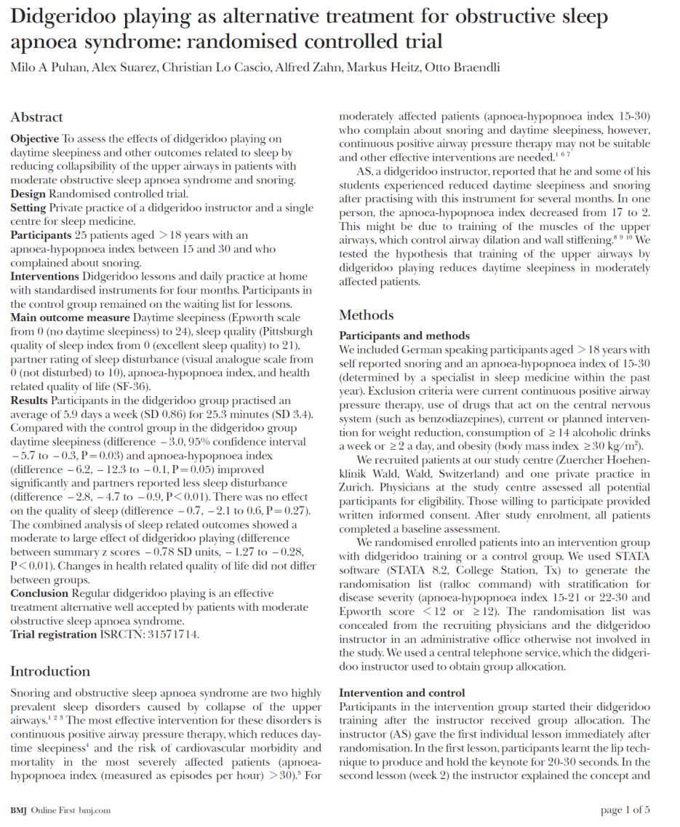

Beispielstudie

Slide 13
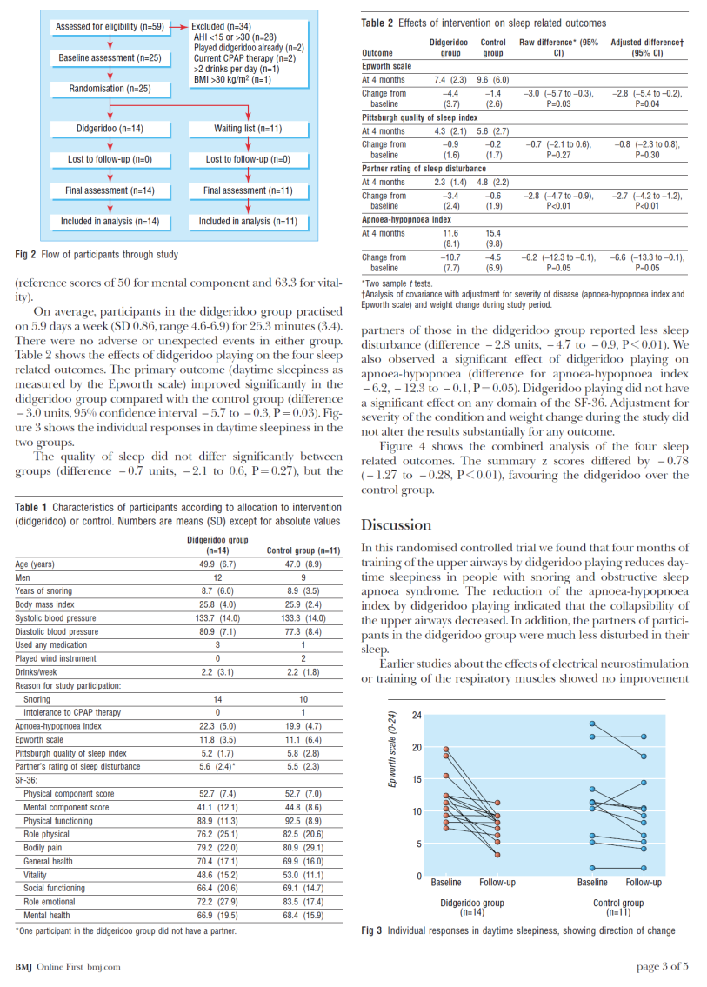
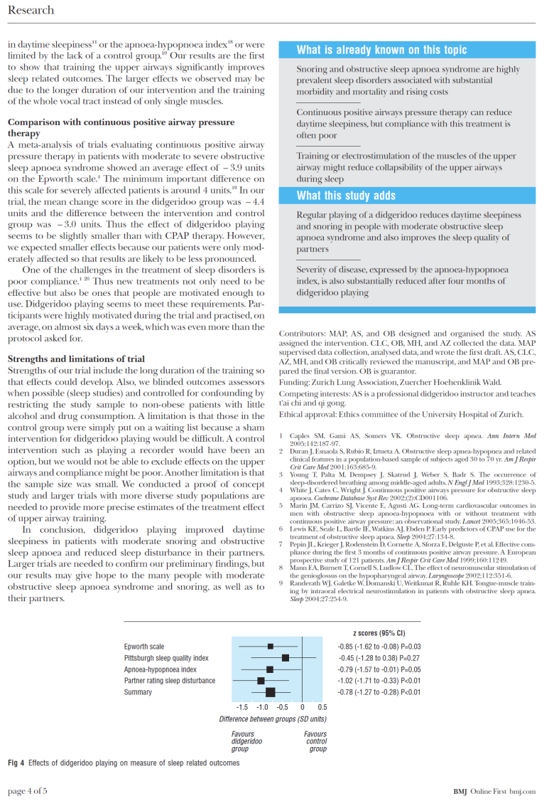
Beispielstudie

Slide 14
„Wie lese ich eine Studie in 10 Minuten“
Grundlegender Aufbau eines Studienberichts (papers):
IMRaD Schema
Weitere Strukturierungen
CONSORT Statement für Interventionsstudien (RCTs)
STROBE Statement für Beobachtungsstudien (epidemiologische Studien: Kohortenstudie, Fall-Kontroll-Studie u. Querschnittstudie)
STARD Statement für diagnostische Studien

Slide 15
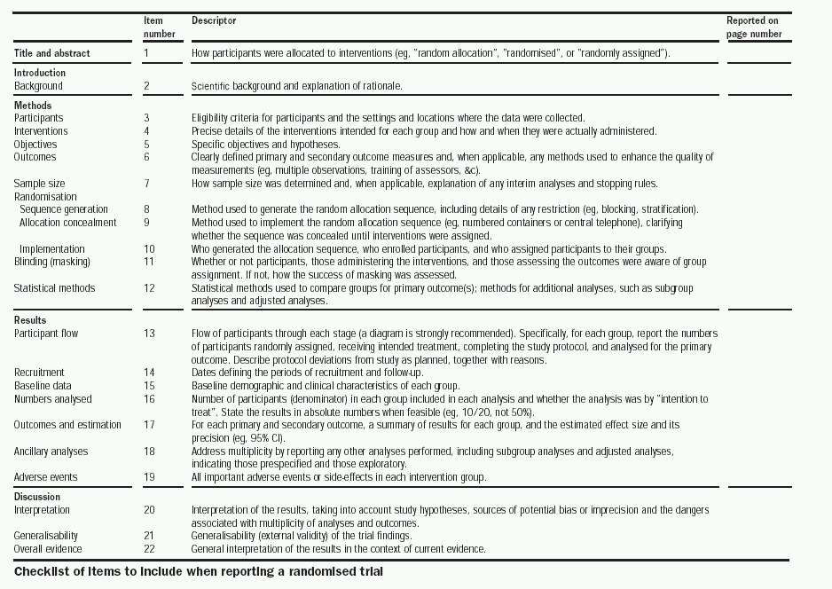

Slide 16

Medizinproduktestudie

Slide 17
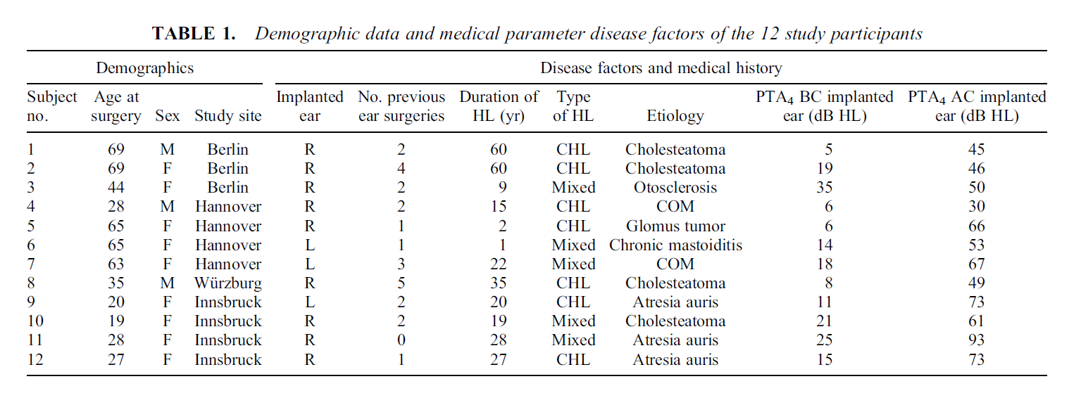
Medizinproduktestudie

Slide 18
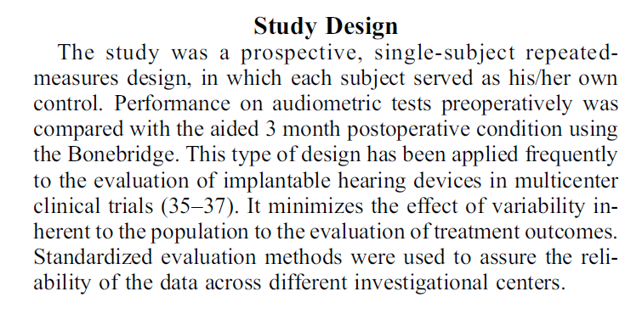
Medizinproduktestudie

Slide 19
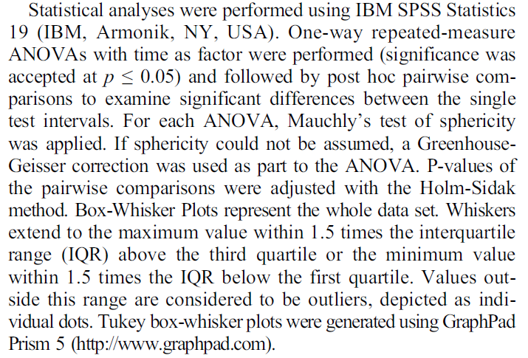
Medizinproduktestudie

Slide 20
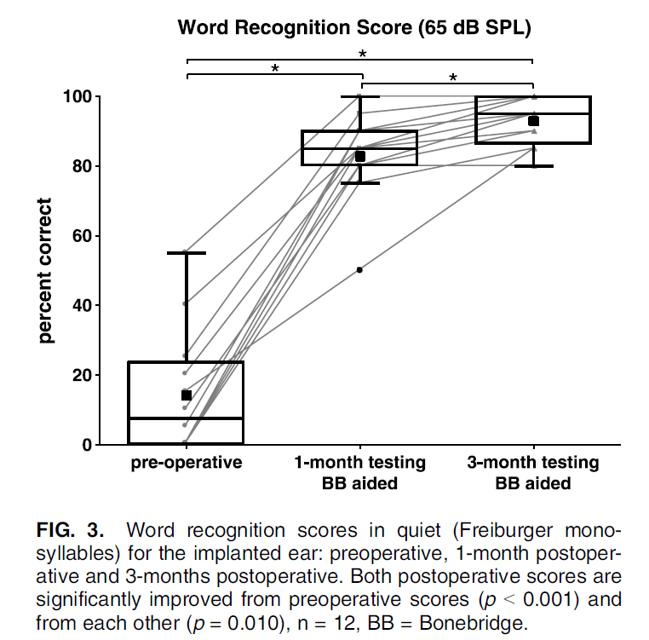
Medizinproduktestudie

Slide 21
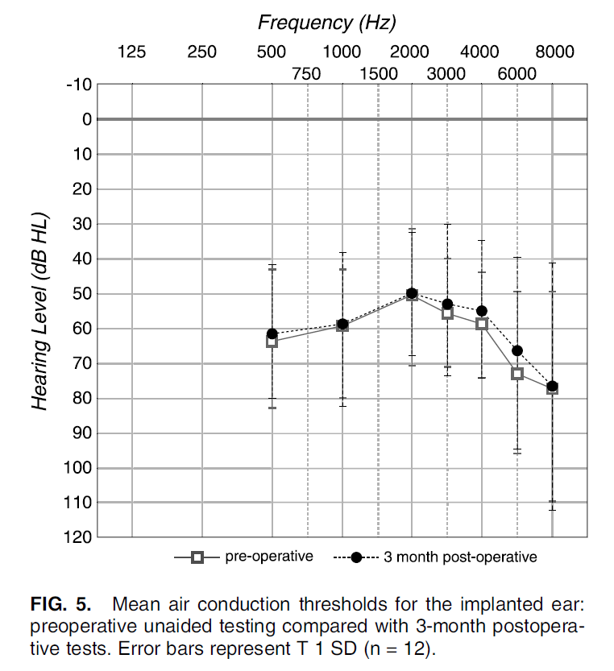
Medizinproduktestudie

Slide 22
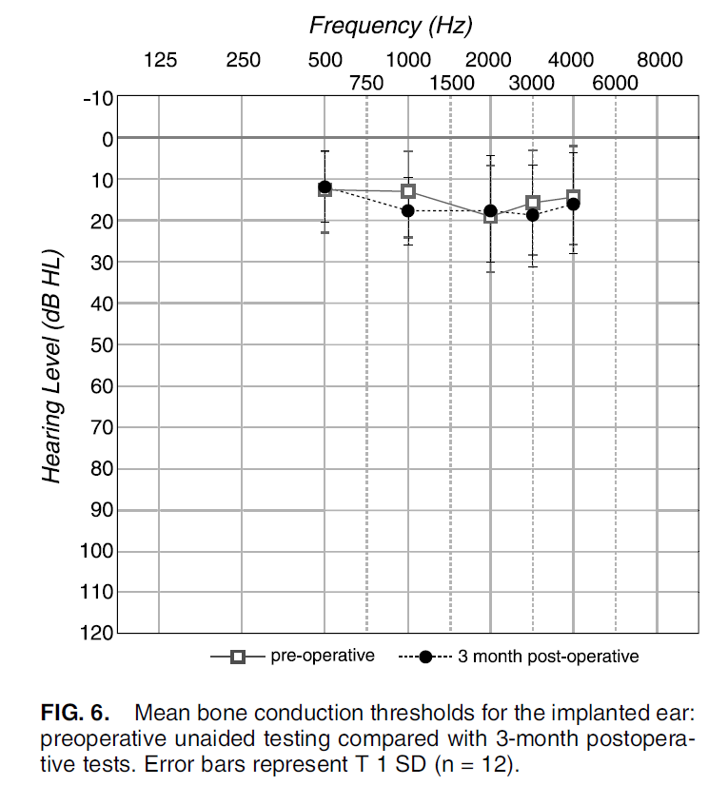
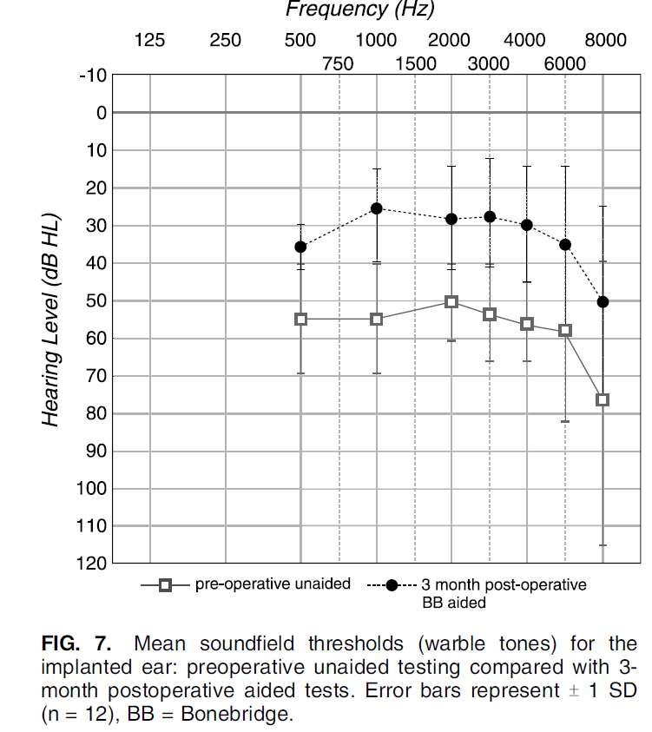
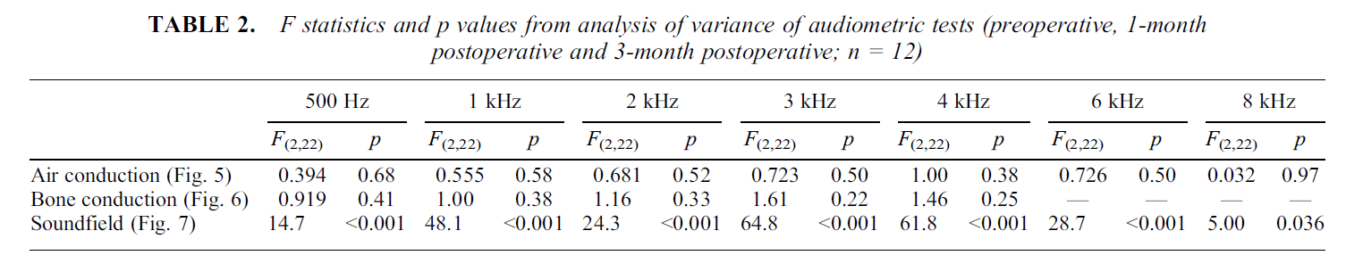
Medizinproduktestudie

Slide 23
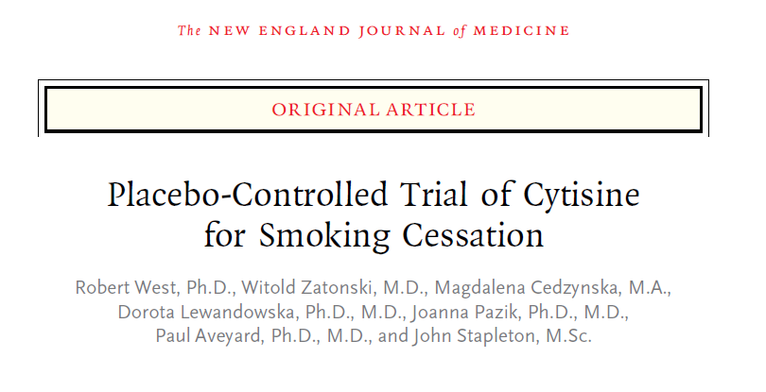
Arzneimittelstudie

Slide 24
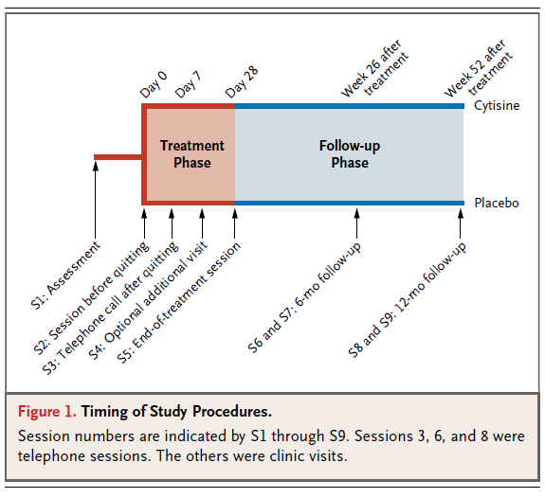
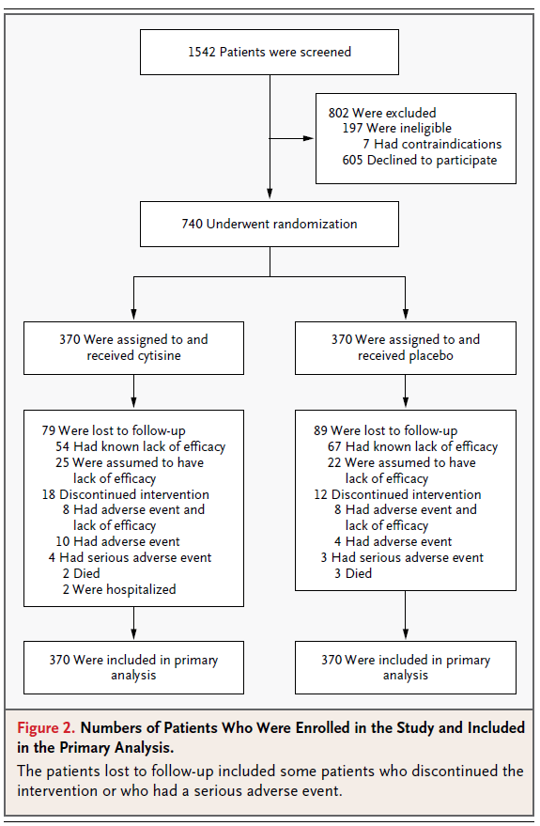
Arzneimittelstudie

Slide 25
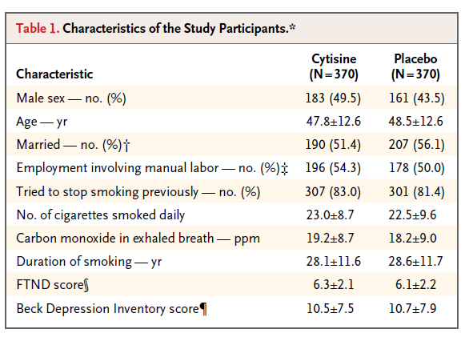
Arzneimittelstudie

Slide 26
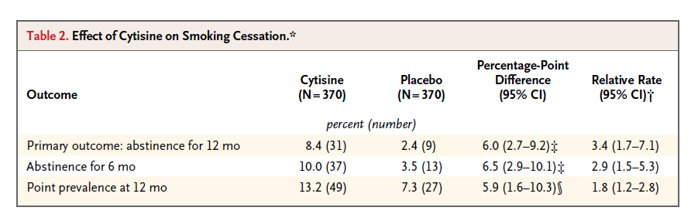
Arzneimittelstudie

Slide 27
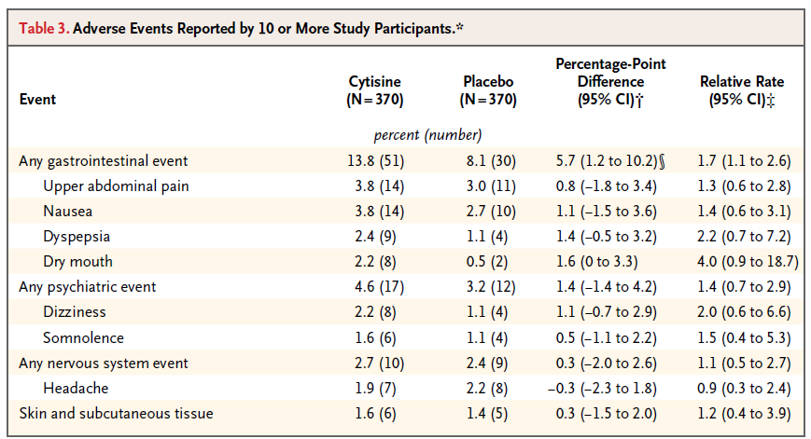
Arzneimittelstudie

Slide 28
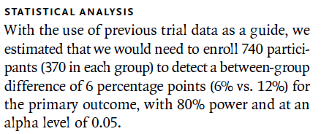
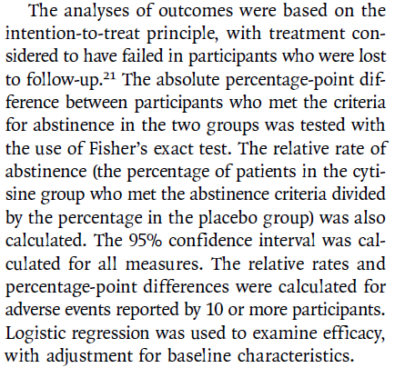
Arzneimittelstudie

Slide 29
Deskriptive Statistik
Hanno Ulmer
hanno.ulmer@i-med.ac.at
Department für Medizinische Statistik, Informatik und Gesundheitsökonomie, Medizinische Universität Innsbruck

Slide 30
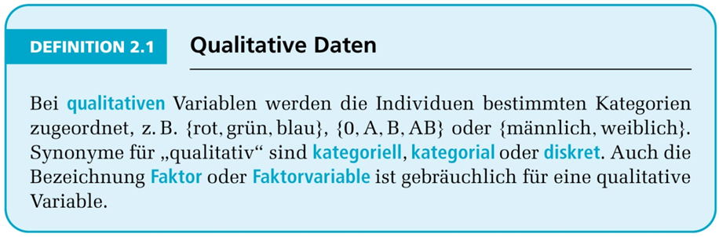
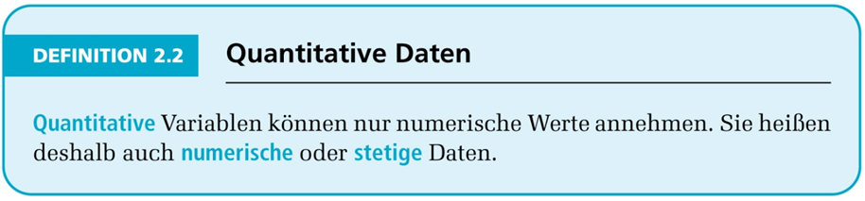
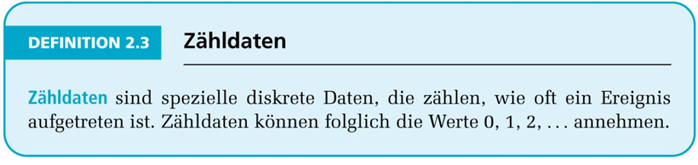
Deskriptive Statistik,
Merkmalstypen

Slide 31
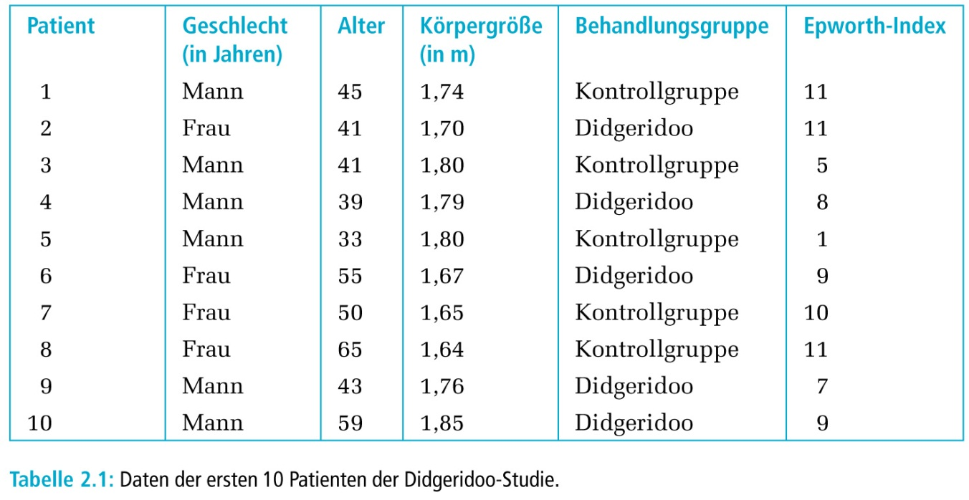
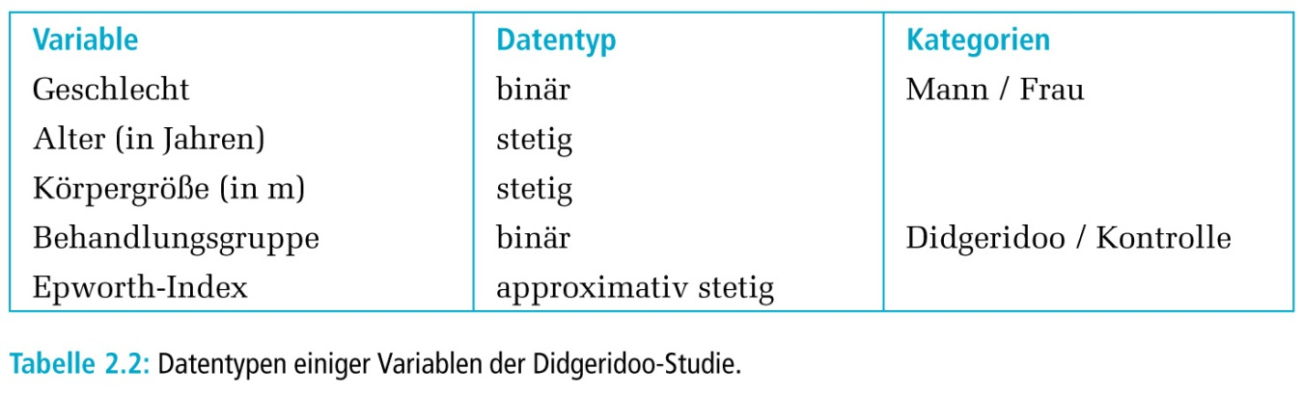
Beispieldaten, BMJ 2005
Didgeridoo playing as alternative treatment for obstructive sleep apnoea syndrome: randomised controlled trial Milo A Puhan, Alex Suarez, Christian Lo Cascio, Alfred Zahn, Markus Heitz, Otto Braendli, BMJ 2005

Slide 32
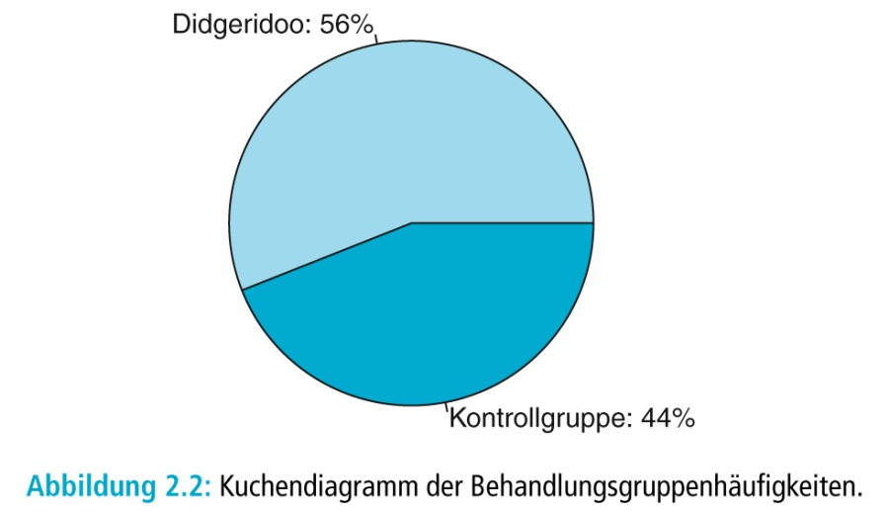
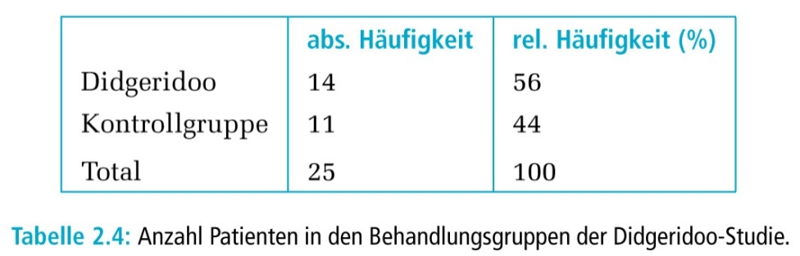
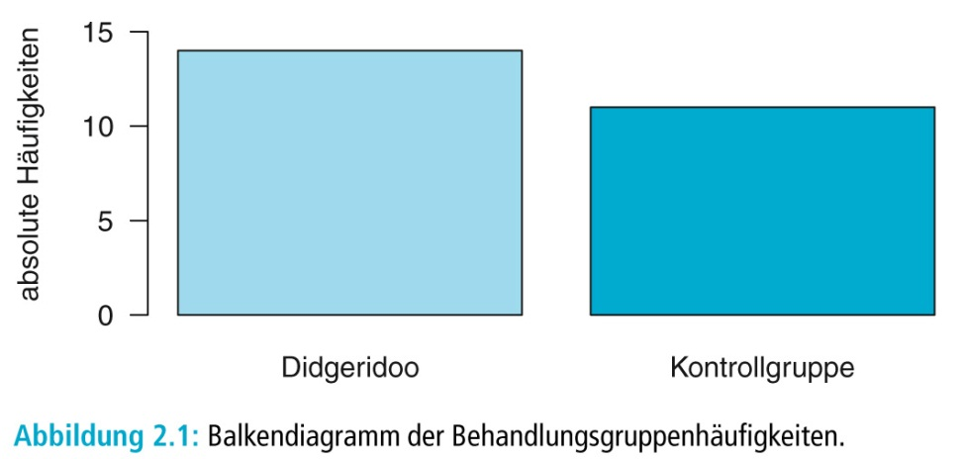
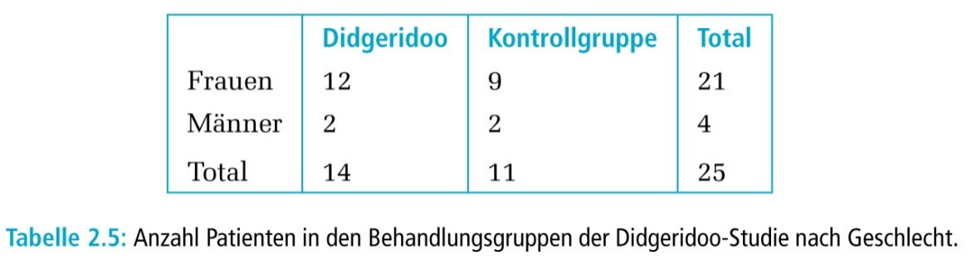
Deskription qualitativer Daten

Slide 33
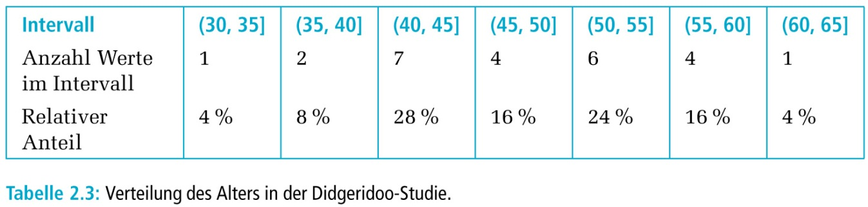
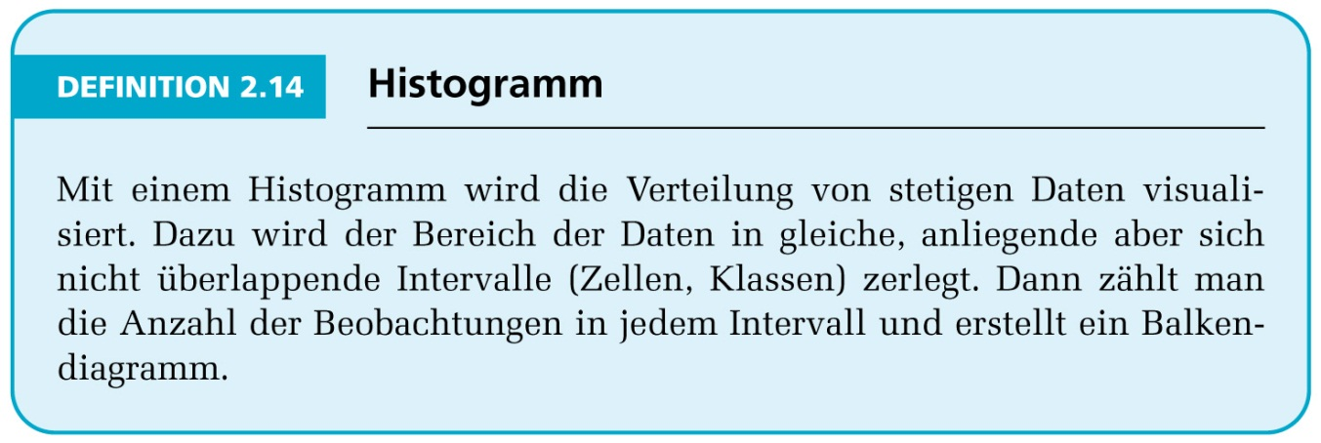
Deskription quantitativer Daten

Slide 34
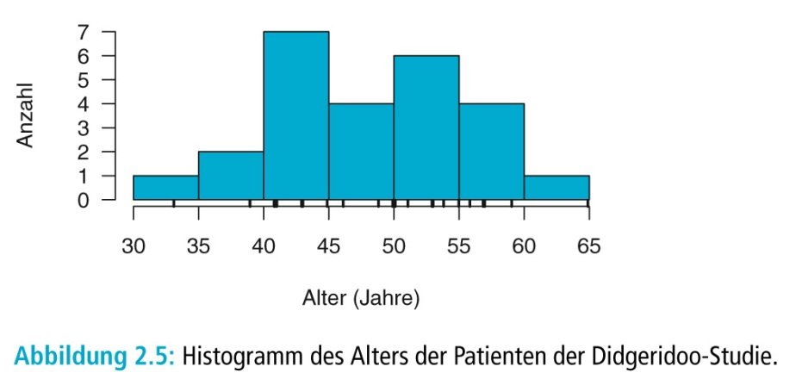
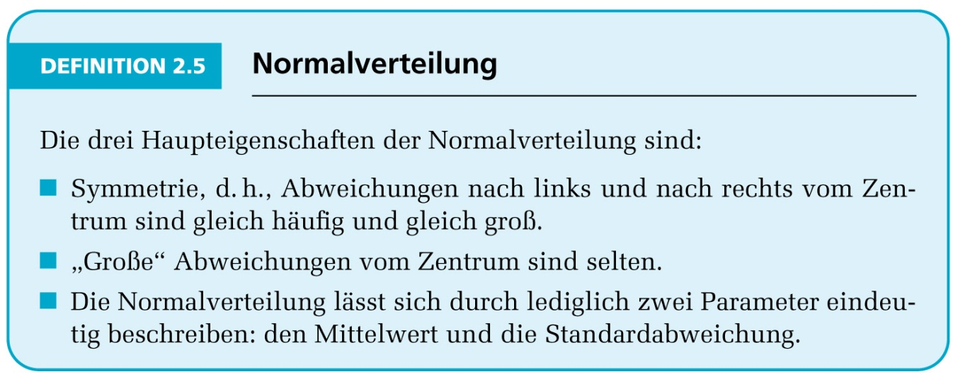
Deskription quantitativer Daten

Slide 35
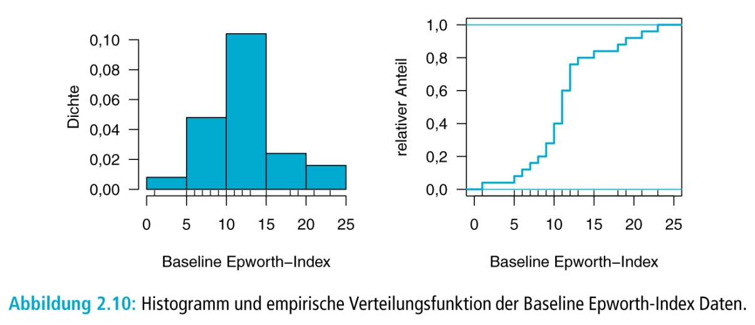
Deskription quantitativer Daten

Slide 36
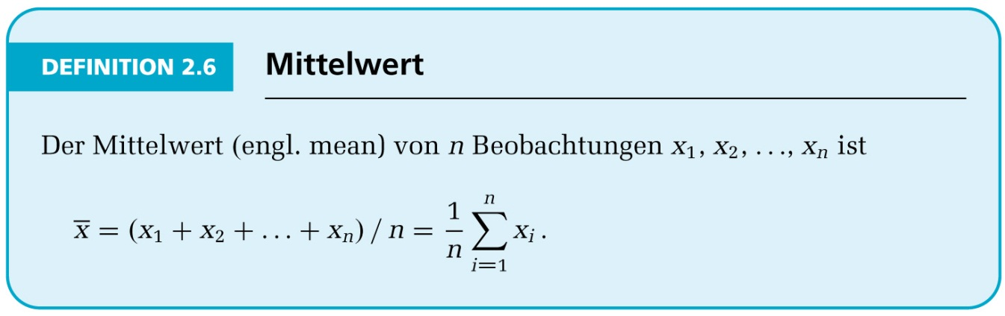
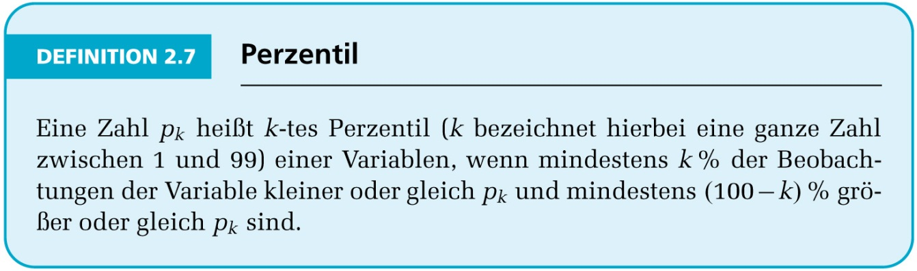
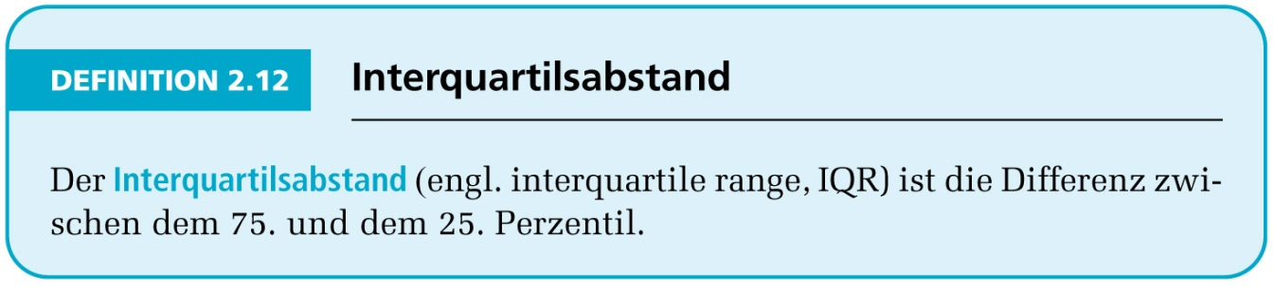
Statistische Kennwerte

Slide 37
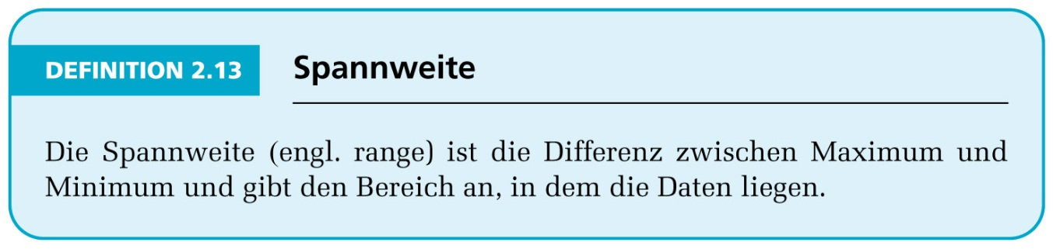
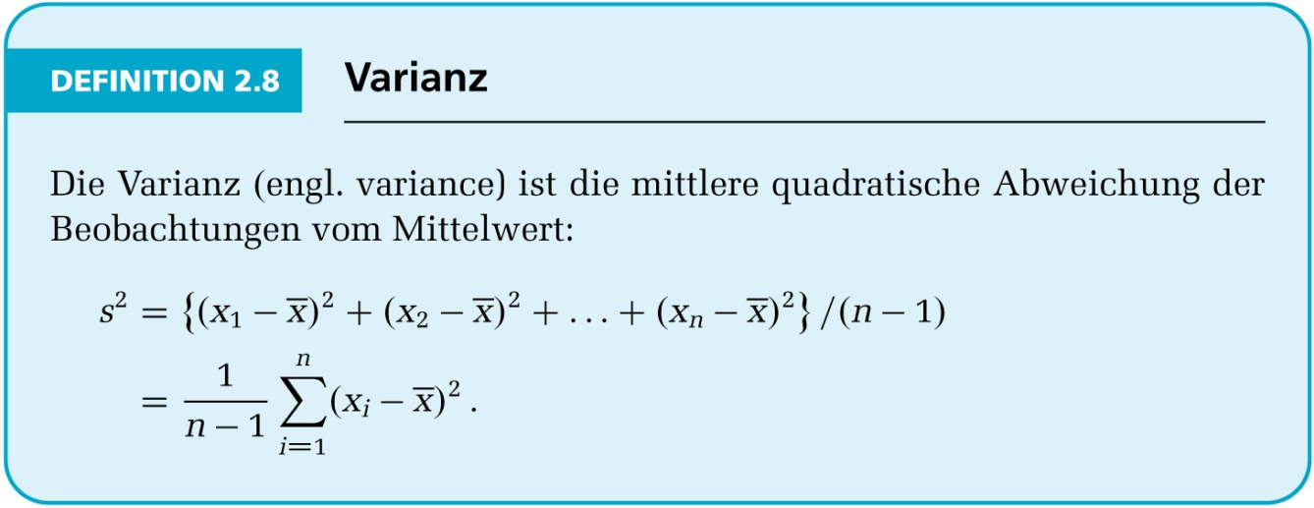
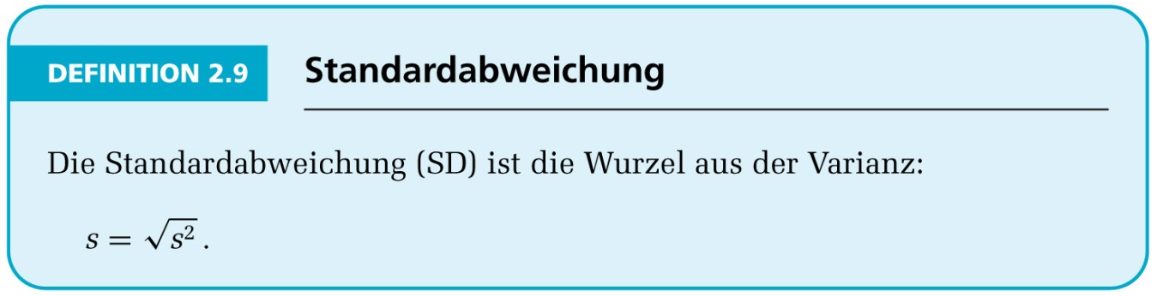
Statistische Kennwerte

Slide 38
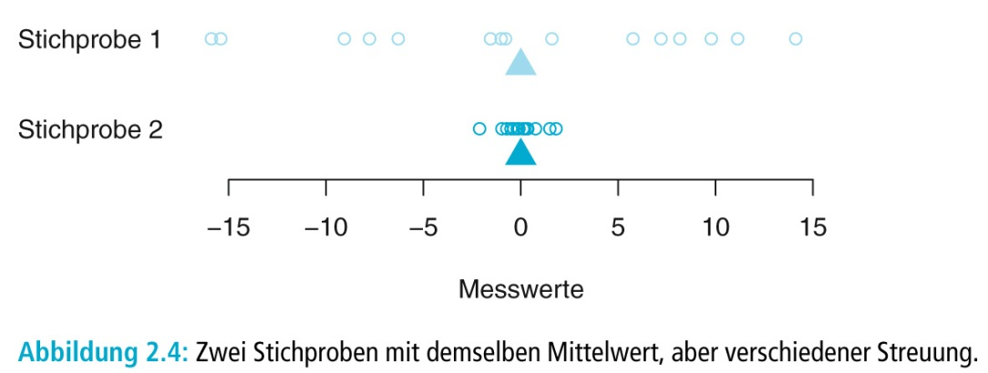
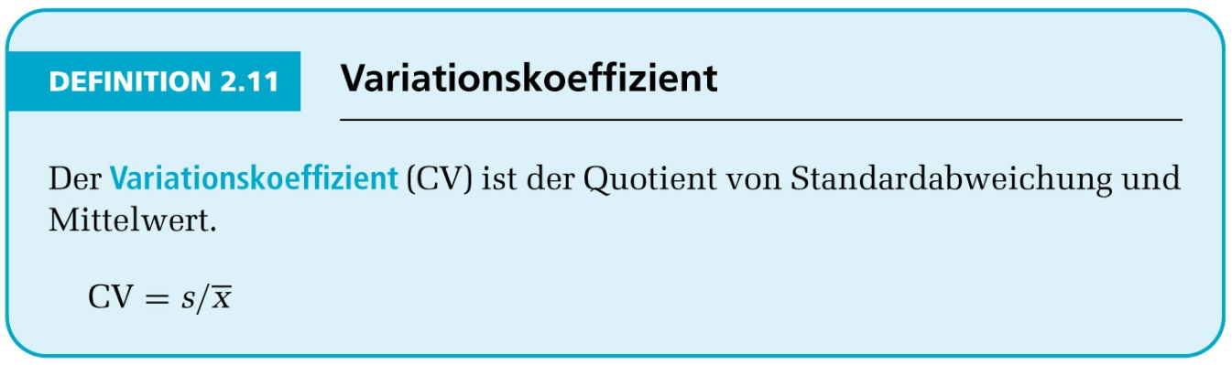
Streuung

Slide 39
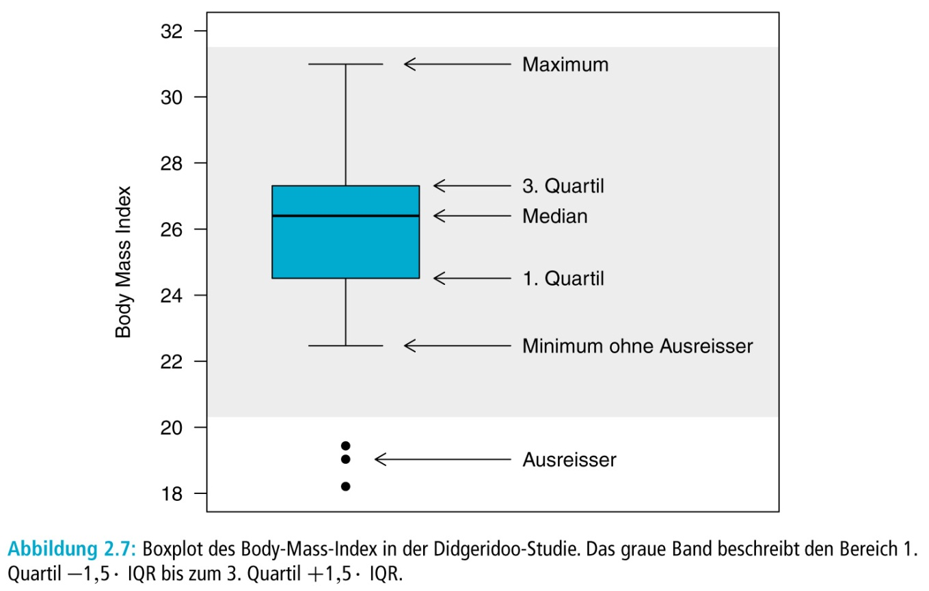
Boxplot

Slide 40
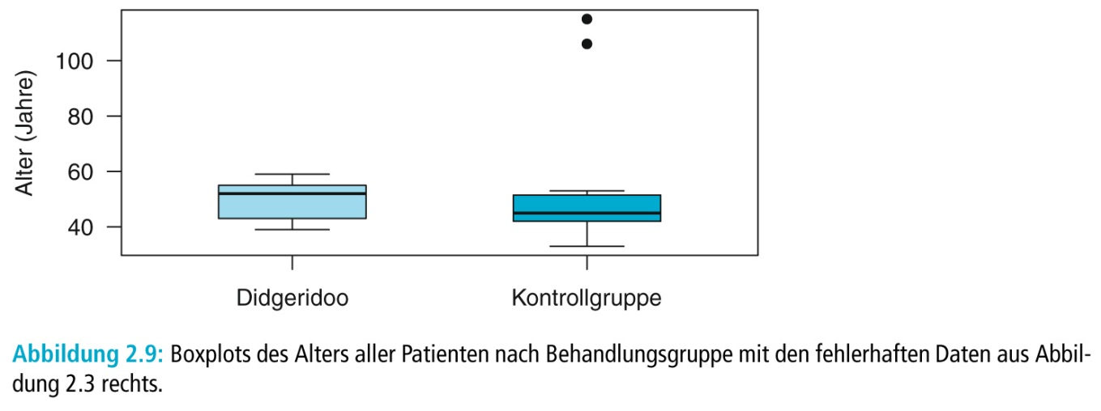
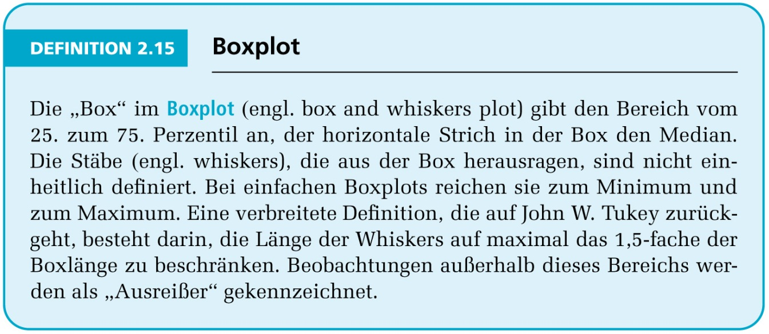
Vergleiche mit Boxplot

Slide 41
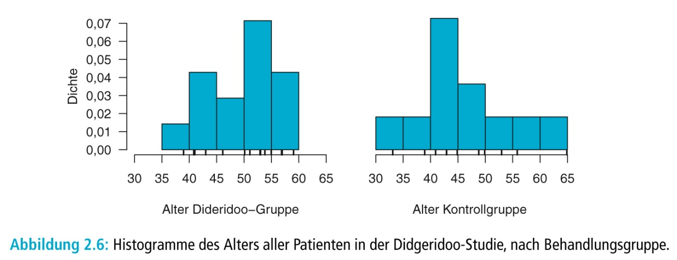
Deskriptive Vergleiche Didgeridoo Studie

Slide 42
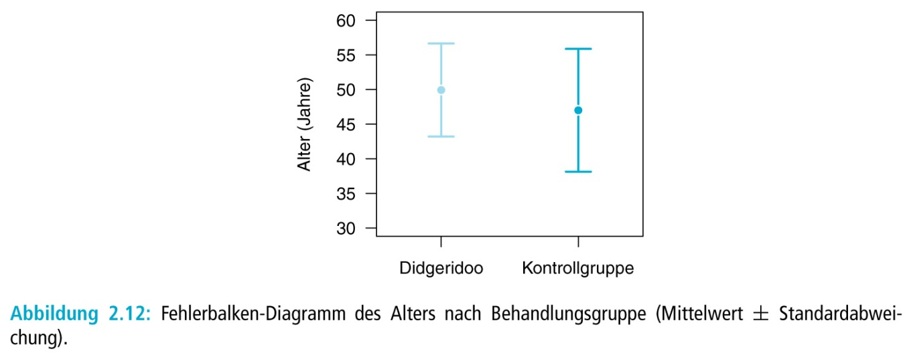
Deskriptive Vergleiche Didgeridoo Studie

Slide 43

Deskriptive Vergleiche Didgeridoo Studie

Slide 44


Streudiagramm und Korrelation

Slide 45


Korrelationskoeffizient

Slide 46

Korrelationskoeffizient

Slide 47

Regression

Slide 48
Deskriptive Statistik
Qualitative Merkmale |  | Quantitative Merkmale normalverteilt | beliebig verteilt
n,% |  | Arithmetischer Mittelwert | Median
 |  | Standardabweichung | Perzentile
Kreis-, Balkendiagramm |  | Histogramm | Boxplot
Beispiele:
Geschlecht, Ansprechen auf Therapie, etc. |  | Blutdruck | CRP, GGT Schweregrade

Slide 49


Merkmalstypen und statistische Maßzahlen, Grafiken

Slide 50




Statistische Grafiken

Slide 51





Deskriptive Statistik

Slide 52

Mittelwert vs. Median - Beispiel

Slide 53
Standardabweichung oder Standardfehler?
Standardfehler beschreibt nicht die Daten, sondern gibt die Genauigkeit des Mittelwerts als Schätzwerts an.

Slide 54
Übung: Statistische Maßzahlen
Berechnen Sie bitte den arithmetischen:
  Mittelwert
  Median
  Varianz
  Standardabweichung
  Spannweite
  Interquartilsabstand
  und den Variationskoeffizient
  Erstellen Sie Histogramme und Boxplots für:

Slide 55
Punktezahlen von 20 Studenten
  6,3,7,5,6,4,4,6,7,3,5,9,6,4,2,7,5,5,8,6
Anzahl der Angestellten in 20 Apotheken
  2,3,3,3,4,4,4,4,5,5,5,5,5,5,6,6,6,8,10,15
Krankheitstage von 20 Personen
  0,0,0,0,0,0,0,0,1,1,1,1,1,2,2,2,3,3,15,76

Slide 56

Inferenzstatistik III: Zusammenhänge, Korrelations- und Regressionsanalysen

Slide 57

Inferenzstatistik III: Zusammenhänge, Korrelations- und Regressionsanalysen

Slide 58
Correlation
Measuring Relationships
  Scatterplots
  Covariance
  Pearson’s Correlation Coefficient
Nonparametric measures
  Spearman’s Rho
  Kendall’s Tau
Interpreting Correlations
  Causality

Slide 59
What is a Correlation?
In statistics, dependence or association is any statistical relationship, whether causal or not, between two random variables or bivariate data.
  This means that the marginal distribution of a random variable A is different from the distribution of A knowing B
Correlation is a way of measuring the relationship between two metric or ordinal variables
Correlation is a measure of association
In common usage, it most often refers to the extent to which two variables have a linear relationship with each other
(Linear) correlation => Dependence
But: Dependence ≠> (Linear) correlation

Slide 60
Very small relationship

Slide 61
Positive relationship

Slide 62
Negative relationship

Slide 63

Measuring (linear) relationships
We need to see whether as one variable increases, the other increases, decreases or stays the same.
This can be done by calculating the covariance.
  We look at how much each score deviates from the mean.
  If both variables deviate from the mean by the same amount, they are likely to be related.
  Example:

Slide 64
Covariance
The variance tells us by how much scores deviate from the mean for a single variable.
It is closely linked to the sum of squares.
Covariance is similar – it tells us by how much scores on two variables differ from their respective means.

Slide 65
Example

Slide 66
Pearson correlation coefficient (1)
It depends upon the units of measurement.
  E.g. The Covariance of two variables measured in Miles might be 4.25, but if the same scores are converted to Km, the Covariance is 11.
One solution: standardise it!
  Divide by the standard deviations of both variables.
The standardised version of Covariance is known as the Pearson correlation coefficient.
  In the example:

Slide 67
Pearson Correlation Coefficient (2)
Measure of linear dependence
It varies between -1 (perfect negative) and +1 (perfect positive)
  0 = no relationship
It is an effect size
  ±.1 = small effect
  ±.3 = medium effect
  ±.5 = large effect
Coefficient of determination, r²
  By squaring the value of r you get the proportion of variance in one variable shared by the other.
In our example: 0.87², i.e. 75.7% of the variability in “Packets bought” can be explained by “Adverts watched”

Slide 68

Examples

Slide 69


Steepness of slope ≠ Strength of correlation!

Slide 70

Non-linear dependencies
Pearson correlation coefficient not meaningful for non-linear dependencies!

Slide 71
Correlation/Association and causality (1)
Direction of causality:
  Correlation coefficients say nothing about which variable causes the other to change
The third-variable problem:
  in any correlation, causality between two variables cannot be automatically assumed because there may be other measured or unmeasured variables (“confounders”) affecting the results.
C
A
B

Slide 72


Correlation/Association and causality (2)
Due to confounders, the estimated of the effect can be distorted so severely that even the estimate shows even in the opposite direction than the true effect
Simpson‘s paradox
Appleton et al. (The American Statistician 1996;50(4))
UC Berkeley gender bias
Department
Gender
Admission

Slide 73

Correlation/Association and causality (3)
In many experiments/studies, the main focus is on establishing causal relationships rather than mere associations
Prerequisite:
  Appropriate study design
    Minimizing selection bias
    Minimizing measurement errors
    Minimize confounding, e.g. through randomization
    Appropriate statistical methods
    Multivariate statistics adjusting for potential third variables
    Matching
http://tylervigen.com/view_correlation?id=1703

Slide 74


Nonparametric Correlation
Spearman’s Rho
  Pearson’s correlation on the ranked data
Kendall’s Tau
  Better than Spearman’s for small samples
Rho and Tau also appropriate for ordinal data if the assumed dependence is monotonic
R = 0.871
Monotonic
Non-monotonic
Rho = 0.667

Slide 75
Conducting Correlation Analysis

Slide 76
Reporting the results of a correlation analysis

Slide 77
Exercise
Analyse the data in Data_correlation.csv!

Slide 78

Importance of looking at a set of data graphically
Anscombe‘s quartet
All four sets (x₁ and y₁, x₂ and y₂, x₃ and y₃, x₄ and y₄) are identical when examined using only summary statsticis
Mean of x: 9, Variance of x: 11
Mean of y: 7.5, Variance of y: 4.125
Correlation between x and y: 0.816
Coefficient of determination: 0.67
Linear regression line: y=3+0.5*x
However, they vary considerably
when graphed

Slide 79
(Simple) linear regression (1)
A procedure to predict the value of one variable Y from another variable X
  X – independent variable, predictor
  Y – dependent variable, outcome
  Because there is only one predictor -> simple linear regression
  More than one predictor -> multiple linear regression
It is a hypothetical model of the relationship between two variables.
The model used is a linear one

Slide 80
(Simple) linear regression (2)
  Therefore, we describe the relationship using the equation of a straight line
b₁
  Regression coefficient for the predictor
  Gradient (slope) of the regression line
  Direction/Strength of Relationship
b₀
  Intercept (value of Y when X = 0)
  Point at which the regression line
  crosses the Y-axis (ordinate)

Slide 81
The Method of Least Squares (1)
  From all possible lines choose the one which minimizes the sum of the squared residuals (differences between the prediction from the line and the true y-value)

Slide 82



The Method of Least Squares (2)
Coefficients b₀ and b₁ of this minimation task are given by:
b₁ can also be formulated with the Pearson correlation coefficient:
$$b_{1}=r_{xy}∗\frac{s_{y}}{s_{x}}$$

Slide 83

Example
Calculate variances of x and y, covariance and the Pearson correlation coefficient!
Calculate the regression line according to the least squares approach!
Calculate the variance of the residuals (ŷ-y)!

Slide 84



Example
$$\overline{x}=162.85$$
$$\overline{y}=49.03$$
b₁:
b₀:

Slide 85


How Good is the model?
The regression line is only a model based on the data.
This model might not reflect reality.
  We need some way of testing how well the model fits the observed data.
  Graphically: Deviation from linearity?
  Diagnostics of residuals
  Coefficient of determination via decomposition of variance

Slide 86
Decomposition of variance (1)
SS_{tot}
  Total variability (variability between scores and the mean)
SS_{res}
  Residual/Error variability (variability between the regression model and the actual data)
SS_{reg}
  Model variability (difference in variability between the model and the mean)

Slide 87


Decomposition of variance (2)
${SS}_{tot}=\sum_{i}{{(y_{i}−\overline{y})}^{2}}$
${SS}_{reg}=\sum_{i}{{({\text{ŷ}}_{i}−\overline{y})}^{2}}$
${SS}_{res}=\sum_{i}{{(y_{i}−{\text{ŷ}}_{i})}^{2}}$
${\text{ŷ}}_{i}$ … predicted values
One has: SS_{tot}=SS_{reg}+SS_{res}
If the model results in better prediction than using the mean, then we expect SS_{reg} to be much greater than SS_{res}
The coefficient of determination, R², is defined as $1−\frac{{SS}_{res}}{{SS}_{tot}}$ (or $\frac{{SS}_{reg}}{{SS}_{tot}}$), i.e. the proportion of the variance of the outcome variable accounted for by the regression model
R² equals the square of the Pearson correlation coefficient between y and ŷ (or – equivalently – between x and y)
0≤R²≤1
SS_{tot}
SS_{reg}
SS_{res}
$$R^{2}=\frac{{SS}_{reg}}{{SS}_{tot}}$$

Slide 88
Exercise: Album_Sales.sav
A record company boss was interested in predicting album sales from advertising.
Data
  200 different album releases
Outcome variable:
  Sales (CDs and Downloads) in the week after release
Predictor variable:
  The amount (in £s) spent promoting the album before release.
Analyse the data and perform a regression analysis (in SPSS)!

Slide 89

What is Multiple Regression?
(Simple) Linear Regression is a model to predict the value of one variable from another
Multiple Regression is a natural extension of this model:
  We use it to predict values of an outcome from several predictors
  It is a hypothetical model of the relationship between several variables
Simple regression - line
Multiple regression with 2 predictors - plane

Slide 90
Multiple regression: an example
A record company boss was interested in predicting album sales from advertising.
Data
  200 different album releases
Outcome variable:
  Sales (CDs and Downloads) in the week after release
Predictor variables
  The amount (in £s) spent promoting the album before release (see last lecture)
  Number of plays on the radio (new variable)

Slide 91

Multiple Regression as an Equation
With multiple regression the relationship is described using a variation of the equation of a straight line
b₀ is the intercept
  the intercept is the value of the Y variable when all X_{s} = 0
b₁ is the regression coefficient for variable 1
b₂ is the regression coefficient for variable 2
b_{n} is the regression coefficient for n^{th} variable.
$ε_{i}$ is the residual (error term)

Slide 92

Model fit (1)
  As in the simple linear regression model
  SS_{tot} = SS_{reg} + SS_{res}
  Coefficient of determination, R²
    The proportion of variance accounted for by the model.
R² equals the square of the Pearson correlation coefficient between y and ŷ
0≤R²≤1
Diagnostics of residuals:
  Standardized residuals
Influential cases:
    Cook’s distance
$$R^{2}=\frac{{SS}_{reg}}{{SS}_{tot}}$$

Slide 93
Model fit (2)
Diagnostics of residuals:
  Standardized residuals
  In an average sample, 95% of standardized residuals should lie between ± 2.
  99% of standardized residuals should lie between ± 2.5.
  Outliers: any case for which the absolute value of the standardized residual is 3 or more, is likely to be an outlier.
Influential cases:
  Cook’s distance
  Measures the influence of a single case on the model as a whole.
  Weisberg (1982): absolute values greater than 1 may be cause for concern

Slide 94

Which variables to include?
    First step: scatterplot

Slide 95
Method 1: Forced entry
All variables are entered into the model simultaneously
The results obtained depend on the variables entered into the model
  It is important, therefore, to have good theoretical reasons for including a particular variable

Slide 96
Method 2: Stepwise entry
Variables are entered into the model based on mathematical criteria
Computer selects variables in steps.
Step 1: Choose the predictor that can explain the most variance in the outcome variable.
Step 2: Having selected the 1st predictor, a second one is chosen from the remaining predictors.
The semi-partial correlation is used as a criterion for selection.
  The semi-partial correlation measures the relationship between two variables controlling for the effect that a third variable has on only one of the others
  It measures the unique contribution of a predictor to explaining the variance of the outcome
Drawbacks of stepwise entry:
  Rely on a mathematical criterion.
    Variable selection may depend upon only slight differences in the semi-partial correlation
    These slight numerical differences can lead to major theoretical differences
  Should be used only for exploration

Slide 97




Doing Multiple Regression in SPSS (1)

Slide 98


Doing Multiple Regression in SPSS (2)

Slide 99
How to interpret beta values?
Beta values:
  the change in the outcome associated with a unit change in the predictor
  b1= 0.085: as advertising increases by £1, album sales increase by 0.085 units.
  b2= 3367: each time (per week) a song is played on the radio its sales increase by 3367 units.
Standardised beta values:
  tell us the same but expressed as standard deviations
  β1= 0.511: As advertising increases by 1 standard deviation, album sales increase by 0.511 of a standard deviation.
  β2= 0.512: When the number of plays on the radio increases by 1 SD its sales increase by 0.512 standard deviations.

Slide 100

Reporting the model

Slide 101
Generalization (1)
When we run regression, we hope to be able to generalize the sample model to the entire population
To do this, several assumptions must be met
Violating these assumptions stops us generalizing conclusions to our target population
Variable Type:
  Outcome must be continuous
  Predictors can be continuous or dichotomous
Non-Zero Variance:
  Predictors must not have zero variance
Linearity:
  The relationship we model is, in reality, linear
Independence:
  All values of the outcome should come from a different person

Slide 102
Generalization (2)
No Multicollinearity:
  Predictors must not be highly correlated.
  Collinearity diagnostics
Homoscedasticity:
  For each value of the predictors the variance of the error term should be constant.
  plot ZRESID against ZPRED
Independent Errors:
  For any pair of observations, the error terms should be uncorrelated
Normally-distributed Errors
  Normal probability plot

Slide 103




Regression plots
Homoscedasticity: ZRESID vs. ZPRED
Normality of Errors: Histograms and P-P plots

Slide 104

Collinearity diagnostics
Tolerance should be more than 0.2 (Menard, 1995)
VIF should be less than 10 (Myers, 1990)

Slide 105
Signifikanztests und Konfidenzintervalle
Hanno Ulmer
hanno.ulmer@i-med.ac.at
Department für Medizinische Statistik, Informatik und Gesundheitsökonomie, Medizinische Universität Innsbruck

Slide 106
Statistische Auswertung
Deskriptive Statistik
Inferenzstatistik I: Schätzen von Parametern mittels Konfidenzintervallen
Inferenzstatistik II: Unterschiede, Hypothesenprüfung mittels Signifikanztests
Inferenzstatistik III: Zusammenhänge, Korrelations- und Regressionsanalysen

Slide 107

Schließende Statistik

Slide 108
Ziel der schließenden Statistik
Aufgrund der Stichprobe Aussagen über die Grundgesamtheit machen
Von der Stichprobe auf die Grundgesamtheit schließen
Grundgesamtheit
  ist eine entsprechend dem jeweiligen Untersuchungsziel abgegrenzte Menge von Personen oder Objekten, über die man eine Aussage machen will.
Stichprobe
  ist eine (kleinere) Menge von Einheiten, die aus der Grundgesamtheit ausgewählt werden und die man misst oder beobachtet, um aus ihnen Schlüsse mit Gültigkeit auch für den nicht ausgewählten Teil der Grundgesamtheit zu ziehen.
Repräsentativ
  hinsichtlich der für die Untersuchung relevanten Merkmale die Struktur der Grundgesamtheit widerspiegeln

Slide 109
Grundlagen der schließenden Statistik: Verteilungsannahmen
Gleichverteilung
  Bsp.: Würfel, Münze
Binomialverteilung
  Bsp.: Ziehen mit Zurücklegen
Poissonverteilung
  Bsp.: Seltene Ereignisse mit grossen Stichprobenumfängen und konstanter Wahrscheinlichkeit
Exponentialverteilung
  Bsp.: Überlebenszeiten
Gauß- oder Normalverteilung
  Wichtigste Verteilung siehe die folgenden Folien
Testverteilungen
  Chi-Quadrat-Verteilung
  T-Verteilung
  F-Verteilung
  Anwendung bei Signifikanztests und Konfidenzintervallen

Slide 110

Normalverteilung

Slide 111


Dichtefunktion

Slide 112

Gauss- oder Normalverteilung

Slide 113
Gauss- oder Normalverteilung
-∞ < X < + ∞
Parameter Erwartungswert μ und Varianz σ²
tabelliert ist die Standardnormalverteilung N(0,1)
  N(0,1)...Mittelwert 0, Streuung 1
    Da eine Transformation möglich ist

Slide 114


Quantile der Standardnormalverteilung

Slide 115
Für alle Normalverteilungen gilt
• ≈ 68% aller Beobachtungen liegen innerhalb einer
Standardabweichung um den Mittelwert
(zwischen μ − σ und μ + σ )
• ≈ 95% aller Beobachtungen liegen innerhalb zweier Standardabweichung (zwischen μ − 2σ und μ + 2σ )
• 99.7% aller Beobachtungen liegen innerhalb dreier
Standardabweichung (zwischen μ − 3σ und μ + 3σ
Die 68-95-99.7% Regel:

Slide 116
Rolle der Normalverteilung
Viele Messwerte sind annähernd normalverteilt
  Z.B.: Gewicht einer bestimmten Gruppe
Manche Messwerte können durch Transformation an eine Normalverteilung angenähert werden
  Auch diskrete Verteilungen, wie z.B. die Binomialverteilung können durch die Normalverteilung approximiert werden
Wichtige (und günstige) statistisch-theoretische Eigenschaften
Die Normalverteilung ist Grundlage wichtiger Testverteilungen

Slide 117
Exercise 1
Entry to a certain University is determined by a national test. The scores on this test are normally distributed with a mean of 500 and a standard deviation of 100. Tom wants to be admitted to this university and he knows that he must score better than at least 70% of the students who took the test. Tom takes the test and scores 585. Will he be admitted to this university?
Z=(585 - 500) / 100 = 0.85
P = [area to the left of z = 0.85] = 0.8023 = 80.23%
Tom scored better than 80.23% of the students who took the test and he will be admitted to this University.

Slide 118
Exercise 2
The length of life of an instrument produced by a machine has a normal distribution with a mean of 12 months and standard deviation of 2 months. Find the probability that an instrument produced by this machine will last a) less than 7 months. ) between 7 and 12 months.
P(x < 7) = P(z < -2.5) = 0.0062
P(7 < x < 12) = P(-2.5 < z < 0) = 0.4938

Slide 119
Inferenzstatistik I: Schätzen von Parametern (Konfidenzintervalle)
Ein Konfidenzintervall ist ein Vertrauensbereich oder eigentlich besser ein Unsicherheitsbereich für die Schätzung eines bestimmten, nicht bekannten Parameters der Grundgesamtheit.
Konfidenzintervall – ein Bereich, in welchem der zu schätzende, unbekannte Parameter der Grundgesamtheit mit Wahrscheinlichkeit (1- α) liegt
Der interessierende Parameter kann ein Anteil, ein Mittelwert, ein relatives Risiko etc. sein.
Ein 95%Konfidenzintervall beispielsweise enthält den gesuchten Parameter mit einer Wahrscheinlichkeit von 95%.

Slide 120

Der Weg zum Konfidenzintervall
Punktschätzer aus einer Stichprobe liefert nur einen einzigen Wert
  Verschiedene Stichproben aus ein und derselben Grundgesamtheit liefern unterschiedliche numerische Werte für den zu schätzenden Parameter
Berücksichtigung der Standardabweichung der Schätzstatistik (= Standardfehler)

Slide 121
Inferenzstatistik I: Schätzen von Parametern (Konfidenzintervalle)
Beispiel: Rule of three (adverse Events)
Keine AE in n=10 Patienten
95% KI (0-30%)
Keine AE in n=100 Patienten
95% KI (0-3%)
Keine AE in n=1000 Patienten
95% KI (0-0,3%)

Slide 122

Konfidenzintervalle
“A confidence interval is used when estimating an unknown parameter from sample data. The interval gives a range for the parameter – and a confidence level that the range covers the true value.”
Freedman et al. (1991), p. 385.

Slide 123
(1-α)-Konfidenzintervall
Punktschätzer aus einer Stichprobe liefert nur einen einzigen Wert
  Verschiedene Stichproben aus ein und derselben Grundgesamtheit liefern unterschiedliche numerische Werte für den zu schätzenden Parameter
Berücksichtigung der Standardabweichung der Schätzstatistik
Konfidenzintervall – ein Bereich, in welchem der zu schätzende, unbekannte Parameter der Grundgesamtheit mit Wahrscheinlichkeit (1- α) liegt

Slide 124

Zwei- und Einseitige Konfidenzintervalle

Slide 125
(1-α)-Konfidenzintervall
Einseitig
  Bestimmung einer Ober- bzw. Untergrenze
Zweiseitig
  symmetrisch
Üblich Werte für α
  α=0.05, α=0.01, α=0.001
Grundsätzlich kann für alle statistisch geschätzten Parameter ein Konfidenzintervall berechnet werden
  Mittelwert, Standardabweichung, Häufigkeit, Korrelationskoeffizient, ...

Slide 126
Konfidenzintervall für den Mittelwert μ
Bei unbekannter Varianz σ², geschätzt durch s²
Gegeben: X₁,...,X_{N} unabhängige normalverteilte Zufallsvariable N(μ,σ²)
Obere bzw. untere Grenze des Konfidenzintervalls
t_{(N-1),1-α/2}...t-Verteilung mit N-1 Freiheitsgraden
Allgemein gilt: t_{(N-1),1-α} >z_{1- α}

Slide 127
Konfidenzintervall für einen Anteil π
Wahrscheinlichkeit π wird durch p aus einer Stichprobe vom Umfang N geschätzt
  Das Konfidenzintervall ist asymmetrisch
Approximation durch Normalverteilung
  Wenn N>30
Approximation nach Wald
Approximation nach Pearson-Clopper

Slide 128

95% Konfidenzintervalle

Slide 129

Klinische Relevanz versus statistische Signifikanz

Slide 130
Beispiel: Schätzen von Parametern (Konfidenzintervalle)

Slide 131
Inferenzstatistik II: Signifikanztests
Eine vorgegebene Annahme (Nullhypothese H0 ) wird anhand von Daten überprüft. Wenn die Daten "stark" von dem abweichen, was man unter der Nullhypothese erwartet, lässt man die Nullhypothese fallen.
Im statistischen Test wird dieses Vorgehen formalisiert.
Nachdem die Nullhypothese H0 und die Alternativhypothese H1 so formuliert sind, dass sie sich gegenseitig ausschließen und keine dritte Möglichkeit zulassen, ergibt sich ein einfaches Entscheidungsschema mit 4 Möglichkeiten
Der Fehler 1. Art ist der Fehler, die Nullhypothese zu verwerfen, obwohl sie richtig ist.
Der Fehler 2. Art ist der Fehler, die Nullhypothese zu behalten, obwohl sie falsch ist.

Slide 132
Inferenzstatistik II: Signifikanztests
Ergebnis eines Signifikanztests ist die Teststatistik.
Der Wertebereich der Teststatistik wird in zwei Teilmengen zerlegt, den Verwerfungsbereich und den Annahmebereich. Wenn die Prüfgröße in den Verwerfungsbereich fällt, wird die Nullhypothese verworfen, ansonsten wird sie behalten.
Man wählt den Verwerfungsbereich so, dass unter H0 seine Wahrscheinlichkeit unter einen vorgegebenen Wert α fällt. α, das sogenannte Signifikanzniveau des Tests, ist damit die Obergrenze für die Wahrscheinlichkeit, den Fehler 1. Art zu begehen. α wird vom Versuchsleiter vorgegeben. Übliche Werte für α sind 0.05, 0.01 und 0.001.
Welches α man wählt, hängt von den Konsequenzen ab, die der Fehler 1. Art hat. Der naheliegende Wunsch, α = 0 zu wählen, scheitert daran, dass dann ß, die Wahrscheinlichkeit für den Fehler 2. Art, groß wird.

Slide 133




Definitionen

Slide 134

Mögliche Entscheidungen

Slide 135
Type I versus Type II Error
 |  | Decide for
 |  | H₀ | H₁
Reality | H₀ | Correct decision | Wrong decision: Type I error (α)
 | H₁ | Wrong decision: Type II error (β) | Correct decision: Power (1-β)

Slide 136
Parallelgruppenstudie
z.B. Untersuchung der Wirksamkeit eines neuen blutdrucksenkenden Medikaments im Vergleich zu einer Standardtherapie oder Placebo (=Kontrolle)
    Nullhypothese H0: die beiden Therapien sind im Mittel gleich wirksam
      z.B. die Änderung des systolischen Blutdrucks ist im Mittel in beiden Gruppen gleich
      Die Ungültigkeit der Nullhypothese ist zu beweisen
Alternativhypothese H1: die beiden Therapien sind im Mittel unterschiedlich stark wirksam
Voraussetzung: Die beiden Gruppen stimmen in den wesentlichen Merkmalen überein – siehe Randomisierung
  Nur die Therapien sind unterschiedlich
  Strukturgleichheit der Gruppen
Notes:
136

Slide 137
Die statistischen Hypothesen
Alternativhypothese H_{A}
Forschungshypothese
  ungerichtet gerichtet
Nullhypothese H₀
geht davon aus, dass das, was mit der Alternativhypothese behauptet wird, nicht zutrifft.
  Es gibt keinen Behandlungseffekt

Slide 138
Vorgehen bei der Hypothesenüberprüfung
Formulierung der Hypothese, Auswahl des Tests
Datenerhebung
Analyse der Daten mit Methoden der beschreibenden Statistik (Häufigkeiten, Mittelwert, ….)
Überprüfung der Daten auf Ihre Verteilung
  Grafische Darstellung mittels Boxplot und Histogramm
  Statistische Überprüfung mit dem Kolmogorov-Smirnov Test
Adaptierung der Testauswahl
Durchführung des Tests
Interpretation des Ergebnisses

Slide 139
Formulating hypothesis & statistical tests
Steps in conducting a statistical test:
Quantify the scientific problem from a clinical / biological perspective
Formulate the model assumptions (distribution of the variable of interest)
Formulate the problem as a statistical testing problem:
Nullhypothesis versus alternative hypothesis
Define the „error“ you are willing to tolerate
Calculate the appropriate test statistic
Decide for the null hypothesis or against it
Formulating Hypothesis
&
Test statistics
&
p-values

Slide 140
Principles of statistical testing
Three primary measures of interest:
a point estimate,
a confidence interval, and
a p-value
Different approaches:
Test for superiority,
standard hypothesis testing
Test for non-inferiority
the difference between the new treatment and the standard is less than the smallest clinically meaningful difference, define delta, use confidence intervals
Test for equivalence
To demonstrate the difference between the new treatment and standard treatment has no clinical importance, define delta

Slide 141

Example

Slide 142

2008: 100 Jahre Student`s t-Test:
William Sealy Gosset

Slide 143
t-Test quantitatives Merkmal
 | Therapie | Syst. Blutdruck
1 | Therapie A | 169
2 | Therapie A | 139
3 | Therapie A | 137
4 | Therapie A | 152
5 | Therapie A | 142
6 | Therapie A | 163
7 | Therapie A | 183
8 | Therapie A | 143
 | 8 | 153,5
1 | Therapie B | 155
2 | Therapie B | 154
3 | Therapie B | 176
4 | Therapie B | 158
5 | Therapie B | 156
6 | Therapie B | 170
7 | Therapie B | 168
8 | Therapie B | 179
9 | Therapie B | 167
10 | Therapie B | 142
11 | Therapie B | 163
12 | Therapie B | 144
 | 12 | 161
H₀: Es besteht kein Therapieunterschied bzgl. mittleren Blutdrucks ( )
H₁: Es besteht ein Unterschied ( )
Teststatistik:
Syst. Blutdruck bei Therapie A größer bzw. kleiner als bei Therapie B => 2-seitiger t-Test
Testentscheidung:
=> Nullhypothese kann nicht abgelehnt werden

Slide 144


Student`s t-Test für unabhängige Stichproben (1)
Parametrischer Test zum Vergleich von Mittelwerten
Teststatistik:
Falls die Nullhypothese gilt, ist die Teststatistik t(N_{x}+N_{y}-2)-verteilt
Entscheidung:
  H0 wird mit Irrtumswahrscheinlichkeit α verworfen, wenn:
critical values
Rejection region: „H₀ wird abgelehnt, da Daten zu stark von dem abweichen, was man sich unter H0 erwarten würde“
Acceptance
region
Rejection
region
Rejection
region
α/2
Area = 1-α
α/2
- t_{n-1,1-α/2}
t_{n-1,1-α/2}

Slide 145

Student`s t-Test für unabhängige Stichproben (2)
Wie gelangt man von der Teststatistik zum genauen p-Wert?
Z.B.
P-value (two-sided) = 0.005 + 0.005 = 0.01 (= Area under the curve)
~0.005
~0.005
-2.6
critical value
critical value
2.6

Slide 146

Fehler 1. und 2. Art - Zusammenhang

Slide 147
Was ist der p-Wert
Wahrscheinlichkeit, daher 0<p-Wert<=1
Er deutet an, wie wahrscheinlich es ist, ein Stichprobenergebnis wie beobachtet oder extremer zu erhalten, wenn die Nullhypothese wahr ist.
Mit dem p-Wert wird also angedeutet, wie extrem das Ergebnis ist: je kleiner der p-Wert, desto mehr spricht das Ergebnis gegen die Nullhypothese
p-Wert = P(Daten so extrem wie beobachtet|H₀)
Häufige Fehlinterpretation: p-Wert gibt an, wie wahrscheinlich die Nullhypothese bei Erhalt eines Stichprobenergebnisses wie beobachtet ist, d.h. P(H₀|Daten so extrem wie beobachtet|H₀)
Die Nullhypothese wird verworfen, wenn der p-Wert kleiner als das vom Anwender festgelegte Signifikanzniveau α ist (oft 0.01, 0.001, oder 0.05)
Wenn die Nullhypothese zugunsten der Alternativhypothese verworfen wird, wird das Resultat als statistisch signifikant bezeichnet.
Die Größe des p-Werts gibt keine Aussage über die Größe des wahren Effekts

Slide 148

Falsche Schlußfolgerungen

Slide 149
Falsche Schlußfolgerungen

Slide 150
Student`s t-Test für unabhängige Stichproben (3)
Ein zwei-Stichproben t-Test zum Vergleich der Mittelwerte in zwei Gruppen liefert einen Wert der Teststatistik von 2,6, was einen p-Wert von 0.01 liefert.
Richtige Interpretation:
  Falls das Experiment 100 Mal wiederholt wird, d.h. 100 Mal zufällig eine Stichprobe gezogen wird, dann Teststatistik berechnet wird etc., und falls es in Wirklichkeit keinen Unterschied zwischen den beiden Gruppen gibt (Mittelwerte sind gleich), dann kann man erwarten, dass nur eine dieser 100 Teststatistiken einen Wert ≥ |2.6| aufweist
  Falsche Interpretation:
  Die Nullhypothese ist zu 99% falsch
https://www.graphpad.com/quickcalcs/ttest1.cfm

Slide 151

Student`s t-Test für unabhängige Stichproben (4)
Damit die Teststatistik unter H₀ auch tatsächlich t-verteilt ist und der Test valide ist, müssen folgende Voraussetzungen erfüllt sein:
  Jede der beiden Grundgesamtheiten sollten normalverteilt sein, Abweichungen bei größeren Stichprobenumfängen (N>=30) zulässig (zentraler Grenzwertsatz)
  -> Graphische Überprüfung mittels Histogramm
    -> Kolmogoroff-Smirnov-Test
      H₀: Daten sind normalverteilt vs. H₁: Daten sind nicht normalverteilt
  Gleiche Varianzen in den beiden Gruppen
    -> Levene-Test

Slide 152
Gepaarter Zwei-Stichproben t-Test
Vorher-Nachher-Messungen
Gruppe 1 (vorher) nicht unabhängig von Gruppe 2 (nachher)
Modifikation der t-Tests notwendig
->Abhängiger/Gepaarter t-Test
Berechnung der Differenz D für jedes Paar

Slide 153

Verbundene versus unverbundene Stichproben

Slide 154





Beispiel
Um eine neue Therapie zur Senkung des Cholesterinspiegels zu testen, werden bei zehn Probanden vor und nach der Behandlung die Cholesterinwerte bestimmt. Es ergeben sich die folgenden Messergebnisse:
https://www.graphpad.com/quickcalcs/ttest1.cfm
Teststatistik
Kritischer Wert
Die Nullhypothese, dass die Erwartungswerte der Cholesterinwerte vor und nach der Behandlung gleich sind, kann nicht abgelehnt werden. Wenn die Behandlung überhaupt einen Effekt hat, so ist dieser nicht groß genug, um ihn mit einem so kleinen Stichprobenumfang zu entdecken.

Slide 155
ANOVA
Analysis of Variance - Streuungszerlegung
Parametrischer Test zum Vergleich von Mittelwerten
T-test = Zweigruppenvergleich, ANOVA mehrere Gruppen möglich
Mittelwertsvergleich erfolgt durch die Zerlegung der Varianz in:
- Streuung zwischen den Gruppen
- Streuung innerhalb der Gruppen
Voraussetzungen
- Normalverteilung
- Varianzhomogenität

Slide 156
ANOVA
Einfache ANOVA,
ein Faktor mit >= 2 Stufen
Mehrweg-ANOVA,
mehrere Faktoren mit >= 2 Stufen
Kovarianzanalyse, auch stetige Einflussfaktoren
Multivariate ANOVA, mehrere abhängige Variablen
ANOVA für Messwiederholungen, aufeinanderfolgende Beobachtungen sind abhängig

Slide 157
ANOVA, post hoc Vergleiche
Bonferroni
Bonferroni-Holm
Holm-Sidak
Tukey
Scheffe
LSD
Dunnett

Slide 158
Why Not Use Lots of t-Tests?
If we want to compare several means why don’t we compare pairs of means with t-tests?
  Can’t look at several independent variables.
  Inflates the Type I error rate.
1
1
2
Vs
1
3
Vs
2
3
2
Vs
3

Slide 159
Analysis of Variance (ANOVA)
Situation: Compare the means of k samples (k>2)
Assumption: normal distribution of the population, σ = σ₁ = σ₂ =…= σ_{k}
Hypothesis: H₀: μ₁= μ₂ =… = μ_{k} versus H₁: μ_{i} ≠ μ_{j} (i ≠ j): At least two of the means differ
Nowadays, linear mixed effects models are preferred instead of ANOVA
Group 1
Group 2
Group 3
| | | | | | | | |
all observations x_{ij}
Variability
within the group
₁
₂
₃
= means within the groups
Difference /Variability
between the groups
= is the overall mean of the variable

Slide 160



Pearson`s Chi-Quadrat Test
1900
Korrelation und Regression
Fisher`s Exakter Test
Varianzanalyse
Karl Pearson (1857-1936)
Sir Ronald Aylmer Fisher (1890-1962)

Slide 161
Chi-Quadrat-Test qualitatives Merkmal
Blutdruck | Therapie A | Therapie B | Gesamt
Hypertonie | n_{1.1}=300 | n_{1.2}=150 | n_{1.}=450
Normotonie | n_{2.1}=300 | n_{2.2}=250 | n_{2.}=550
Gesamt | n_{.1}=600 | n_{.2}=400 | n=1000
H0: Es besteht kein Zusammenhang zwischen Therapie und Blutdruck ( )
H1: Es besteht ein Zusammenhang ( )
Teststatistik:
Testentscheidung: => Ablehnen der Nullhypothese

Slide 162

Beispiel
Teststatistik: 121.9218 ~ χ² ((2-1)*(3-1)) = χ² (2)
Kritischer Wert von χ² (2) = 5.99
Nullhypothese (Rauchverhalten unterscheidet sich nicht zwischen Männern und Frauen) kann abgelehnt werden(p = 3.3e-27)

Slide 163
Übung: Führen Sie einen Chi-Quadrat Test durch

Slide 164


Regression – significance testing (1)
SS_{tot}=SS_{reg}+SS_{res}
$R^{2}=\frac{{SS}_{reg}}{{SS}_{tot}}$ … Coefficient of determination
Using the regression model, can we significantly better predict values of the outcome than using the mean?
H0: R²=0 (alternativ: β₁= β₂=…= β_{n}=0)
H1: R²≠0
Test statistic:
MS … Mean Squares (averages of total values)
F ~ F(n,N-(n+1))-distributed
ANOVA test – ANalysis Of VAriance
F-distribution:

Slide 165
Regression – significance testing (2)
Critical values for the F-distribution:
http://www.socr.ucla.edu/applets.dir/f_table.html
Critical value for F(1,198) for α=0.05: ~3.9

Slide 166


Regression – significance testing (3)
To test the significance of individual regression coefficients
  t-test
  Test statistic: ~ t(N-2)-distributed

Slide 167
Regression – significance testing (4)
Prerequisites that F-test (ANOVA) and t-test for regression are valid
  Homoscedasticity:
    For each value of the predictors the variance of the error term should be constant.
  Independent Errors:
    For any pair of observations, the error terms should be uncorrelated
  Normally-distributed Errors
    Normal probability plot

Slide 168




Nicht-parametrische Tests
Mann-Whitney U Test (1)
20 Patienten einer Klinik werden untersucht. 12 davon sind in kardiologischer Behandlung, während 8 dies nicht sind. Sie alle beantworten einen Fragebogen zum allgemeinen Wohlbefinden (Werte von 0 bis 35, 0 steht für ein sehr hohes, 35 für ein sehr geringes Wohlbefinden). Es soll geprüft werden, ob es Unterschiede hinsichtlich der zentralen Tendenz des Wohlbefindens zwischen den Herzpatienten und den übrigen Patienten gibt.
Mann-Whitney.sav
T-Test: Nur zulässig, falls Daten normalverteilt
Falls Voraussetzungen für T-Test nicht erfüllt, dann:
Mann-Whitney U Test: zulässig für alle Verteilungen,
solange gilt (Verteilung in den
beiden Gruppen bis auf Verschiebung gleich)

Slide 169




Nicht-parametrische Tests
Mann-Whitney U Test (2)
MWU-Test rechnet mit den Rängen, nicht mit den Messwerten selbst
Berechnung der Rangsummen in beiden Gruppen
Teststatistik U:
n1=Stichprobengrösse der Gruppe mit der größeren Rangsumme
n2=Stichprobengrösse der Gruppe mit der kleineren Rangsumme
R1=größere der beiden Rangsummen
Im Bsp.:
Stichprobe hinreichend groß (n₁+n₂>30): U annähernd normalverteilt
Im Bsp.:
p < 0.05, da -2.34 < -1.96

Slide 170

Overview of statistical tests (2)

Slide 171

Overview of statistical tests (3)

Slide 172
Common statistical tests
 | Quantitative outcome variable |  | Qualitative outcome variable
 | Normal distribution | Any other distribution | Expected frequency in each cell of the crosstable „high“ | Expected frequency in each cell of the crosstable „low“
Compare 2 groups | t-test | Wilcoxon-test / Mann-Whitney U-Test | Chi-Square | Fishers exact test
Compare >2 groups | Analysis of Variance (ANOVA) | Kruskal-Wallis-Test | Chi-Square
Testing measures of location:
Does the mean/median differ between groups
Testing frequencies in a crosstable:
Are the rows and columns independent from each other?

Slide 173
Wichtige Signifikanztests
Zielvariable(Outcome)
Qualitativ
Quantitativ
Normalverteilung
Beliebige Verteilung
Vergleich zweier Gruppen
Unverbunden
Chi-Quadrat Test, Fisher Test
t-Test für unverbundene Stichproben
Mann-Whitney U Test
Verbunden
McNemar Test
t-Test für verbundene Stichproben
Wilcoxon Test
Vergleich von mehr als zwei Gruppen
Unverbunden
Chi-Quadrat Test
Einfache Varianzanalyse
Kruskal-Wallis Test
Verbunden
Q-Test von Cochran
Varianzanalyse für Meßwiederholungen
Friedman Test
=>

Slide 174
Multiples Testen
„The multiple comparison problem involves the repeated testing of a series of hypotheses and the resultant increasing probability of a type I error.” Van Belle (2002), p. 149.
P (Fehler 1. Art)
z.B. Bonferroni-Korrektur

Slide 175
Sample size estimation
Question: How many individuals do you have to include in your study to get a reliable result ?
We want to maximize the probability
for rejecting H₀, if H₁ is true
while keeping the Type I error α fixed
What do you have to know
to calculate the sample size
needed?
Power (typically set to 80% or 90%)
Type I error α (typically set to α = 0.05)
The difference you want to find (for t-tests: the mean difference between groups)
standard deviation / measure of variance

Slide 176
Sample size estimation
Example
Hypothesis: H₀: μ_{A}= μ_{B} versus H₁: μ_{A} ≠ μ_{B} → two-sided t-test
You consider a difference of 10 as relevant
From former studies, you know, that the standard deviation is ~ 15 mmHG
So far, you have recruited 20 patients (10 in each treatment arm)
→ What is your power?
http://campus.uni-muenster.de/fileadmin/einrichtung/imib/lehre/skripte/biomathe/bio/fallz.html

Slide 177

Sample size estimation

Slide 178
The multiple testing problem
The situation:
Consider a dataset with 100 independent parameters, which do not play a role in the etiology of the disease of interest (what you don‘t know, of course)
→ 100 statistical tests are performed with a significance level of α=0.05
→ The tests are constructed in that way, that maximum 5 of 100 tests reject the Nullhypothesis, although it is true (which is the case in this example)
→ You expect 5 tests to be significant just by chance

Slide 179
The multiple testing problem
The probability to get at least one Type I error increases with increasing number of tests.
Family-wise error rate (the error rate for the complete family of tests performed): α*=1-(1-α)^{k}, with α being the comparison-wise error rate
→ The significance level has to be modified for multiple testing situations
The probability
to get one or more
false discoveries
(Type I error)
k | α* (α=0.05)
1 | 0.05
5 | 0.226
10 | 0.401
100 | 0.994

Slide 180
The multiple testing problem
The Bonferroni correction method:
Control the comparison-wise error rate: Reject H₀, if p < α
Control the family-wise error rate (including k tests): Reject H₀, if p < α/k
→ Advantage: simple
Problem: Bonferroni-correction increases the probability of a type II error
→ the power of detecting a true association is reduced → Disadvantage:
too conservative
k | α/k (α=0.05)
1 | 0.05
5 | 0.01
10 | 0.005
100 | 0.0005
0.05/5=0.01

Slide 181

Problem of Multiplicity
Already by 14 tests we have over 50% chance of falsely rejecting H₀ in at least one of the tests.

Slide 182
Das Problem der Multiplizität
ICH E9:
„Multiplicity may arise, for example, from multiple primary variables, …
multiple comparisons of treatments, repeated evaluations over time
and/or interim analyses.“
Mehrere Zielkriterien
Mehr als 2 Behandlungsgruppen
Zielkriterium an mehreren Zeitpunkten gemessen
Zwischenauswertungen

Slide 183
How to correct for multiplicity?
Bonferroni correction:
Create a corrected significance level α/N and test each of the analyses on this new level.
Example: We have 5 tests (N=5) and we wish to have an overall α=0.05. Conduct each test on the corrected significance level α=0.05/5=0.01.
Advantages:
Easy to implement.
No order of objectives
Disadvantages:
Very conservative

Slide 184

How to correct for multiplicity?
Gate keeping procedures:
Order objectives/analyses. Test each level at
If significant => move to next level.
If non significant => STOP!
Advantages:
Easy to implement.
All tests on the same αl evel
Disadvantages:
Must be pre-planed.
Requires order of analyses.
Some analyses may not be conducted.
Test 1
p<0.05?
No
Yes
Test 2
p<0.05?
No
Yes
Test 3
p<0.05?
No
Yes
Test 4

Slide 185
Combined Bonferroni and Gate keeping
Test 1
p<0.05?
No
Yes
Test 1
Test 1
No
p<0.025?
p<0.025?
No
Yes
Yes

Slide 186
How to correct for multiplicity?
Bonferroni-Holm
Conduct all tests (N tests). Order all the p-values from smallest to biggest: P₍₁₎, P₍₂₎,…P_{(N)}
Test the smallest p-value (P₍₁₎) on P₍₁₎ <α/(N+1) and the m^{th} p-value on P_{(m)} <α/(N+1-m). STOP at first non significant p-value (this p-value and all bigger p-values will be considered non-significant).
Advantages:
No order of objectives.
Not as conservative as Bonferroni.
Disadvantages:
Hard to implement/explain.

Slide 187
Beispiel für Adjustierung des Fehlers 1. Art in Zwischenauswertungen

Slide 188

Subgruppenanalysen

Slide 189
Lösungen für das Multiplizitätsproblem
die Studie als explorativ zu definieren – data mining, fishing for significance erlaubt
1 primärer Zielparameter wird konfirmatorisch ausgewertet, alle übrigen explorativ
Alfa-Adjustierung: Aufteilung des Signifikanzniveaus (erhöht Fallzahl)
Extrembeispiel: Biomarkersuche in Proteomics und Genomics
A priori Ordnung der Hypothesen (bis zur ersten Nichtsignifikanz mit alfa=0,05 testen)

Slide 190
ANOVA
Null Hyothesis:
  Like a t-test, ANOVA tests the null hypothesis that the means are the same.
Experimental Hypothesis:
  The means differ.
ANOVA is an Omnibus test
  It test for an overall difference between groups.
  It tells us that the group means are different.
  It doesn’t tell us exactly which means differ.
H0: μ₁ = μ₂ = … = μ_{k}
H1: es gibt i und j mit μ_{i} ≠ μ_{j}

Slide 191
Theory of ANOVA (1)
Same concept as shown for the F-test for regression
Decomposition of the total variability (SS_{T}) into (i) variability between groups (SS_{M}) and (ii) variability within groups (SS_{R})
k … number of groups, ni … size of group i, N … n1+ … + nk
SS … Sum of squares
MS … Mean squares
SS_{T}=SS_{M}+SS_{R}

Slide 192
Theory of ANOVA (2)
        follows a F(k-1,N-k) distribution
Decision about H0 (μ₁ = μ₂ = … = μ_{k}) by comparing F with the critical value of the F(k-1,N-k) distribution
Assumptions which have to be fulfilled for the ANOVA (the same as for the t-test)
- data normally distributed
- homogeneity of variances

Slide 193
ANOVA by hand (1)
Testing the effects of viagra on libido using three groups:
  Placebo (Sugar Pill)
  Low Dose Viagra
  High Dose Viagra
The outcome/dependent variable (DV) was an objective measure of libido.

Slide 194
ANOVA by hand (2)

Slide 195
ANOVA by hand (3)
Step 1:
Step 2:
Step 3:
Step 4: Double check

Slide 196

ANOVA by hand (4)
Step 5: Calculate mean squared errors
Step 6:
Summary table:
Step 7: Critical value of F(2,12): 3.89
5.12 > 3.89 – therefore H₀ can be rejected

Slide 197
Follow-up tests
The F-ratio does not tell us specifically which group means differ from which
We need additional tests to find out where the group differences lie
-> Post Hoc tests
Compare each mean against all others.
Multiple tests
To control the family-wise error rate, stricter criteria to accept an effect as significant must be used
Simplest example is the Bonferroni method

Slide 198

Post-hoc tests
SPSS has 18 types of Post Hoc tests!
  Bonferroni (conservative option)
  Bonferroni-Holm
  Holm-Sidak
  Tukey HSD
  Scheffe
  LSD
  Dunnett

Slide 199


ANOVA in SPSS

Slide 200
ANOVA - Variants
Till now: only one factor (group variable)
  Simple ANOVA / One-way ANOVA
Extension: several factors each with >=2 levels
  Two-way/Three-way etc. ANOVA
  Several Independent Variables is known as a factorial design
ANCOVA: Analysis of Covariance, also continuous/metric independent variables are allowed
Multivariate ANOVA: several dependent variable
ANOVA for repeated measurements: subsequent observations are dependent

Slide 201



Two-way (independent) ANOVA
Two Independent Variables
Several independent variables is known as a factorial design
Benefit of factorial designs
  We can look at how variables interact
Interactions
  Show how the effects of one IV might depend on the effects of another
  Are often more interesting than main effects.
Examples:

Slide 202
Variance decomposition

Slide 203
Two-way ANOVA – example (1)
Field (2013): Testing the effects of Alcohol and Gender on ‘the beer-goggles effect’:
  IV 1 (Alcohol): None, 2 pints, 4 pints
  IV 2 (Gender): Male, Female
Dependent Variable (DV) was an objective measure of the attractiveness of the partner selected at the end of the evening.
Grand mean: 58.33

Slide 204
Two-way ANOVA – example (2)
Step 1: Calculate SS_{T}
Step 2: Calculate SS_{M}
Grand mean: 58.33

Slide 205
Two-way ANOVA – example (3)
Step 2a: Calculate SS_{A}
A₁: Female |  |  |  | A₂: Male
65 | 70 | 55 |  | 50 | 45 | 30
70 | 65 | 65 |  | 55 | 60 | 30
60 | 60 | 70 |  | 80 | 85 | 30
60 | 70 | 55 |  | 65 | 65 | 55
60 | 65 | 55 |  | 70 | 70 | 35
55 | 60 | 60 |  | 75 | 70 | 20
60 | 60 | 50 |  | 75 | 80 | 45
55 | 50 | 50 |  | 65 | 60 | 40
Mean Female = 60.21 |  |  |  | Mean Male = 56.46

Slide 206
Two-way ANOVA – example (4)
Step 2b: Calculate SS_{B}
Step 2c: Calculate SS_{AxB}
B₁: None |  |  | B₂: 2 Pints |  |  | B₃: 4 Pints
65 | 50 |  | 70 | 45 |  | 55 | 30
70 | 55 |  | 65 | 60 |  | 65 | 30
60 | 80 |  | 60 | 85 |  | 70 | 30
60 | 65 |  | 70 | 65 |  | 55 | 55
60 | 70 |  | 65 | 70 |  | 55 | 35
55 | 75 |  | 60 | 70 |  | 60 | 20
60 | 75 |  | 60 | 80 |  | 50 | 45
55 | 65 |  | 50 | 60 |  | 50 | 40
Mean None = 63.75 |  |  | Mean 2 Pints = 64.6875 |  |  | Mean 4 Pints = 46.5625

Slide 207
Two-way ANOVA – example (5)
Step 3: Calculate SS_{R}

Slide 208

Two-way ANOVA – example (6)
F-statistic for each factor (gender, alcohol, gender*alcohol):
F-distributed

Slide 209

Interpretation: Main Effect Alcohol
There was a significant main effect of the amount of alcohol consumed at the night-club, on the attractiveness of the mate that was selected, F(2, 42) = 20.07, p < .001.

Slide 210

Interpretation: Main Effect Gender
There was a no significant main effect of gender on the attractiveness of selected mates, F(1, 42) = 2.03, p = .161.

Slide 211
Interpretation: Interaction
There was a significant interaction between the amount of alcohol consumed and the gender of the person selecting a mate, on the attractiveness of the partner selected, F(2, 42) = 11.91, p < .001.

Slide 212


Is there likely to be a significant interaction effect?
Yes
No

Slide 213
Fallzahlschätzung
Je größer die Fallzahl desto geringer die Wahrscheinlichkeit für den Fehler 2. Art, desto höher die Präzision der Schätzung
Fallzahlschätzung bedingt bereits die Definition des Testproblems durch Operationalisierung der Fragestellung, durch Formulierung von Null- und Alternativhypothese
Fallzahlschätzung bedingt das Festlegen einer speziellen Alternative. „Es gibt keinen Unterschied zwischen den Gruppen“ genügt nicht. Die Größe des zu erwartenden Unterschieds muss festgelegt werden.
Fallzahlschätzung bedingt bereits die Auswahl des statistischen Tests, die Definition von Fehler 1. und 2. Art

Slide 214
Sample size estimation
Question: How many individuals do you have to include in your study to get a reliable result ?
We want to maximize the probability
for rejecting H₀, if H₁ is true
while keeping the Type I error α fixed
What do you have to know
to calculate the sample size
needed?
Power (typically set to 80% or 90%)
Type I error α (typically set to α = 0.05)
The difference you want to find (for t-tests: the mean difference between groups)
standard deviation / measure of variance

Slide 215
Sample size estimation
Example
Hypothesis: H₀: μ_{A}= μ_{B} versus H₁: μ_{A} ≠ μ_{B} → two-sided t-test
You consider a difference of 10 as relevant
From former studies, you know, that the standard deviation is ~ 15 mmHG
So far, you have recruited 20 patients (10 in each treatment arm)
→ What is your power?
http://campus.uni-muenster.de/fileadmin/einrichtung/imib/lehre/skripte/biomathe/bio/fallz.html

Slide 216
Sample size estimation

Slide 217
Vergleich von Häufigkeiten zweier unverbundener Stichproben
In einer Karzinomstudie erhofft man sich, die bisher mit der Standardtherapie (S) erreichte Rezidivrate von 50% mit einer neuen Therapie (T) auf 40% zu senken.
Für eine kontrollierte klinische Studie mit den beiden Therapiegruppen S und T und dem Zielkriterium 'Rezidivrate' sowie den weiteren Festlegungen (zweiseitiger Test, Irrtumswahrscheinlichkeit 5%, Power 80%) ergeben sich folgende Parameter für die Fallzahlberechnung:
p1 = 0.5, p2 = 0.4, α = 0.05, 1-ß = 0.80.
ergibt eine Fallzahl von 388 Patienten für jede Behandlungsgruppe.

Slide 218
Vergleich von Mittelwerten zweier unverbundener Stichproben
In einer Hypertoniestudie erhofft man sich, die bisher mit der Standardtherapie (S) erreichte durchschnittliche Blutdrucksenkung von 15 mm mit einer neuen Therapie (T) auf 20 mm zu senken.
Für eine kontrollierte klinische Studie mit den beiden Therapiegruppen S und T und dem Zielkriterium 'Senkung des Blutdrucks' sowie den weiteren Festlegungen (Standardabweichung = 15, zweiseitiger Test, Irrtumswahrscheinlichkeit 5%, Power 80%) ergeben sich folgende Parameter für die Fallzahlberechnung:
µ1 = 15, µ2 = 20, σ= 15, α = 0.05, 1-ß = 0.80
ergibt eine Fallzahl von 142 Patienten für jede Behandlungsgruppe.

Slide 219
Vergleich von Mittelwerten zweier verbundener Stichproben
In einer Phase-II-Studie soll überprüft werden, ob sich ein neues Medikament zur Blutdrucksenkung eignet. Geeignet ist das Medikament dann, wenn bei Hypertonikern mit einem durchschnittlichen systolischen Blutdruck von 150 mm eine Senkung um mindestens 10 mm erreicht wird.
Für diese klinische Studie lautet das Zielkriterium 'Differenz des Blutdrucks vor und nach Behandlung'. Mit den weiteren Festlegungen (Standardabweichung = 15, zweiseitiger Test, Irrtumswahrscheinlichkeit 5%, Power 80%) ergeben sich folgende Parameter für die Fallzahlberechnung:
µ1 = 150, µ2 = 140, σ = 15, α= 0.05, 1-ß = 0.80
ergibt eine Fallzahl von 20 Patienten.

Slide 220
Vergleich von Überlebenszeiten zweier unverbundener Stichproben
In einer Karzinomstudie erhofft man sich, die bisher mit der Standardtherapie (S) erreichte mediane Überlebenszeit von 36 Monaten mit einer neuen Therapie (T) auf 48 Monate zu erhöhen.
Für eine kontrollierte klinische Studie mit den beiden Therapiegruppen S und T und dem Zielkriterium 'Überlebenszeit' sowie den weiteren Festlegungen (Rekrutierungszeit=24 Monate, Nachbeobachtungszeit = 36 Monate, zweiseitiger Test, Irrtumswahrscheinlichkeit 5%, Power 80%)
ergibt eine Fallzahl von 349 Patienten für jede Behandlungsgruppe.

Slide 221
Checklist für Fallzahlschätzung (Testproblem)
Studiendesign mit
Auswahl des Hauptzielkriteriums
Zu erwartender Unterschied und Angabe eines Variationsmaßes
Begründung dafür – Literatur oder Vorstudie
Fehler 1. Art (üblicherweise 0,05)
Fehler 2. Art (0,1 oder 0,2)
Auswahl des statistischen Tests
Falls mehrere Hypothesen formuliert werden, Korrektur des Fehler 1. Art oder Hierarchisierung der Hypothesen
Drop-Out Rate berücksichtigen

Slide 222
Übung: Berechnen Sie die statistische Power

Slide 223
Kategoriale Daten und
4-Felder Tafeln
Dr. Hanno Ulmer
hanno.ulmer@imed.ac.at
Innsbruck, Oktober 2010
Department für Medizinische Statistik, Informatik und Gesundheitsökonomie, Medizinische Universität Innsbruck

Slide 224
Zusammenhänge qualitativ: Vierfelder Tafel
Interventionsstudie
Diagnostische Studie

Slide 225
Therapiestudie, epidemiologische Studie
 | Outcome positiv | Outcome negativ
Exposition positiv | a | b | Rel. Risiko =
Exposition negativ | c | d | Odds Ratio
 | Abs. Risiko Reduk. | Number needed to treat (NNT) = 1/ARR

Slide 226
 | Outcome positiv | Outcome negativ
Exposition positiv | 52 (16,9%) | 255 | RR = 2,5
Exposition negativ | 21 (6,7%) | 294 | OR = 2,9
 | ARR = 10,2% | NNT = 9,8 NNT = 1/ARR

Slide 227
Relative Risiken
Relatives Risiko (RR): Das Verhältnis der Risiken für ein bestimmtes Ereignis (z.B. Neuropathie) in zwei Vergleichsgruppen
Odds ratio (OR): «Odds» entspricht der «Chance», dass ein bestimmtes Ereignis eintritt, bezeichnet also etwas Ähnliches wie ein Risiko, wird aber (wie beim Pferderennen) als Verhältnis (z.B. 1:9) angegeben.
Hazard Ratio (HR): «Hazard» bezeichnet die Wahrscheinlichkeit, dass ein bestimmtes Ereignis eintritt. Dabei wird der Zeitpunkt berücksichtigt, wann das Ereignis eintritt. Im Gegensatz zum relativen Risiko wird also mit einer «hazard ratio» nicht nur ein Ausbleiben, sondern auch ein späteres Eintreffen eines Ereignisses als Effekt erfasst.

Slide 228
Logistische Regressionsanalyse
Untersuchung / Modellierung von prognostischen Faktoren für binäre Outcomes bei gleichzeitiger Adjustierung für Störfaktoren („confounders“)
Multivariate Erweiterung zur Kontingenztafelanalyse und Chi-Quadrat Test
Berechnet wird das adjustierte Relative Risiko oder das adjustierte Odds Ratio

Slide 230
Diagnostische Studie
 | Goldstandard positiv | Goldstandard negativ
Neues Verfahren positiv | a | b | Pos. Präd. W.
Neues Verfahren negativ | c | d | Neg. Präd. W.
 | Sensitivität | Spezifität

Slide 231
 | Goldstandard positiv | Goldstandard negativ
Neues Verfahren positiv | 22 | 418 | PPV = 5%
Neues Verfahren negativ | 10 | 7043 | NPV = 99,9%
 | Sensitivität 68,8% | Spezifität 94,4%

Slide 232

Formel von Bayes
Thomas Bayes ~1702 - 1761
PPV = (Sensitivität x Prävalenz) /
(Sensitivität x Prävalenz +(1- Spezifität) x (1-Prävalenz))
Beispiel Mammografie:
Prävalenz: 1%, Sensitivität: 90%, Spezifität: 98%
0.90 · 0.01
ppV =
= 0.31
0.90 · 0.01 + 0.02 · 0.99

Slide 233




Zur Diskussion

Slide 234
Übung: Berechnen Sie das relative und absolute Risiko

Slide 235



Überlebenszeitanalyse (Survival Analysis)
Literatur:
Ziegler A., Lange S., Bender R.:
Statistik-Supplement DMW

Slide 236
Überlebenszeitanalyse (Survival Analysis)
Time-to-Event Analyse - Ereigniszeitanalyse
Zwei Variablen:
- Zeit
- Ereignis: bereits eingetreten
(noch) nicht eingetreten = zensiert

Slide 237

Zensierte Daten

Slide 238
Überlebenszeitanalyse (Survival Analysis)
Kaplan-Meier Methode
KAPLAN, E. L. and MEIER, P. (1958). Nonparametric estimation from incomplete observations. J. Amer. Statist. Assoc. 53 457-481.
Log-Rank Test
Cox Proportional Hazards Modelle
Cox, D. R. (1972). Regression Models and Life Tables (with discussion). J. R. Statistic. Soc. 34: 187-220.

Slide 239
Kaplan-Meier Methode

Slide 240
Log-Rank Test
Vergleich von Überlebenszeiten
  H₀: Es besteht eine Gleichverteilung der Überlebenszeiten
  H₁: Die Überlebenszeiten sind unterschiedlich verteilt
Einschränkungen
  Probleme bei Überscheidungen der Kurven
  Alternative Peto-Test

Slide 241


Disease-free/Overall Survival
Incidence of Relapse/Death

Slide 242
Cox Proportional Hazards
Regressionsanalyse
Untersuchung / Modellierung von prognostischen Faktoren für Ereigniszeiten bei gleichzeitiger Adjustierung für Störfaktoren („Confounder“)
Multivariate Erweiterung zu Kaplan-Meier und Log-Rank Test
Berechnet wird die (adjustierte) Hazard Ratio als Maß für das relative Risiko

Slide 243
COX Modell für Versuche bis zur Lebendgeburt
Variablen Signifikanz Hazard Ratio (95% CI)
Alter 30 – 34,9 Jahre 0,008 0,82 (0,70 - 0,95) vs. <30J
Alter 35 - < 39,9 Jahre <,001 0,58 (0,46 - 0,65)
Alter 40 + <,001 0,15 (0,11 - 0,22)
Blastozystentransfer <0,01 2,13 (1,90 - 2,40)
Endometriose 0,51 0,95 (0,80 - 1,11)
PCO 0,24 0,92 (0,80 - 1,06)
Mit Hilfe des Cox-Modells läßt sich der Einfluß
von erklärenden Variablen auf eine Ereigniszeit untersuchen.
Aus den Regressionskoeffizienten lassen sich adjustierte
Hazard Ratios für die Stärke des Zusammenhangs berechnen.

Slide 244
Design of Experiments
Dr. Hanno Ulmer
hanno.ulmer@imed.ac.at
Innsbruck, Oktober 2010
Department für Medizinische Statistik, Informatik und Gesundheitsökonomie, Medizinische Universität Innsbruck

Slide 245
DOE Grundlagen
DOE = Design of Experiments
Idee:
  Simultane Bewertung von mehreren Einflussfaktoren
  Auswahl der Zielvariable
  Planung des Experiments, Anzahl der Durchläufe
  Verwendung von ANOVA/Regressionsanalyse
Anwendungen: Naturwissenschaftliche Experimente, Marktforschung, Simulationsexperimente
Software (MODDE, SAS JMP,…) erlaubt
  Auswahl des experimentellen Designs
  Analyse der Ergebnisse des Experiments

Slide 246


DOE Grundlagen
Input: Beeinflussbare Faktoren x1, x2, x3
Output Y: Response, wird gemessen
Noise: bekannte oder unbekannte Störungen
Bestimmung der Koeffizienten c1, c2, c3 mittels Varianzanalyse (ANOVA)

Slide 247
Geschichte von DOE
The agricultural origins, 1918 – 1940s
  R. A. Fisher & his co-workers
  Profound impact on agricultural science
  Factorial designs, ANOVA
The first industrial era, 1951 – late 1970s
  Box & Wilson, response surfaces
  Applications in the chemical & process industries
The second industrial era, late 1970s – 1990
  Quality improvement initiatives in many companies
  Taguchi and robust parameter design, process robustness
The modern era, beginning circa 1990
  Wide use of computer technology in DOE
  Expanded use of DOE in Six-Sigma and in business
  Use of DOE in computer experiments

Slide 248

CakeMix Beispiel mit MODDE

Slide 249

CakeMix Beispiel mit MODDE

Slide 250

CakeMix Beispiel mit MODDE

Slide 251
Designs
Full Factorial Design:
Alle Level Kombinationen werden getestet
Latin Square Design:
nur ein zufällige Teilmenge aller Level-Kombinationen werden getestet
Plackett-Burman Designs:
sehr effizient, große Anzahl von Hauptfaktoren wird mit so wenig Durchgängen wie möglich untersucht
Box-Behnken, Central Composite, Orthogonal Arrays, Center Point Designs, etc.

Slide 252

DOE Beispiel Crash Test

Slide 253
Statistik und Gender Medicine
Dr. Hanno Ulmer
hanno.ulmer@imed.ac.at
Department für Medizinische Statistik, Informatik und Gesundheitsökonomie, Medizinische Universität Innsbruck

Slide 254

Pubmed
(ulmer h[Author] OR ulmer h[Investigator]) AND ("sex"[MeSH Terms] OR "sex"[All Fields] OR "gender"[All Fields] OR "gender identity"[MeSH Terms] OR ("gender"[All Fields] AND "identity"[All Fields]) OR "gender identity"[All Fields])

Slide 255
Verwendung
sex-specific
by sex
age-sex-groups
Independent of sex
sex-matched
after adjustment for sex, adjusting for sex
stratified by sex
age- and sex standardized

Slide 256
Verwendung
Auswertung separat für Männer und Frauen, Unterschiede zwischen Männer und Frauen
sex-specific, by sex, sex-groups
Geschlecht als Störvariable (Confounder) und Berücksichtigung dieses Einflusses
adjusting for sex, independent of sex, stratified by sex, sex standardized
Im Studiendesign (z.B. Fall-Kontroll Studie) wird jedem männlichen Fall eine männliche Kontrolle und jedem weiblichen Fall eine weibliche Kontrolle zugewiesen
sex-matched
Randomisierung führt zu gleicher Anzahl von Männern und Frauen

Slide 257
Für den Statistiker
Ist Geschlecht in der Regel oft ein Störfaktor (Confounder) oder Effektmodifikator (effect modifier)
Alter und Geschlecht sind die wichtigsten Einflussfaktoren in der Medizin,
deren Einfluss muss entweder
im Studiendesign durch Randomisierung und Matching
oder nachträglich in der Analyse durch separate Auswertung, Standardisierung, Adjustierung oder Stratifizierung (Gewichtung)
berücksichtigt werden
Voraussetzung: Variable Geschlecht muss vorhanden sein!

Slide 258

DAG: Geschlecht und Alter als Confounder

Slide 259
Confounding/Modification/Mediation
Epidemiologen sprechen von Verschleierung oder Confounding, wenn die Assoziation zwischen einer Exposition und einem Outcome durch eine Störgröße überlagert oder verzerrt wird. Diese Störgröße heißt Confounder (Zitat aus Razum O et al. Epidemiologie für Dummies).
Zu unterscheiden von:
Wenn sich die Stärke einer Exposition und einem Outcome verändert wenn eine oder mehrere weitere Variablen hinzukommen, dann spricht man von Effektmodifikation (Cholesterin Beispiel).
Intermediärvariablen (Mediatoren) sind Zwischenstufen in der Kausalkette Exposition und Outcome (KHK Beispiel).

Slide 260
Geschlechtsunterschiede und Kausalität
Geschlechtsunterschiede können nur beobachtet werden
Geschlechtsunterschiede können zwar in einem RCT beobachtet werden, aber nicht per se durch einen RCT untersucht werden
Der Faktor Geschlecht kann nicht randomisiert werden
Aber: Geschlecht ist ab Geburt defacto natürlich randomisiert
Für die Gender Medizin Forschung gelten die Limitationen der Beobachtungsstudien ,
Cave: Selection Bias und Informations Bias!
Confounding ist per Definition nicht möglich
Außer Frage stehende Fakten: Männer Prostatakrebs, etc.

Slide 261

DAG: Geschlecht als Untersuchungsobjekt

Slide 262

Glauben Sie den Ergebnissen
einer Studie?
Konzepte zur Kausalität z.B. von
Henle&Koch (1880),
Hill (1965) oder Rothman (1976)
Assoziation
(negativer oder positiver
Zusammenhang)
Kausalität
(Risikofaktor als
(Mit-)Ursache einer
Krankheit)

Slide 263

Statistische Assoziation oder
Kausalität ??
Kausalitätskriterien nach
Sir Austin Bradford-Hill:
  Temporalität
  Konsistenz (Meta-Analysen,
  Systematische Reviews)
  Biologischer Gradient
  Stärke des Effekts (z.B. doppeltes Risiko)
  u.a.

Slide 264
Systematische Fehler, Confounding
Selection Bias
- Nichterreichen von Berufstätigen bei Telefonumfragen
Information Bias
- Fehlklassifikation / Fehldiagnosen,
- Messfehler
Confounding
- Mangelnde Berücksichtigung von Störgrößen
Scheinassoziation von Alkohol und Lungenkarzinom
über Rauchen erklärbar

Slide 265
Systematische versus zufällige Fehler
Systematische Fehler führen zu einer Verzerrung (Bias) der Effektschätzer (RR, OR etc.)
Zufällige Fehler (durch zu geringe Fallzahl, siehe Kapitel Fallzahlschätzung) erniedrigen die Präzision
Systematische Fehler erniedrigen die Validität
Die Validität hat Priorität vor der Präzision.

Slide 266

z.B. unterschiedliches Alter in den Therapiegruppen
Alter beeinflusst den Blutdruck und womöglich die Therapie.
Mögliche Lösung: Adjustierung für Alter
mittels multivariater Analyse

Slide 267


Slide 268


Slide 269
Logistische Regressionsanalyse
Untersuchung / Modellierung von prognostischen Faktoren für binäre Outcomes bei gleichzeitiger Adjustierung für Störfaktoren („confounders“)
Multivariate Erweiterung zur Kontingenztafelanalyse und Chi-Quadrat Test
Berechnet wird das adjustierte Odds Ratio
Cytisine for smoking cessation: Adjustment for all baseline characteristics shown in Table 1 had a negligible effect.

Slide 270
Logistische Regressionsanalyse
Modell mit Reserpin:
B S.E. Wald df Sig. Exp(B) 95% C.I. for EXP(B)
Lower Upper
reserpin ,280 ,242 1,339 1 ,247 1,323 ,824 2,123
Modell mit Reserpin und Alter:
B S.E. Wald df Sig. Exp(B) 95% C.I. for EXP(B)
Lower Upper
reserpin -,179 ,255 ,491 1 ,483 ,836 ,507 1,379
alter50 1,474 ,205 51,497 1 ,000 4,367 2,920 6,532

Slide 271
Logistische Regression
Untersuchungsziel: hat eine/mehrere (unabhängige) Variable/n X
einen Einfluss auf eine andere (abhängige) Variable Y?
Abhängige Variable ist binär (Ausprägungen z. B. ja/nein)
Unabhängige Variablen sind intervallskaliert oder als Dummy-Variablen codiert
Unterschied zur linearen Regression: Y kann nur die Werte 0 oder 1 annehmen
Hintergrund der logistischen Regression: Untersuchung des Zusammenhang p=P(Y=1) und der unabhängigen Variable(n) X
Es wird nicht der Wert der abhängigen Variablen vorhergesagt, sondern die Wahrscheinlichkeit, dass die abhängige Variable den Wert 1 annimmt
Cave: erwarteter kausaler Zusammenhang zwischen unabhängiger und abhängiger Variable muss theoretisch erklärbar sein

Slide 272

Logistische Regression – statistischer Hintergrund
Logistische Regressionsanalyse basiert auf der Maximum-Likelihood-Schätzung (MLE) und unterscheidet sich von der Methode der kleinsten Quadrate (lineare Regressionsanalyse)
Ziel der Analyse: Identifikation einer Funktionskurve zu finden, die möglichst gut zu den Daten passt
Funktion ist eine logistische Funktion (bei linearen Regressionsanalyse eine Gerade)
Werte der logistischen Funktion werden als Wahrscheinlichkeit interpretiert (dass die abhängige Variable y den Wert 1 annimmt
- gegeben die unabhängigen Variablen x_{k})
Wert nahe bei 0 bedeutet, dass das Eintreten von y (y = 1) sehr
unwahrscheinlich ist; Wert nahe bei 1, dass das Eintreten von y sehr wahrscheinlich ist.

Slide 273






Logistische Regression – statistischer Hintergrund
Logistische Regressionsfunktion:
= | Wahrscheinlichkeit, dass y = 1
= | Basis des natürlichen Logarithmus, Eulersche Zahl
= | Logit (lineares Regressionsmodell der unabhängigen Variablen)
z, der sogenannte "Logit", stellt dabei ein lineares Regressionsmodell dar:
= | unabhängige Variablen
= | Regressionskoeffizienten
= | Fehlerwert

Slide 274


Logistische Regression - Interpretation
Zusammenhang zwischen unabhängigen Variablen und abhängiger Variable wird mittels sogenannter "Odds" interpretiert
Odds: Wahrscheinlichkeit, dass das Ereignis eintrifft, in Relation zum Nichteintreffen des Ereignisses

Slide 275
Logistische Regression - Interpretation
Odds Ratio einer unabhängigen Variablen = Veränderung der relativen Wahrscheinlichkeit von y = 1 an, wenn diese unabhängige Variable um eine Einheit steigt
Odds Ratio einer unabhängigen Variablen ist der Faktor, um den sich die Odds verändern, wenn diese Variable um eine Einheit ansteigt
Beträgt eine Odds Ratio (Exp(B)) = 1 ergibt sich keine Veränderung (Odds_{nach} = Odds_{vor})
Odds Ratio > 1 ergibt eine Zunahme der Odds (Odds_{nach} > Odds_{vor})
Odds Ratio < 1 ergibt eine Abnahme der Odds (Odds_{nach} < Odds_{vor})
Zusammenhang Odds Ratios und Regressionskoeffizienten: Odds Ratio = Exp(B) = e^{β}
Odds Ratio = 1 wenn Regressionskoeffizient = 0, > 1 wenn Regressionskoeffizient positiv ist,
< 1 wenn Regressionskoeffizient negativ ist

Slide 276

Logistische Regression – statistische Signifikanz
1. Schritt: Überprüfen ob das Regressionsmodell insgesamt signifikant ist: Chi-Quadrat-Test
Prüft ob das Modell insgesamt einen Erklärungsbeitrag leistet
  Modellgüte: Passung zwischen Modell und Daten ("Goodness of fit"): Analog zum R-Quadrat der linearen Regression - verschiedene Pseudo-R-Quadrate
2. Schritt: Überprüfen ob Regressionskoeffizienten (Betas) ebenfalls signifikant sind
Wald-Test für jeden der Regressionskoeffizienten
Exp(B) = entlogarithmierter logit-Koeffizienten – wenn Konfidenzintervall von Exp(B) den Wert 1 nicht einschließt: signifikanter Einfluss
Risikobereitschaft Exp(B) > 1 positiver Zusammenhang: steigt Risikobereitschaft um eine Einheit steigt die relative Wahrscheinlichkeit, dass eine Person bereits einmal Aktien gekauft hat, um 41.6% (1.416 - 1 = .416)

Slide 277

Vergleichbarkeit: Patientenflussdiagramm
Intention-To-Treat
versus
Per-Protocol
Vergleichbarkeit der Gruppen:
- Strukturgleichheit
- Beobachtungsgleichheit
- Behandlungsgleichheit

Slide 278
Effektmodifikation (Interaktion)
Existieren in verschiedenen Strata (Schichten) einer Variablen unterschiedliche Effektschätzer,
so spricht man von Effektmodifikation bzw. Interaktion.
Die Schichtvariable wird als Effektmodifikator (effect modifier) bezeichnet
Reine Effektmodifikation führt nicht zu einer Verzerrung des Effektmaßes und gehört damit nicht zu den Fehlern in epidemiologischen Studien
Modellierung durch Aufnahme von multiplikativen Termen in Regressionsmodellen

Slide 279
Mittleres Gesamtcholesterin für Männer und Frauen nach Alter bei der Erstuntersuchung

Slide 280
Mittleres Gesamtcholesterin für Männer und Frauen mit kardiovaskulärer Mortalität
Männer
Männer, kardiovaskuläres Ereignis
Frauen
Frauen, kardiovaskuläres Ereignis
275
250
Cholesterin mg/dL
225
200
175
20-24
25-29
30-34
35-39
40-44
45-49
50-54
55-59
60-64
65-69
70-74
75-79
80-84
85+
Alter

Slide 281
Grundlagen der
Epidemiologie
Hanno Ulmer
Department für Medizinische Statistik, Informatik und Gesundheitsökonomie, Medizinische Universität Innsbruck

Slide 282
Epidemiologie, Definition
Die Epidemiologie (von griech. epi „auf, über“, demos „Volk“, logos „Lehre“, ursprünglich: "Seuchenkunde") ist jene wissenschaftliche Disziplin, die sich mit den Ursachen und Folgen sowie der Verbreitung von gesundheitsbezogenen Zuständen und Ereignissen in Populationen beschäftigt. Die Epidemiologie untersucht somit jene Faktoren, die zu Gesundheit und Krankheit von Individuen und Populationen beitragen und ist deshalb die Basis aller Maßnahmen, die im Interesse der Volksgesundheit unternommen werden.
Im Gegensatz dazu kümmert sich die Medizin darum, dem einzelnen Menschen in einem konkreten Krankheitsfall zu helfen.

Slide 283
Bereiche/Teilgebiete der Epidemiologie
Infektionsepidemiologie, Epidemiologie allergischer und dermatologischer Erkrankungen, Epidemiologie der Arbeitswelt, Epidemiologische Methoden, Ernährungsepidemiologie, Genetische Epidemiologie, Herz-Kreislauf-Epidemiologie, Krebsepidemiologie, etc.

Slide 284
Schlüsselfragen der Epidemiologie
Was?
  Um welches Gesundheitsproblem geht es? Spezifizierung
Wann?
  Zu welchem Zeitpunkt oder in welchem Zeitraum?
Wo?
  An welchen Orten tritt das Problem auf?
Wer?
  Wer ist von dem Problem betroffen? Geschlecht, Alter, Sozialstatus…
Warum?
  Welche Ursachen gibt es für das Problem?

Slide 285
Herzkreislauf-
Epidemiologie:
Beispiel Schlaganfalls
Hanno Ulmer
Department für Medizinische Statistik, Informatik und Gesundheitsökonomie, Medizinische Universität Innsbruck

Slide 286

Notes:
Modul1: Definition und Epidemiologie

Slide 287

Notes:
Modul1: Definition und Epidemiologie

Slide 288

Notes:
Modul1: Definition und Epidemiologie

Slide 289

Notes:
Modul1: Definition und Epidemiologie

Slide 290

Notes:
Modul1: Definition und Epidemiologie

Slide 291

Notes:
Modul1: Definition und Epidemiologie

Slide 292

Notes:
Modul1: Definition und Epidemiologie

Slide 293

Notes:
Modul1: Definition und Epidemiologie

Slide 294
Grundbegriffe der Epidemiologie
Hanno Ulmer
Department für Medizinische Statistik, Informatik und Gesundheitsökonomie, Medizinische Universität Innsbruck

Slide 295
Epidemiologische Maßzahlen
Inzidenz: Maß für die Anzahl der Neuerkrankungen in einem definierten Zeitraum
Prävalenz: Maß für die Anzahl von Erkrankten zu einem definierten Zeitpunkt
Mortalität: Maß für die Anzahl der Todesfälle
Altersstandardisierung

Slide 296
Epidemiologische Maßzahlen
Inzidenz = Anzahl der Neuerkrankungen im Beobachtungszeitraum / Anzahl der Personen unter Risiko (zu Beginn des Zeitraums)
Beispiel: In einer Stadt leben 100.000 Frauen. Aktuell leiden 800 von ihnen an Brustkrebs. Von den anderen 99.200 erkranken im Laufe eines Jahres 110 an Brustkrebs.
Inzidenz = 110/99.200 = 0,001109 oder 110,9 pro 100,000 Frauen

Slide 297
Epidemiologische Maßzahlen
Prävalenz = Anzahl der Erkrankungsfälle in der Bevölkerung / Bevölkerungsumfang
Beispiel: Aktuell sind 800 von 100.000 Frauen an Brustkrebs erkrankt.
Prävalenz = 800/100.000 = 0,008 oder 800 pro
100,000 Frauen
Prävalenz = Inzidenz x Krankheitsdauer

Slide 298

Prävalenz versus Inzidenz
Inzidenz
(absolutes Risiko)
Neuerkrankungen
Prävalenz
Kranke

Slide 299
Epidemiologische Maßzahlen
Gesamtmortalität = Anzahl der Todesfälle in einem Zeitraum / Bevölkerungsumfang
Beispiel: Im Laufe eines Jahres versterben in der Beispielstadt 100 Frauen.
Gesamtmortalität = 100/100.000 = 0,001 oder 100 pro
100,000 Frauen

Slide 300
Epidemiologische Maßzahlen
Ursachenspezifische Mortalität = Anzahl der Todesfälle nach Ursache in einem Zeitraum / Bevölkerungsumfang
Beispiel: Von den 100 Todesfällen sind 40 auf Brustkrebs zurückzuführen. Somit beträgt die
Brustkrebsmortalität = 40/100.000 = 0,0004 oder 40 von 100.000 Frauen.

Slide 301
Epidemiologische Maßzahlen
Altersspezifische Mortalität = Anzahl der Todesfälle in einer bestimmten Altersklasse / Bevölkerungsumfang in dieser Altersklasse
Beispiel: In der betrachteten Stadt sind 16.000 Frauen zwischen 55 und 60 Jahre alt. In dieser Altersklasse versterben im Laufe des Jahres 10 Frauen.
Altersspezifische Mortalität = 10/16.000 = 0,000625 oder 63 von 100.000 Frauen.

Slide 302
Epidemiologische Maßzahlen
Letalität („Tödlichkeit einer Erkrankung“) = Anzahl der Todesfälle nach Ursache in einem Zeitraum / Anzahl der Neuerkrankungen an dieser Ursache im selben Zeitraum
Beispiel: Von den 110 neu an Brustkrebs erkrankten Frauen sterben im Laufe des Jahres 10 Frauen.
Letalität = 10/110 = 0,091 oder 9,1%

Slide 303
Altersstandardisierung
Ermöglicht den Vergleich von Bevölkerungen mit unterschiedlicher Altersstruktur, indem verzerrende Alterseinflüsse beseitigt werden.
Aufgrund des demographischen Wandels nimmt die Anzahl der über 70-jährigen stark zu. Dies muss bei temporalen Vergleichen berücksichtigt werden

Slide 304
Beispiel zur Altersstandardisierung,
entnommen einem Vortrag von A. Daugs, Tumorzentrum Erlangen-Nürnberg

Slide 310

Prävalenz/Inzidenz schätzen

Slide 311
Die wichtigsten
Studientypen
Dr. Hanno Ulmer
hanno.ulmer@i-med.ac.at
Department für Medizinische Statistik, Informatik und Gesundheitsökonomie, Medizinische Universität Innsbruck

Slide 312
EPI DEMOS – ‚Was auf dem Volke liegt‘
Gesundheitsproblem beschreiben
Kasuistik
Fallserie
quantifizieren
Survey
Register
analysieren
Kontrollierte Studie
RCT
Fazit für die Praxis
Anwendungsbeobachtung
Meta-Analyse, system. Review
Leitlinien-, HTA-Bericht

Slide 313
Welche Studientypen kennen Sie?
Querschnittstudie
Ökologische Studie
Klinische Prüfung/RCT
Kasuistik/Fallserie
Prävalenzstudie
Interventionsstudie
Kohortenstudie
Meta-Analyse
Fall-Kontroll-Studie

Slide 314

Hierarchie von Medizinischen Studien

Slide 315
RCT: Randomisierte kontrollierte Studie
Klinische Studien sind ein Experiment
  Einflussfaktor wird gesteuert
  Alle anderen Faktoren sollen möglichst konstant gehalten werden
Randomisierung
  Zufällige Behandlungszuteilung
  Ausschluss von Verzerrungen (Bias) durch Selektion
Verblindung
  Ausschluss von Verzerrungen (Bias) durch Information

Slide 316
Experiment vs. Erhebung
Zu untersuchender Faktor
(z.B. Wirksamkeit einer Therapie oder eines Medikaments,
schädlicher Einfluss von Rauchen oder Übergewicht,
Schützender Einfluss von Obst/Gemüse, Sport...)
Intervention
Beobachtung
Der Faktor wird gezielt eingesetzt und vorgegeben. Wirksamkeit (und Verträglichkeit) in Hinblick auf die Zielerkrankung werden geprüft.
Der Faktor wird beobachtet und Zusammenhänge mit bzw. sein Einfluss auf das Auftreten von Krankheit geprüft.

Slide 317

Kohortenstudie

Slide 318

Kohortenstudie

Slide 319

Kohorten Studie:
Framingham Heart Study
1948 Rekrutierung von 5209 gesunden Probanden (30-62J)
1960
Rauchen ↑ KHK
1970
Bluthochdruck
↑ Schlaganfall
1978
Psychosoziale
Faktoren ↑ KHK
1961
Cholesterin, Blutdruck ↑ KHK
1988
HDL ↓ KHK
1976
Menopause ↑ KHK
1967
Bewegung ↓ KHK
Übergewicht ↑ KHK

Slide 320

Fall-Kontroll Studie

Slide 321

Fall-Kontroll Studie:
Passivrauchen (ETS) und Lungenkrebs
Kreuzer, Krauss, Kreienbrock, Jöckel, Wichmann in AJE, 1999

Slide 322
Kohortenstudie
Fall-Kontroll-Studie
prospektiv
retrospektiv
Risikofaktor +
Krank
Risikofaktor +
Fälle
(Krank)
Studien-
population
von
Gesunden
Gesund
Risikofaktor -
Krank
Risikofaktor +
Kontrollen
(Gesund)
Risikofaktor -
Gesund
Risikofaktor -
Kranke
Gesunde
Kranke
Gesunde
Risikofaktor +
A
B
A + B
Risikofaktor +
A
B
A + B
Risikofaktor -
C
D
C + D
Risikofaktor -
C
D
C + D
Relatives
Risiko
A / A+B
Odds
Ratio
(A / A+B) / (B / A+B)
A x D
=
=
C / C+D
=
(C / C+D) / (D / C+D)
B x C

Slide 323

Interventionsstudie: Women`s Health Initiative

Slide 324
Meta-Analyse
Dr. Hanno Ulmer
hanno.ulmer@i-med.ac.at
Department für Medizinische Statistik, Informatik und Gesundheitsökonomie, Medizinische Universität Innsbruck

Slide 325
Gliederung
Allgemeiner Teil
Praktische Meta-Analyse mit MedCalc
Übung Lionheart-Levorep

Slide 326
Literaturhinweise, Quellen
Marcus Müllner - Erfolgreich wissenschaftlich arbeiten in der Klinik; Evidence Based Medicine-Springer Wien 2005, S.125 ff.
George Davey Smith, Matthias Egger – Meta-Analysen, pharma-kritik Jahrgang 14 , Nummer 14, 1992
Hansueli Stamm, Thomas M. Schwarb: Meta-analyse- Eine Einführung; ZfP 1995
A. Ziegler, S. Lange, R. Bender; Systematische Übersichten und Meta-Analysen, Deutsche Medizinische Wochenschrift, 129. Ausgabe, 2004.
Leo Held, Burkhart Seifert, Kaspar Rufibach Medizinische Statistik, Pearson 2013.
https://training.cochrane.org/interactivelearning

Slide 327
Definition und Idee
Die Meta-Analyse ist die quantitative Kombination der Resultate mehrerer Einzelstudien
Idee ca. 100 Jahre alt, erste Analyse 1955 (Becher et al JAMA 1955)
Begriff erstmals 1979 durch Psychologen Gene V. Glass verwendet
Mit der Entwicklung von geeigneteren statistischen Methoden haben Meta-Analysen seit dem Anfang der achtziger Jahre zunehmend an Bedeutung gewonnen. Der meta-analytische Ansatz blieb jedoch von heftiger Kritik nicht verschont. Während die einen die Meta-Analyse als «objektive, quantitative Methode» rühmen, wird das Verfahren von anderen als «statistischer Trick» bezeichnet, der «ungerechtfertigte Annahmen macht und zu unzulässigen Verallgemeinerungen führt».
Notes:
statistische Analyse einer großen Sammlung von Analyse-Ergebnissen mehrerer Einzelstudien

Slide 328
Ziel
Einzelergebnisse inhaltlich homogener Primärstudien werden zusammengefasst und empirisch ausgewertet.
Ziel ist eine Effektgrößenschätzung. Es soll untersucht werden, ob ein Effekt vorliegt und wie groß dieser ist.
Effektgrößen können sein: Mittelwerte, Differenzen, relative oder absolute Risiken, Odds Ratio, etc.
Mit Hilfe der Meta-Analyse lassen sich mehrere geeignete Einzelstudien statistisch zusammenfassen, diese können dabei verschieden gewichtet werden.
Gewinn neuer Erkenntnisse aus alten Daten

Slide 329
Zweck
Voraussetzung, es wurden zwei oder mehr Studien mit ähnlicher Fragestellung durchgeführt und/oder publiziert
Stichprobenumfang der Einzelstudien zu klein
Vorhandene Studien liefern inkonsistente Ergebnisse
Untersuchung von Einflüssen und ihre Stärke auf das Ergebnis
Grundlage für künftige Forschungstätigkeit
Ermittlung des Publikationsbias

Slide 330
Beispiel

Slide 331

Beispiel
Wirksamkeit von Lidocain zur Reduktion von Mortalität im akuten Myokardinfarkt
[A. Ziegler, S. Lange, R. Bender; Systematische Übersichten und Meta-Analysen .]
Notes:
Häufiger Gebrauch in der Medizin
Forest Plot
Rechtecke sind Gewicht der Einzelstudien, die „Schnurrbärte die Konfidenzintervalle

Slide 332
Beispiel, Heterogenität

Slide 333

Meta-Analyse

Slide 334
Stufen einer Meta-Analyse
Definition der Hypothese
  Definition der abhängigen und unabhängigen Variablen
  Standardisierung der Terminologie
Definition der Keywords für Literatursuche und Datensammlung
  MeSH
Definition von Ein- und Ausschlusskriterien für Studien
Analyse und Validierung der Ergebnisse
  Mit geeigneter Software

Slide 335
Ablauf der Meta-Analyse
Systematische Literatursuche
Sensitivitätsanalyse
Fragestellung und statistisches Verfahren festlegen
Elektronische Datenextraktion
Statistische Zusammenfassung
Heterogenität untersuchen
Ein- und Ausschlusskriterien zur Selektion der Studien
Interpretation
Notes:
Ablauf fast wie bei Primärstudie, nur keine Probanden
Auch nicht veröffentlichte Studien sind relevant (systematische Verzehrung zu einem signifikanten Ergebnis). Wissenschaftler und Institutionen nach nicht veröffent
Lichten Studien und deren Ergebnissen zu befragen. Literaturrecherche beeinflusst die Qualität der Meta-Analyse enorm.
Ein- und Ausschlusskriterien zur Selektion der Studien

Slide 336
Meta-Analyis Protocol (FDA guidance)
The planned purpose of the meta-analysis
The background information available at the time of protocol development that motivated the meta-analysis
The design features of the meta-analysis, including outcome definition and ascertainment, exposure periods and assessment, comparator drugs, and target subject population
A description of the search strategy that will be used to identify candidate trials and the criteria that will be applied for trial selection
The analysis strategy for conducting the meta-analysis, including planned subgroup analyses and sensitivity analyses

Slide 337
Methods: Search strategy
Search strategy
Databases
Key terms:
“physical activity”, “exercise”, “increase”, “brief intervention”, “counselling”, “systematic review”, “meta analysis”.
Period covered: 1854 - October 2011.
CINAHL
Cochrane Database of Systematic Reviews
Database of Abstracts of Reviews of Effects (DARE) on Cochrane Library and Centre for Reviews and Dissemination (CRD)
Health Technology Assessment database on Cochrane Library and Centre for Reviews and Dissemination (CRD)
Embase
MEDLINE
PsycINFO
SCI-Expanded
SSCI SIGN
Hand search of first authors’(LL) personal collections of articles
Notes:
We systematically searched a number of databases using a strategy comprising four filters. These filters were developed by looking at previous reviews and in consultation with a medical librarian, as well as taking the design filters from the Hedges team.

Slide 338
Hierarchie von Medizinischen Studien

Slide 339

Konsistenz
Beta-
Carotin
und
kardio-
vaskuläre
Mortalität
Davey Smith & Ebrahim, Int J Epidemiol 2001

Slide 340
Evidenzgrade von Studien

Slide 341
Fragen zur Meta-Analyse
Ist die Qualität der berücksichtigten Studien zufriedenstellend?
Zwischen verschiedenen Studien bestehen zum Teil erhebliche Qualitätsunterschiede, die in einer Meta- Analyse zunächst nicht berücksichtigt werden. Als Mindestanforderung gilt, dass nur korrekt randomisierte Studien mit vollständigen Angaben über alle am Anfang in die Studie aufgenommenen Personen meta-analysiert werden. Der Randomisierungsvorgang, der leider oft ungenügend beschrieben ist, verdient deshalb besondere Aufmerksamkeit.
Daneben ist es auch von Bedeutung, dass in den verschiedenen Studien tatsächlich gleiche oder vergleichbare Therapien und Beurteilungsverfahren eingesetzt wurden. Bei vielen Medikamentenstudien muss z.B. gefordert werden, dass die Bewertung der Therapieergebnisse blind erfolgt.
Wurden alle relevanten Studien berücksichtigt?
Da «positive» Resultate mit grösserer Wahrscheinlichkeit veröffentlicht werden als Studien, die keinen Effekt zeigen, sollten auch unpublizierte Studien berücksichtigt werden. Dies gilt natürlich nur, soweit die erwähnten Qualitätskriterien erfüllt sind. Wenn allenfalls in Frage kommende Studien nicht in eine Meta-Analyse aufgenommen werden, so sollten sie erwähnt und die entsprechende Entscheidung begründet werden.

Slide 342
Fragen zur Meta-Analyse
Haben die berücksichtigten Studien teilweise entgegengesetzte Resultate erbracht?
Der Variabilität der Ergebnisse wird oft nicht genügend Beachtung geschenkt. Das Problem der Heterogenität von Studienresultaten kann nicht durch die Anwendung eines statistischen Tests gelöst werden. Wenn stark voneinander abweichende Resultate vorliegen, geben klinische und biologische Überlegungen den Ausschlag, ob überhaupt eine Meta-Analyse sinnvoll ist.
Wie «robust» sind die Ergebnisse der Meta-Analyse?
Bei der Durchführung einer Meta-Analyse gibt es eine Reihe von teilweise arbiträren Entscheiden (Ausschluss von Studien, Wahl der statistischen Methoden, Interpretation bestimmter Resultate). Das Resultat einer Meta- Analyse sollte von solchen Entscheiden einigermaßen unabhängig sein. Wenn also die gleiche Meta-Analyse z.B. mit einer etwas anderen Studienauswahl oder mit einem anderen statistischen Verfahren durchgeführt wird, sollte sie ungefähr dasselbe Resultat ergeben.

Slide 343
Stärken
Mathematische-statistische Zusammenfassung von Einzelstudien
Im Gegensatz dazu steht der narrative Review
Meta-Analyse objektiver durch ihre Festlegung von Kriterien für die Auswahl von Primärstudien (gegebenenfalls sinkt aber die Studienanzahl)
Relativ kostengünstig
Erhöhung der Validität und Trennschärfe
Ermittlung welche Eigenschaften zu welchen Effektstärken führen
Notes:
Trennstärke: Fähigkeit einen Effekt zu erkenne wenn einer vorliegt

Slide 344
Schwächen
Aussagekraft abhängig von den Einzelstudien
Geringe wissenschaftliche Qualität
Heterogenität
Apfel-Birnen Problematik
Bias
Notes:
Garbage in –Garbage out
Bias (insbesondere Publication- und Language Bias) : verzerrte Dartstellung bzw. Wahrnehmung von Ergebnissen
durch falsche Untersuchungsmethoden (z. B. Suggestivfragen) verursachte Verzerrung des Ergebnisses einer Repräsentativerhebung; Pupliacations Bias ist die statistisch verzerrte (engl. bias [ˈbaɪəs]) Darstellung der Datenlage in wissenschaftlichen Zeitschriften infolge einer bevorzugten Veröffentlichung von Studien mit „positiven“ bzw. signifikanten Ergebnissen. Er wurde 1959 von dem Statistiker Theodore Sterling entdeckt.[1][2][3] Positive Befunde sind leichter zu publizieren als solche mit „negativen“, also nicht-signifikanten Ergebnissen und sind zudem häufiger in Fachzeitschriften mit hohem Einflussfaktor veröffentlicht
Heterogenität (mangelnde Vergleichbarkeit der eingeschlossenen Studien)
Problem der Abhängigen Messungen (Siehe Wiki letzter Absatz)

Slide 345


Meta-Analyse

Slide 346

Publications Bias

Slide 347
Stratifying the analysis by trial
An important principle involved in estimating risk from a meta-analysis is that the randomized comparisons of the individual trials should be maintained when analyzing the combined data.
In other words, when comparing drug A to drug B, subjects randomly assigned to drug A in a single trial are compared to subjects assigned to drug B from the same trial and not to subjects from other trials. In the statistics literature, this is referred to as stratifying the analysis by trial.

Slide 348

Simpson`s Paradoxon
The hypothetical example in Table 1 illustrates an extreme example of Simpson’s paradox in which, for each of four trials, the estimated risk of a safety event is identical for both Drug A and Drug B. With simple pooling, however, the risk for Drug A appears to be more than twice as high as that for Drug B (12.8 percent vs. 6.2 percent)

Slide 349



Mantel-Haenszel Methode – stratifizierte Analyse
$Odds Ratio Mantel−Haenszel=\frac{\frac{81x36}{357}+\frac{192x25}{343}}{\frac{6x234}{357}+\frac{71x55}{343}}$ = 1,45 (p=0,12)

Slide 350
Sensitivity Analysis
The goal of any sensitivity analysis should not be to search for additional findings, but to support and 634 understand the primary findings of the meta-analysis.
For example, a meta-analysis that included one very large study contributing a large proportion of subjects and events could raise a concern that it was overly influencing the meta-analytic results. A sensitivity analysis that excluded that study would have reduced numbers of subjects and events and lower power to yield a significant finding, but a risk estimate that was consistent with the original estimate would add to the weight of evidence of the finding

Slide 351

FDA Meta-Analysis of Antidepressants and Suicidal Behaviour
Hammad, Laughren et al. BMJ 2009

Slide 352

Cochrane
Das Cochrane-Logo spiegelt die Ergebnisse eines Systematischen Cochrane Reviews mit Kultcharakter wider. In dem Review von 1989 ging es um die Frage, ob die Reifung der Lungen bei Frühgeborenen durch die Gabe von Kortikosteroiden unterstützt werden kann. Der Cartoonist David Mostyn kreierte aus den Studienergebnissen ein prägnantes Logo.

Slide 353
MedCalc statistical software:
Meta-analysis Introduction
A meta-analysis integrates the quantitative findings from separate but similar studies and provides a numerical estimate of the overall effect of interest (Petrie et al., 2003).
Different weights are assigned to the different studies for calculating the summary or pooled effect. The weighting is related with the inverse of the standard error (and therefore indirectly to the sample size) reported in the studies. Studies with smaller standard error and larger sample size are given more weight in the calculation of the pooled effect size.

Slide 354
The effect of interest can be
The effect of interest can be:
an average of a continuous variable
a correlation between two variables
an odds ratio, suitable for analyzing retrospective studies
a relative risk (risk ratio) or risk difference, suitable for analyzing prospective studies
a proportion
the area under the ROC curve

Slide 355
Fixed and random effects model
Under the fixed effects model, it is assumed that the studies share a common true effect, and the summary effect is an estimate of the common effect size.
Under the random effects model the true effects in the studies are assumed to vary between studies and the summary effect is the weighted average of the effects reported in the different studies (Borenstein et al., 2009).
The random effects model will tend to give a more conservative estimate (i.e. with wider confidence interval), but the results from the two models usually agree when there is no heterogeneity.
When heterogeneity is present (see below) the random effects model should be the preferred model.

Slide 356
Heterogeneity
Cochran’s Q is the weighted sum of squares on a standardized scale. It is reported with a P value with low P-values indicating presence of heterogeneity. This test however is known to have low power to detect heterogeneity and it is suggested to use a value of 0.10 as a cut-off for significance (Higgins et al., 2003). Conversely, Q has too much power as a test of heterogeneity if the number of studies is large.
I² statistics is the percentage of observed total variation across studies that is due to real heterogeneity rather than chance. It is calculated as I² = 100% x (Q - df)/Q, where Q is Cochran's heterogeneity statistic and df the degrees of freedom. Negative values of I² are put equal to zero so that I²lies between 0% and 100%. A value of 0% indicates no observed heterogeneity, and larger values show increasing heterogeneity (Higgins et al., 2003).

Slide 357


Forest plot
The results of the different studies, with 95% CI, and the overall effect (under the fixed and random effects model) with 95% CI are illustrated in a graph called "forest plot", e.g.:
In this example the markers representing the effect size all have the same size. Optionally, the marker size may vary in size according to the weights assigned to the different studies. In addition, the pooled effects can be represented using a diamond. The location of the diamond represents the estimated effect size and the width of the diamond reflects the precision of the estimate,

Slide 358
Funnel plot
A funnel plot (Egger et al., 1997) is a graphical tool for detecting bias in meta-analysis.
In a funnel plot treatment effect is plotted on the horizontal axis and MedCalc plots the standard error on the vertical axis (Sterne & Egger, 2001).
The vertical line represents the summary estimated derived using fixed-effect meta-analysis.
Two diagonal lines represent (pseudo) 95% confidence limits (effect ± 1.96 SE) around the summary effect for each standard error on the vertical axis. These show the expected distribution of studies in the absence of heterogeneity or of selection bias. In the absence of heterogeneity, 95% of the studies should lie within the funnel defined by these diagonal lines.

Slide 359


Funnel plot
Publication bias results in asymmetry of the funnel plot. If publication bias is present, the smaller studies will show the larger effects. See Sterne et al. (2011) for interpreting funnel plot asymmetry. The funnel plot may not always be a reliable tool, in particular when the number of studies included in the analysis is small.

Slide 360
References
Borenstein M, Hedges LV, Higgins JPT, Rothstein HR (2009) Introduction to meta-analysis. Chichester, UK: Wiley.
Egger M, Smith GD, Schneider M, Minder C (1997) Bias in meta-analysis detected by a simple, graphical test. BMJ 315: 629–634.
Higgins JP, Thompson SG, Deeks JJ, Altman DG (2003) Measuring inconsistency in meta-analyses. BMJ 327:557-560.
Petrie A, Bulman JS, Osborn JF (2003) Further statistics in dentistry. Part 8: systematic reviews and meta-analyses. British Dental Journal 194:73-78.
Sterne JA, Egger E (2001) Funnel plots for detecting bias in meta-analysis: guidelines on choice of axis. Journal of Clinical Epidemiology 54:1046–1055.
Sterne JA, Sutton AJ, Ioannidis JP et al. (2011) Recommendations for examining and interpreting funnel plot asymmetry in meta-analyses of randomised controlled trials. BMJ 2011;343:d4002.
DerSimonian R, Laird N (1986) Meta-analysis in clinical trials. Controlled Clinical Trials 7:177-188
Mantel N, Haenszel W (1959) Statistical aspects of the analysis of data from the retrospective analysis of disease. Journal of the National Cancer Institute 22: 719-748.
Hedges LV, Olkin I (1985) Statistical methods for meta-analysis. London: Academic Press.
Zhou XH, NA Obuchowski, DK McClish (2002) Statistical methods in diagnostic medicine. New York: Wiley.

Slide 361
Meta-analysis in MedCalc
Continuous measure
Correlation
Proportion
Relative risk
Risk difference
Odds ratio
Area under ROC curve
Generic inverse variance method

Slide 362

Meta-analysis: odds ratio
MedCalc uses the Mantel-Haenszel method (Mantel & Haenszel, 1959) for calculating the weighted pooled odds ratio under the fixed effects model. Next the heterogeneity statistic is incorporated to calculate the summary odds ratio under the random effects model (DerSimonian & Laird, 1986).

Slide 363

Meta-analysis: odds ratio

Slide 364

Meta-analysis: relative risk and risk difference
MedCalc uses the Mantel-Haenszel method (based on Mantel & Haenszel, 1959) for calculating the weighted pooled relative risk and risk difference under the fixed effects model. Next the heterogeneity statistic is incorporated to calculate the summary relative risk under the random effects model (DerSimonian & Laird, 1986).

Slide 365

Meta-analysis: relative risk

Slide 366

Meta-analysis: hazard ratio (generic inverse variance method)
Estimates and their standard errors are entered directly. For ratio measures of intervention effect, the data should be entered as natural logarithms (for example as a log Hazard ratio and the standard error of the log Hazard ratio).
In the inverse variance method the weight given to each study is the inverse of the variance of the effect estimate (i.e. one over the square of its standard error). Thus larger studies are given more weight than smaller studies, which have larger standard errors.

Slide 367

Meta-analysis: hazard ratio (generic inverse variance method)

Slide 368
Meta-analysis: continuous measure
For meta-analysis of studies with comparison of means between treated cases and controls, MedCalc uses the Hedges g statistic as a formulation for the standardized mean difference under the fixed effects model. Next, the heterogeneity statistic is incorporated to calculate the summary standardized mean difference under the random effects model (DerSimonian & Laird, 1986).
The standardized mean difference Hedges g is the difference between the two means divided by the pooled standard deviation, with a correction for small sample bias.

Slide 369

Meta-analysis: continuous measure

Slide 370

Meta-analysis: continuous measure

Slide 371

Meta-analysis: correlation
MedCalc uses the Hedges-Olkin (1985) method for calculating the weighted summary Correlation coefficient under the fixed effects model, using a Fisher Z transformation of the correlation coefficients. Next, the heterogeneity statistic is incorporated to calculate the summary Correlation coefficient under the random effects model (DerSimonian and Laird, 1986).

Slide 372

Meta-analysis: correlation

Slide 373

Meta-analysis: proportions
MedCalc uses a Freeman-Tukey transformation (arcsine square root transformation; Freeman and Tukey, 1950) to calculate the weighted summary proportion under the fixed and random effects model (DerSimonian & Laird, 1986).

Slide 374

Meta-analysis: proportions

Slide 375

Meta-analysis: AUC
MedCalc uses the methods described by Zhou et al. (2002) for calculating the weighted summary Area under the ROC curve under the fixed effects model and random effects model.

Slide 376

Meta-analysis: AUC

Slide 377
Lionheart+Levorep

Slide 378
Lionheart+Levorep

Slide 379
Lionheart+Levorep

Slide 380

Lionheart+Levorep
Study Levo_N Levo_Deaths Placebo_N Placebo_Deaths
Lionheart 48 15 21 8
LevoRep 63 1 57 4

Slide 381
Lionheart+Levorep

Slide 382


Figure 1. Flow of information through the different phases of a systematic review.
Moher D, Liberati A, Tetzlaff J, Altman DG, The PRISMA Group (2009) Preferred Reporting Items for Systematic Reviews and Meta-Analyses: The PRISMA Statement. PLOS Medicine 6(7): e1000097. https://doi.org/10.1371/journal.pmed.1000097
https://journals.plos.org/plosmedicine/article?id=10.1371/journal.pmed.1000097

Slide 383

Table 1. Checklist of items to include when reporting a systematic review or meta-analysis.
Moher D, Liberati A, Tetzlaff J, Altman DG, The PRISMA Group (2009) Preferred Reporting Items for Systematic Reviews and Meta-Analyses: The PRISMA Statement. PLOS Medicine 6(7): e1000097. https://doi.org/10.1371/journal.pmed.1000097
https://journals.plos.org/plosmedicine/article?id=10.1371/journal.pmed.1000097

Slide 384
PRISMA for Individual Patient Data
PRISMA for Individual Patient Data systematic reviews (PRISMA-IPD)
PRISMA-IPD was published in 2015 and provides guidelines for reporting systematic reviews and meta-analyses of IPD. Systematic reviews and meta-analyses of IPD aim to collect, check, and reanalyze individual-level data from all studies addressing a particular research question.
Statement paper:
Stewart LA, Clarke M, Rovers M, Riley RD, Simmonds M, Stewart G, Tierney JF; PRISMA-IPD Development Group. Preferred Reporting Items for Systematic Review and Meta-Analyses of individual participant data: the PRISMA-IPD Statement. JAMA. 2015;313(16):1657-1665.

Slide 385
Effect size calculator
Practical Meta-Analysis Effect Size Calculator David B. Wilson, Ph.D., George Mason University:
http://www.campbellcollaboration.org/escalc/html/EffectSizeCalculator-Home.php

Slide 386

Network Meta-Analysis
Cipriani A et al. Comparative efficacy and acceptability of 21 antidepressant drugs for the acute treatment of adults with major depressive disorder: a systematic review and network meta-analysis.
Lancet 2018

Slide 387


Network Meta-Analysis

Slide 388
PRISMA for Network Meta-Analyses
PRISMA for Network Meta-Analyses (PRISMA-NMA)
The PRISMA-NMA extension was published in 2015. It provides guidance for reporting systematic reviews comparing multiple treatments using direct and indirect evidence in network meta-analyses. In addition to providing guidance It also highlights educational information related to key considerations in the practice of network meta-analysis.
Statement/Explanatory paper:
Hutton B, Salanti G, Caldwell DM, Chaimani A, Schmid CH, Cameron C, Ioannidis JP, Straus S, Thorlund K, Jansen JP, Mulrow C, Catalá-López F, Gøtzsche PC, Dickersin K, Boutron I, Altman DG, Moher D. The PRISMA Extension Statement for Reporting of Systematic Reviews Incorporating Network Meta-analyses of Health Care Interventions: Checklist and Explanations. Ann Intern Med. 2015;162(11):777-784.

Slide 389
Richtlinien und Empfehlungen
Deklaration von Helsinki (World Medical Association)
Ethische Gesichtspunkte
GCP ... Good Clinical Practice
  International anerkannte formale Kriterien
ICH … International Committee on Harmonization
  Ergänzt durch nationale Gesetzgebung (z.B. Arzneimittelgesetz)
Consort-Richtlinien
  Studienberichterstellung

Slide 390
Deklaration von Helsinki
hanno.ulmer@i-med.ac.at
390
Regelt seit 1964 ethische Prinzipien für die medizinische Forschung am Menschen
Revision 1983, 1989, 1996, 2000
  Seit 2000 (52. Generalversammlung, Edinburgh)
Einleitung (Abschnitt 1-9)
Allgemeine Grundsätze für jede Art von medizinischer Forschung (Abschnitt 10-27)
Grundsätze für die medizinische Forschung in Verbindung mit ärztlicher Versorgung (Abschnitt 28-32)
Download: World Medical Association: http://www.wma.net
Inoffizielle Übersetzung: http://www.bundesaerztekammer.de

Slide 391
Deklaration von Helsinki
Auszug
hanno.ulmer@i-med.ac.at
391
Ethische Grundsätze als Leitlinie für Personen, die in der medizinischen Forschung am Menschen tätig sind, incl identifizierbaren menschlichen Daten und Materialien
Forschung muss allgemein anerkannten wissenschaftlichen Grundsätzen entsprechen
Anlegen eines Versuchsprotokoll, der Ethikkommission vorlegen
Überwachung der laufenden Versuche durch die Ethikkommission

Slide 392
Deklaration von Helsinki
Auszug
hanno.ulmer@i-med.ac.at
392
Forscher muss Ethikkommission informieren über
  Finanzierung
  Sponsoren
  institutionelle Verbindungen
  potentielle Interessenskonflikte
  Anreize für Versuchspersonen

Slide 393
International Conference of Harmonisation (ICH)
Mitglieder:
Kommission der Europäischen Gemeinschaft
European Federation of Pharmaceutical Industries and Associations (EFPIA)
Ministry of Health, Labor and Welfare (MHLW)
Japan Pharmaceutical Manufactures Association (JPMA)
US Food and Drug Administration (FDA)
Pharmaceutical Research and Manufactures of America (PhRMA)
hanno.ulmer@i-med.ac.at
393

Slide 394
Richtlinie ICH E9
(Statistical Priciples for Clinical Trials, 1998)
Harmonisierung statistischer Vorgehensweisen
  Biostatistical Methodology in Clinical Trials in Application for Marketing Authorisations (Commitee for Propriatary Medicinal Products, 1994)
  Guidelines on Statistical Analysis of Clinical Studies (Japanese Ministry of Health and Welfare, 1992)
  Guideline for the Format and Content of Clinical and Statistical Sections of a New Drug Application (U.S. Food and Drug Administration, 1988)
hanno.ulmer@i-med.ac.at
394

Slide 395
Weitere wichtige Richtlinien
ICH E6 Guideline for good clinical practice
  Beschreibung der wichtigsten Elemente
  Richtlinie muß für Zulassungsstudien befolgt werden
  Bezieht sich auf Aspekte zur Durchführung klinischer Studien
  Beschreibt die Rolle der Ethikkommission
  Beschreibt Aufgaben des Prüfarztes, des Sponsors und des Monitors
hanno.ulmer@i-med.ac.at
395

Slide 396
CONSORT-Richtlinien
CONSORT (Consolidated Standards of Reporting Trials)
22 internationale Standards und Richtlinien zur Darstellung von Ergebnissen in wissenschaftlichen Arbeiten
    Studienplanung
    Durchführung
    Statistische Analyse
    Interpretation
Flussdiagramm über die Rekrutierung der Patienten
Transparenz einer Studie gewährleisten
www.consort-statement.org/
  Revidierte Version 2001

Slide 397
Randomisierte Klinische
Studien (Randomised
Clinical Trials)
Dr. Hanno Ulmer
hanno.ulmer@imed.ac.at
Innsbruck, Oktober 2010
Department für Medizinische Statistik, Informatik und Gesundheitsökonomie, Medizinische Universität Innsbruck

Slide 398
RCTs
Randomisiert
  Zufällige Zuteilung zu einer Therapieform
    Stratifizierung
      Unterteilung in Subgruppen nach bestimmten Merkmalen, wie Alter, Ausgangswerte, ...
Kontrolliert
  Mindestens eine Kontrollgruppe
    z.B.: Vergleich mit Standardtherapie, Placebo-Kontrolle
    Statistische Vergleichbarkeit der wesentlichen Merkmale zwischen Gruppen
Verblindet – wenn möglich
  Offen
  Einfach verblindet: Patient weiß nicht, welche Therapie er bekommt
  Doppel-blind: Patient und Arzt wissen nicht, welche Therapie Patient bekommt

Slide 399
Einige einfache Studienpläne
Parallelgruppen
  Zwei oder mehrere unabhängige, aber vergleichbare Gruppen
    Werden zeitlich parallel behandelt
    Mit unterschiedlichen Therapieformen
Cross-Over
  Eine Gruppe mit zwei oder mehreren aufeinander folgenden Therapien behandeln
  Jeder Proband erhält jede Therapie aber in unterschiedlicher Reihenfolge
    Randomisierung der Reihenfolge
      z.B.: ABC, ACB, BAC, BCA, CAB, CBA
      Carry-over-Effekte beachten
Faktorielle Pläne
  Kombination von zwei oder mehreren Einflussfaktoren
    Wechselwirkungen überprüfbar

Slide 400
Parallelgruppenstudie
z.B. Untersuchung der Wirksamkeit eines neuen blutdrucksenkenden Medikaments im Vergleich zu einer Standardtherapie (=Kontrolle)
    Manchmal Placebo
Nullhypothese H₀: die beiden Therapien sind im Mittel gleich wirksam
      z.B. die Änderung des diastolischen Blutdrucks ist im Mittel in beiden Gruppen gleich hoch
    Die Ungültigkeit der Nullhypothese ist zu beweisen
Alternativhypothese H₁: die beiden Therapien sind im Mittel unterschiedlich stark wirksam
Voraussetzung: Die beiden Gruppen stimmen in den wesentlichen Merkmalen überein – siehe Randomisierung
  Nur die Therapien sind unterschiedlich
  Strukturgleichheit der Gruppen

Slide 401
Was muss man messen?
Störgrößen
Einflussgröße
System
Zielgröße
Zielgröße(n)
  Haupt- und Nebenzielkriterien
    In engem Zusammenhang mit dem Studienziel
    Klinisch relevant
Einflussgröße(n)
    Können Auswirkungen auf die Zielgröße(n) haben
Störgröße(n)
    Nicht von primären Studieninteresse
    Können jedoch das Studienergebnis wesentlich beeinflussen bzw. verzerren („Bias“!)

Slide 402
Primäre und sekundäre Zielgrößen
Wenn möglich nur ein einziges Hauptzielkriterium (=primäre Zielgrösse)
    Blutdrucksenkung, Überlebenszeit, ...
    Kann multidimensional sein
    Fragebogen, QALY, DALY, …
Im Studienprotokoll operationalisieren
  Messbar machen
Mehrere sekundäre Zielvariablen sind zulässig
Surrogatkriterien

Slide 403
Vergleichbarkeit der Gruppen
Bezüglich der
  Gemessenen Merkmale
    Dokumentieren
    Bei der Auswertung berücksichtigen
  Nicht-gemessenen Merkmale
  Unbekannten Merkmale
    Können möglicherweise zu Verzerrungen führen
Randomisierung
Stratifizierung
Paarbildung
  Zwillinge, Matching

Slide 404

Randomisierung
Zufällige Zuordnung eines Subjektes/Objektes einer Stichprobe zu einer der Gruppen des Einflussfaktors
  z.B. mit Hilfe eines Zufallsgenerators
ZIEL:
  Vermeidung eines Selektions-Bias
    Jedes Objekt hat die gleiche Chance zufällig einer Gruppe zugeteilt zu werden
  Strukturgleichheit (Zusätzliche Stratifizierung ist möglich)

Slide 405
Randomisierung / Stratifizierung
Statifizierung nach Stadium
Frühstadien
N=100
Spätstadien
Randomisierung
Randomisierung
N=50
N=50
Therapie A
N=25
Therapie B
N=25
Therapie A
N=25
Therapie B
N=25

Slide 406
Verblindung
Ausschaltung von Verzerrungen/systematischen Fehlern (Bias) aufgrund von Vorinformationen
  Selektions-Bias, Beobachter-Bias
Ausprägungen des Einflussfaktors sind für den Beobachter unbekannt
  Doppel-Blindstudie
    Patient und Arzt wissen nicht, welche Therapieform angewendet wird
    Nicht immer möglich!!!
Beschreibung der Art der Verblindung
  äußere Form, Geschmack, Farbe
  sichtbare Unterschiede bei Behandlung (z.B. Farbe des Urins)
Beurteilung des Outcomes
  unabhängige Beurteilung durch Dritte
Was passiert, wenn Code gebrochen/entziffert wird?

Slide 407
Fallzahl
Fixe, berechnete Fahlzahl
  Basierend auf Annahmen über Unterschiede/Behandlungseffekte
  Fehler 1. und 2. Art (z.B. Signifikanzniveau=0.05, Power=80%)
Sequentielle Pläne
  1 bis K geplante Zwischenauswertungen
      Interimsanalysen, Adaptive Studienpläne
  Möglicherweise frühere Entscheidung
Berücksichtigung der Ausfallsrate bei statistischen Analyse
  Intention-to-treat Analyse: alle eingeschlossenen Fälle
  Per Protokoll Analyse: alle abgeschlossenen Fälle

Slide 408
Patientenflussdiagramm
Intention-To-Treat
versus
Per-Protocol
Vergleichbarkeit der Gruppen:
- Strukturgleichheit
- Beobachtungsgleichheit
- Behandlungsgleichheit

Slide 409
Checklist für Fallzahlschätzung (Testproblem)
Fehler 1. Art (üblicherweise 0,05)
Fehler 2. Art (0,1 oder 0,2)
Auswahl des Hauptzielkriteriums
Zu erwartender Unterschied und Angabe eines Variationsmaßes
Begründung dafür – Literatur oder Vorstudie
Auswahl des statistischen Tests
Falls mehrere Hypothesen formuliert werden, Korrektur des Fehler 1. Art oder Hierarchisierung der Hypothesen
Drop-Out Rate berücksichtigen

Slide 410
Vorschlag „Studienprotokoll –
Statistik“
ad 9 Statistik
9.1 Fallzahlplanung
Die Fallzahl wird in der Regel berechnet aus der primären Zielvariablen, dem klinisch relevanten
Unterschied, der in der Studie nachgewiesen werden soll, dem statistischen Verfahren, das dazu
verwendet wird, sowie aus dem Fehler 1. Art α und der Power 1-β, die erzielt werden soll. Die Fallzahl
ist außerdem abhängig von der Anzahl der Gruppen, die verglichen werden sollen. Angaben zu diesen
Parametern sowie zum Verfahren der Fallzahlplanung sind erforderlich. .
9.2 Randomisierung
Bei der Beschreibung der Randomisierung sind Angaben erforderlich zur Art der Randomisierung, zur Anzahl der Gruppen und der erforderlichen Strata und ggf. zum organisatorischen Ablauf der Randomisierung. Dabei sind besonders bei verblindeten Studien Maßnahmen aufzulisten, die die Verblindung gewährleisten.
9.3 Statistische Methoden
Zielgrößen, Definition von Auswertungskollektiven, Datenanalyse, Zwischenauswertungen, Verweis auf ICH-GCP E9: Statistical Principles for Clinical Trials
hanno.ulmer@i-med.ac.at

Slide 411

Übung: EK1 Statistik ausfüllen

Slide 412

Confounding, Moderation, Mediation anhand einer Fallstudie erklärt

Slide 413
Regressionsanalyse
Regressionsanalyse als statistische Methode um Zusammenhänge zu beschreiben :
Exposition (z.B. Risikofaktor, Therapie) -- > Outcome (z.B. Erkrankung)
Multivariable Analyse:
k unabhängige Variable (Prädiktoren) -- > 1 abhängige Variable (Outcome)
Verschiedene Arten und Berechnungsweisen von Regressionsanalysen:
Bereits 1805 wurde beispielsweise die Methode der kleinsten Quadrate von Legendre publiziert.

Slide 414
Die wichtigsten Regressionsanalysen
Multivariable Analyse: Regression von k unabhängigen auf 1 abhängige Variable
Abhängige Variable ist metrisch (stetig): Linear Regression
z.B. Geschlecht, Alter, BMI -> systolischer Blutdruck
Geschätzt (berechnet) wird das (standardisierte) Beta
Abhängige Variable ist kategoriell : Logistische Regression
z.B. Geschlecht, Alter, BMI -> KHK in den nächsten 10 Jahren
Geschätzt wird das Odds Ratio
Abhängige Variable ist eine Ereigniszeit: Cox proportional hazards Regression
z.B. Geschlecht, Alter, BMI -> Zeit bis KHK (survival analysis)
Geschätzt wird das Hazard Ratio

Slide 415
Confounding,
Moderation, Mediation
Die Regressionsanalyse ermöglicht es, den Effekt einer Prädiktorvariable (z.B. Adipositas) auf eine Zielvariable (z.b. KHK) unter Berücksichtigung von ‘dritten Faktoren’ (z.B. Geschlecht, Alter, Rauchen, Blutdruck, Cholesterin, Diabetes, etc.) abzuschätzen.
Diese ‘dritten Faktoren’ können als Confounder, Moderatoren, oder Mediatoren agieren, je nach angenommenen kausalen Wirkzusammenhang.
Die drei Konzepte werden nun am Beispiel (engl.)
BMI --- > KHK illustriert.

Slide 416
Lu et al, Epidemiology 2015

Slide 417
Example data
Vorarlberg Health Examinations (VHM&PP)
Sex (male, female) categorical
Age in years continuous
Year of examination continuous
Body mass index in kg/m2 continuous
Systolic blood pressure in mmHG continuous
Total cholesterol in mg/dl continuous
Fasting glucose in mg/dl continuous
Smoking (current or past, never) categorical
Coronary heart disease mortality time to event
(ICD-10: I20-I25) continuous and categorical

Slide 418
Confounding
Confounding:
A “mixing of the effect” of the exposure-disease relationship with a third (or more) factors
BMI ----------------------------------------- > CHD
< ------ sex, age, smoking ----- >

Slide 419
Example
Relationship between BMI and CHD incidence:
Crude Hazard Ratio
Obesity (30+ kg/m2) versus normal weight (20-25 kg/m2)
HR = 2.54 95%CI (2.32-2.78)
Sex, age and smoking adjusting hazard ratio:
HR = 1.60 95%CI (1.46-1.75)
Adjusted = controlled for confounding
Calculated with Cox proportional hazards regression analysis

Slide 420
Confounding
Three essential characteristics:
The confounder is associated with the exposure of interest (BMI)
The confounder is associated with the disease (CHD)
The confounder is not in the causal pathway leading from the exposure of interest (BMI) to the disease of interest (CHD)

Slide 421
Methods for Preventing Confounding in Study Designs
1. Stringent inclusion criteria to narrow the variability between study participants
2. Randomization (intervention/RCT only)
In an optimal RCT, study groups only differ regarding the intervention
3. Matching (observational studies):
Simple Matching e.g. for age and sex in case-controls studies
versus
Propensity Score Matching (involves logistic regression analysis)
Very popular in clinical research:
Blackstone EH. Comparing apples and oranges. J Thoracic and Cardiovascular Surgery 2002; 1: 8-15.
An example:
Ruttmann E et al. Second internal thoracic artery versus radial artery in coronary artery bypass grafting: a long-term, propensity score-matched follow-up study. Circulation. 2011 20;124(12):1321-9.

Slide 422
Effect Modification/Moderation
Effect modification occurs when the association between the exposure (BMI) and the disease (CHD) varies by levels of a third factor.
How to assess: include interaction terms into the regression model
Interaction age*obesity p<0.001
Young: BMI ----------------------------------------- > CHD
Old: BMI ----------------------------------------- > CHD

Slide 423
Example
Relationship between BMI and CHD incidence moderated by age:
Interaction age*obesity p<0.001
Obesity (30+ kg/m2) versus normal weight (20-25 kg/m2)
Sex, age and smoking adjusting hazard ratio:
<50 years of age:
HR = 3.13 95%CI (2.27-4.31)
50+ years of age:
HR = 1.51 95%CI (1.37- 1.66)

Slide 424
Mediation
Mediation occurs if factors, like confounders, are associated with the exposure of interest (BMI) and the disease (CHD), but are in the causal pathway leading from the exposure to the disease.
These factors are called mediators:
BMI ---- > blood Pressure, cholesterol, diabetes ---- > CHD

Slide 425
Example
Mediators in the relationship between BMI and CHD incidence:
Sex, age and smoking adjusting hazard ratio:
Total effect of BMI (obesity versus normal weight) on CHD:
HR = 1.70 95%CI (1.57-1.85)
Direct effect of BMI on CHD
HR = 1.30 95%CI (1.15–1.47)
Indirect effect mediated by blood pressure, cholesterol and glucose
HR = 1.31 95%CI ( 1.16-1.48) (95%CIs estimated by Bootstrap)
HRs … multiplicative, do not add

Slide 426
Example
Mediators in the relationship between BMI and CHD incidence:
Effect of BMI on CHD mediated by blood pressure, cholesterol and glucose
PERM (Percentage of excess risk mediated) =
(1.70-1.30)/(1.70-1)*100
= 57% (approximative formula)
Global Burden of Metabolic Risk Factors for Chronic Diseases Collaboration. Metabolic mediators of the effects of body-mass index, overweight, and obesity on coronary heart disease and stroke: a pooled analysis of 97 prospective cohorts with 1·8 million participants. Lancet. 2014 Mar 15;383(9921):970-83

Slide 427
Mediation Techniques
Traditional approach:
Baron RM, Kenny DA. The moderator-mediator variable distinction in social
psychological research: conceptual, strategic, and statistical considerations. J
Pers Soc Psychol. 1986 Dec;51(6):1173-82
New approaches:
Lange T, Rasmussen M, Thygesen LC. Assessing natural direct and indirect effects through multiple pathways. Am J Epidemiol. 2014 Feb 15;179(4):513-8.
VanderWeele T. Explanation in Causal Inference: Methods for Mediation and Interaction. Oxford University Press 2015.
New approaches applied on BMI --- > CHD problem:
Lu Y, Hajifathalian K, Rimm EB, Ezzati M, Danaei G. Mediators of the effect of body mass index on coronary heart disease: decomposing direct and indirect effects. Epidemiology. 2015 Mar;26(2):153-62.

Slide 428

Do risk factors explain the sex/gender gap in mortality from coronary heart disease?
Josef Fritz, Michael Edlinger, Cecily Kelleher, Susanne Strohmaier, Gabriele Nagel, Hans Concin, Elfriede Ruttmann, Margarethe Hochleitner, Hanno Ulmer
Medical University of Innsbruck, Austria, University College Dublin, Ireland
University of Oslo, Norway, University of Ulm, Germany
Agency for Preventive and Social Medicine, Bregenz, Austria
Notes:
Folie zu DOI noch ergänzen!!!

Slide 429
Purpose
Age and sex are the strongest predictors of
coronary heart disease mortality
Premature CHD (I20-I25) deaths – before age 65 - in Europe:
330,000 death cases, of which 77% in males, 23% in females
(Nichols et al, Eur Heart J 2014)
Aim of study:
to estimate, how much of this large sex difference is explained
by the major risk factors (RFs):
- systolic blood pressure
- total cholesterol
- fasting glucose
- smoking

Slide 430
Figure 1. Underlying model
confounders in red mediators in blue
We assume that the 4 RFs are in the causal chain between sex and mortality, mediating the total sex effect,
e.g. male sex causes hypertension, and hypertension causes CHD

Slide 431
Material and methods
      We used prospective cohort data from the Vorarlberg Health Monitoring and Promotion Programme (VHM&PP), Austria
      A total of 172,262 individuals underwent baseline
      health examinations with fasting measurements of RFs
      There were 3,892 CHD deaths during a follow-up of 14.6 years
      For data analysis, we used a recently developed statistical mediation method (Lange et al, Am J Epidemiol 2014)
      Designed for survival data
Allowing breakdown into single components of the indirect sex effect (that is explained by the RFs)

Slide 432
Results and conclusions
      The mortality difference between sexes decreased with age
      <50 years: HR=4.7 (95%CI 3.5-6.1)
      ≥50 years: HR=1.9 (95%CI 1.7-2.1)
      The extent to which risk factors contributed varied with age
      <50 years: the 4 RF explained 41% (95%CI 27-54%) of sex effect
      ≥50 years: the 4 RF explained 8% (95%CI 4-12%) of sex effect
      In younger individuals, the female survival advantage was explained to a substantial part through the pathways of the
      4 major risk factors
      As blood pressure and cholesterol were the strongest factors, our results correspond to the oestrogen/testosterone thesis

Slide 433
Figure 2. What risk factors explain

Slide 434


Statistik in medizinischen Studien

Slide 435
Appendix (SMW-Artikel)

Slide 436


Slide 439


