Slide 1
Statistical methods in cancer research
ao. Univ.-Prof. Mag. Dr. Hanno Ulmer
hanno.ulmer@i-med.ac.at
Department für Medizinische Statistik, Informatik und Gesundheitsökonomie, Medizinische Universität Innsbruck

Slide 2
Basic principles of statistical analyses
Introduction
Different types of statistical analyses
Power calculation
Multiplicity
Example: Aluminium and Breast Cancer Study

Slide 3

Use of statistics in top journals

Slide 4
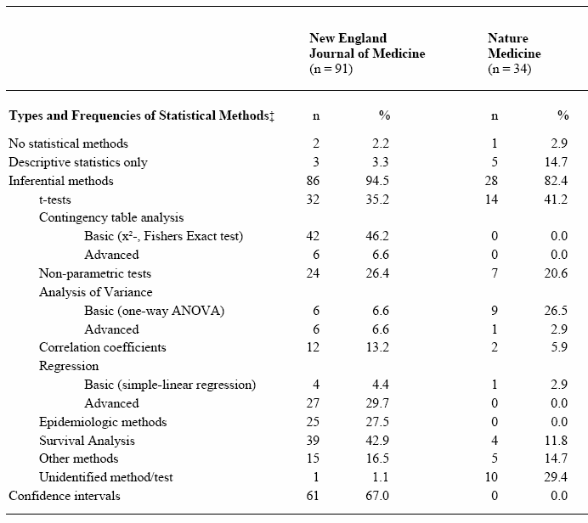
Statistical methods
Kategorien nach
Emerson/Colditz 1985

Slide 5
Design and analysis
Study planning
Resarch question, hypotheses, primary efficacy variable
Study design (interventional/observational, randomization, blinding, etc. )
Sample size estimation
Data management, etc.
Statistical analysis
Descriptive statistics
Univariable statistical testing
Parameter estimation with confidence intervals
Multivariable statistical testing using regression analyses

Slide 6

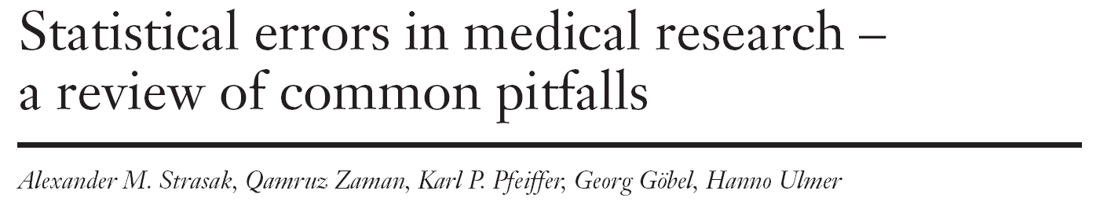
Statistical errors in medical research

Slide 7
Appendix (SMW-Artikel)

Slide 8
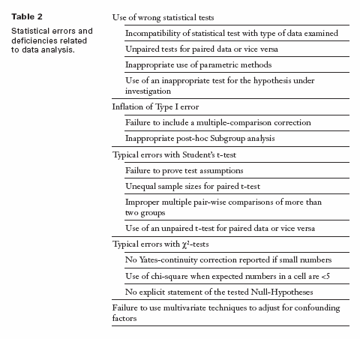

Slide 11
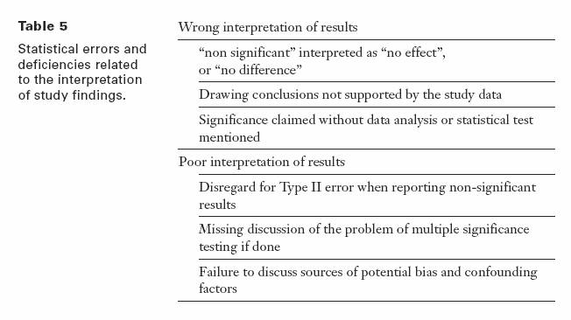

Slide 12
Internet sources, software
British Medical Journal Statistics at Square One
Deutsches Ärzteblatt Bewertung wissenschaftlicher Publikationen
Deutsche Medizinische Wochenschrift Statistik-Serie
Jumbo Münster
Graphpad Quickcalcs
R, Stata, SPSS, SAS, Statistica, GraphPad, MedCalc
nQuery Advisor, East, PASS, StudySize

Slide 13







Literaturhinweise
Grundlagenwissenschaft
Klinische Forschung
Epidemiologische Forschung

Slide 14
Formulating hypothesis & statistical tests
Steps in conducting a statistical test:
Quantify the scientific problem from a clinical / biological perspective
Formulate the model assumptions (distribution of the variable of interest)
Formulate the problem as a statistical testing problem:
Nullhypothesis versus alternative hypothesis
Define the „error“ you are willing to tolerate
Calculate the appropriate test statistic
Decide for the null hypothesis or against it
Formulating Hypothesis
&
Test statistics
&
p-values

Slide 15
Principles of statistical testing
Three primary measures of interest:
a point estimate,
a confidence interval, and
a p-value
Different approaches:
Test for superiority,
standard hypothesis testing
Test for non-inferiority
the difference between the new treatment and the standard is less than the smallest clinically meaningful difference, define delta, use confidence intervals
Test for equivalence
To demonstrate the difference between the new treatment and standard treatment has no clinical importance, define delta

Slide 16
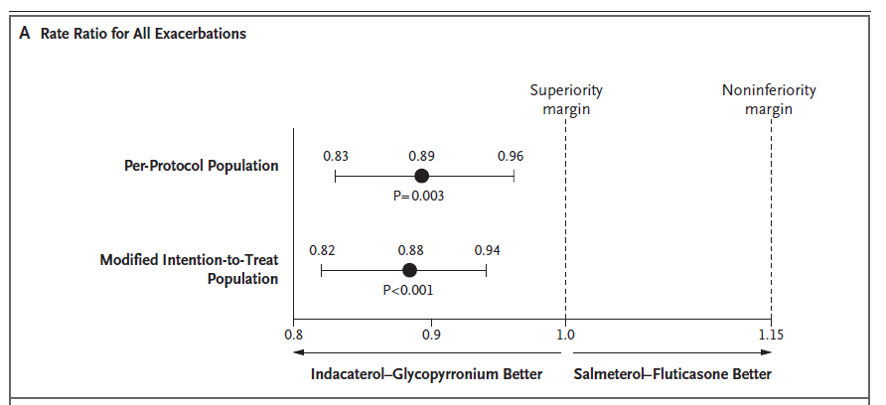
Example

Slide 17
Type I versus Type II Error
 |  | Decide for
 |  | H₀ | H₁
Reality | H₀ | Correct decision | Wrong decision: Type I error (α)
 | H₁ | Wrong decision: Type II error (β) | Correct decision: Power (1-β)

Slide 18
Common statistical tests
 | Quantitative outcome variable |  | Qualitative outcome variable
 | Normal distribution | Any other distribution | Expected frequency in each cell of the crosstable „high“ | Expected frequency in each cell of the crosstable „low“
Compare 2 groups | t-test | Wilcoxon-test / Mann-Whitney U-Test | Chi-Square | Fishers exact test
Compare >2 groups | Analysis of Variance (ANOVA) | Kruskal-Wallis-Test | Chi-Square
Testing measures of location:
Does the mean/median differ between groups
Testing frequencies in a crosstable:
Are the rows and columns independent from each other?

Slide 19
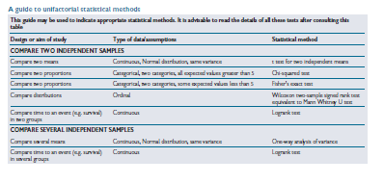
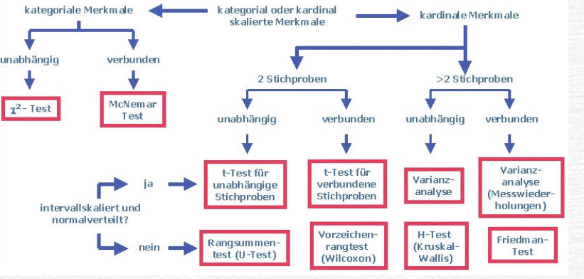
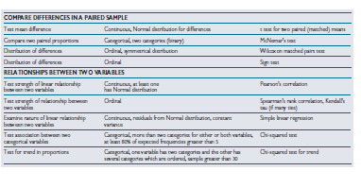
Univariate statistical testing

Slide 20
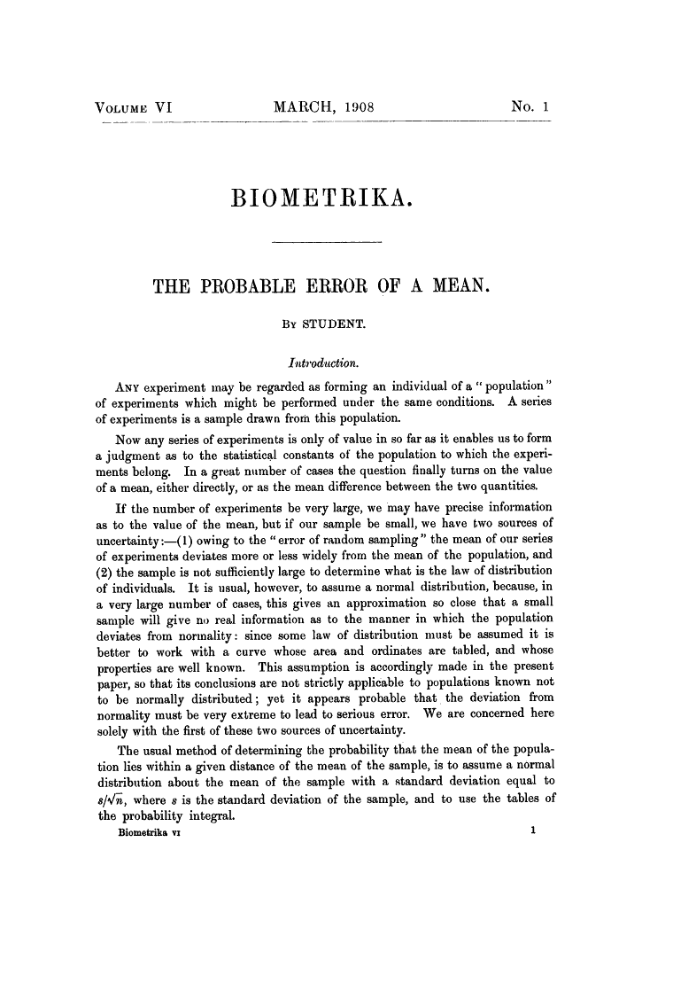
2008: 100 years Student`s t-test:
William Sealy Gosset

Slide 21
T-test
Dependent t-test
  Compares two means based on related data.
  E.g., Data from the same people measured at different times.
  Data from ‘matched’ samples.
Independent t-test
  Compares two means based on independent data
  E.g., data from different groups of people
Significance testing
  Testing the significance of Pearson’s correlation coefficient
  Testing the significance of b in regression.

Slide 22

Online statistical calculators
https://www.graphpad.com/quickcalcs/

Slide 23
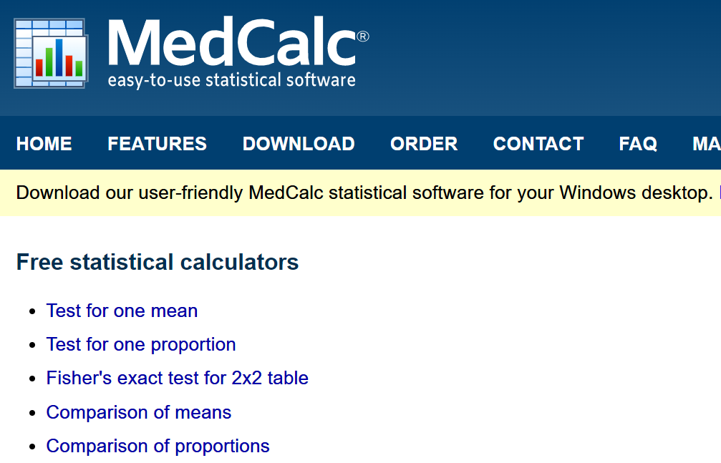
Online statistical calculators
https://www.medcalc.org/calc/

Slide 24



Pearson`s chi-Square test
1900
Correlation and regression
Analysis of Variance
Karl Pearson (1857-1936)
Sir Ronald Aylmer Fisher (1890-1962)

Slide 25
Analysis of Variance (ANOVA)
Situation: Compare the means of k samples (k>2)
Assumption: normal distribution of the population, σ = σ₁ = σ₂ =…= σ_{k}
Hypothesis: H₀: μ₁= μ₂ =… = μ_{k} versus H₁: μ_{i} ≠ μ_{j} (i ≠ j): At least two of the means differ
Nowadays, linear mixed effects models are preferred instead of ANOVA
Group 1
Group 2
Group 3
| | | | | | | | |
all observations x_{ij}
Variability
within the group
₁
₂
₃
= means within the groups
Difference /Variability
between the groups
= is the overall mean of the variable

Slide 26
Why Not Use Lots of t-Tests?
If we want to compare several means why don’t we compare pairs of means with t-tests?
  Can’t look at several independent variables.
  Inflates the Type I error rate.
1
1
2
Vs
1
3
Vs
2
3
2
Vs
3

Slide 27
The multiple testing problem
The situation:
Consider a dataset with 100 independent parameters, which do not play a role in the etiology of the disease of interest (what you don‘t know, of course)
→ 100 statistical tests are performed with a significance level of α=0.05
→ The tests are constructed in that way, that maximum 5 of 100 tests reject the Nullhypothesis, although it is true (which is the case in this example)
→ You expect 5 tests to be significant just by chance

Slide 28
Multiple testing
„The multiple comparison problem involves the repeated testing of a series of hypotheses and the resultant increasing probability of a type I error.” Van Belle (2002), p. 149.
P (type I error)
Bonferroni-correction

Slide 29
The multiple testing problem
The probability to get at least one Type I error increases with increasing number of tests.
Family-wise error rate (the error rate for the complete family of tests performed): α*=1-(1-α)^{k}, with α being the comparison-wise error rate
→ The significance level has to be modified for multiple testing situations
The probability
to get one or more
false discoveries
(Type I error)
k | α* (α=0.05)
1 | 0.05
5 | 0.226
10 | 0.401
100 | 0.994

Slide 30
The multiple testing problem
The Bonferroni correction method:
Control the comparison-wise error rate: Reject H₀, if p < α
Control the family-wise error rate (including k tests): Reject H₀, if p < α/k
→ Advantage: simple
Problem: Bonferroni-correction increases the probability of a type II error
→ the power of detecting a true association is reduced → Disadvantage:
too conservative
k | α/k (α=0.05)
1 | 0.05
5 | 0.01
10 | 0.005
100 | 0.0005
0.05/5=0.01

Slide 31
Survival analysis (time-to-event data)
Kaplan-Meier curves
KAPLAN, E. L. and MEIER, P. (1958). Nonparametric estimation from incomplete observations. J. Amer. Statist. Assoc. 53 457-481.
Log-rank test
Cox Proportional Hazards Model
Cox, D. R. (1972). Regression Models and Life Tables (with discussion). J. R. Statistic. Soc. 34: 187-220.

Slide 32
Sample size estimation
Question: How many individuals do you have to include in your study to get a reliable result ?
We want to maximize the probability
for rejecting H₀, if H₁ is true
while keeping the Type I error α fixed
What do you have to know
to calculate the sample size
needed?
Power (typically set to 80% or 90%)
Type I error α (typically set to α = 0.05)
The difference you want to find (for t-tests: the mean difference between groups)
standard deviation / measure of variance

Slide 33
Sample size estimation
Example
Hypothesis: H₀: μ_{A}= μ_{B} versus H₁: μ_{A} ≠ μ_{B} → two-sided t-test
You consider a difference of 10 as relevant
From former studies, you know, that the standard deviation is ~ 15 mmHG
So far, you have recruited 20 patients (10 in each treatment arm)
→ What is your power?
http://campus.uni-muenster.de/fileadmin/einrichtung/imib/lehre/skripte/biomathe/bio/fallz.html

Slide 34
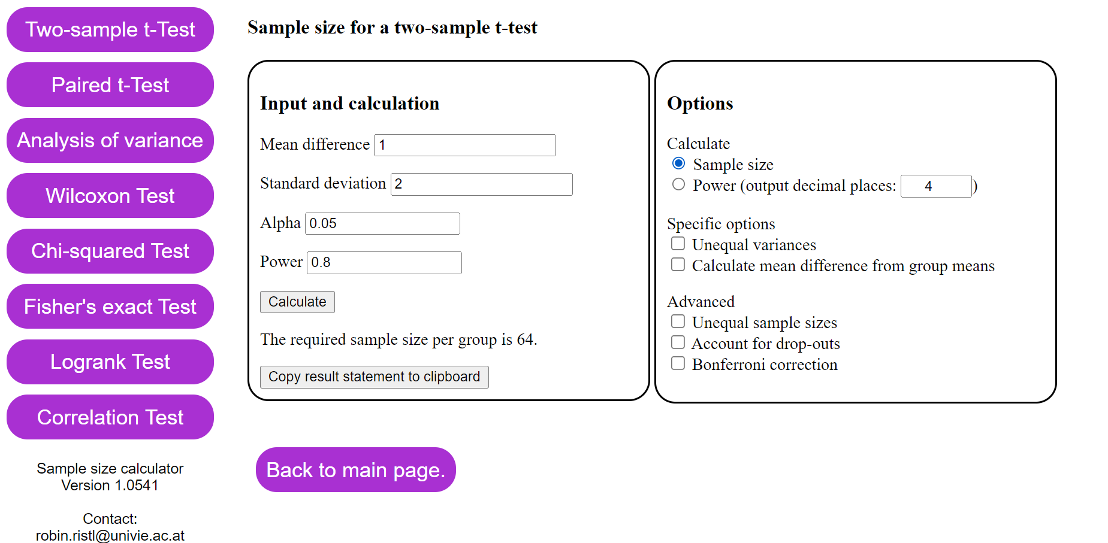
Sample size estimation
https://homepage.univie.ac.at/robin.ristl/samplesize.php

