Slide 1

Cancer Statistics 2013
A Presentation from the
American Cancer Society
©2013, American Cancer Society, Inc.

Slide 2
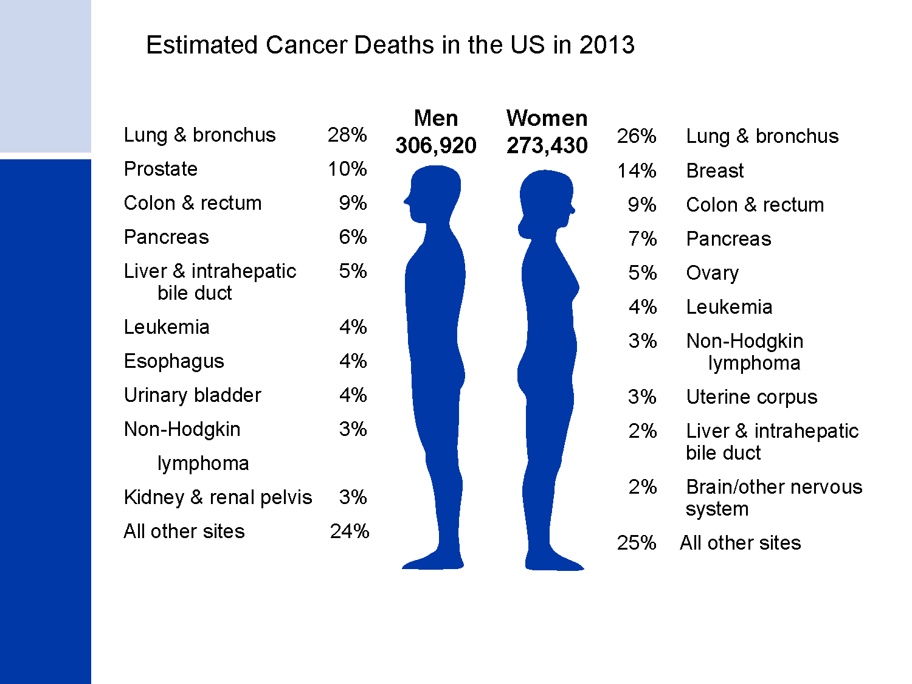
Estimated Cancer Deaths in the US in 2013
Notes:
Lung cancer is by far the most common cancer in men (28%), followed by prostate (10%), and colon & rectum (9%). In women, lung (26%), breast (14%), and colon & rectum (9%) are the leading sites of cancer death.

Slide 3
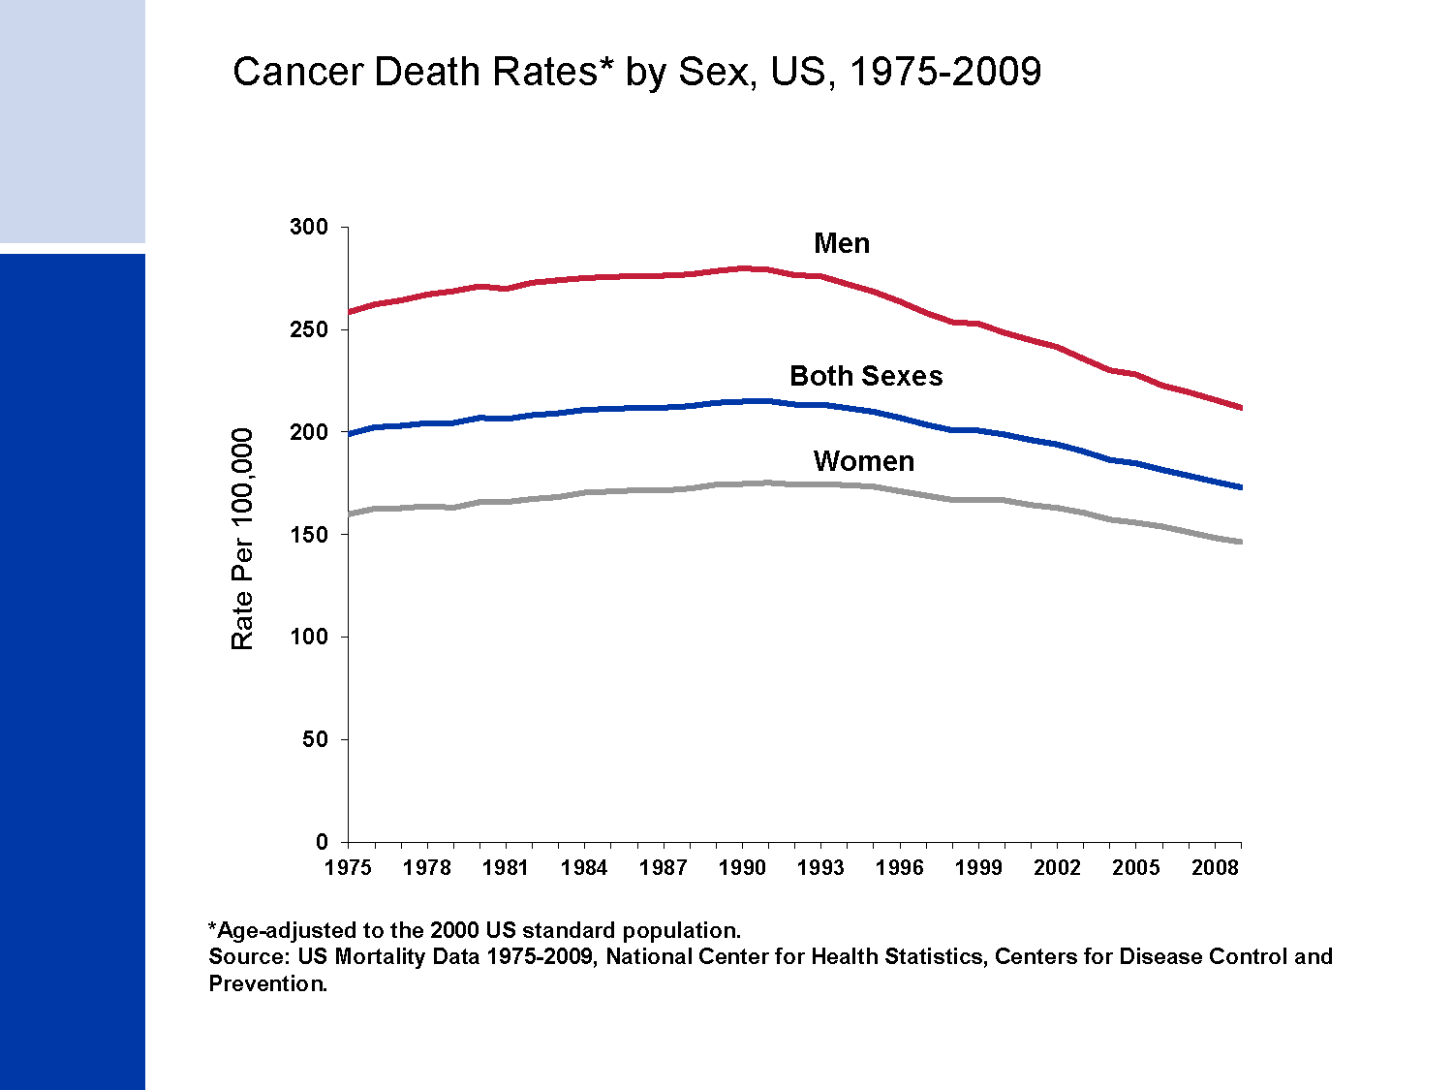
Cancer Death Rates* by Sex, US, 1975-2009
Notes:
From 2005 to 2009, the death rate for all cancers combined decreased by 1.8% per year in men and by 1.5% per year in women. Compared to the peak rates -- in 1990 for men and 1991 for women -- the cancer death rate for all sites combined in 2009 was 24% lower in men, 16% lower in women, and 20% lower overall.

Slide 4
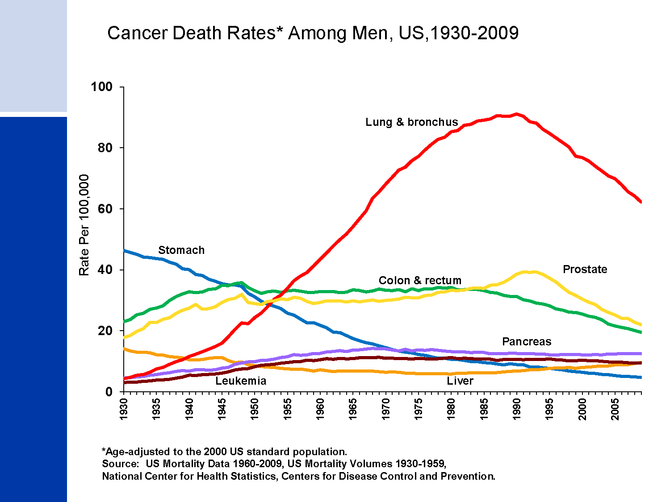
Cancer Death Rates* Among Men, US,1930-2009
Notes:
Most of the increase in overall cancer death rates for men prior to 1990 was attributable to the rapid increase in lung cancer deaths due to the tobacco epidemic. However, since 1990, the lung cancer death rate in men has been decreasing; this decline has accounted for nearly 40% of the overall decrease in cancer death rates in men. The death rate for stomach cancer, which was the leading cause of cancer death among men early in the 20th century, has decreased by 90% since 1930. Death rates for prostate and colorectal cancers have been declining since the early 1990s and 1980s, respectively.

Slide 5
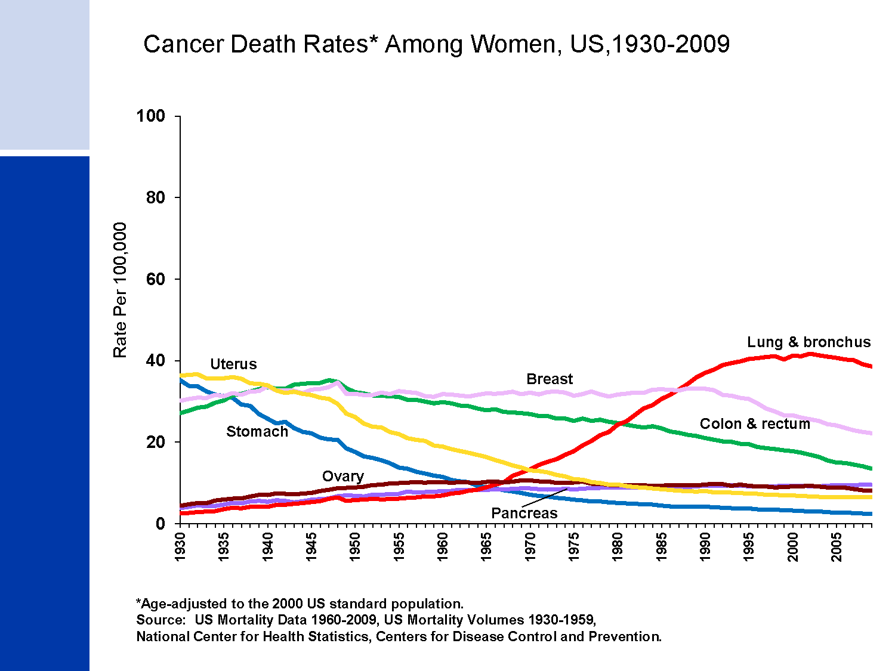
Cancer Death Rates* Among Women, US,1930-2009
Notes:
The lung cancer death rate in women began declining in the early 2000s after increasing for the previous 70 years. The lag in the decline in lung cancer in women compared to men reflects differences in smoking patterns; smoking rates peaked about two decades later in women than in men and women lagged behind men in quitting smoking in large numbers. In comparison, breast cancer death rates changed little between 1930 and 1990, but decreased 33% between the peak year (1989) and 2009. Since 1930, the death rate for stomach cancer has decreased by more than 90%. The death rate for uterine cancer, which was the leading cause of cancer death in the early 20th century, declined from 1930 to 1997, but has since been fairly stable. Colorectal cancer death rates have been decreasing for more than 50 years.

Slide 6
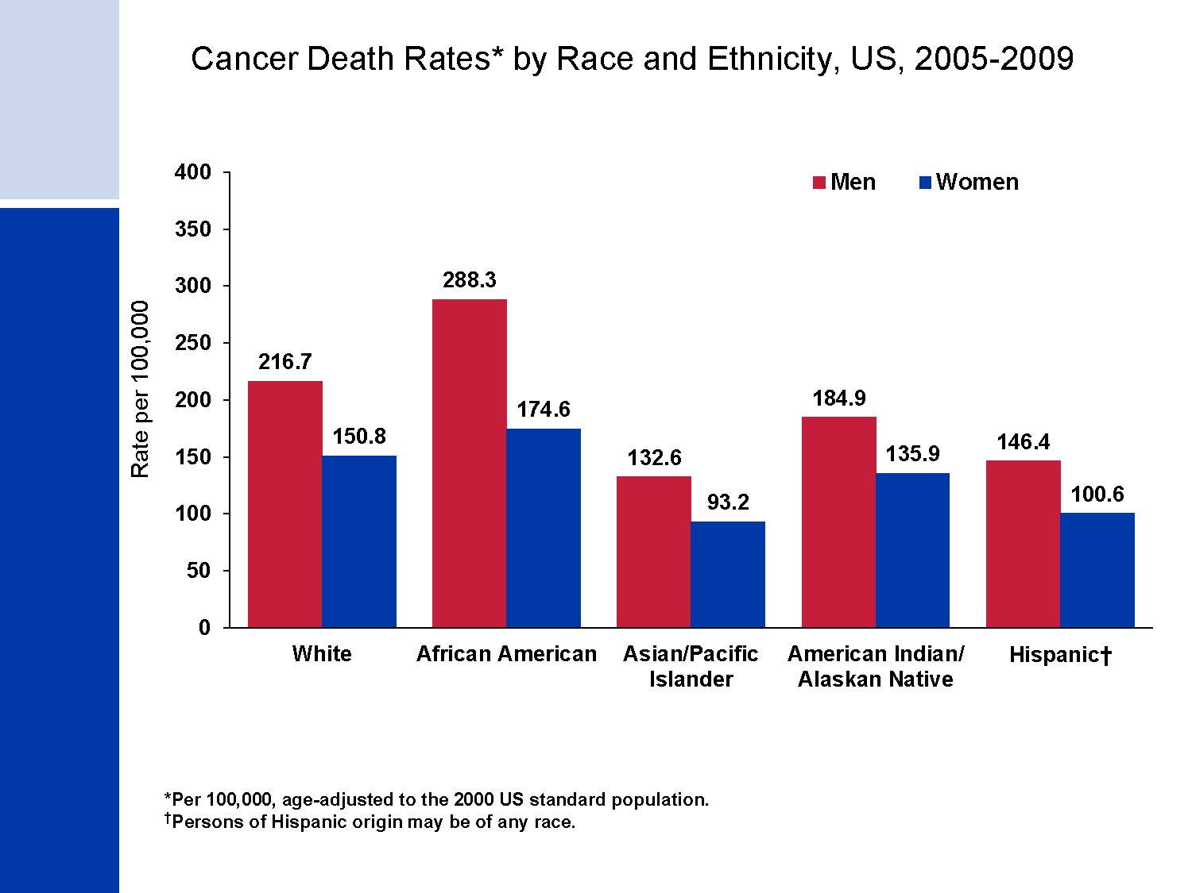
Cancer Death Rates* by Race and Ethnicity, US, 2005-2009
Notes:
Cancer death rates are higher in men than in women for every racial and ethnic group. African American men and women have higher rates of cancer mortality than their counterparts in every other racial and ethnic group. Asian American and Pacific Islander men and women have the lowest cancer death rates, about half the rate of African American men and women, respectively.
Note: Rates for populations other than white and African American may be affected by problems in ascertaining race/ethnicity from medical records, which likely results in underreported cancer death rates.

Slide 7
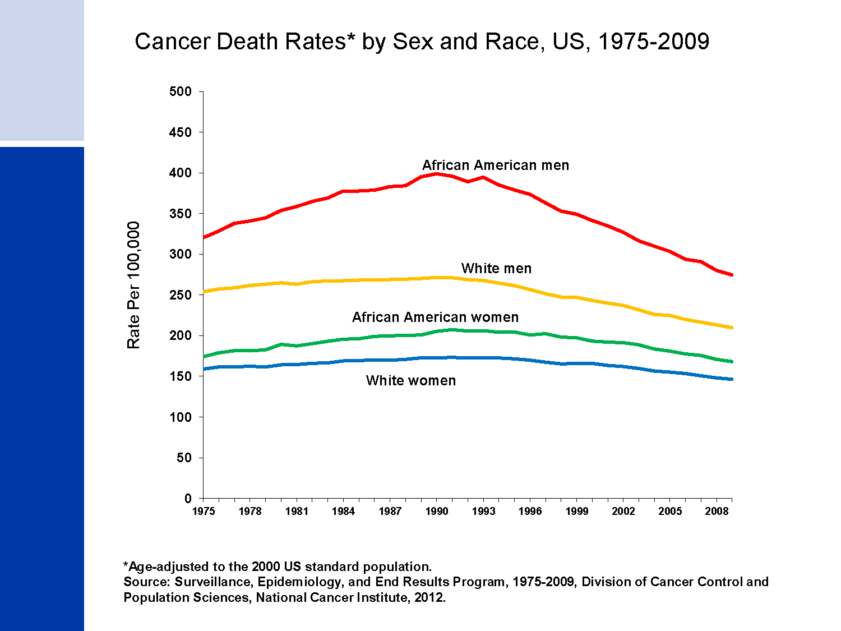
Cancer Death Rates* by Sex and Race, US, 1975-2009
Notes:
Although the overall cancer death rate continues to be higher in African American men than white men, from 2000 to 2009, the decline in death rates was larger for African American men (2.4% per year versus 1.7% per year).

Slide 8
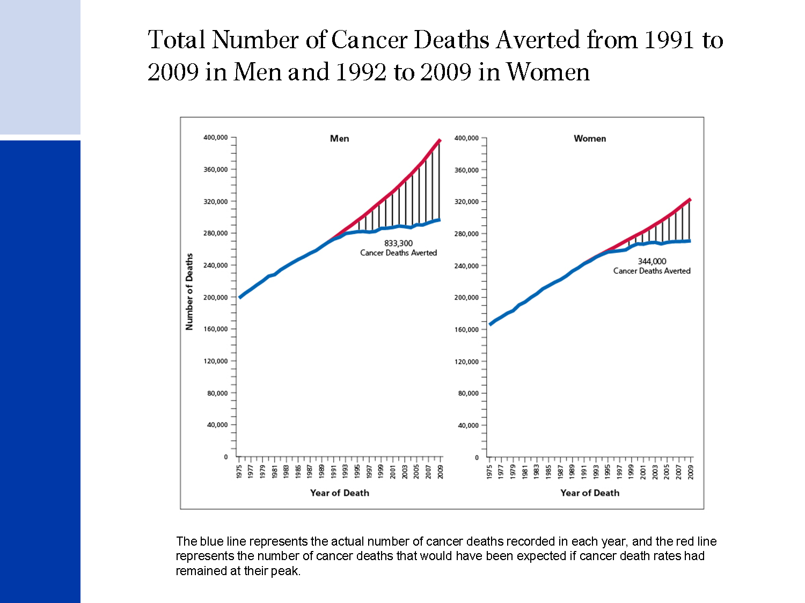
Total Number of Cancer Deaths Averted from 1991 to 2009 in Men and 1992 to 2009 in Women
Notes:
Almost 1.2 million cancer deaths were averted as a result of almost two decades of consistent declines in cancer deaths rates.

Slide 9
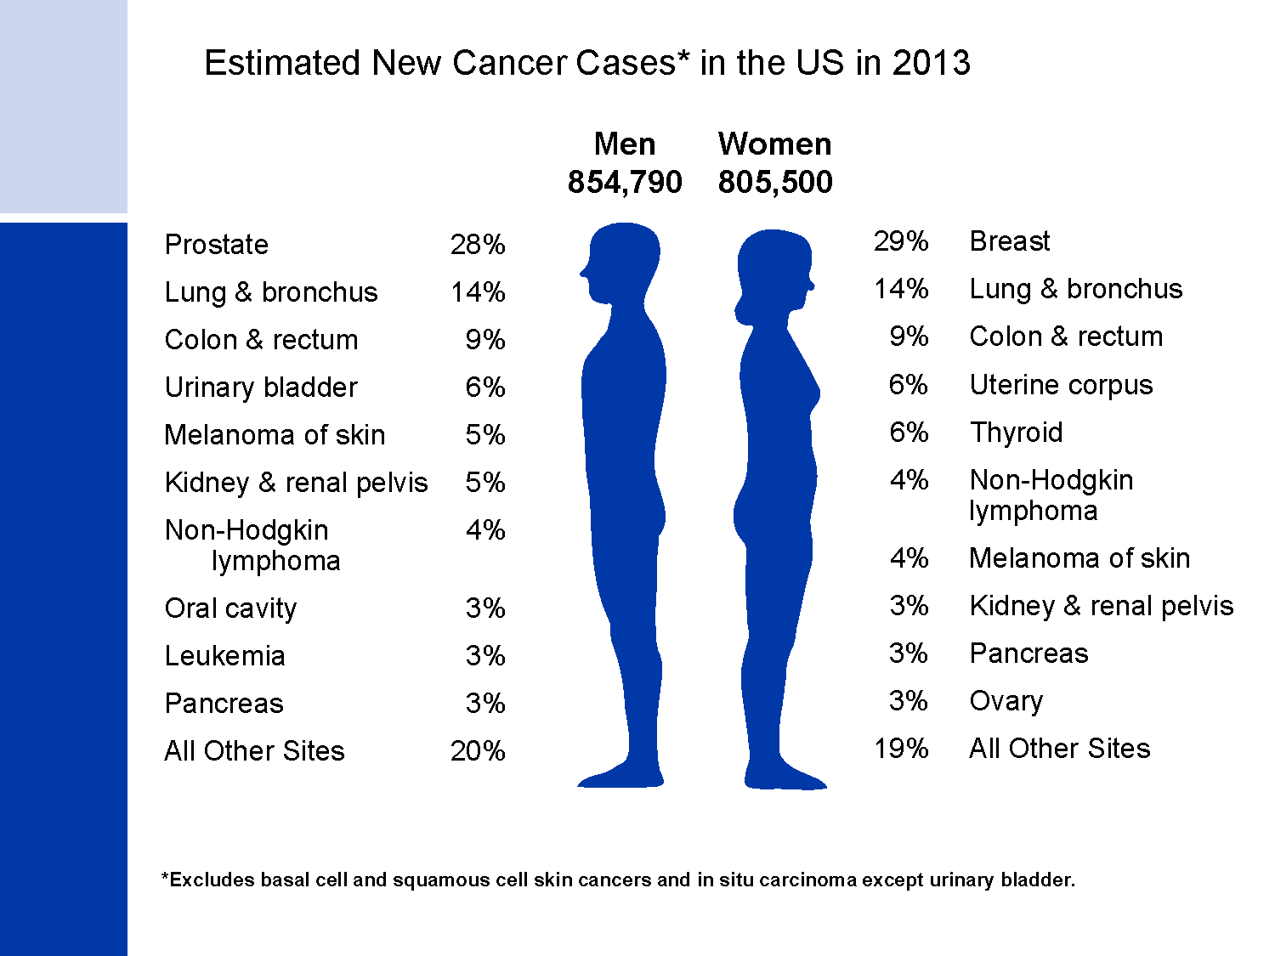
Estimated New Cancer Cases* in the US in 2013
Notes:
Now we will turn our attention to the number of new cancers projected for the US this year. It is estimated that more than 1.6 million new cases of cancer will be diagnosed in 2013. The most common cancers are prostate in men and breast in women; lung and colorectal cancers are the second and third most common cancers in both men and in women.

Slide 10
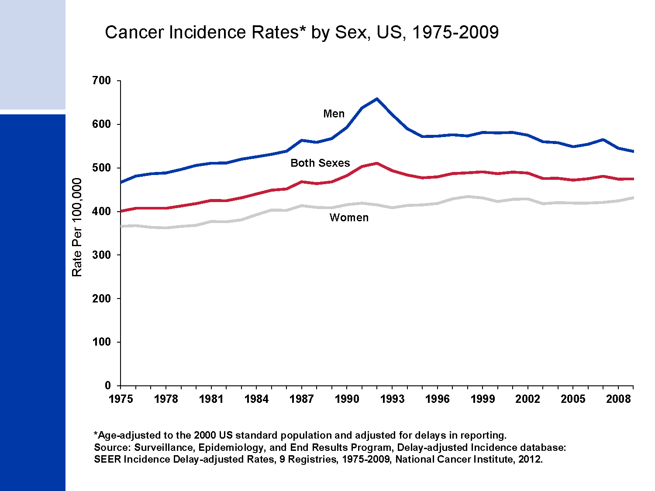
Cancer Incidence Rates* by Sex, US, 1975-2009
Notes:
This slide shows trends in cancer incidence rates for all sites combined from 1975 to 2009. Over the most recent ten years of available data – 2000 to 2009 – on average, overall incidence rates in the SEER 9 areas decreased slightly in men (by 0.8% per year) and were stable in women. SEER 9 represents approximately 10% of the US population and is the only source for long-term (since 1975) population-based incidence data.

Slide 11
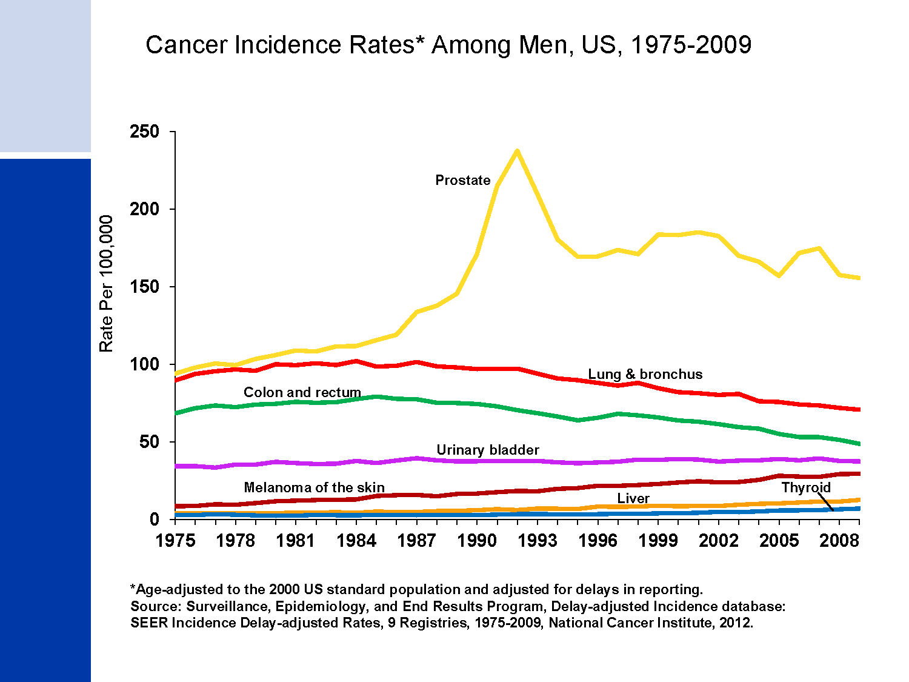
Cancer Incidence Rates* Among Men, US, 1975-2009
Notes:
Incidence rates of prostate cancer have changed substantially over the past 20 years: rapidly increasing from 1988 to 1992, declining sharply from 1992 to 1995, remaining stable from 1995 to 2000, and decreasing (on average) from 2000 to 2009. This erratic trend primarily reflects changing patterns in the utilization of prostate-specific antigen (PSA) blood testing for the detection of prostate cancer. Incidence rates for both lung and colorectal cancers in men have been declining for many decades, while rates for liver and thyroid cancers and melanoma are increasing.

Slide 12
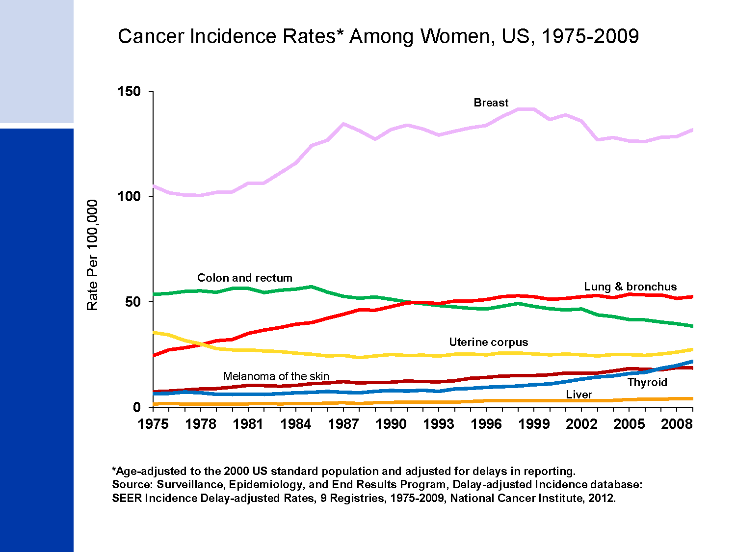
Cancer Incidence Rates* Among Women, US, 1975-2009
Notes:
Breast cancer incidence rates in women have been relatively stable since dramatically decreasing from 2002 to 2003, attributed primarily to a reduction in use of hormone replacement therapy. Lung cancer rates have begun to level off after increasing steadily since at least 1975. Colorectal cancer incidence rates have been decreasing rapidly, by 2.1% per year since 1998.

Slide 13
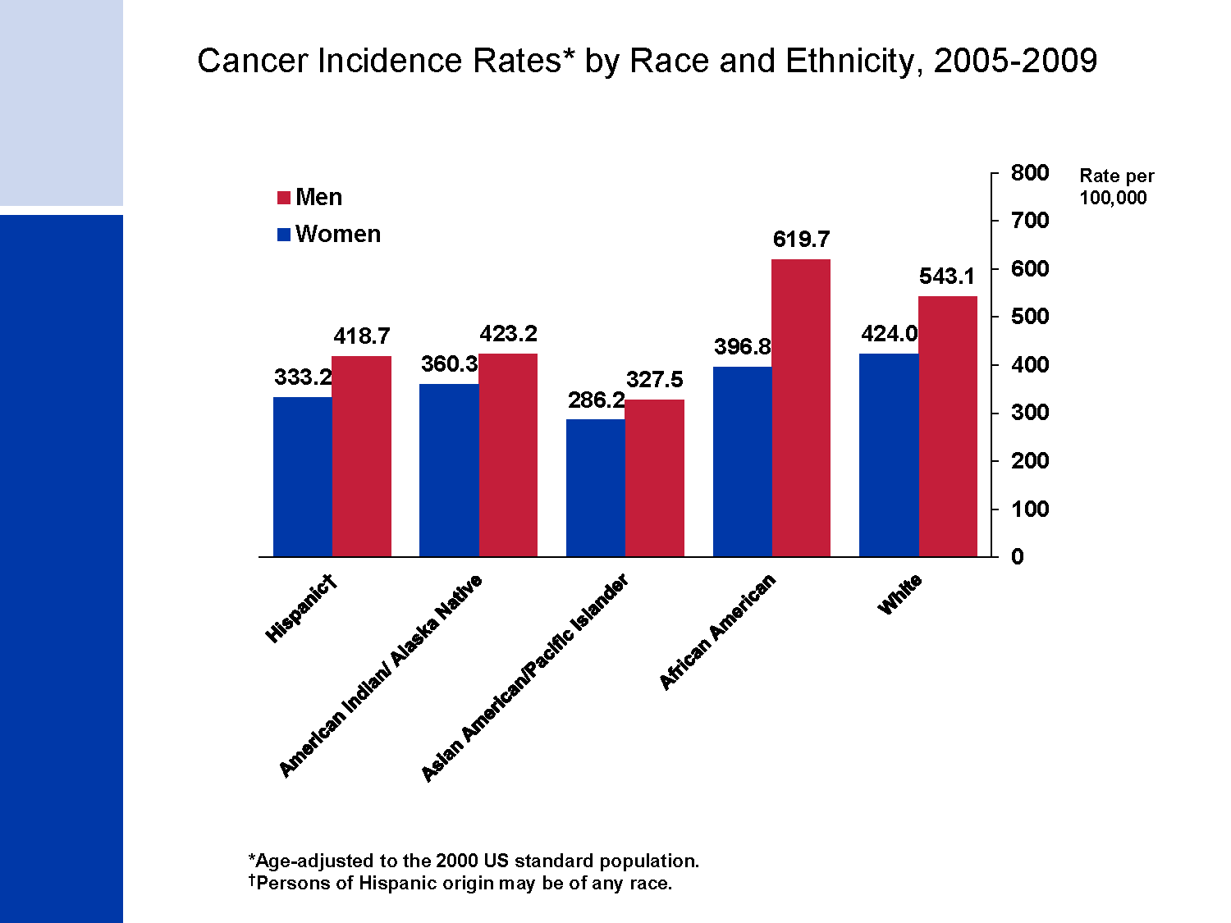
Cancer Incidence Rates* by Race and Ethnicity, 2005-2009
Notes:
Cancer incidence rates are higher in men than women in each racial/ethnic population. Among men, African Americans have the highest incidence followed by whites, American Indians/Alaska Natives, Hispanics, and Asian Americans/Pacific Islanders. Among women, whites have the highest rates, followed by African Americans, American Indians/Alaska Natives, Hispanics, and Asian American/Pacific Islanders.
Important Note: Rates for populations other than white and African American may be affected by problems in ascertaining race/ethnicity information from medical records. This is likely to result in reported rates that are lower than true incidence rates. Data for American Indians/Alaska Natives is based on Contract Health Service Delivery Areas.

Slide 14
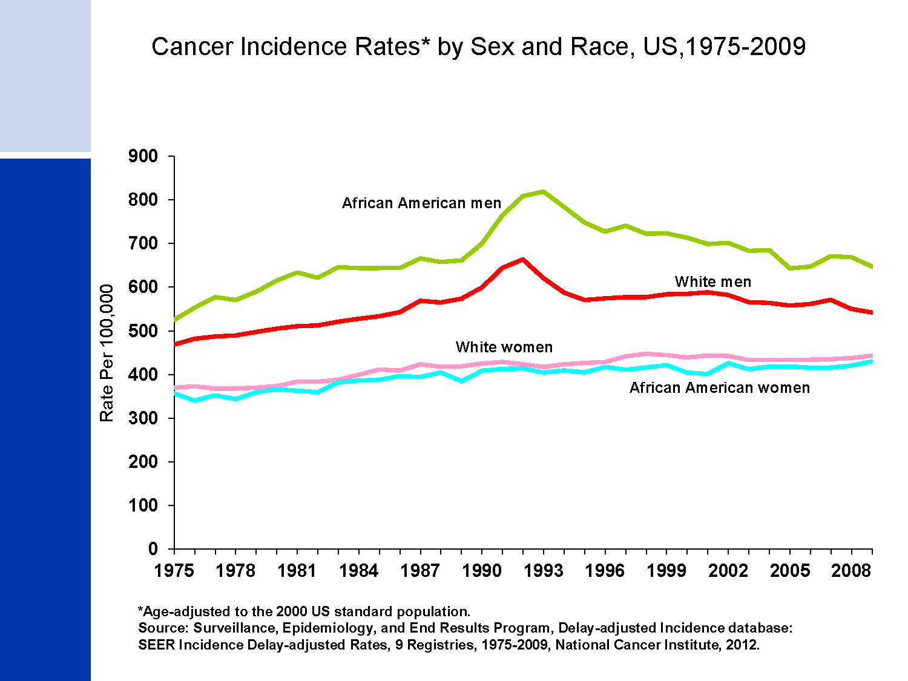
Cancer Incidence Rates* by Sex and Race, US,1975-2009
Notes:
Cancer incidence rates are consistently higher in African American men than white men. In contrast, overall cancer incidence rates are higher for white than for African American women, largely driven by higher rates of melanoma of the skin and thyroid cancers among whites.

Slide 15
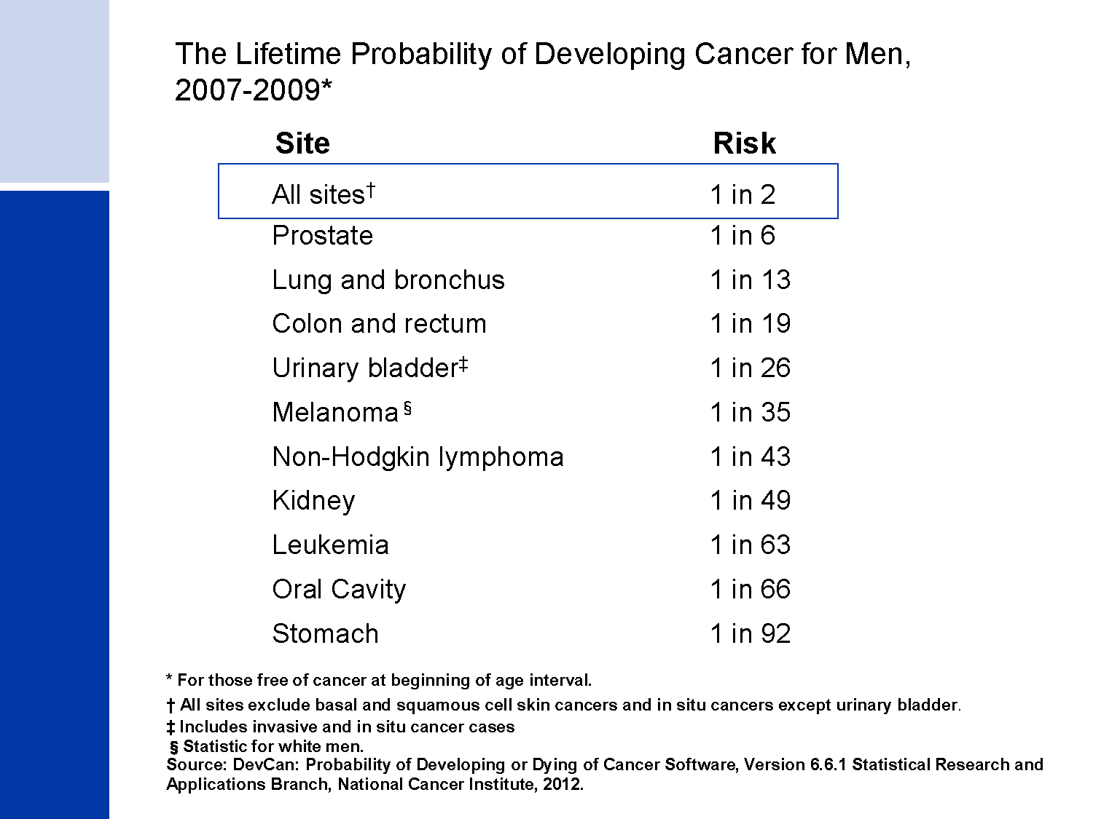
The Lifetime Probability of Developing Cancer for Men,
2007-2009*
Notes:
The next four slides look at the lifetime probability of developing cancer and relative survival rates of cancer.
Presently, the risk of an American man developing cancer over his lifetime is a little less than one in two.

Slide 16
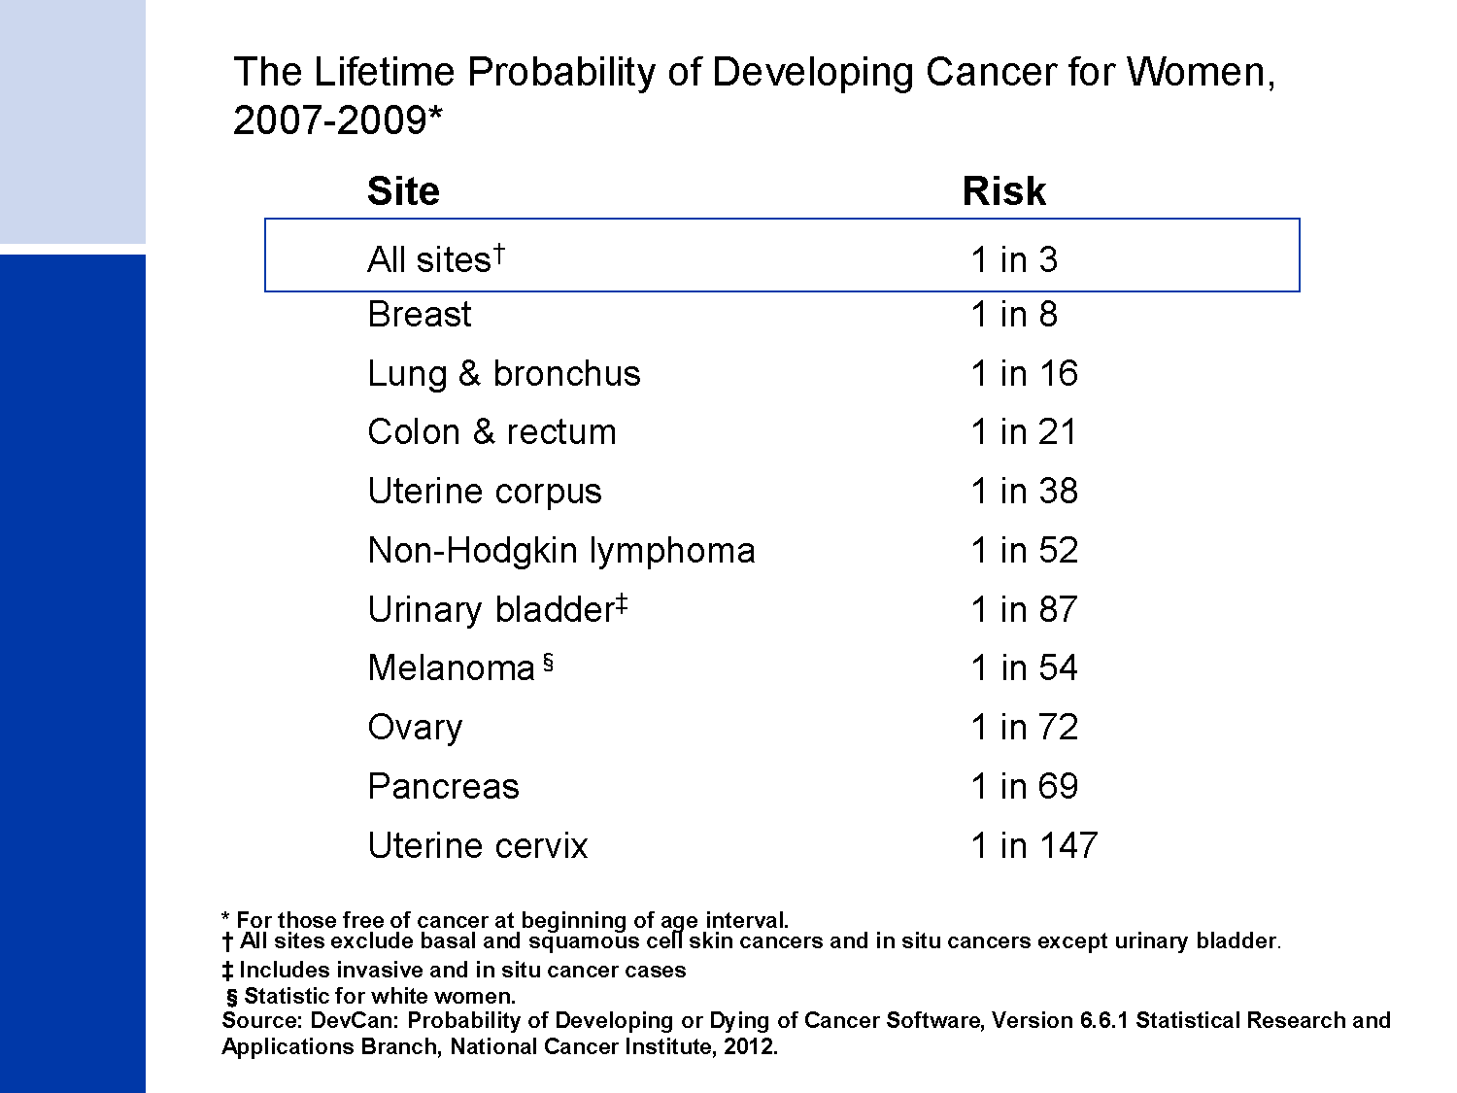
The Lifetime Probability of Developing Cancer for Women,
2007-2009*
Notes:
The risk of an American woman developing cancer over her lifetime is a little more than one in three.

Slide 17
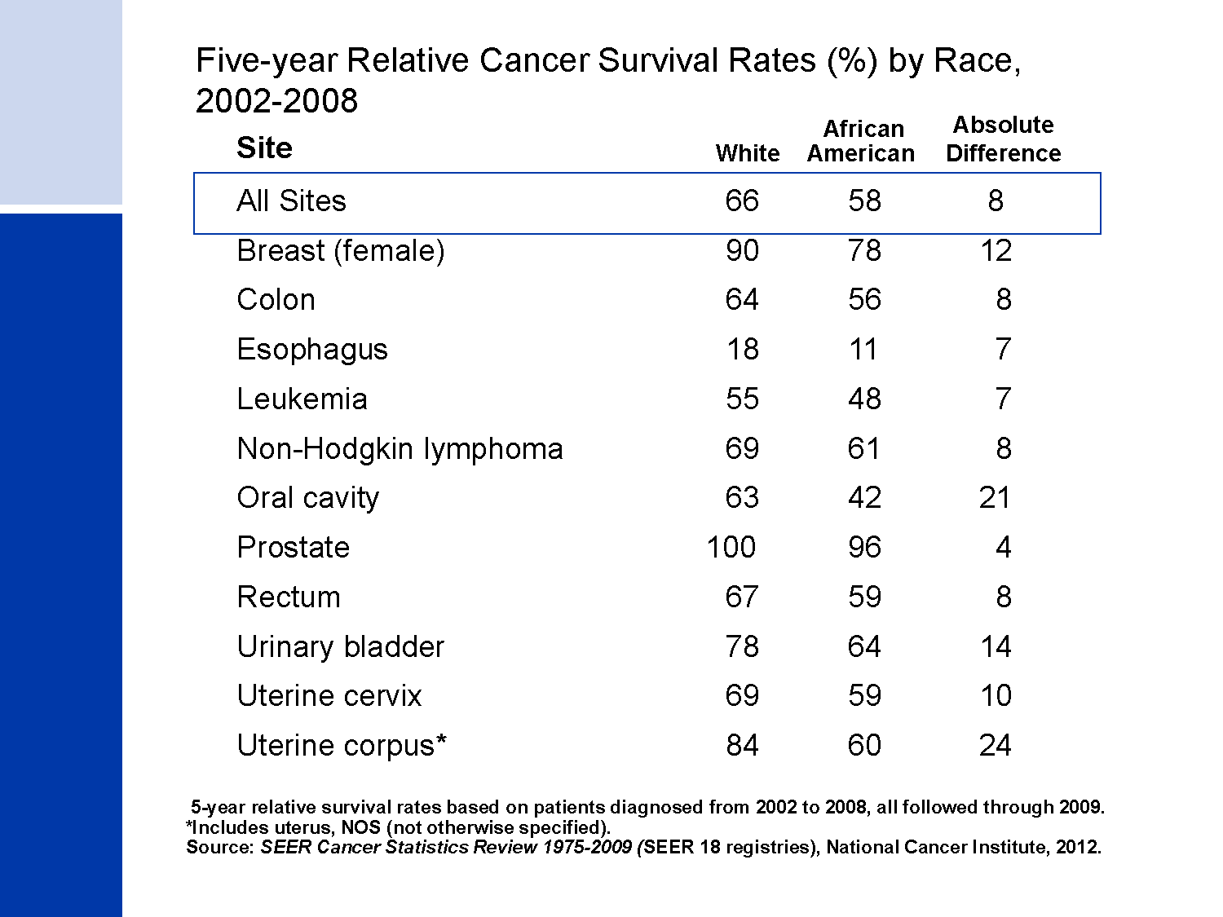
Five-year Relative Cancer Survival Rates (%) by Race, 2002-2008
Notes:
The 5-year relative survival rate for cancer is 66% among whites and 58% among African Americans (taking normal life expectancy into consideration) in the 18 SEER areas (covering approximately 28% of the US population). Survival rates for African Americans are 10% to 24% lower than for whites for 5 of the 11 cancer sites shown in this slide. This is due, in part, to African Americans being less likely to receive a cancer diagnosis at an early, localized stage, when treatment is more successful. Additional factors that contribute to survival differences include unequal access to medical care, differences in tumor characteristics not related to early detection, and differences in the prevalence of comorbidities (other health conditions).

Slide 18
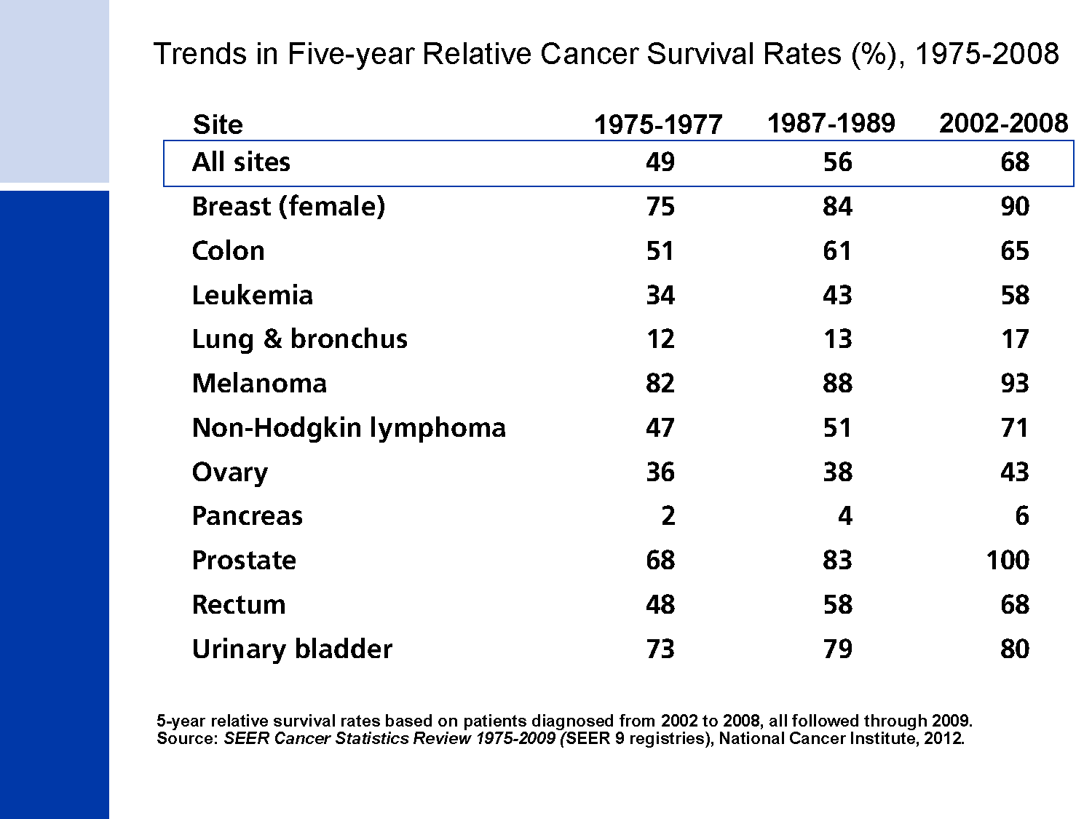
Trends in Five-year Relative Cancer Survival Rates (%), 1975-2008
Notes:
In the SEER 9 areas (covering approximately 10% of the US population), survival rates for most cancers (all of those presented on this slide) have improved significantly since the 1970s, due largely to earlier detection and/or advances in treatment. Survival rates have markedly increased for cancers of the prostate, breast, colon, and rectum, and for leukemia. Progress has been slower for cancers of the pancreas and lung and bronchus.

Slide 19
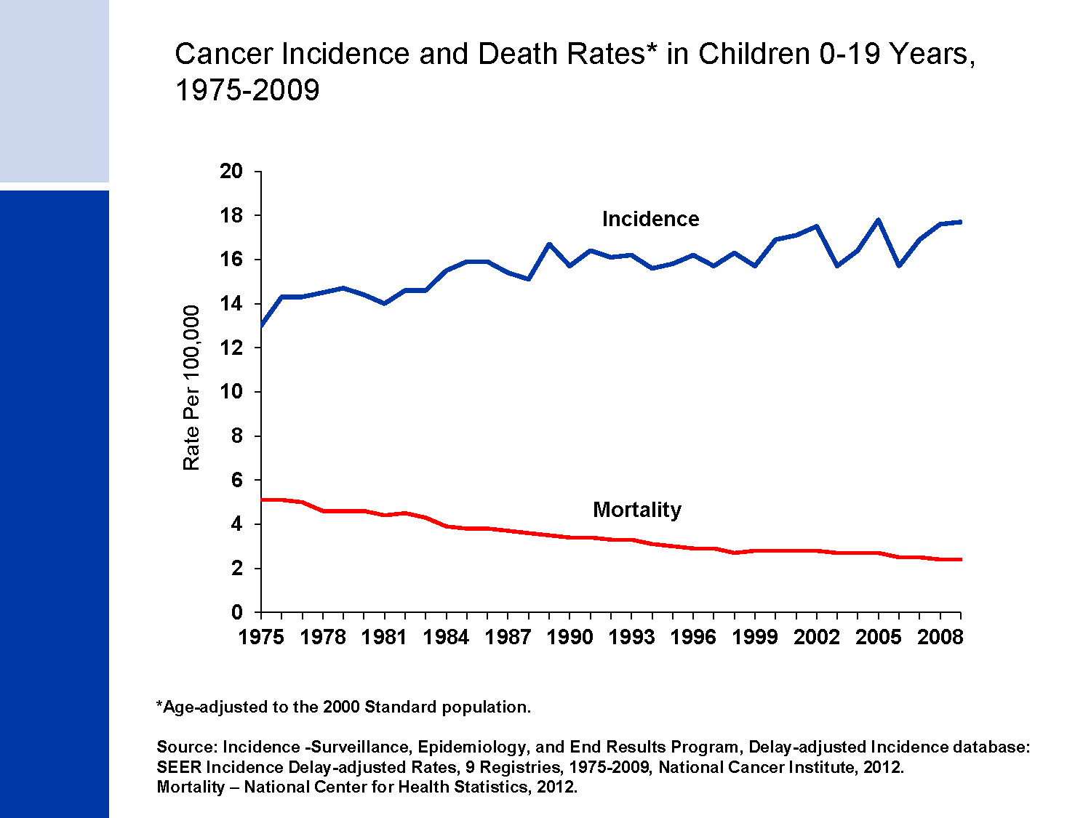
Cancer Incidence and Death Rates* in Children 0-19 Years,
1975-2009
Notes:
The next series of slides present the burden of cancer among our nation's children. Since 1975, cancer incidence rates among children have been increasing slightly (by about 0.6% per year), while cancer death rates have decreased by more than half (from 5.1 to 2.4 per 100,000 children younger than 20 years).

Slide 20
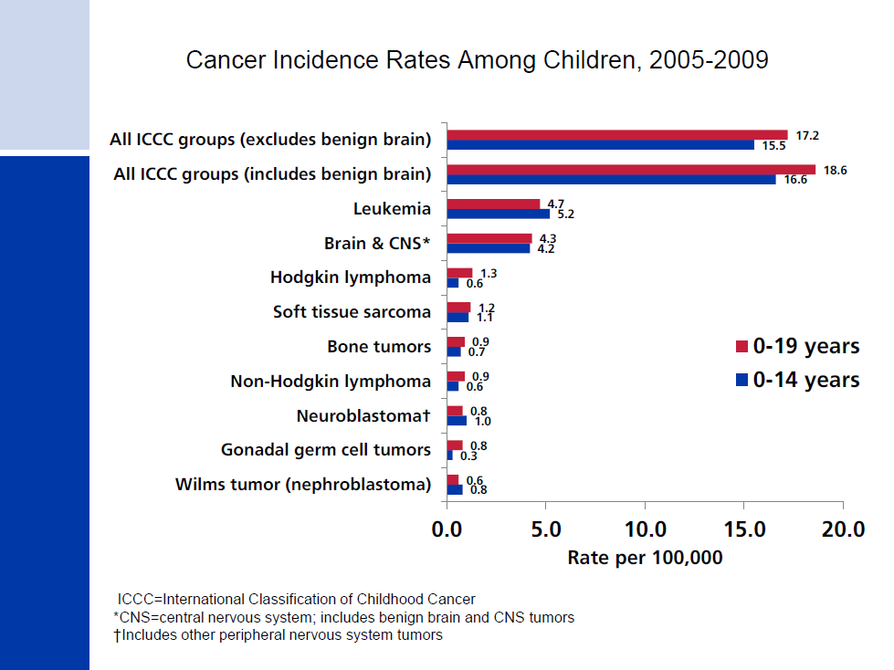
Cancer Incidence Rates Among Children, 2005-2009
Notes:
Childhood cancers are best categorized based on a combination of the histology (microscopic structure) and site of the tumor rather than the primary site alone, as adult tumors are classified. For this reason, the cancers presented in this slide are grouped according to the International Classification of Childhood Cancers. Leukemia accounts for about one-quarter of all cancers diagnosed in those younger than 20 years, but about one-third among kids diagnosed before age 15.
Cancer registries were mandated by law to begin reporting benign and borderline malignant brain and central nervous system tumors on January 1, 2004. Reporting was expanded for these cancers because benign tumors cause disruption to normal function similar to malignant tumors and because the location of a brain tumor is as important as whether it is benign or malignant in terms of prognosis. One-third of all brain tumors diagnosed in children and adolescents from 2005 to 2009 were benign or borderline malignant.

Slide 21
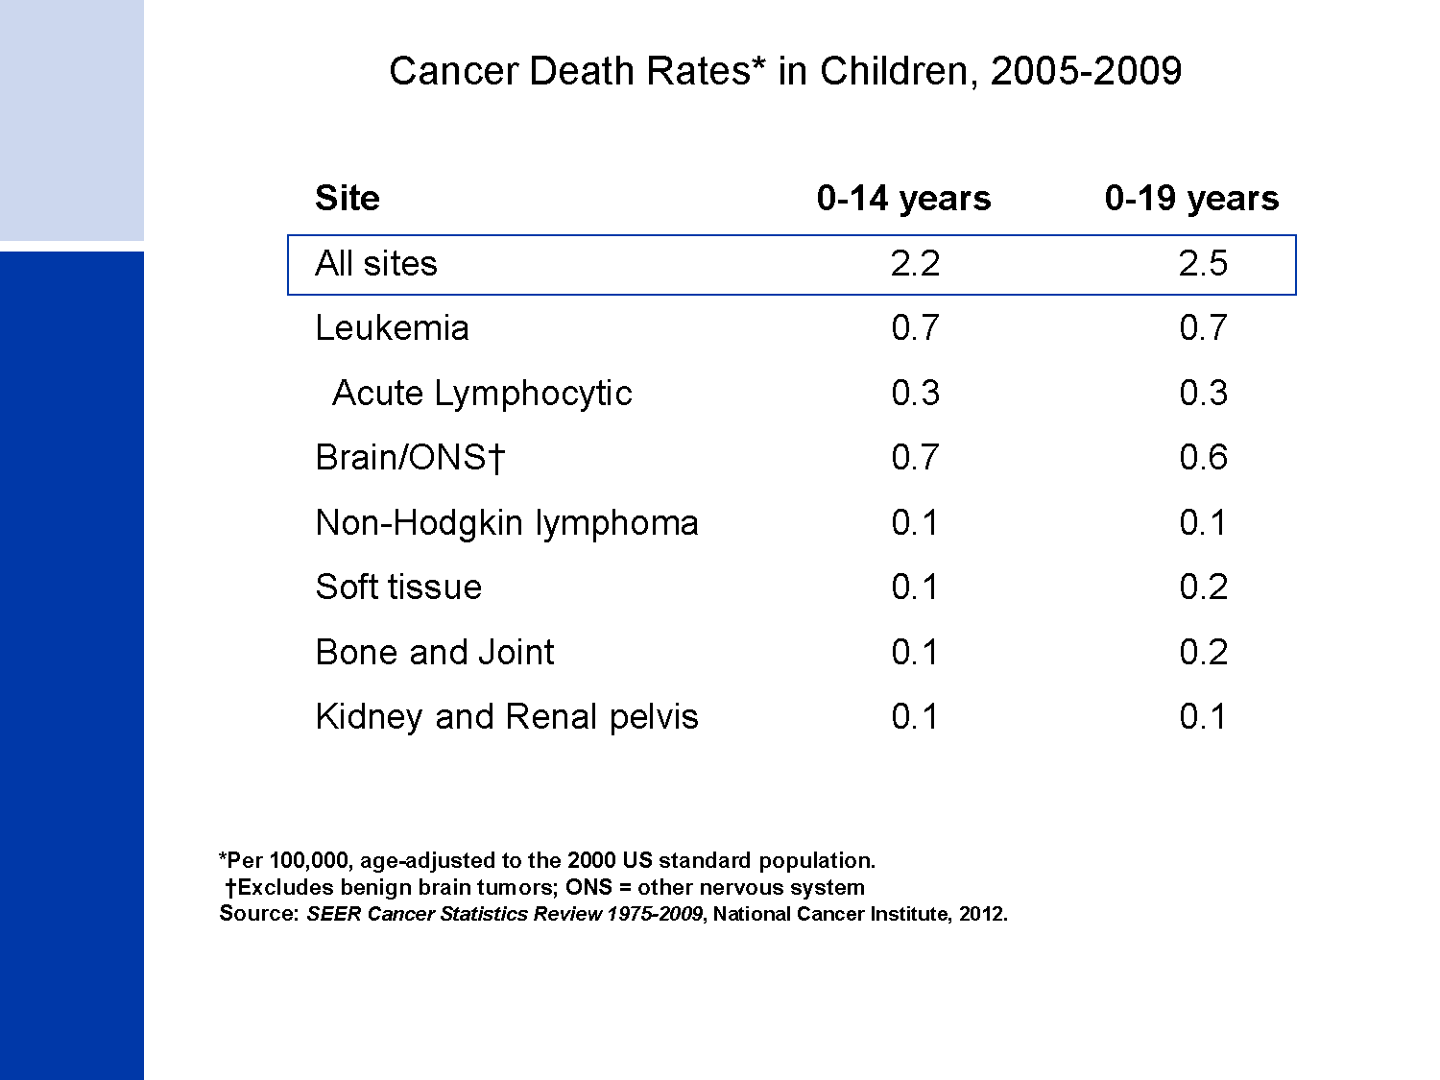
Cancer Death Rates* in Children, 2005-2009
Notes:
Leukemia also accounts for the most cancer deaths in children, comprising almost one-third of cancer deaths among boys and girls 0-14 years. Cancers of the brain and other nervous system are the second leading cause of cancer death in children.

Slide 22
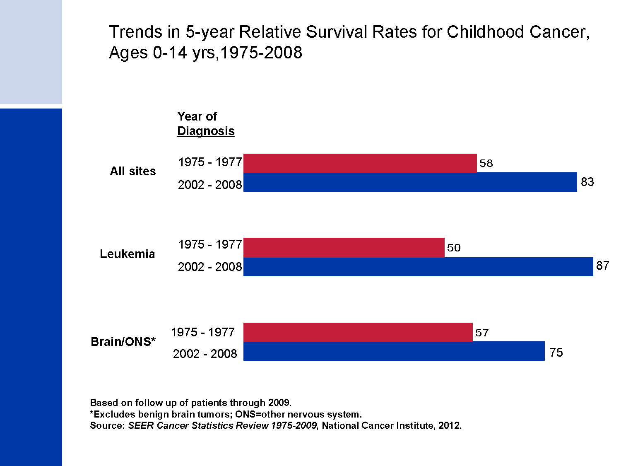
Trends in 5-year Relative Survival Rates for Childhood Cancer,
Ages 0-14 yrs,1975-2008
Notes:
The 5-year relative survival rate for childhood cancer has increased significantly during the past 3 decades. For example, the 5-year survival for childhood leukemia patients has improved from 50% for those diagnosed in the mid 1970s to 87% in the most recent time period.

Slide 23
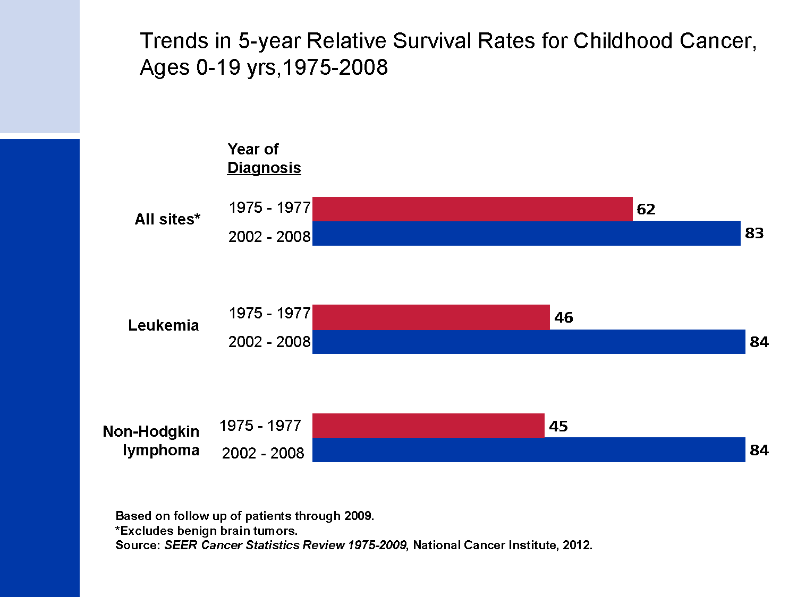
Trends in 5-year Relative Survival Rates for Childhood Cancer,
Ages 0-19 yrs,1975-2008
Notes:
The 5-year relative survival rate for leukemia among children and adolescents 0-19 years has increased significantly during the past 3 decades, largely driven by the survival improvement for acute lymphocytic leukemia, which increased from 54% to 89%. The 5-year survival for Non-Hodgkin lymphoma also increased dramatically, from 45% in the mid 1970s to 84% during 2002-2008. These increases in survival are largely due to improvements in treatment over time.

Slide 24
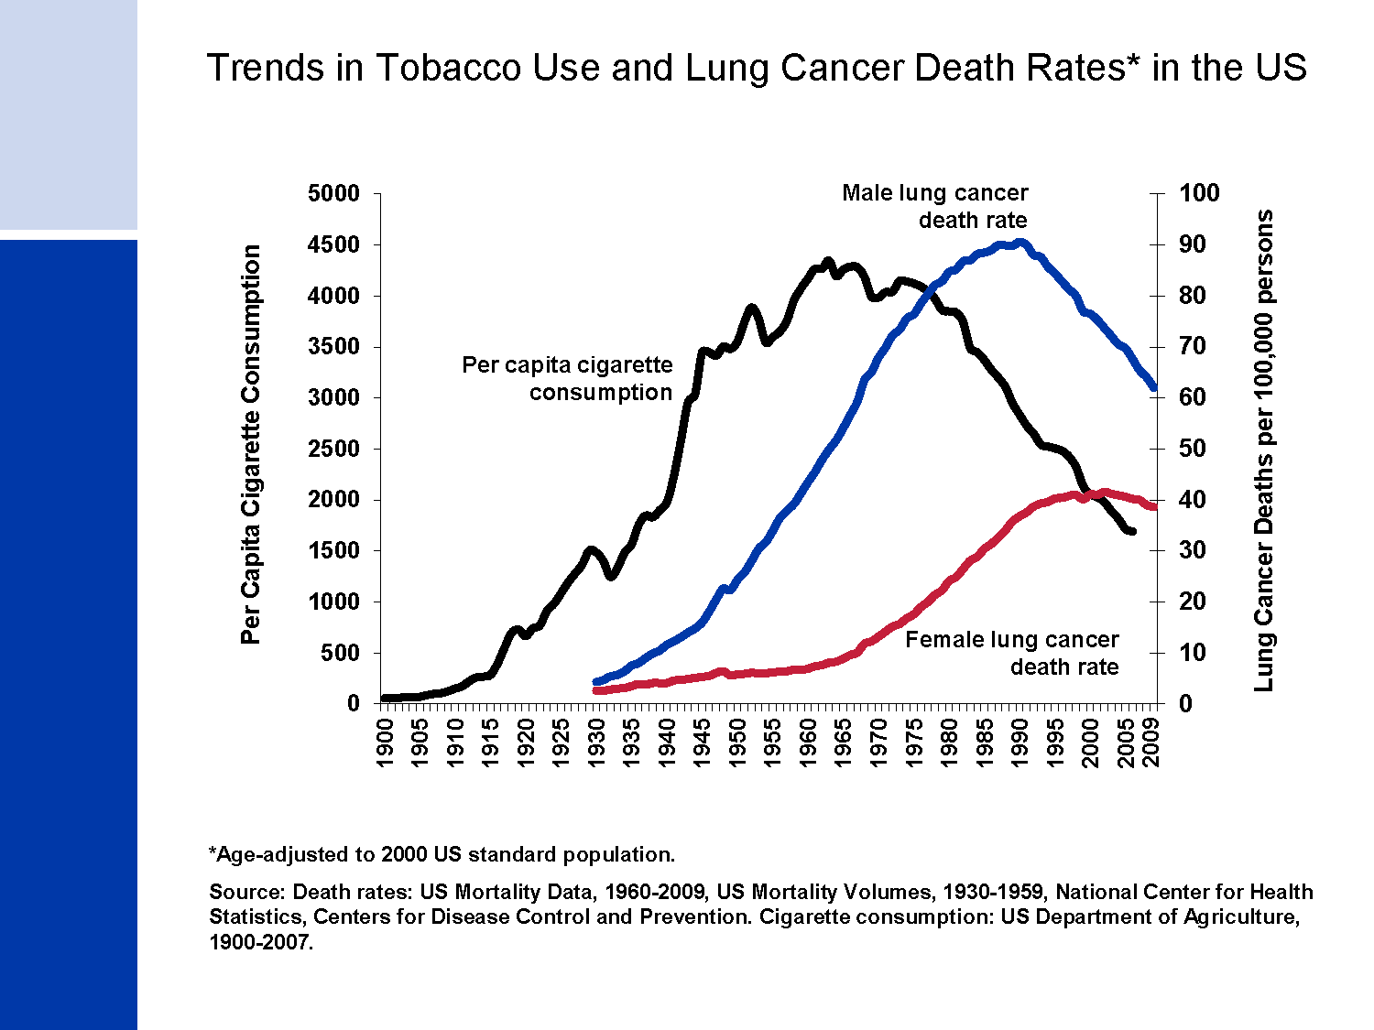
Trends in Tobacco Use and Lung Cancer Death Rates* in the US
Notes:
Tobacco use is a major preventable cause of death, particularly from lung cancer. The release of the first Surgeon General’s report on Tobacco and Health in 1964 initiated a decline in per capita cigarette consumption in the United States. However, lung cancer death rates in men did not begin to decrease until 1990 because of the 40 to 50 year average delay from exposure to cancer occurrence. The lung cancer death rate among US women, who both began smoking and quit smoking in large numbers later than men, began to decrease in the early 2000s after increasing for many decades.

Slide 25
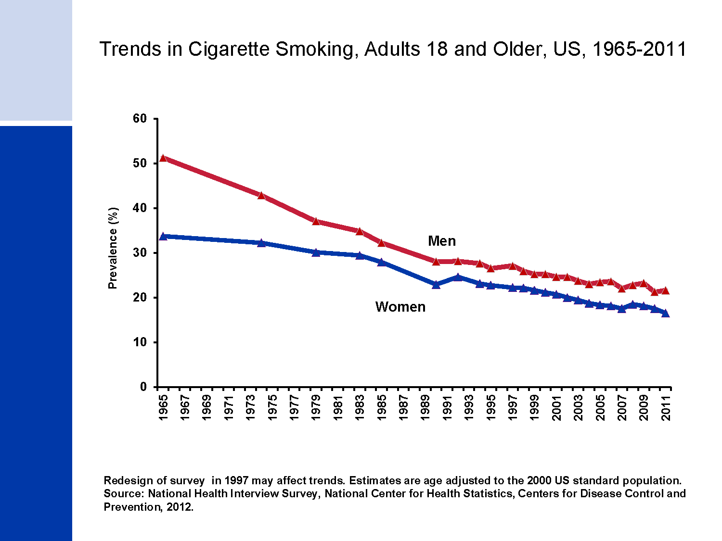
Trends in Cigarette Smoking, Adults 18 and Older, US, 1965-2011
Notes:
The difference in cigarette smoking across gender narrowed from 1965 to 1985 as a result of both higher rates of quitting among male smokers following the Surgeon General’s Report and targeted advertisement of cigarettes to women. Since 1985, smoking prevalence has continued to decline in both men and women, though these declines have slowed in recent years. Between 2005 and 2011, heavy smoking declined significantly while light smoking (<10 cigarettes/day) increased, reflecting long-term historical trends towards lower cigarette consumption among smokers. In 2011, smoking prevalence was 22% among men and 17% among women.

Slide 26
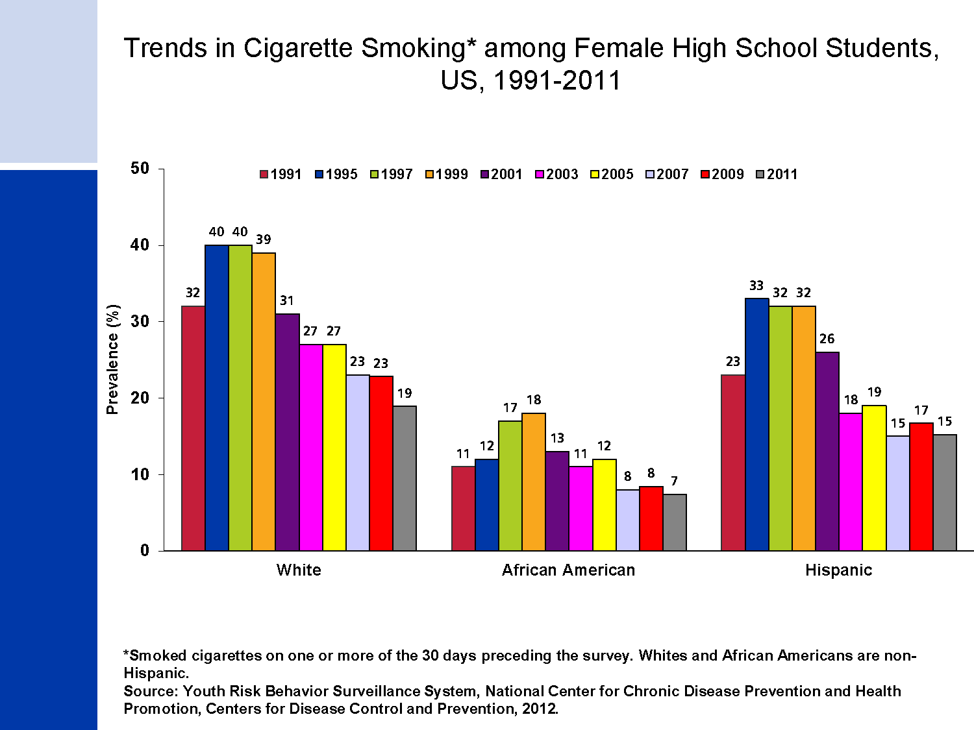
Trends in Cigarette Smoking* among Female High School Students, US, 1991-2011
Notes:
Reduction in cigarette smoking among youth is an important factor in reducing prevalence and addiction in adulthood. Smoking among high school girls peaked in the late 1990s and has since been declining, though the rate of decline has slowed since 2007. It is thought that the increase in smoking from 1991 to 1997 is a reflection of increased expenditures on aggressive youth-targeted marketing and promotions by tobacco companies during the early 1990s. The subsequent decline is thought to be due to increased price of cigarettes as well as comprehensive tobacco control efforts. However, slower rate of decline in recent years may reflect increased tobacco industry marketing expenditures and promotions and declines in funding for comprehensive tobacco control programs. Patterns were similar for all racial/ethnic groups.

Slide 27
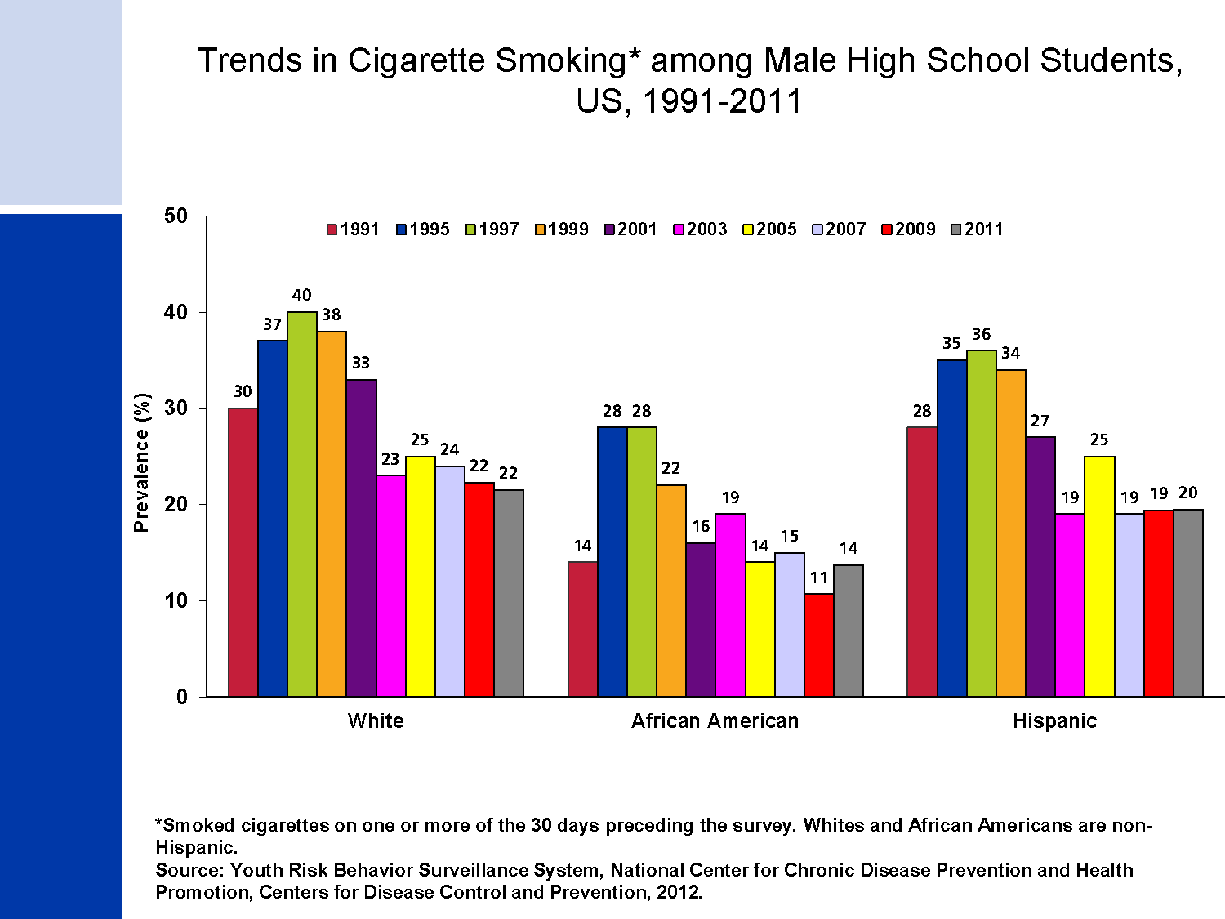
Trends in Cigarette Smoking* among Male High School Students, US, 1991-2011
Notes:
Cigarette smoking trends among boys are very similar to those among girls. However, African American and Hispanic boys smoking among high school boys peaked in the late 1990s1997 and has since been declining, though the rate of decline has slowed since 2003. Tobacco companies greatly increased their expenditures and promotions during the early 1990s, and it is thought that the increase in smoking from 1991 to 1997 was due to aggressive youth-targeted marketing and promotions. The subsequent decline is thought to be due to increased price of cigarettes as well as comprehensive tobacco control efforts. However, slower rate of decline in recent years may reflect increased tobacco industry expenditures on marketing and promotion and declines in funding for comprehensive tobacco control programs. Patterns were similar for all gender and racial/ethnic groups.

Slide 28
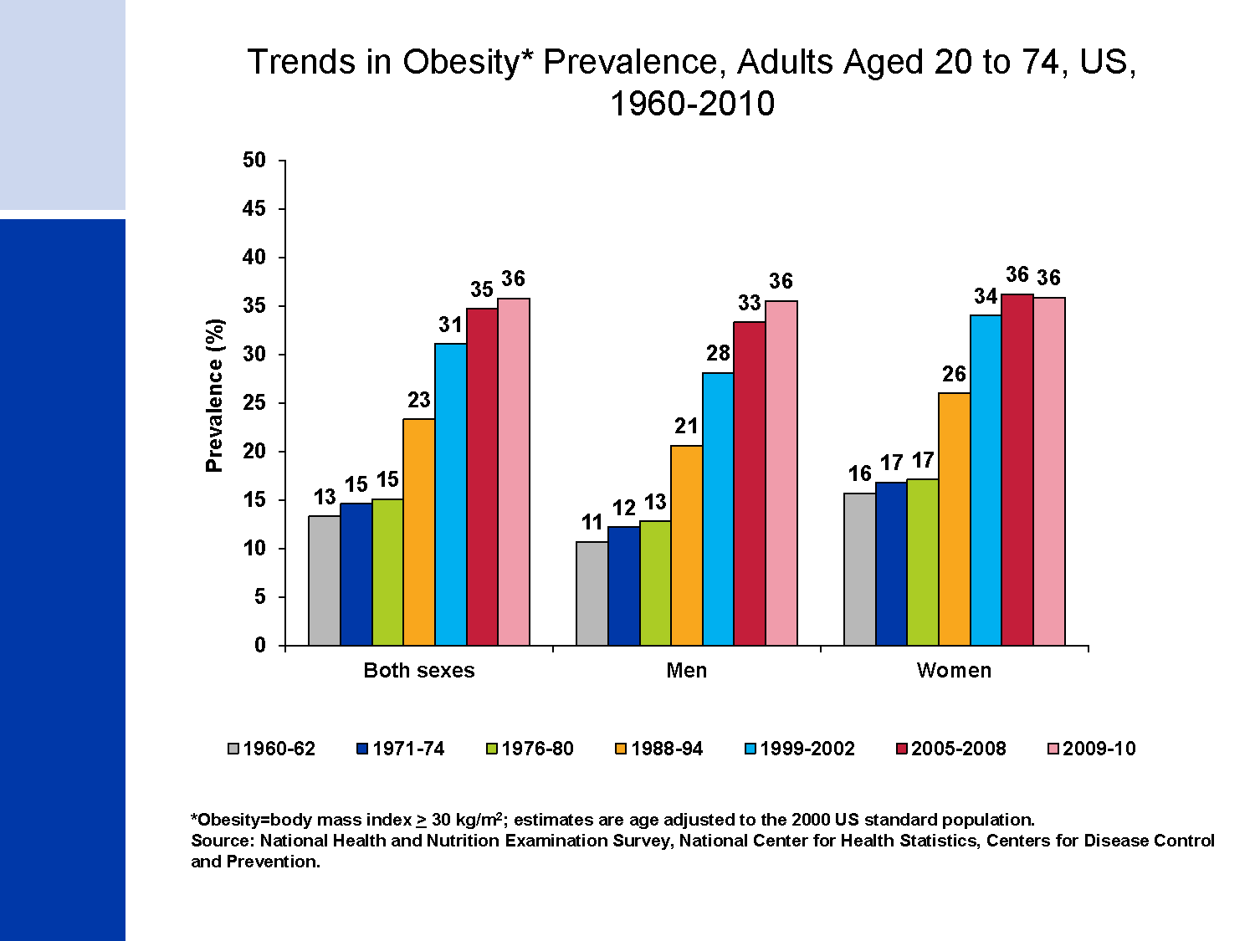
Trends in Obesity* Prevalence, Adults Aged 20 to 74, US, 1960-2010
Notes:
Obesity has reached epidemic proportions in the United States. The percentage of adults age 20 to 74 who are obese increased from the late 1970s to 2000, with the largest increases occurring in the 1990s. During this time, similar trends were observed among men and women. In the past decade, obesity trends in women have remained relatively stable while among men, prevalence increased from 28% during 1999-2002 to 36% during 2009-2010.

Slide 29
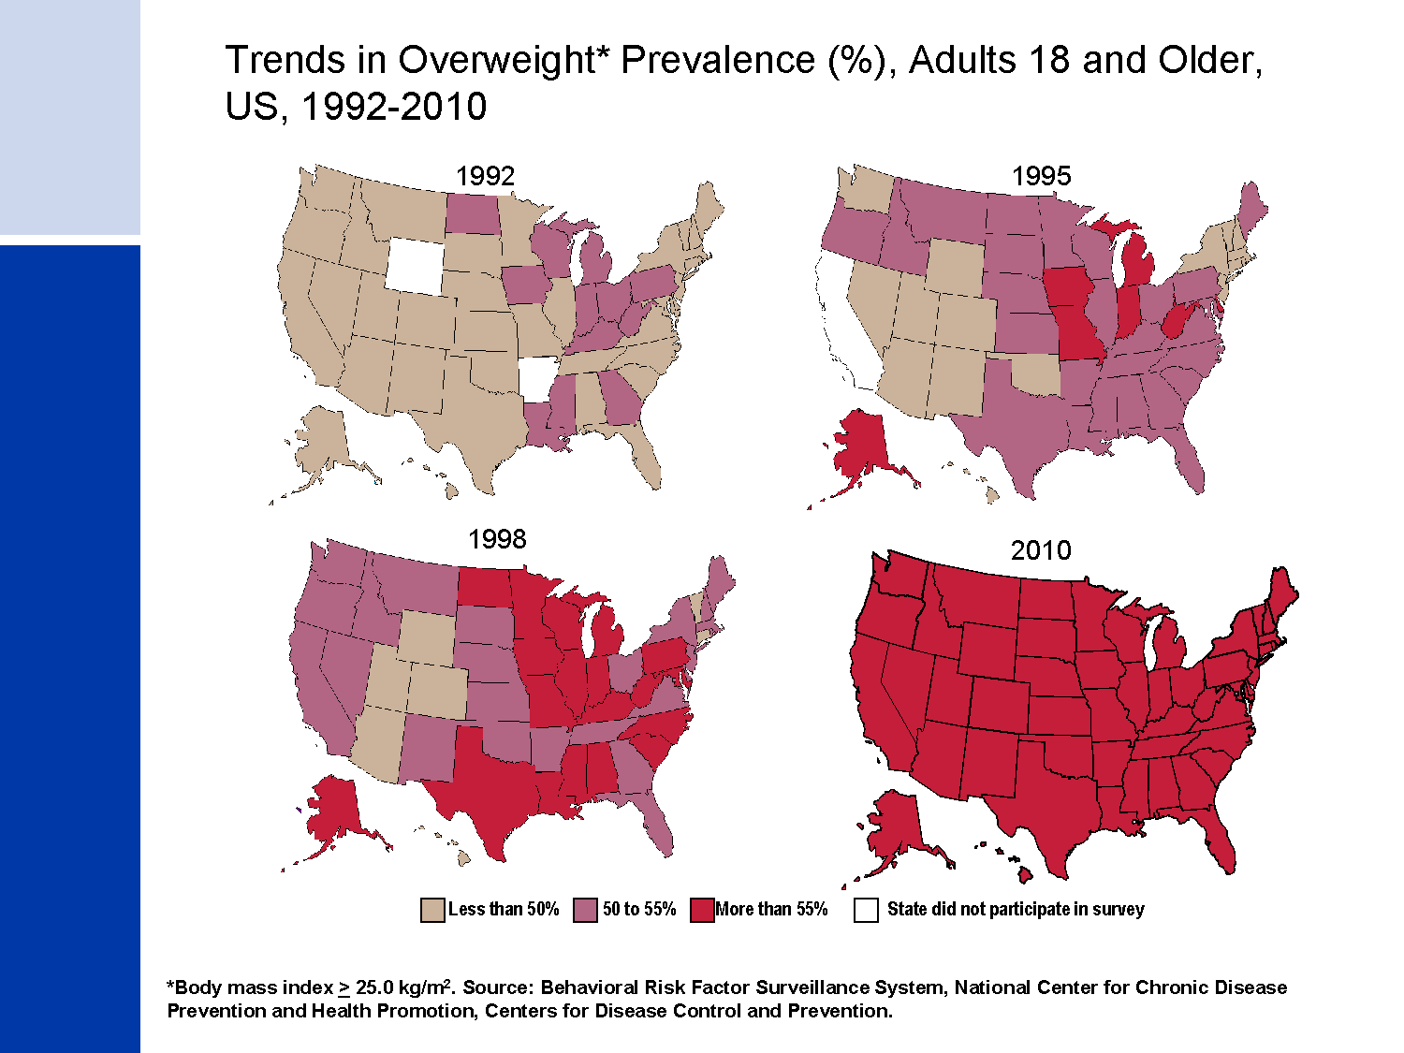
Trends in Overweight* Prevalence (%), Adults 18 and Older, US, 1992-2010
Notes:
This slide highlights the obesity epidemic as mentioned in the previous slide. In 2010, more than 55% of adults were overweight or obese in every state.

Slide 30
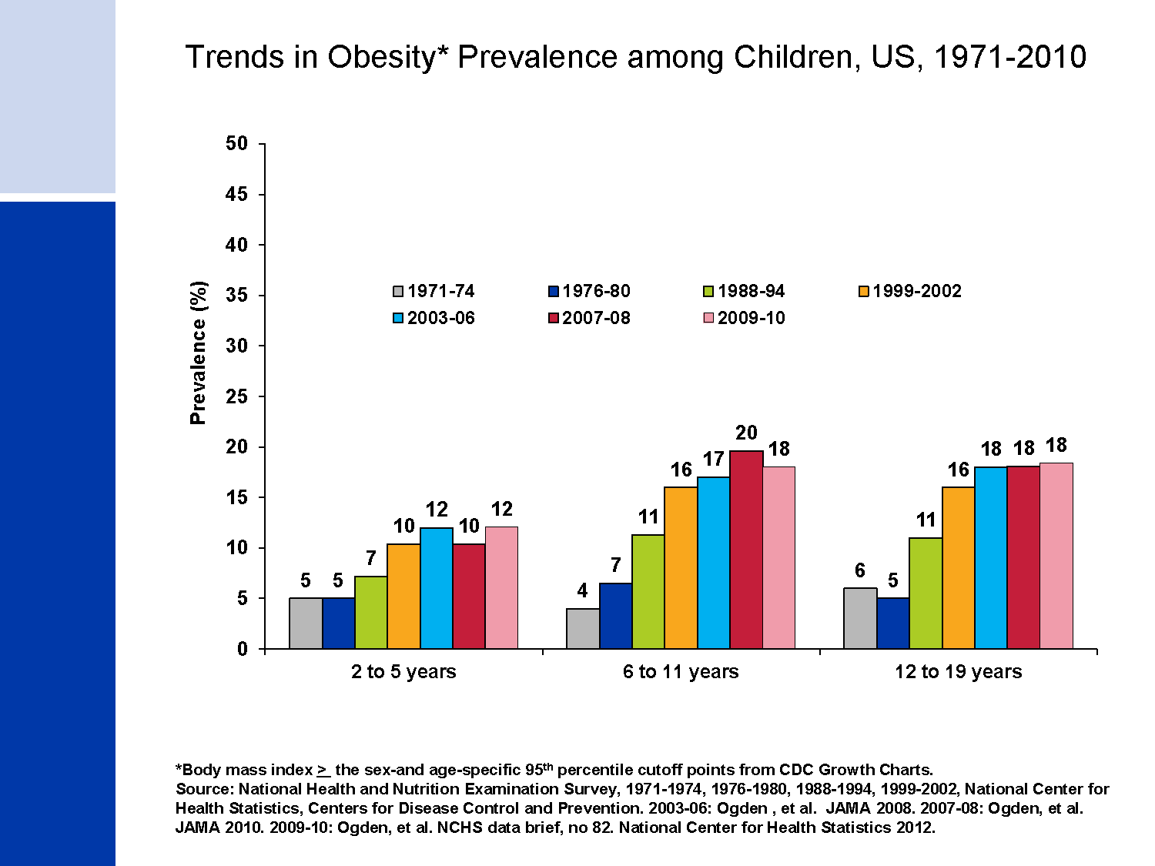
Trends in Obesity* Prevalence among Children, US, 1971-2010
Notes:
People who become overweight in childhood and adolescence are more likely to be overweight or obese as adults. With at least half of the overweight children becoming overweight adults, future adult populations are at increased risk for developing cancer and other serious chronic diseases.
The prevalence of obese children and adolescents has increased since the 1970s, with the most dramatic increases occurring in the late 1980s and 1990s. In fact, over the past three decades the proportion of obese children has more than doubled among children 2-5 years and 6-11 years, and tripled among adolescents 12-19 years. However, in the past decade, obesity prevalence among children and adolescents has appeared to stabilize.

Slide 31
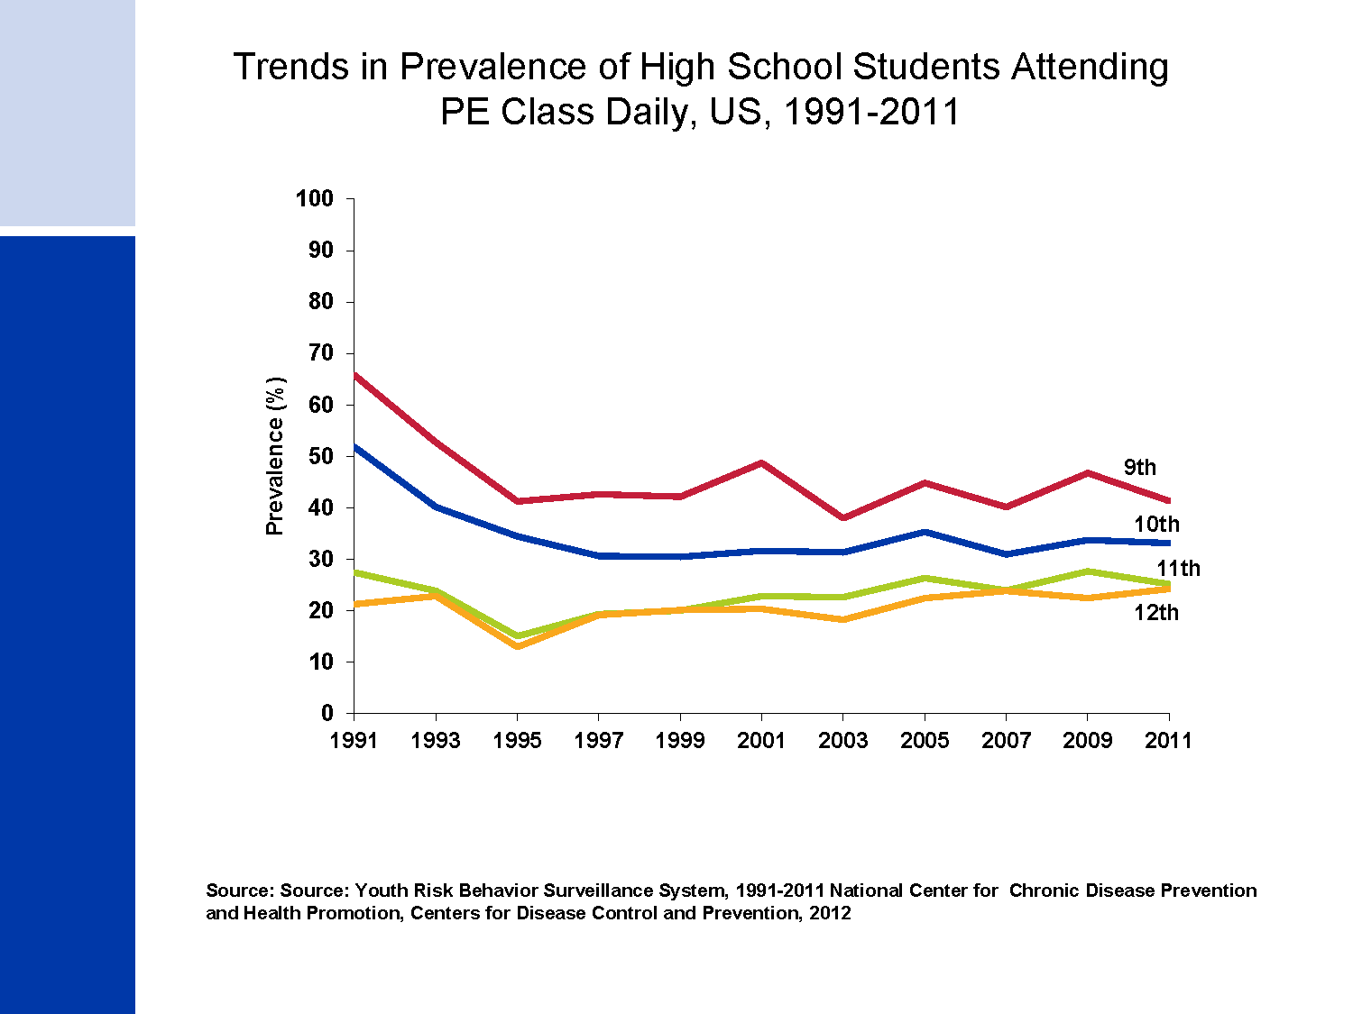
Trends in Prevalence of High School Students Attending PE Class Daily, US, 1991-2011
Notes:
Regular physical activity has many important health benefits, including reducing risk factors for cardiovascular disease, cancer, and other chronic diseases. The prevalence of students attending physical education (PE) class daily declined substantially between 1991 and 1995 and has since remained relatively unchanged. Given that the prevalence of overweight among adolescents has tripled since 1980, schools are increasingly being identified as an opportunity to increase physical activity among students.

Slide 32
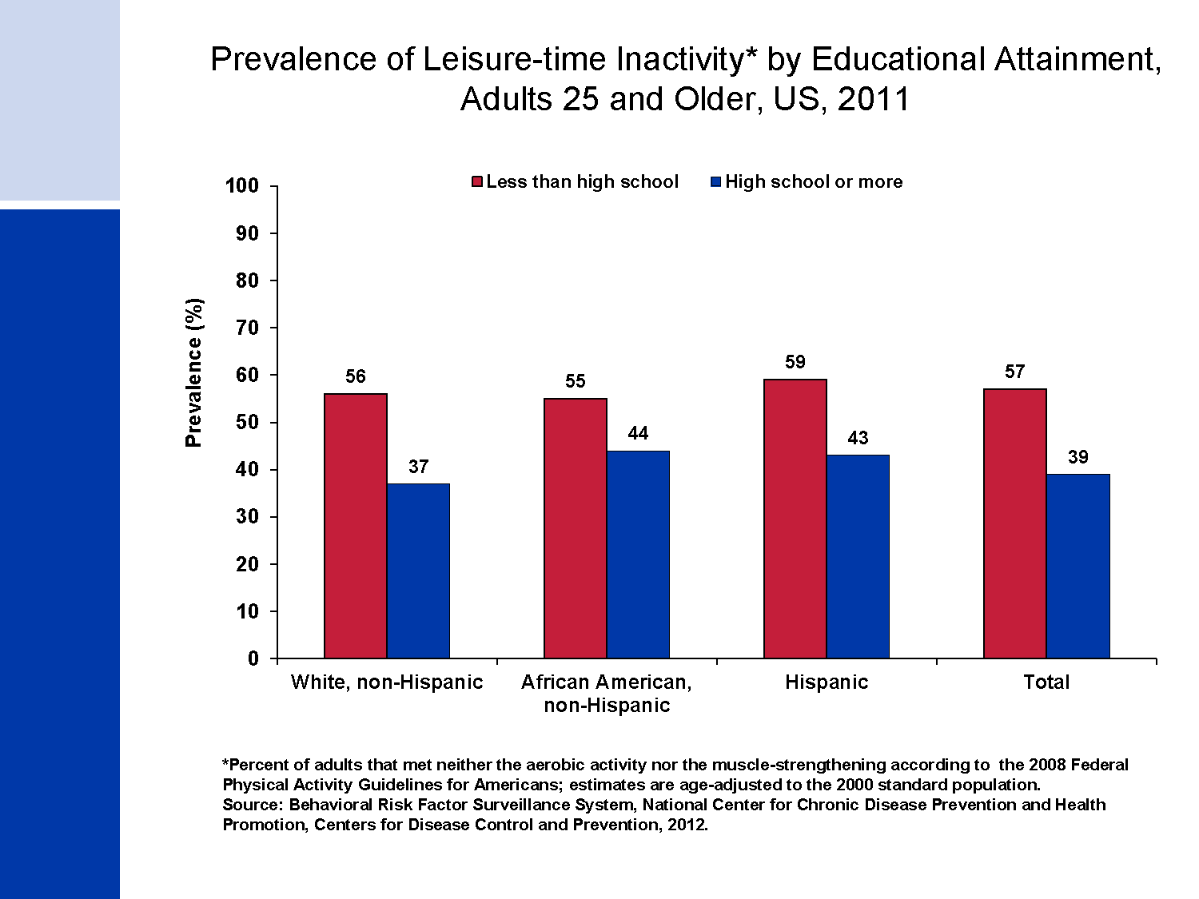
Prevalence of Leisure-time Inactivity* by Educational Attainment,
Adults 25 and Older, US, 2011
Notes:
The American Cancer Society recommends that adults engage in at least 150 minutes of moderate physical activity or 75 minutes of vigorous physical activity each week. The 2008 Federal Physical Activity Guidelines are similar to the ACS recommendations, with an additional recommendation for muscle-strengthening activities that are moderate or high intensity and involve all major muscle groups on 2 or more days a week. In 2011, roughly 40% of adults 25 years and older were physically inactive. There was significantly more physical inactivity among non-Hispanic blacks and Hispanics compared to non-Hispanic whites. In addition, less educated adults are more likely to be physically inactive than more educated adults in every racial/ethnic group.

Slide 33
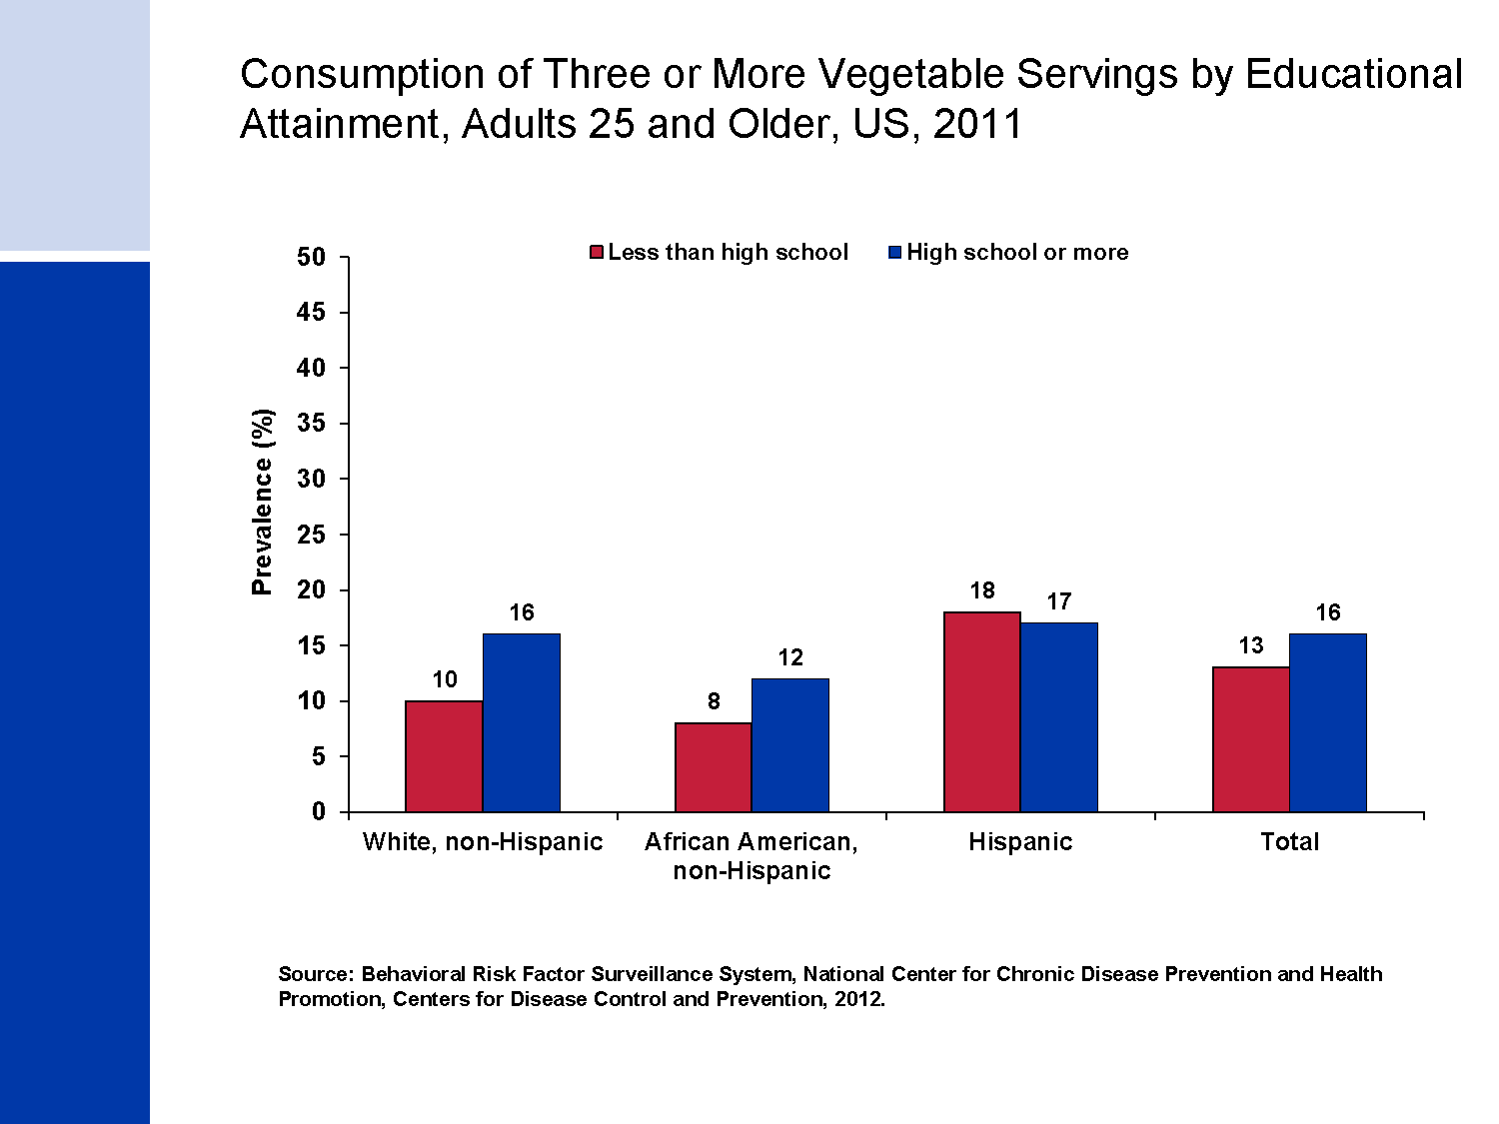
Consumption of Three or More Vegetable Servings by Educational Attainment, Adults 25 and Older, US, 2011
Notes:
The American Cancer Society recommends that individuals eat at least 2.5 cups of vegetables and fruits a day for cancer prevention. About 15% of adults 25 years and older consumed recommended vegetables servings in 2011 with significantly lower vegetable consumption among African Americans compared to whites. In general, less educated adults were less likely than more educated adults to consume the recommended servings of vegetables, though this did not hold true among Hispanics.

Slide 34
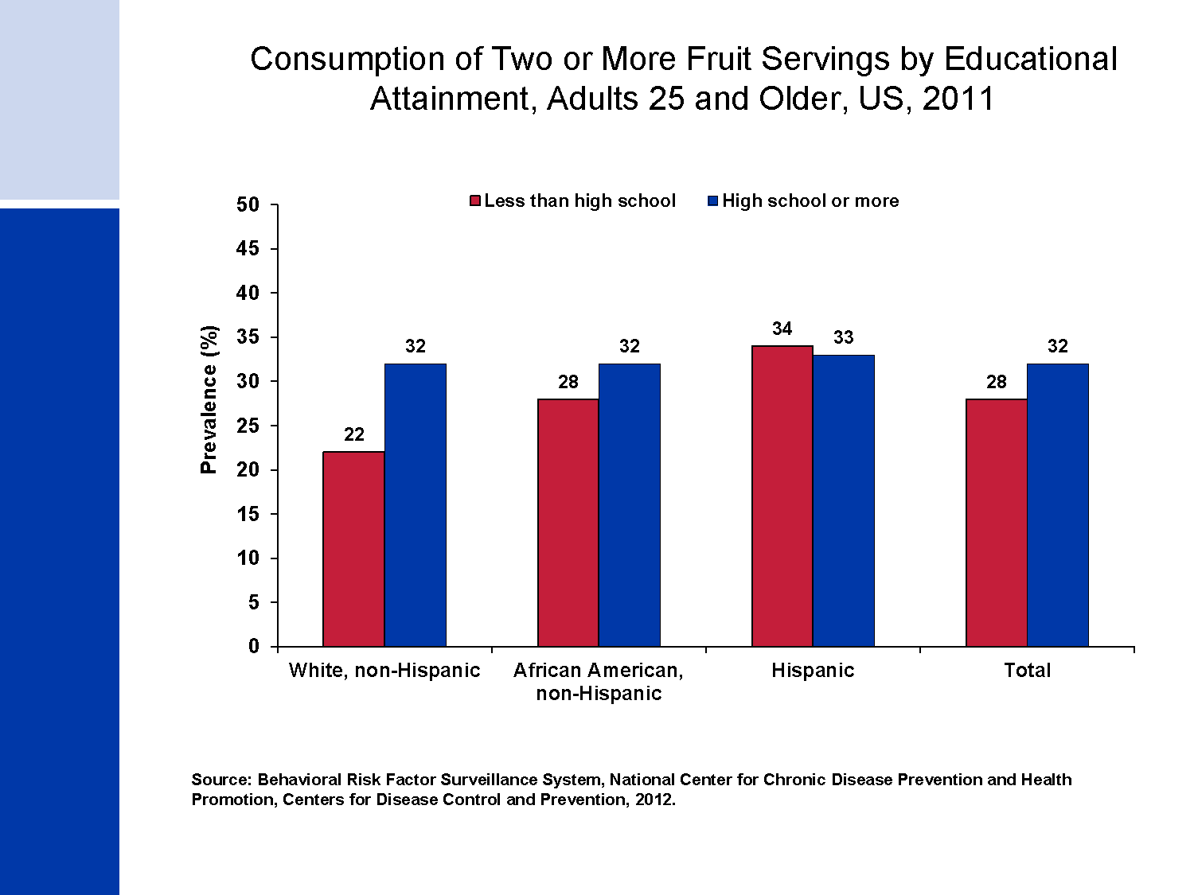
Consumption of Two or More Fruit Servings by Educational Attainment, Adults 25 and Older, US, 2011
Notes:
The American Cancer Society recommends that individuals eat at least 2.5 cups of vegetables and fruits a day for cancer prevention. About one in three adults 25 years and older consumed the recommended fruit servings in 2011, regardless of racial/ethnicity. Similar to vegetable consumption, less educated adults were less likely than those who were more educated to consume 2 or more fruit servings with the exception of Hispanics.

Slide 35
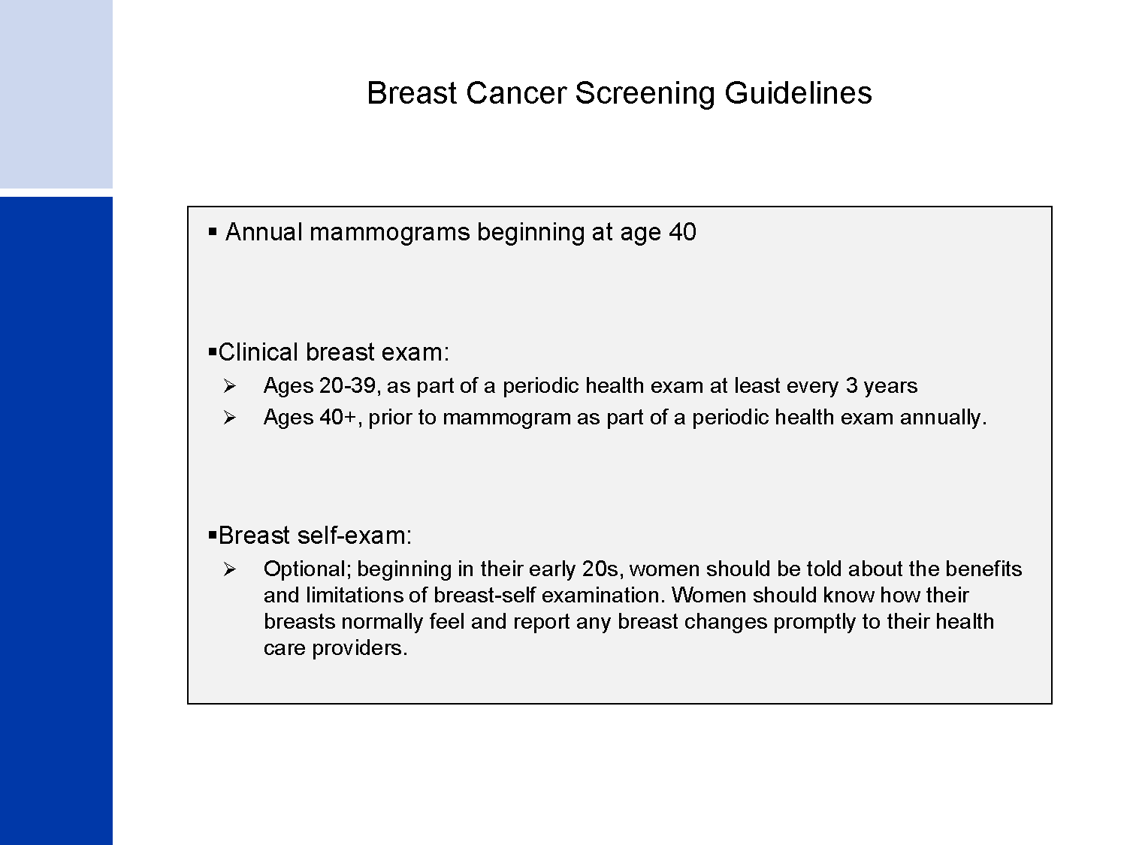
Breast Cancer Screening Guidelines
Notes:
The American Cancer Society recommends that women aged 40 and older should have an annual mammogram and clinical breast exam (CBE) as part of a periodic health exam. Women should know how their breasts normally feel and report any changes to their health care provider. A breast self-examination (BSE) is an option for women starting in their 20s. It is acceptable for women to choose not to do BSE.

Slide 36
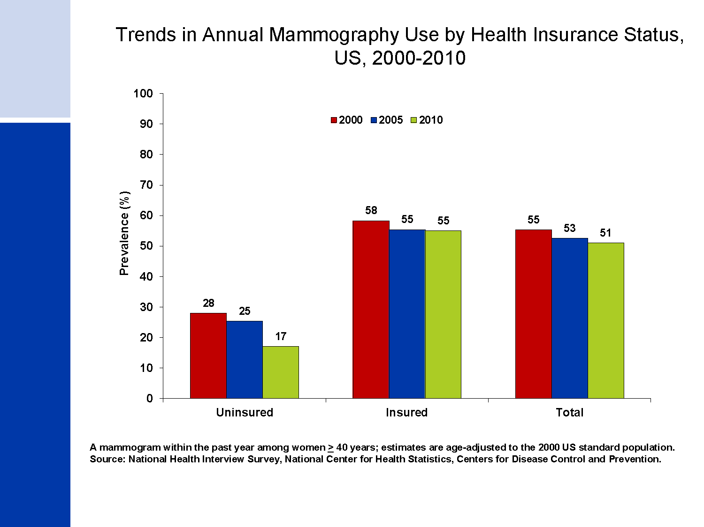
Trends in Annual Mammography Use by Health Insurance Status, US, 2000-2010
Notes:
Between 2000 and 2010, the percentage of women 40 and older who received a mammogram within the past year substantially decreased among uninsured women (from 28% to 17%), while remaining fairly stable among insured women.

Slide 37
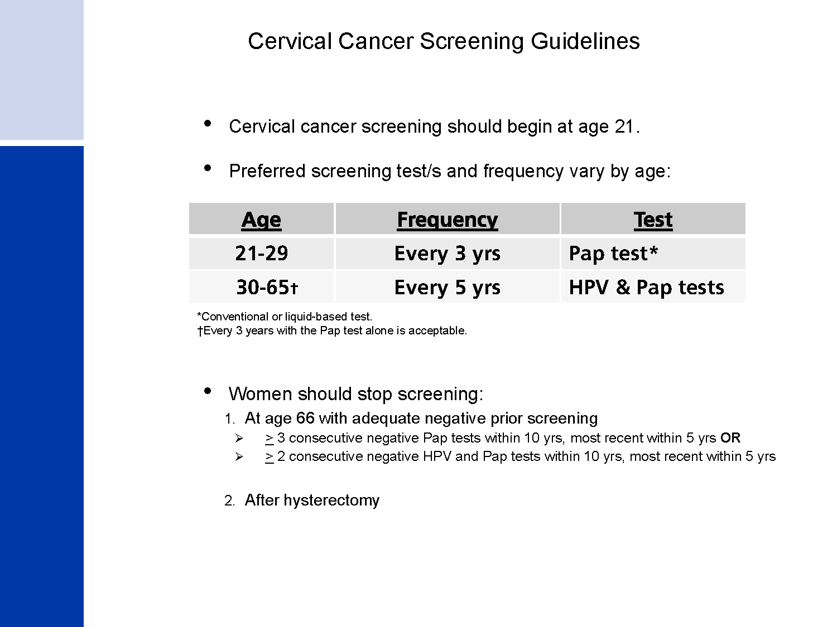
Cervical Cancer Screening Guidelines
Notes:
The American Cancer Society, in collaboration with the American Society for Colposcopy and Cervical Pathology and the American Society for Clinical Pathology, issued new screening guidelines for the prevention and early detection of cervical cancer in 2012. The most important changes to the guidelines were 1) the age range for which screening is appropriate and 2) the emphasis on the incorporation of HPV testing in addition to the Pap test. Among women at average risk, screening is now recommended for ages 21 through 65 years and the preferred screening method for women 30-65 is HPV and Pap co-testing every 5 years.

Slide 38
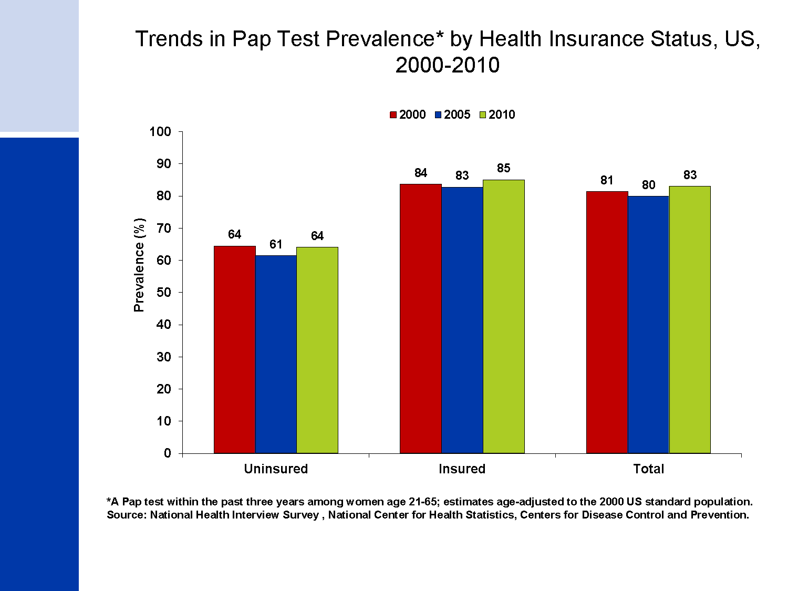
Trends in Pap Test Prevalence* by Health Insurance Status, US, 2000-2010
Notes:
Throughout the past decade, the percentage of women who had a Pap test within the past three years was at least 20% points lower among uninsured women than among women with health insurance.

Slide 39
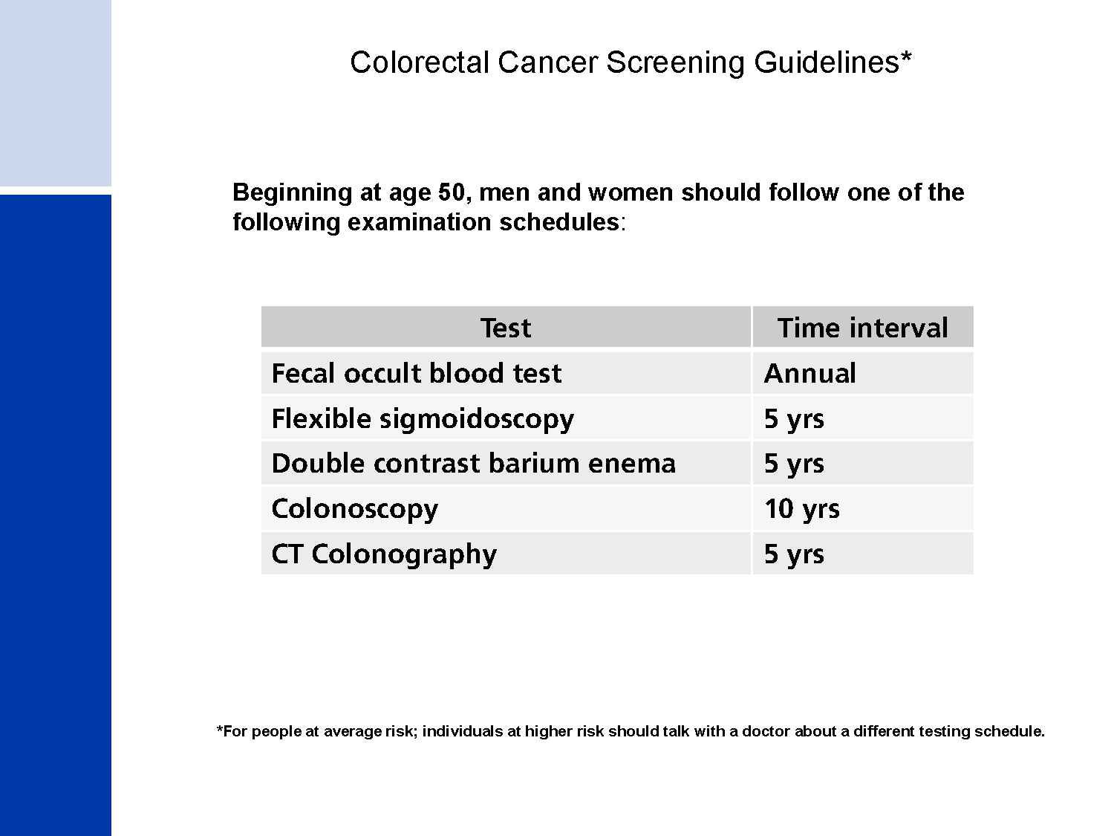
Colorectal Cancer Screening Guidelines*
Notes:
The American Cancer Society recommends that beginning at age 50, men and women at average-risk should receive one of several options to screen for the early detection of colorectal cancer and adenomas. It is the strong opinion of the expert recommendation panel that colon cancer prevention should be the primary goal of colorectal cancer screening. Exams that are designed to detect both early cancer and precancerous polyps should be encouraged if resources are available and patients are willing to undergo an invasive test.

Slide 40
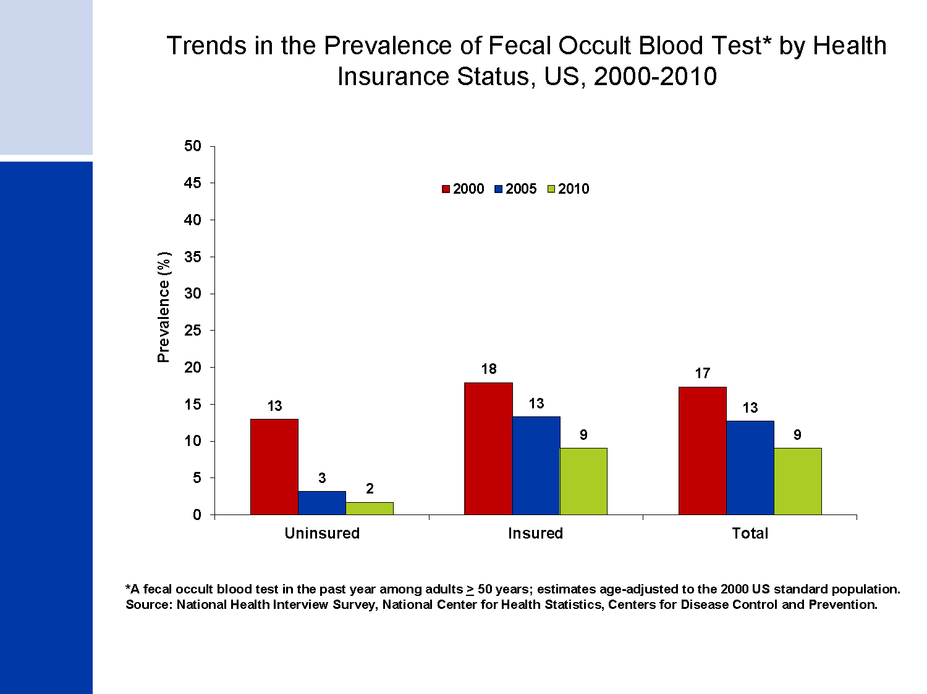
Trends in the Prevalence of Fecal Occult Blood Test* by Health Insurance Status, US, 2000-2010
Notes:
Despite increasing utilization of colorectal cancer screening in the US over the past decade, rates of fecal occult blood testing (FOBT) have decreased rapidly. In 2010, approximately 9% of US adults 50 and older had an FOBT in the previous year. In contrast, the use of colonoscopy has increased substantially since 2000; in 2010 56% of men and women 50 and older reported having a colonoscopy in the past 10 years or a sigmoidoscopy in the past 5 years.
(Trends in endoscopy use for colorectal cancer screening could not be shown because estimates for 2010 are not comparable to those of previous years due to revisions to this question in the National Health Interview Survey.)

Slide 41
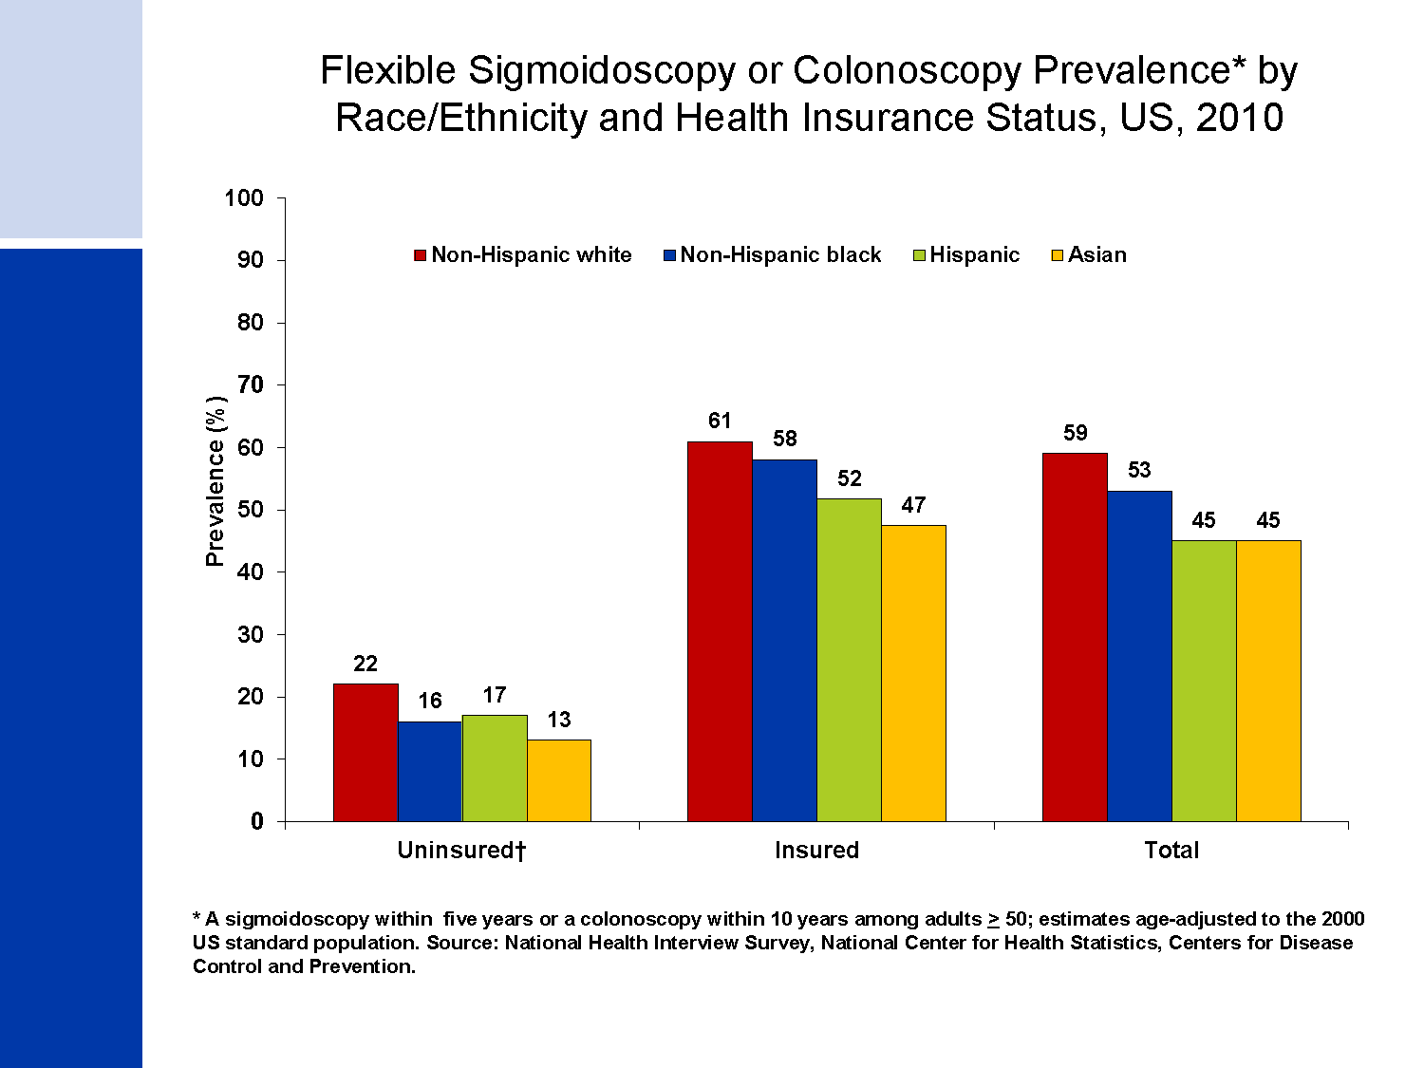
Flexible Sigmoidoscopy or Colonoscopy Prevalence* by Race/Ethnicity and Health Insurance Status, US, 2010
Notes:
This slide highlights the striking differences in the use of CRC screening endoscopy between insured and uninsured individuals, regardless of race and ethnicity. In 2010, the prevalence of recent endoscopy among uninsured adults in all race and ethnic groups was about 3-4 times lower than that among the insured.

Slide 42
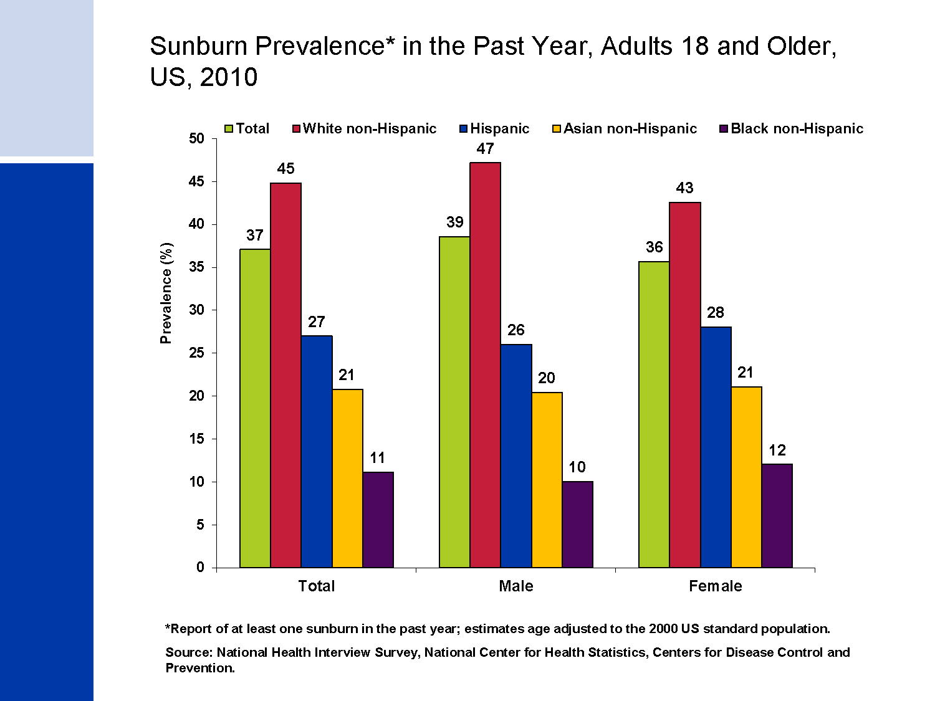
Sunburn Prevalence* in the Past Year, Adults 18 and Older, US, 2010
Notes:
Sunburns, a short-term consequence of unprotected or excessive UV exposure, were reported much more frequently by whites than by other racial/ethnic groups. The vast majority of skin cancers are caused by unprotected exposure to excessive ultraviolet radiation (UVR), primarily from the sun. The most serious form of skin cancer is melanoma, which is expected to be diagnosed in about 76,690 persons this year and is responsible for most skin deaths (9,480 deaths in 2013). The number of cases for the two most common types of skin cancer, basal cell and squamous cell, is unknown because these are not required to be reported to cancer registries. However, a recent study estimated that in 2006, 3.5 million cases were diagnosed and 2.2 million people were treated for these skin cancers, which are usually highly curable.

Slide 43
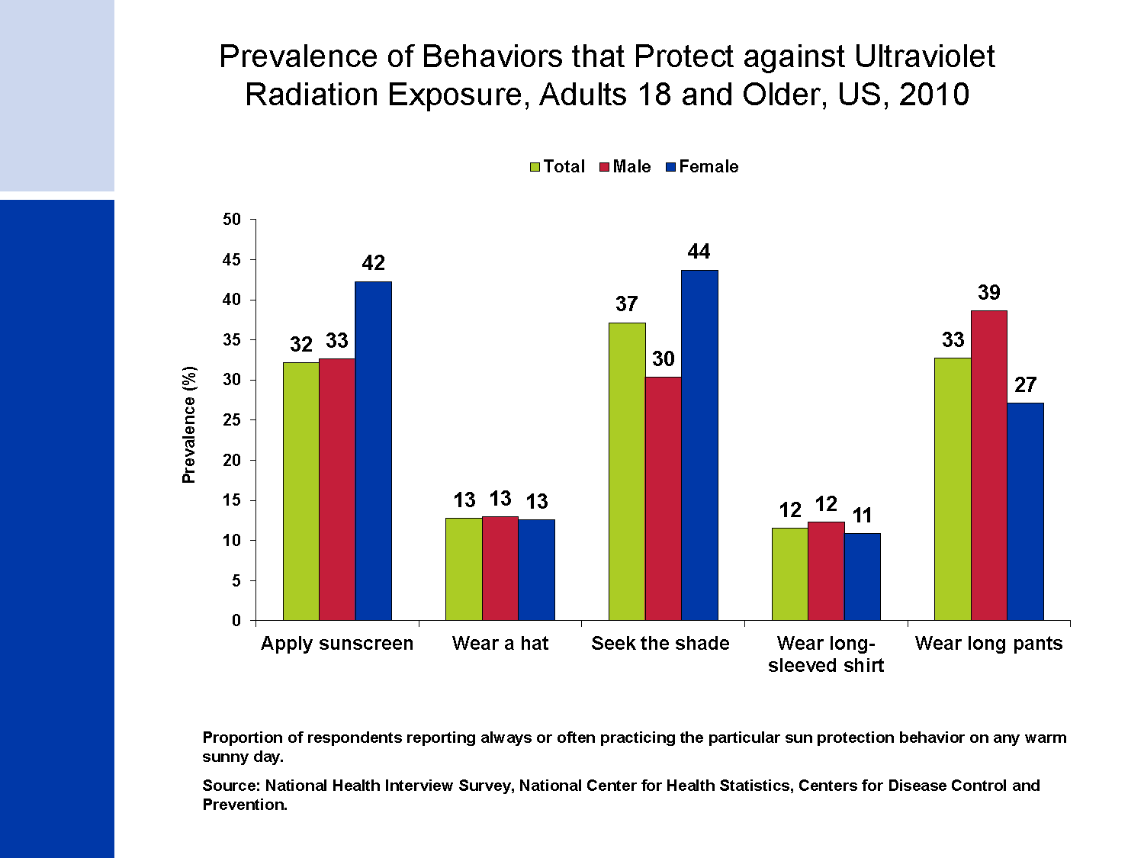
Prevalence of Behaviors that Protect against Ultraviolet Radiation Exposure, Adults 18 and Older, US, 2010
Notes:
Studies also suggest that exposure to artificial UVR exposure from indoor tanning devices is a risk factor for skin cancer. UVR damage of unprotected skin can be avoided by practicing recommended sun protection behaviors and avoiding indoor tanning devices, including lamps and booths. The practice of UVR protection behaviors is generally low. In a national sample of US adults in 2010, application of sunscreen and shade seeking were the most commonly practiced sun protection behaviors, whereas clothing protection, especially the use of hats and long-sleeved shirts were less frequently practiced.

Slide 44

Thank you

