Slide 1
Statistical analyses in clinical trials
ao. Univ.-Prof. Mag. Dr. Hanno Ulmer
hanno.ulmer@i-med.ac.at
Department für Medizinische Statistik, Informatik und Gesundheitsökonomie, Medizinische Universität Innsbruck

Slide 2
Basic principles of statistical analyses in clinical trials
Introduction
Different types of statistical analyses
Power calculation
Multiplicity in clinical trials including
subgroup analyses,
post-hoc analyses,
interim analyses and pooled analyses

Slide 3

Use of statistics in top journals

Slide 4
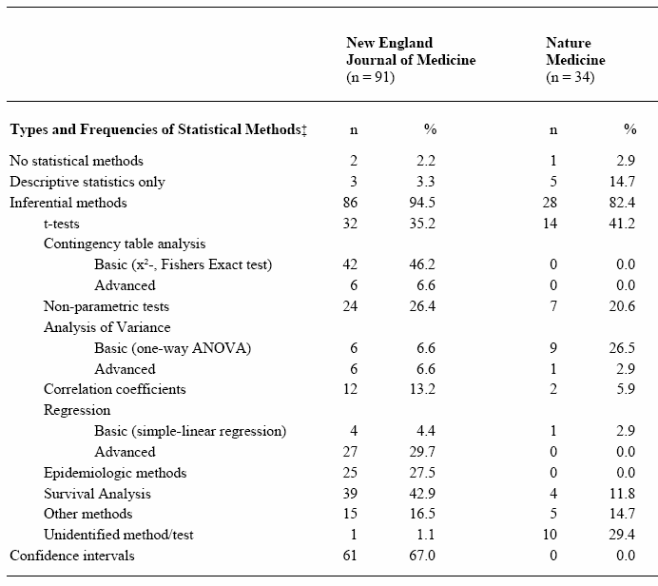
Statistical methods
Kategorien nach
Emerson/Colditz 1985

Slide 5
Design and analysis
Study planning
Resarch question, hypotheses, primary efficacy variable
Study design (interventional/observational, randomization, blinding, etc. )
Sample size estimation
Data management, etc.
Statistical analysis
Descriptive statistics
Univariable statistical testing
Parameter estimation with confidence intervals
Multivariable statistical testing using regression analyses

Slide 6

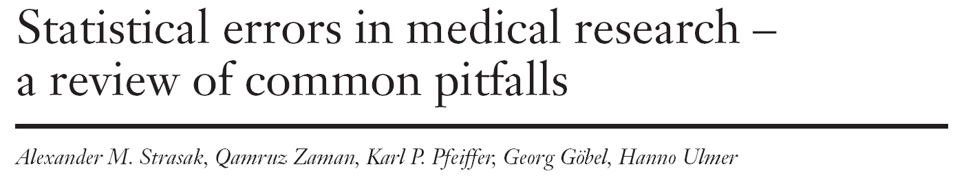
Statistical errors in medical research

Slide 7
Appendix (SMW-Artikel)

Slide 8
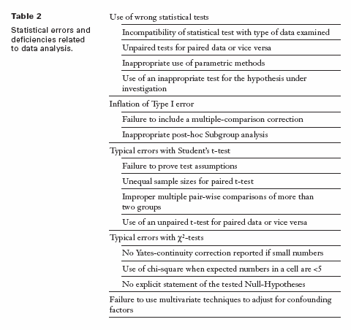

Slide 11
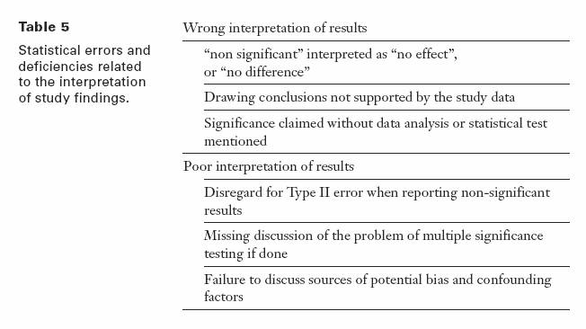

Slide 12
Internet sources, software
British Medical Journal Statistics at Square One
Deutsches Ärzteblatt Bewertung wissenschaftlicher Publikationen
Deutsche Medizinische Wochenschrift Statistik-Serie
Jumbo Münster
Graphpad Quickcalcs
R, Stata, SPSS, SAS, Statistica, GraphPad, MedCalc
nQuery Advisor, East, PASS, StudySize

Slide 13







Literaturhinweise
Grundlagenwissenschaft
Klinische Forschung
Epidemiologische Forschung

Slide 14
Studies
1. TRILOGY – We are developing a triple combination inhalation therapy in COPD (LABA/LAMA/ICS). We expect to be first in class and this was the first article published from our Phase III program. In essence a very important study showing the benefit of triple therapy over the more conventional double therapy.
2. TRINITY (I only have a manuscript at this point, article will follow shortly) – the second pivotal trial for this product. Comparison between LAMA and our triple and an “open triple” vs our single inhaler triple. Two analyses in 1 trial. Of special interest is the subgroup analysis of the open vs closed triple analysis. In the subgroup of 2 or more exacerbations per year the closed triple was statistically significant better in preventing exacerbations than the open triple. Astonishing if you take into account that the patient is receiving the same drugs but in 2 vs 1 inhaler. Your opinion on the value of this outcome would be interesting.
3. FLAME – A landmark study in COPD, very recent, and the competition is overselling the trial to everyone’s opinion. A comparison of LABA/LAMA vs ICS/LABA on the effect on exacerbations. Interesting to hear your opinion on the statistical methodology. We can also test our opinions on the caveats of the trial in a discussion with you.
4. Salford study – A unique study performed by GSK. A real-life interventional randomized open-label trial in which an entire city (at least the COPD population) was either put on their new ICS/LABA or remained on usual care. Interesting to hear from you the effect of this study design on the value of the outcomes and the statistical difficulties (biases). As an example, the competition is spreading the word on this article that you can achieve 8% reduction in exacerbations vs. usual care if you switch to their product. Adding a NNT of 7.
5. Transplant International - Additionally, I would like to add 1 article to the earlier sent e-mail. It is a post-hoc pooled analysis of 2 Phase 3 studies in renal transplantation, in which they specifically defined 2 subgroups with a benefit in this analysis (elderly and blacks). We would be very interested in hearing your opinion on the strengths and weaknesses of these types of analyses. Especially the aspects of looking at sub-groups post-hoc and pooling of trials. This is becoming very common in pharma industry.

Slide 15

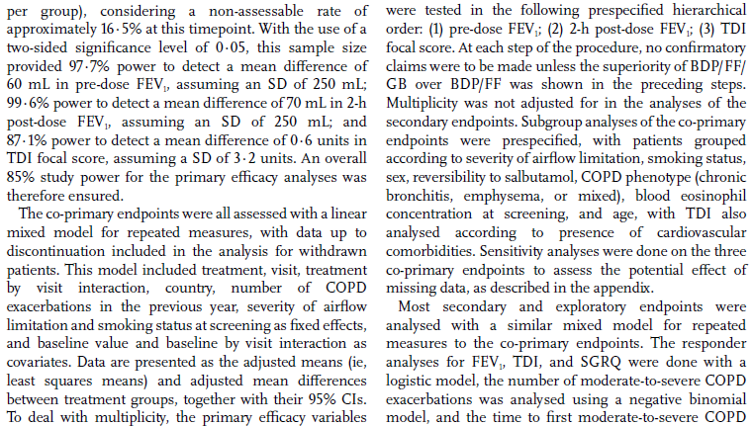
TRILOGY

Slide 16
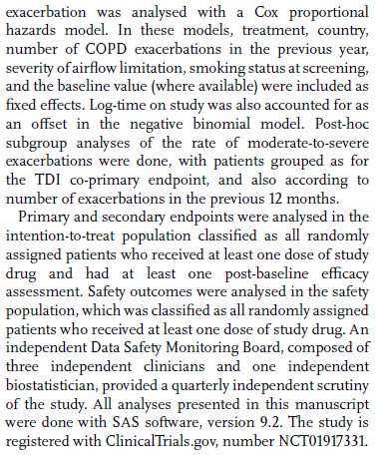
TRILOGY

Slide 17
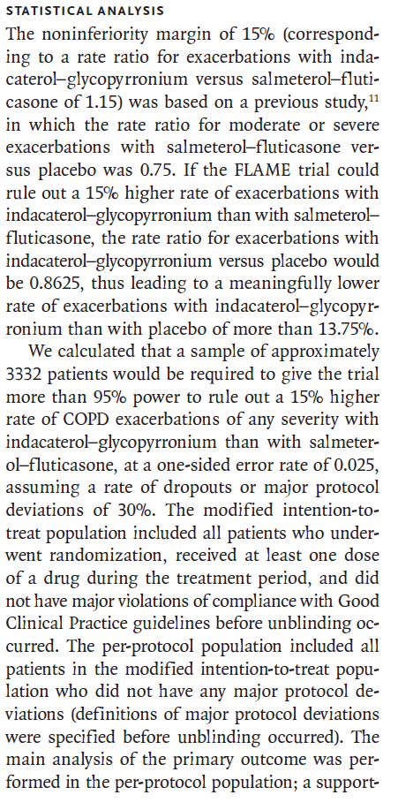
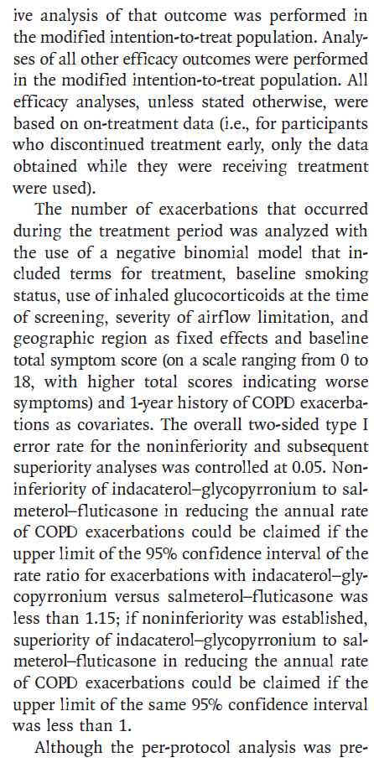
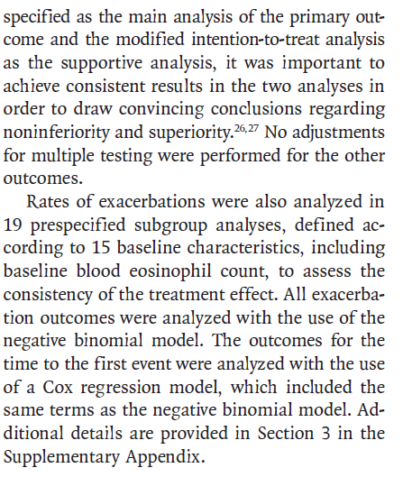
FLAME

Slide 18
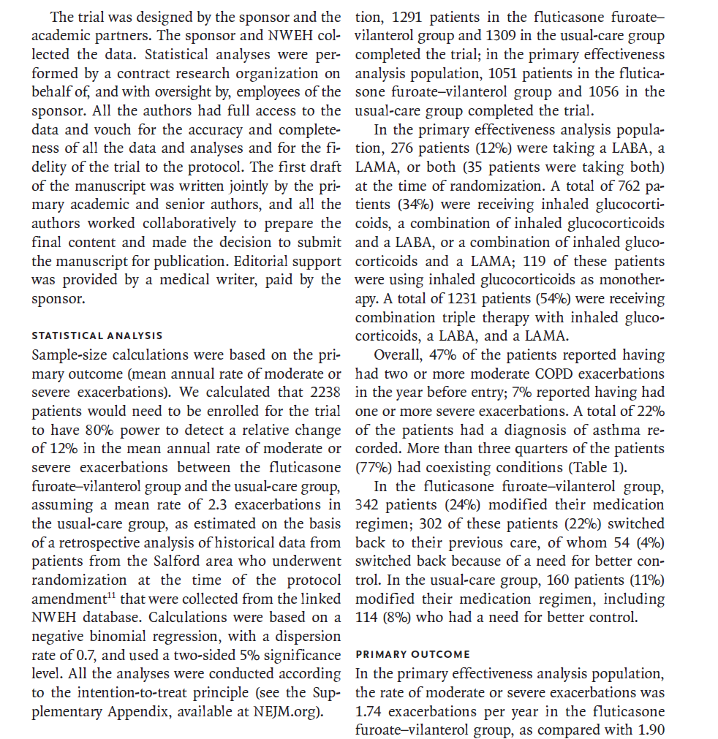
Salford Study

Slide 19
Transplant International study
Efficacy endpoints
The incidence of treatment failures within 12 months after the randomization date was the primary efficacy endpoint in both studies. Treatment failure was a composite endpoint that included any of the following events: death, graft failure, biopsy-proven acute rejection (BPAR; Banff Grade ≥1A, using Banff 2007 criteria; based on biopsy reading from a blinded central pathologist), or lost to follow-up. In this pooled analysis, treatment failure was compared overall and stratified by sex (male; female), age (<65 years; ≥65 years), and race (black; nonblack).
Statistical analysis
All subjects who were randomized and received study medication were included in the analysis. The proportion of patients with treatment failure at 12 months was compared between LCPT and tacrolimus twice-daily (overall and within each stratified by subgroup) using a 2-sided Fisher's exact test and 95% confidence interval (CI) for the difference in proportions (LCPT minus tacrolimus twice-daily). The 2-sided 95% CI for the difference in proportions was calculated using the Newcombe–Wilson score method. Mantel–Haenszel (MH) methods were also used to evaluate the treatment difference, with stratification by study . Differences between study-adjusted MH risk estimates yielded similar results. To simplify the presentation, pooled results are presented in this paper without stratification by study. Preliminary tests of treatment-by-study interaction (Breslow-Day test for homogeneity of the odds ratios) revealed no significant heterogeneity, thereby justifying the pooling of studies.
Baseline characteristics and treatment emergent AEs (TEAE) were tabulated by treatment for the pooled studies.

Slide 20
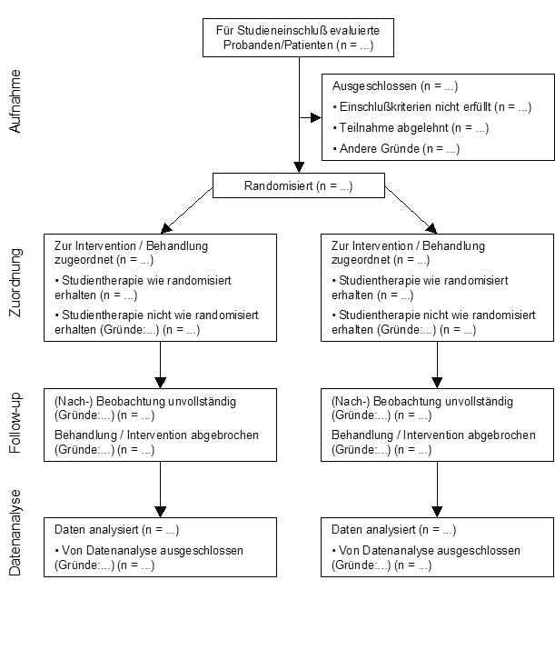
Consort statement, participant flow
Intention-to-treat
versus
Per-protocol

Slide 21
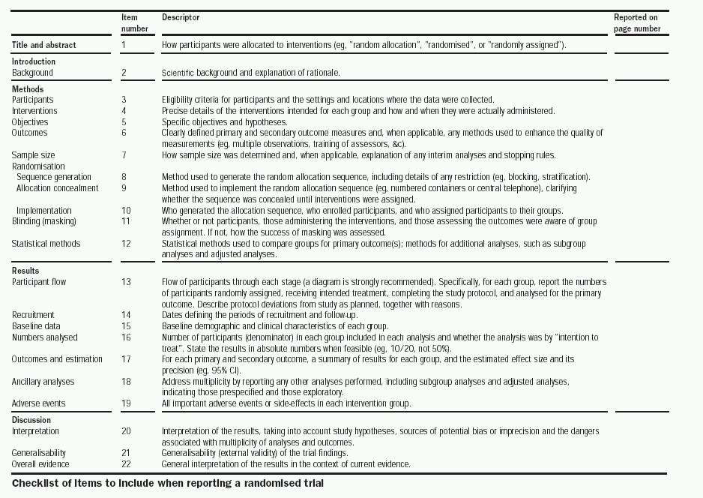

Slide 22
Formulating hypothesis & statistical tests
Steps in conducting a statistical test:
Quantify the scientific problem from a clinical / biological perspective
Formulate the model assumptions (distribution of the variable of interest)
Formulate the problem as a statistical testing problem:
Nullhypothesis versus alternative hypothesis
Define the „error“ you are willing to tolerate
Calculate the appropriate test statistic
Decide for the null hypothesis or against it
Formulating Hypothesis
&
Test statistics
&
p-values

Slide 23
Principles of statistical testing
Three primary measures of interest:
a point estimate,
a confidence interval, and
a p-value
Different approaches:
Test for superiority,
standard hypothesis testing
Test for non-inferiority
the difference between the new treatment and the standard is less than the smallest clinically meaningful difference, define delta, use confidence intervals
Test for equivalence
To demonstrate the difference between the new treatment and standard treatment has no clinical importance, define delta

Slide 24
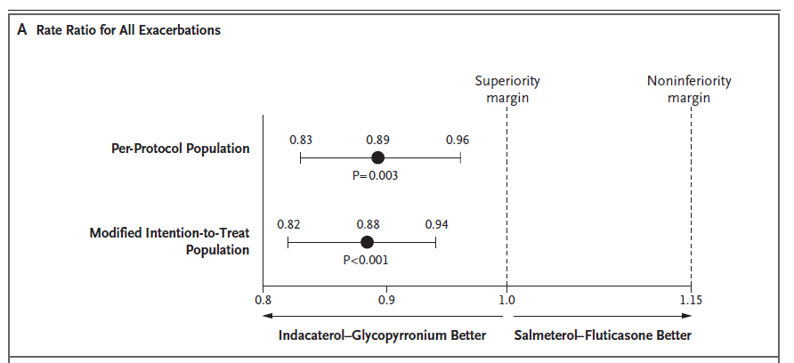
Example

Slide 25
Type I versus Type II Error
 |  | Decide for
 |  | H₀ | H₁
Reality | H₀ | Correct decision | Wrong decision: Type I error (α)
 | H₁ | Wrong decision: Type II error (β) | Correct decision: Power (1-β)

Slide 26
Common statistical tests
 | Quantitative outcome variable |  | Qualitative outcome variable
 | Normal distribution | Any other distribution | Expected frequency in each cell of the crosstable „high“ | Expected frequency in each cell of the crosstable „low“
Compare 2 groups | t-test | Wilcoxon-test / Mann-Whitney U-Test | Chi-Square | Fishers exact test
Compare >2 groups | Analysis of Variance (ANOVA) | Kruskal-Wallis-Test | Chi-Square
Testing measures of location:
Does the mean/median differ between groups
Testing frequencies in a crosstable:
Are the rows and columns independent from each other?

Slide 27
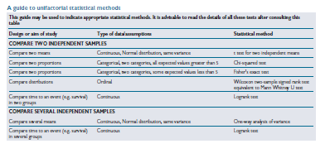
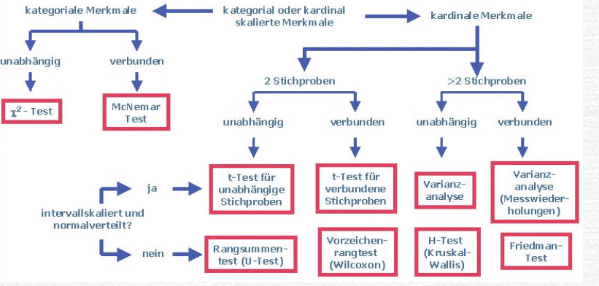
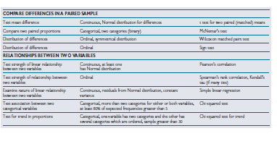
Univariate statistical testing

Slide 28
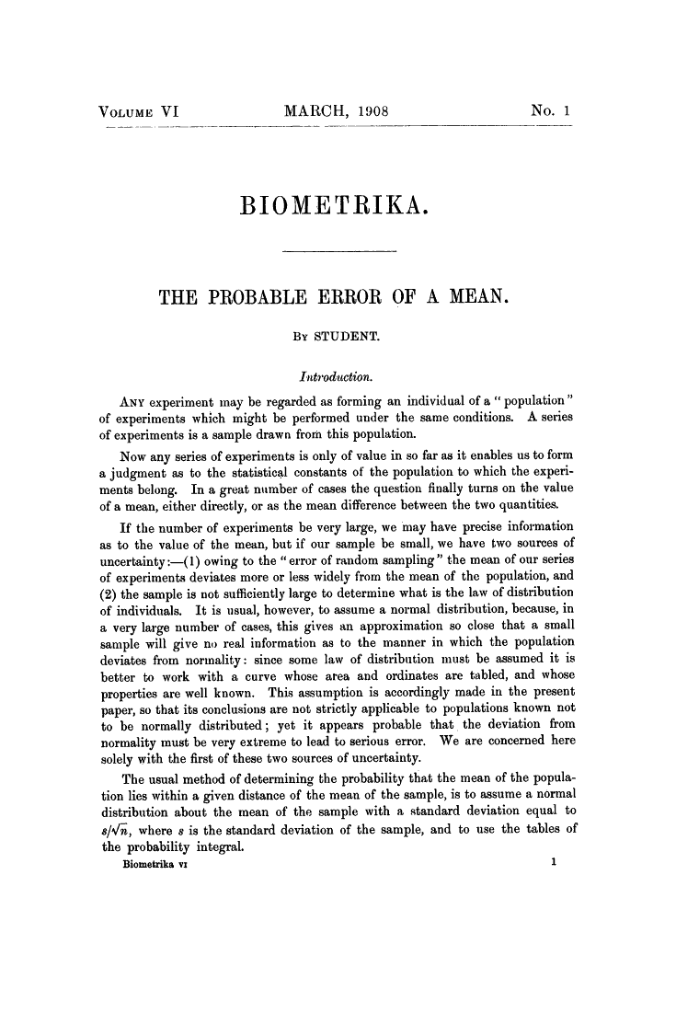
2008: 100 years Student`s t-test:
William Sealy Gosset

Slide 29
T-test
Dependent t-test
  Compares two means based on related data.
  E.g., Data from the same people measured at different times.
  Data from ‘matched’ samples.
Independent t-test
  Compares two means based on independent data
  E.g., data from different groups of people
Significance testing
  Testing the significance of Pearson’s correlation coefficient
  Testing the significance of b in regression.

Slide 30



Pearson`s chi-Square test
1900
Correlation and regression
Analysis of Variance
Karl Pearson (1857-1936)
Sir Ronald Aylmer Fisher (1890-1962)

Slide 31
Analysis of Variance (ANOVA)
Situation: Compare the means of k samples (k>2)
Assumption: normal distribution of the population, σ = σ₁ = σ₂ =…= σ_{k}
Hypothesis: H₀: μ₁= μ₂ =… = μ_{k} versus H₁: μ_{i} ≠ μ_{j} (i ≠ j): At least two of the means differ
Nowadays, linear mixed effects models are preferred instead of ANOVA
Group 1
Group 2
Group 3
| | | | | | | | |
all observations x_{ij}
Variability
within the group
₁
₂
₃
= means within the groups
Difference /Variability
between the groups
= is the overall mean of the variable

Slide 32
Why Not Use Lots of t-Tests?
If we want to compare several means why don’t we compare pairs of means with t-tests?
  Can’t look at several independent variables.
  Inflates the Type I error rate.
1
1
2
Vs
1
3
Vs
2
3
2
Vs
3

Slide 33
Multiple testing
„The multiple comparison problem involves the repeated testing of a series of hypotheses and the resultant increasing probability of a type I error.” Van Belle (2002), p. 149.
P (type I error)
Bonferroni-correction

Slide 34
Survival analysis (time-to-event data)
Kaplan-Meier curves
KAPLAN, E. L. and MEIER, P. (1958). Nonparametric estimation from incomplete observations. J. Amer. Statist. Assoc. 53 457-481.
Log-rank test
Cox Proportional Hazards Model
Cox, D. R. (1972). Regression Models and Life Tables (with discussion). J. R. Statistic. Soc. 34: 187-220.

Slide 35
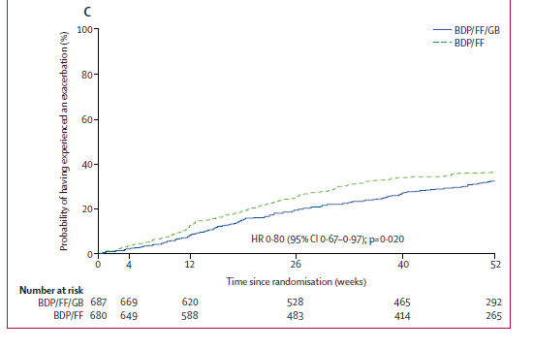
Example

Slide 36
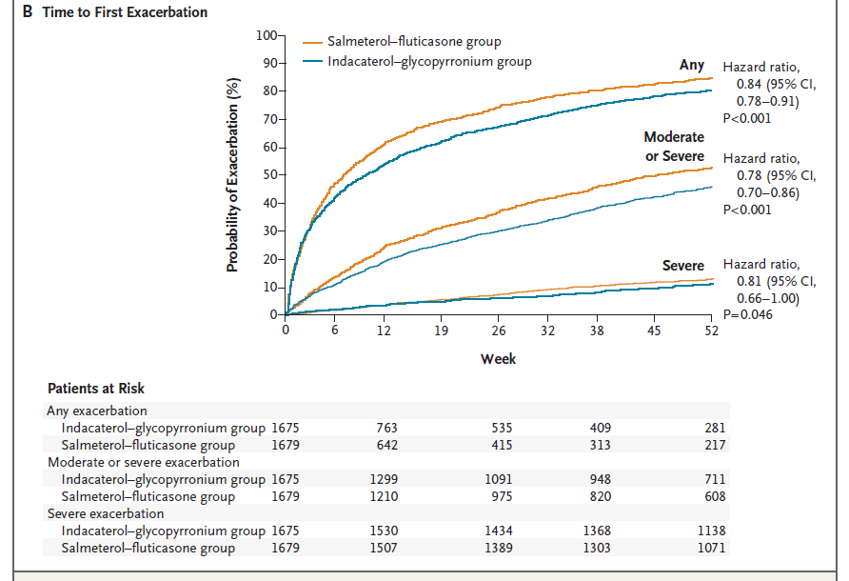
Example

Slide 37
Analysis of count data
Poisson regression
is a generalized linear model form of regression analysis used to model count data and contingency tables
Negative bionomial regression
is a popular generalization of Poisson regression because it loosens the highly restrictive assumption that the variance is equal to the mean made by the Poisson model.
Zero-inflated regression model
attempt to account for excess zeros

Slide 38
Sample size estimation
Question: How many individuals do you have to include in your study to get a reliable result ?
We want to maximize the probability
for rejecting H₀, if H₁ is true
while keeping the Type I error α fixed
What do you have to know
to calculate the sample size
needed?
Power (typically set to 80% or 90%)
Type I error α (typically set to α = 0.05)
The difference you want to find (for t-tests: the mean difference between groups)
standard deviation / measure of variance

Slide 39
Sample size estimation
Example
Hypothesis: H₀: μ_{A}= μ_{B} versus H₁: μ_{A} ≠ μ_{B} → two-sided t-test
You consider a difference of 10 as relevant
From former studies, you know, that the standard deviation is ~ 15 mmHG
So far, you have recruited 20 patients (10 in each treatment arm)
→ What is your power?
http://campus.uni-muenster.de/fileadmin/einrichtung/imib/lehre/skripte/biomathe/bio/fallz.html

Slide 40

Sample size estimation

Slide 41
Vergleich von Häufigkeiten zweier unverbundener Stichproben
In einer Karzinomstudie erhofft man sich, die bisher mit der Standardtherapie (S) erreichte Rezidivrate von 50% mit einer neuen Therapie (T) auf 40% zu senken.
Für eine kontrollierte klinische Studie mit den beiden Therapiegruppen S und T und dem Zielkriterium 'Rezidivrate' sowie den weiteren Festlegungen (zweiseitiger Test, Irrtumswahrscheinlichkeit 5%, Power 80%) ergeben sich folgende Parameter für die Fallzahlberechnung:
p1 = 0.5, p2 = 0.4, α = 0.05, 1-ß = 0.80.
ergibt eine Fallzahl von 388 Patienten für jede Behandlungsgruppe.

Slide 42
Vergleich von Mittelwerten zweier unverbundener Stichproben
In einer Hypertoniestudie erhofft man sich, die bisher mit der Standardtherapie (S) erreichte durchschnittliche Blutdrucksenkung von 15 mm mit einer neuen Therapie (T) auf 20 mm zu senken.
Für eine kontrollierte klinische Studie mit den beiden Therapiegruppen S und T und dem Zielkriterium 'Senkung des Blutdrucks' sowie den weiteren Festlegungen (Standardabweichung = 15, zweiseitiger Test, Irrtumswahrscheinlichkeit 5%, Power 80%) ergeben sich folgende Parameter für die Fallzahlberechnung:
µ1 = 15, µ2 = 20, σ= 15, α = 0.05, 1-ß = 0.80
ergibt eine Fallzahl von 142 Patienten für jede Behandlungsgruppe.

Slide 43
Vergleich von Mittelwerten zweier verbundener Stichproben
In einer Phase-II-Studie soll überprüft werden, ob sich ein neues Medikament zur Blutdrucksenkung eignet. Geeignet ist das Medikament dann, wenn bei Hypertonikern mit einem durchschnittlichen systolischen Blutdruck von 150 mm eine Senkung um mindestens 10 mm erreicht wird.
Für diese klinische Studie lautet das Zielkriterium 'Differenz des Blutdrucks vor und nach Behandlung'. Mit den weiteren Festlegungen (Standardabweichung = 15, zweiseitiger Test, Irrtumswahrscheinlichkeit 5%, Power 80%) ergeben sich folgende Parameter für die Fallzahlberechnung:
µ1 = 150, µ2 = 140, σ = 15, α= 0.05, 1-ß = 0.80
ergibt eine Fallzahl von 20 Patienten.

Slide 44
Vergleich von Überlebenszeiten zweier unverbundener Stichproben
In einer Karzinomstudie erhofft man sich, die bisher mit der Standardtherapie (S) erreichte mediane Überlebenszeit von 36 Monaten mit einer neuen Therapie (T) auf 48 Monate zu erhöhen.
Für eine kontrollierte klinische Studie mit den beiden Therapiegruppen S und T und dem Zielkriterium 'Überlebenszeit' sowie den weiteren Festlegungen (Rekrutierungszeit=24 Monate, Nachbeobachtungszeit = 36 Monate, zweiseitiger Test, Irrtumswahrscheinlichkeit 5%, Power 80%)
ergibt eine Fallzahl von 349 Patienten für jede Behandlungsgruppe.

Slide 45
The multiple testing problem
The situation:
Consider a dataset with 100 independent parameters, which do not play a role in the etiology of the disease of interest (what you don‘t know, of course)
→ 100 statistical tests are performed with a significance level of α=0.05
→ The tests are constructed in that way, that maximum 5 of 100 tests reject the Nullhypothesis, although it is true (which is the case in this example)
→ You expect 5 tests to be significant just by chance

Slide 46
The multiple testing problem
The probability to get at least one Type I error increases with increasing number of tests.
Family-wise error rate (the error rate for the complete family of tests performed): α*=1-(1-α)^{k}, with α being the comparison-wise error rate
→ The significance level has to be modified for multiple testing situations
The probability
to get one or more
false discoveries
(Type I error)
k | α* (α=0.05)
1 | 0.05
5 | 0.226
10 | 0.401
100 | 0.994

Slide 47
The multiple testing problem
The Bonferroni correction method:
Control the comparison-wise error rate: Reject H₀, if p < α
Control the family-wise error rate (including k tests): Reject H₀, if p < α/k
→ Advantage: simple
Problem: Bonferroni-correction increases the probability of a type II error
→ the power of detecting a true association is reduced → Disadvantage:
too conservative
k | α/k (α=0.05)
1 | 0.05
5 | 0.01
10 | 0.005
100 | 0.0005
0.05/5=0.01

Slide 48
Controlling procedures
Family-wise error rate (FWER) is the probability of making one or more false discoveries, or type I errors when performing multiple hypotheses tests.
Alpha controlling algorithms:
Bonferroni, Bonferroni-Holm, Hochberg, Prospective Alpha Allocation Scheme, Fixed-Sequence Method, Gatekeeping Testing Strategies, Resampling-based multiple testing strategies
ANOVA Post-hoc tests: Bonferroni, LSD, Dunnett, Tukey, Scheffe, etc.

Slide 49
The multiple testing problem
How to report p-values / results of significance tests in papers:
If you are only interested in test decisions (significant or not) to a pre-specified α-level → report only the decision
If you are interested in the „certainty“ of your test decision → report all p-values
(can be interpreted as strength of evidence against the Nullhypothesis)
In the case of multiple testing: report all raw p-values + a reasonable correction
How it should be (1):
Statistical test | P-value
Test 1 | 0.005
Test 2 | 0.02
Test 3 | n.s.
Test 4 | <0.0001
Statistical test | P-value
Test 1 | 0.005*
Test 2 | 0.02
Test 3 | 0.2
Test 4 | 0.00008*
*remained significant with Bonferroni correction for multiple testing

Slide 50
The multiple testing problem
How to report p-values / results of significance tests in papers:
If you are only interested in test decisions (significant or not) to a pre-specified α-level → report only the decision
If you are interested in the „certainty“ of your test decision → report all p-values
(can be interpreted as strength of evidence against the Nullhypothesis)
In the case of multiple testing: report all raw p-values + a reasonable correction
How it should be (1): How it should be (2):
Statistical test | P-value
Test 1 | 0.005*
Test 2 | 0.02
Test 3 | 0.2
Test 4 | 0.00008*
Statistical test | P-value | P-value corrected
Test 1 | 0.005 | 0.02
Test 2 | 0.02 | 0.08
Test 3 | 0.2 | 0.8
Test 4 | 0.00008 | 0.00032
*remained significant with Bonferroni correction for multiple testing

Slide 51
Multiplicity issues in clinical trials
ICH E9, EMA Points to Consider on Multiplicity Issues in Clinical Trials,
FDA Multiple Endpoints in Clinical Trials, Guidance for Industry
Multiplicity may arise from multiple primary variables, multiple comparisons of treatments, repeated evaluations over time and/or interim analyses.
A clinical study that requires no adjustment of the type I error is one that consists of the two treatment groups, that uses a single primary variable, and has a confirmatory statistical strategy that pre-specifies just one single null hypothesis relating to the primary variable and no interim analysis… all other situations require attention to the potential effects of multiplicity.
Controlling type I error family-wise means that the accepted and pre-specified alfa has to be split, and that the various null hypotheses have to be tested at the resulting fraction of alfa. This is usually referred to as adjusting the type I error level.

Slide 52
Simple example for type I error adjusting in interim analyses

Slide 53
Commonly used alpha spending procedures in interim analyses
Pocock (1977) Biometrika 64, 191-199
Divide type 1 error evenly across number of analyses. Good opportunity for early stopping.
O’Brien-Fleming (1979) Biometrics 35, 549-556
Use up very little error at early looks and much more error at later looks.
Fleming-Harrington-O’Brien (1984) Controlled Clinical Trials 5, 348-361
Similar to OF above, but less conservative.
Jones & Lewis, “Data and Safety Monitoring” in Biostatistics in Clinical Trials
(ed. Redmond & Colton).

Slide 54
Subgroup analysis (forest plots)

Slide 55
Subgroup analysis (forest plots)

Slide 56
Multiple primary variables
Co-primary endpoints:
Demonstration of treatment effects on all endpoints is necessary
to establish clinical benefit

Slide 57
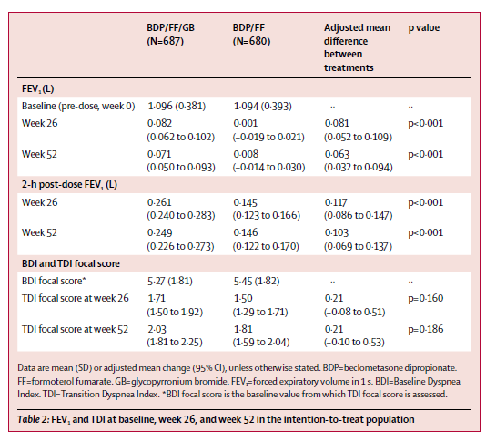
Multiple primary variables

Slide 58
Multiplicity issues in clinical trials
The ICH E9 guideline on biostatistical principles in clinical trials recommends that generally clinical trials have one primary variable.
If, however, a single variable is not sufficient to capture the range of clinically relevant treatment benefits, the use of more than one primary variable may become necessary.
Statistically significance is then needed for all primary variables. Therefore, no formal adjustment is necessary.
Two or more primary variables ranked according to clinical relevance. No formal adjustment is necessary. However, no confirmatory claims can be based on variables that have a lower rank (hierarchical testing).

Slide 59
Multiplicity issues in clinical trials
Composite variables: usually this variable is primary. All components should be analysed separetely. Treatment should beneficially affect all components. However, if claims are based on subgroups of components, this needs to be pre-specified. Composite variables are typically in the context of survival analysis.
Multiple analyses may be performed on the same variable but with varying subsets of patient data. From these sets of subjects one (usually the full set, exception when testing for equivalence) is selected for the primary analysis. No adjustment, supporting analyses.

Slide 60
Multiplicity issues in clinical trials
It is essential to consider the extent to which the analyses were planned prior to the availability of data…This is particularly important in the case of any subgroup analyses, because if such analyses are not preplanned they will ordinarily not provide an adequate basis for definitive conclusions.
Problems with subgroup analyses include increased probability of type I error when H0 true, decreased power (increased type II error) in individual subgroups when H1 true.
A treatment-covariate interaction exists when the treatment effect is not the same for all values of a covariate (e.g., gender, age, etc.)
Quantitative interactions: Treatment effects in the same direction, but of different magnitude in some subgroups (common and even expected)
Qualitative interactions: Treatment effects in opposite direction (rare)

Slide 61
Multiplicity issues in clinical trials
Reliable conclusions from subgroup analyses generally require pre-specification and appropriate statistical analysis strategies. Usually subgroup analyses have only a supportive or exploratory role after the primary objective has been accomplished.
A specific claim of beneficial effects in a subgroup requires pre-specification of the corresponding null hypothesis and an appropriate confirmatory analysis strategy. Considerations of power would be expected in the protocol, and randomisation would generally be stratified.
Enrichment strategies: the prospective use of any patient characteristics to select a study population in which detection of a drug effect is more likely.

Slide 62
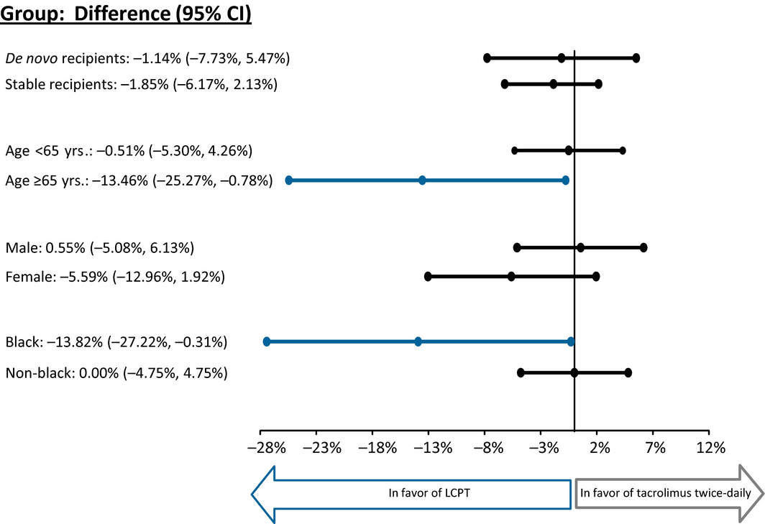
A pooled subgroup-analysis

Slide 63
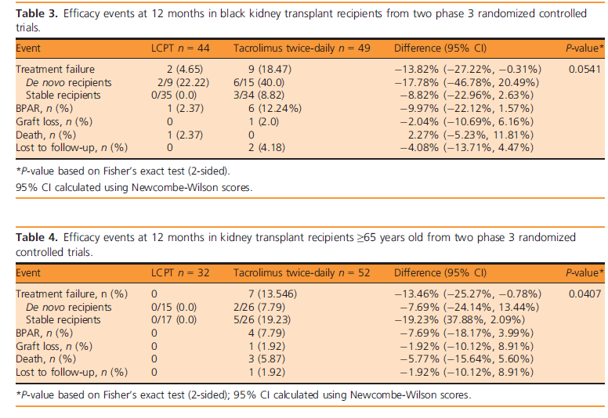
A pooled subgroup-analysis

Slide 64
Effect Modification/Moderation
Effect modification occurs when the association between the exposure (therapy) and the outcome (efficacy eventsD) varies by levels of a third factor (age).
How to assess: include interaction terms into the regression model
Interaction age*therapy p<0.001
Young: therapy --------------------------------------- > outcome Old: therapy --------------------------------------- > outcome
Formal testing for interaction !

